Slide 1
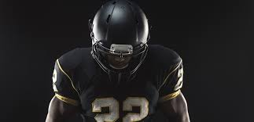
Next Level Football Scouts
“The Next Level in Football Scouting”
www.NxtLvlScouts.com

Slide 2


MISSION
Our Mission is to strengthen the character of young athletes while empowering them with the necessary support for achieving their dreams of playing collegiate football.
ACADEMICS
ATHLETICS
ADVISEMENT
Support and prepare the athlete academically to receive scholarship offers from Division I schools.
    Allow athlete to focus on continuing to develop their abilities while understanding the expectations required to continue playing now and at the next level.
Alleviate stress for athlete and their family by helping them navigate the recruiting process and understand the necessary elements for success beyond athletics and academics including commitment, character, and confidence.

Slide 3
VISION
Mentor
Scout
Public Relations
An organization offering athletes the tools and services to receive college athletic scholarships while building a strong foundation for life.
Marketer
Consultant
Manager
Teacher
Trainer

Slide 4



VALUES
WHAT WE BELIEVE IN
PASSION
INTEGRITY
LEADERSHIP
COMMUNITY
A strong commitment to the athletes, their families, and their overall success.
Full transparency around expectations, mutual trust, and respect for the program.
Lead young athletes to a better future through development of the whole self – physically, intellectually, and spiritually
Teach young athletes the necessity of giving back to the community, the intrinsic values it instills, and the internal joy it gives back

Slide 5

RECRUITING PROCESS
Find Top Level Football Athletes in Georgia
(as well as starting to tap the Southeast States/Region)
Our Process of Finding Talent:
Athletics – EVALUATION of their football athleticism
Academics – IDENTIFY those athletes who focus on their education
Character – RECOGNIZE the athlete who understands success begins with a strong character
Next Level Football Scouts Requirements:
Not Open Enrollment . . . We Find You
Beginning of 8th Grade to the Beginning of 10th Grade
Next Level Football Scouts Athlete Requirements:
Communication is KEY!
Community Service will be required by each athlete
Mentorship of younger athletes . . . Athletes Mentoring Athletes!!
Athleticism
Academics
Character
The Foundation

Slide 6
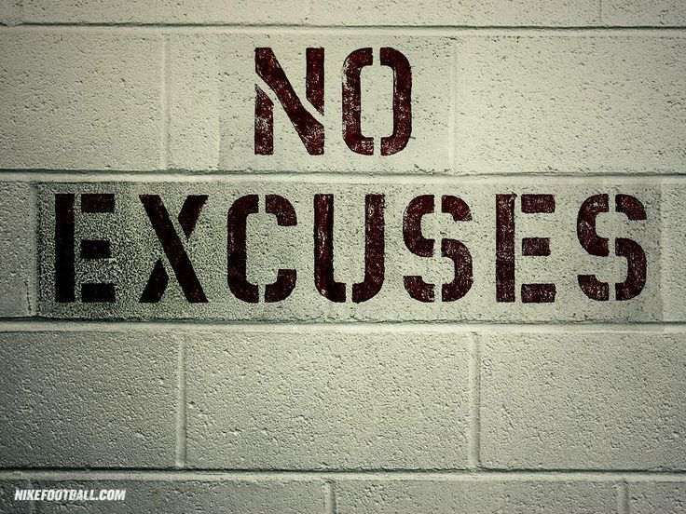
The Time Is NOW!
www.NxtLvlScouts.com

