Slide 1
Pages:
Meet the
partners
System and Operations
Home
Technology
Contact
Font:
Lato
Design:
See attached logo for colour pallet and design inspiration (please also use the pictures attached)

Slide 2

What we want on the home-page
Converting waste to circular resource!
Current challenges
Our Solution!
1) Today polymers are the dominating materials for most application in modern life. Global demand for polymers will double within the next 30 years
Advanced Recycling via Carboliq Technology!
CARBOLIQ’s advanced depolymerisation technology allows the regeneration of a high quality liquid resource suitable for the production of new virgin quality polymers. It is applicable to mixed and contaminated plastics and of high efficiency.
A video featuring a talk show about the initiative with the three company representatives
2) Compounds, additives, colorants and contaminants put the limits to the recycling of polymers. More than 50% of all polymer waste is rejected and incinerated
3) Our industry is failing to meet the sustainability goals set by the EU.

Slide 3


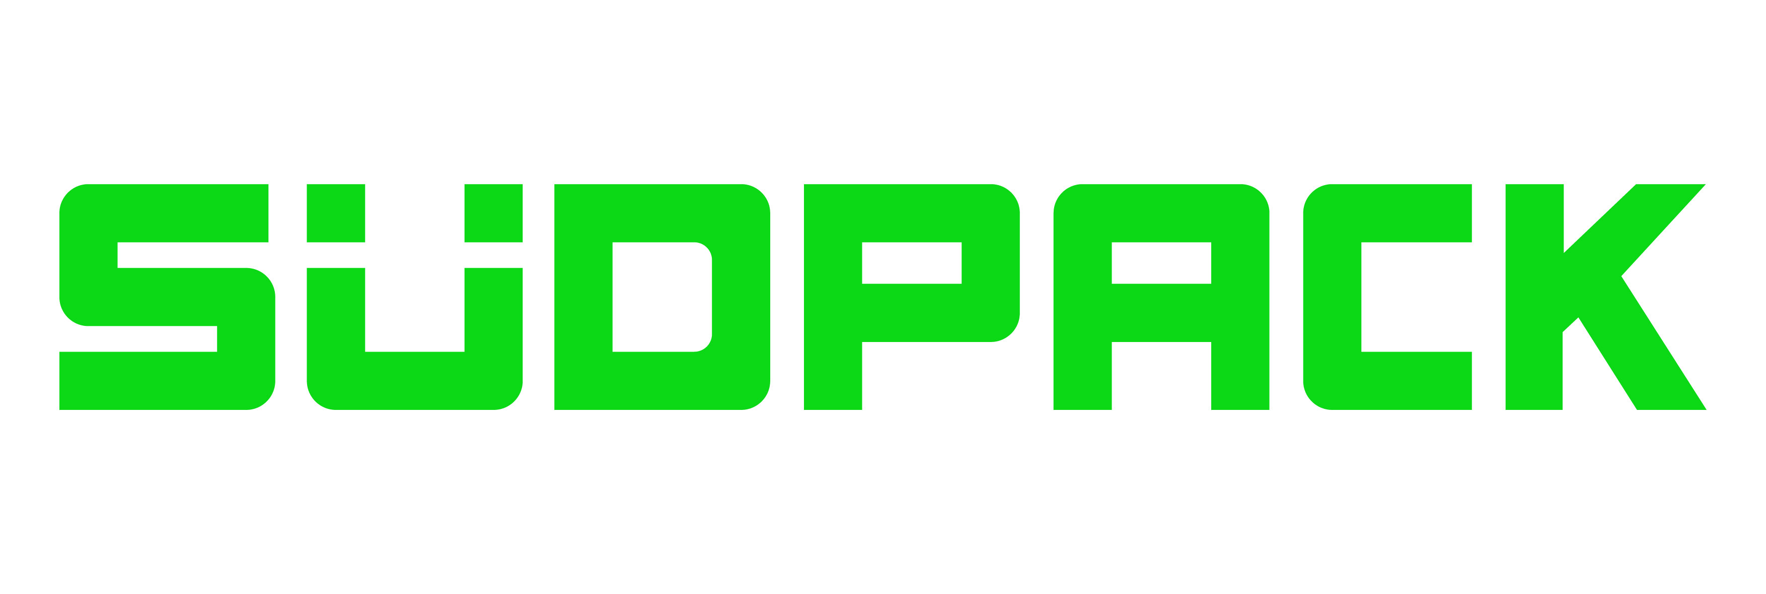






What we want on the home-page
How Does it work?
Our products
Partners in Carboliq
Space for a list and description of products
*Space for pictures, brief descriptions of each company, and links to their websites*
A plastic product is produced and used by individua customers
After being used, the product is being disposed off
The recycled oils are handled by the plastic product producer
The waste is collected and processed via Carboliq’s advanced recycling technology
Notes:
What are the products?

Slide 4


Website Style – Colors / Fonts
Colors:
Energetic/speed
/Carboliq technology
COUNT logo
Sustainable/nature
/SÜDPACK logo
Ocean/peace
/RECENSO logo
Blue sky/clear
/bright/ high tech
Fonts:
Lato
Montserrat
Open Sans
Roboto
Playfair Display
Proxima Nova
Vollkorn
Ubuntu
Georgia
Bebas
Droid Serif
Brand Logo:

Slide 5
Overview - Specifics
Target market | Suppliers, Consumers within the Petrochemicals industry (Shell, Covestro, INEOS, Neste, etc.).
How many pages | 5 pages (Home, Meet the partners, Technology, System & Operation, Contact
Must Haves | A clear image of how the Carboliq technology works/Sustainable aspect elaborated
Nice to Haves | Make use of icons, explained with some text for the technology. / make clear which role every company has within this initiative. / Picture of the first truck, with the banner of the three companies. / short video’s of the factory and technology.
Should Not Haves | A divided theme, it must be clear that it is a collaborated initiative, and that we all work together within our own expertise. / No cliché sustainability pictures, that aren’t relevant to the product.
Industry | Petrochemicals & recycling technology

Slide 6
What we want on the Home-page
COUNT represents a diverse group of experts contributing to a sustainable future. We handle, trade, and explore commodities in energy, and renewables markets, with the aim to bring sustainability into a predominantly unsustainable market.
SÜDPACK specializes in lid films, rigid/flexible films and bags. Films are printed using flexographic, gravure and digital printing processes. Their aspiration is to find the optimal packaging solution for all kinds of products.
RECENSO GmbH is with its engineers and technicians specialists in industrial plant engineering. Founded as a spin-off from a traditional German plant manufacturer, we develop and implement solutions for the growing demand for secondary raw materials.

