Slide 1



Remote Planning
& Scheduling
RPS@KAP.US.COM
Notes:
When KAP formerly started, our number one goal was to always provide our clients with the right; People, Methods, Tools & Technology. Today we are continuing to do just that with one of our newest service offerings. We want to introduce to you “Remote Planning and Scheduling.”

Slide 2

Innovative Approach to Planning and Scheduling
Allows you to focus on managing the plan, let us
focus on planning ………
Able to continually monitor progress ………
No more paying for man hours, buy a finished product…….
RPS@KAP.US.COM
Notes:
RPS is a new and innovative method to planning and scheduling, allowing the client to shift their focus more on managing the plans and not the planning efforts.
With todays current tools and technology, RPS is able to affectively collaborate with clients, track progress, and improve efficiency while removing personnel from your site.
RPS offers a fixed price option, this gets you away from having to pay for non productive hours, overtime, holidays, perdiem, and all other cost that come from having personnel on site.

Slide 3

Savings
Per Diem
Vacations Hours
Overtime
Mobilization / Demobilization
Facility and Logistics
Paid Holidays
Sick Leave
Training
RPS@KAP.US.COM
Notes:
With RPS we can create savings in many ways. As you see here;
Perdiem- with reducing the amount resources and the amount of time the resources need to be on site, automatically reduces your cost for mob, demob, and perdiem.
Overtime- typically have to pay overtime to, make up for lack productivity, attract employees to take the position, or because of continuous turnover. Not anymore!!
Paid Holidays, Sick Leave, Training, Vacation. All the cost that you would normally pay in markups and would have to track cost on, go out the window.
A Fixed price per package……

Slide 4



Staffing Plan On Site vs. Remote
Number of Worklist Items | 1600 | Ready to Plan
Weeks to Plan | 52 | Typical
Work Hours | 50 | 30% Inefficiency T&M
Planning Staff | 10 Planners 2 Doc Control 1 Plan Mgr. | Based on timing & Pkg Count
Perdiem | 13 Employees | 7 Days / Week
Work Hours | Adjustable | Fixed Price
Planning Staff | Remote Scalable | Fixed Price
 | On Site 2 Planners 1 Doc Control 1 Plan Mgr. | Customizable
Perdiem | 4 employees | 7 days / week Customizable
Savings of $500,000 or more Planning cost
RPS@KAP.US.COM
Notes:
Here is an On Site vs. Remote staffing plan comparison I would like to show you.
The box in the middle shows us a common scenario. We have 1600 worklist items that need to be planned with 52 weeks to complete. This includes step outs, BOM’s, photos, etc.… a full job package.
The box on the left shows us how we would staff up for an On Site scenario. We would propose to work 50hrs a week. This would account for 30% inefficiencies per day such as, travel time, meetings, interruptions, waiting on data from others, etc. Simply said out a 10 hour day, only 7hrs will be actually going towards progressing the job plans. The planning Staff you can see consist of 10 planners, 2 Document controls, or 1 DC and a Admin Clerk, and 1 Planning Manager. And in this cases all employees will get per-diem.
Now the box on the right gives us a view of one of the ways RPS would staff for the same size job. As you can see work hours are adjustable. This means we would work what ever was needed to meet our dates. Our remote planning staff would adjust to what ever was necessary to maintain our commitments. All for the same fixed price. The onsite team is estimated to work 50hrs a week, and receive perdiem for 7 days a week. NOW THERE IS A CUSTOMIZABLE OPTION HERE THAT WILL SAVE EVEN MORE MONEY IF THE CLIENT IS ABLE TO PROVIDE RESOURCES TO PERFORM THE DUTIES OF THE ONSITE TEAM. But the current scenario shows KAP employees feeling these roles.
All that being said to show you a savings of $500K or more by using KAP’s RPS service.

Slide 5











Planning Process
Level 3 Schedule
SCHEDULE REVIEW
Level 2 Schedule
Level 1 Schedule
SCHEDULE REVIEW
RPS@KAP.US.COM
Notes:
This slide shows us the major portions of the turnaround planning & scheduling process. We can see it starts with collecting the worklist, then scope review, developing job packages and completing with a level 3 schedule. With the next slide we are going to illustrate how RPS is going to manage this process to save you money.

Slide 6



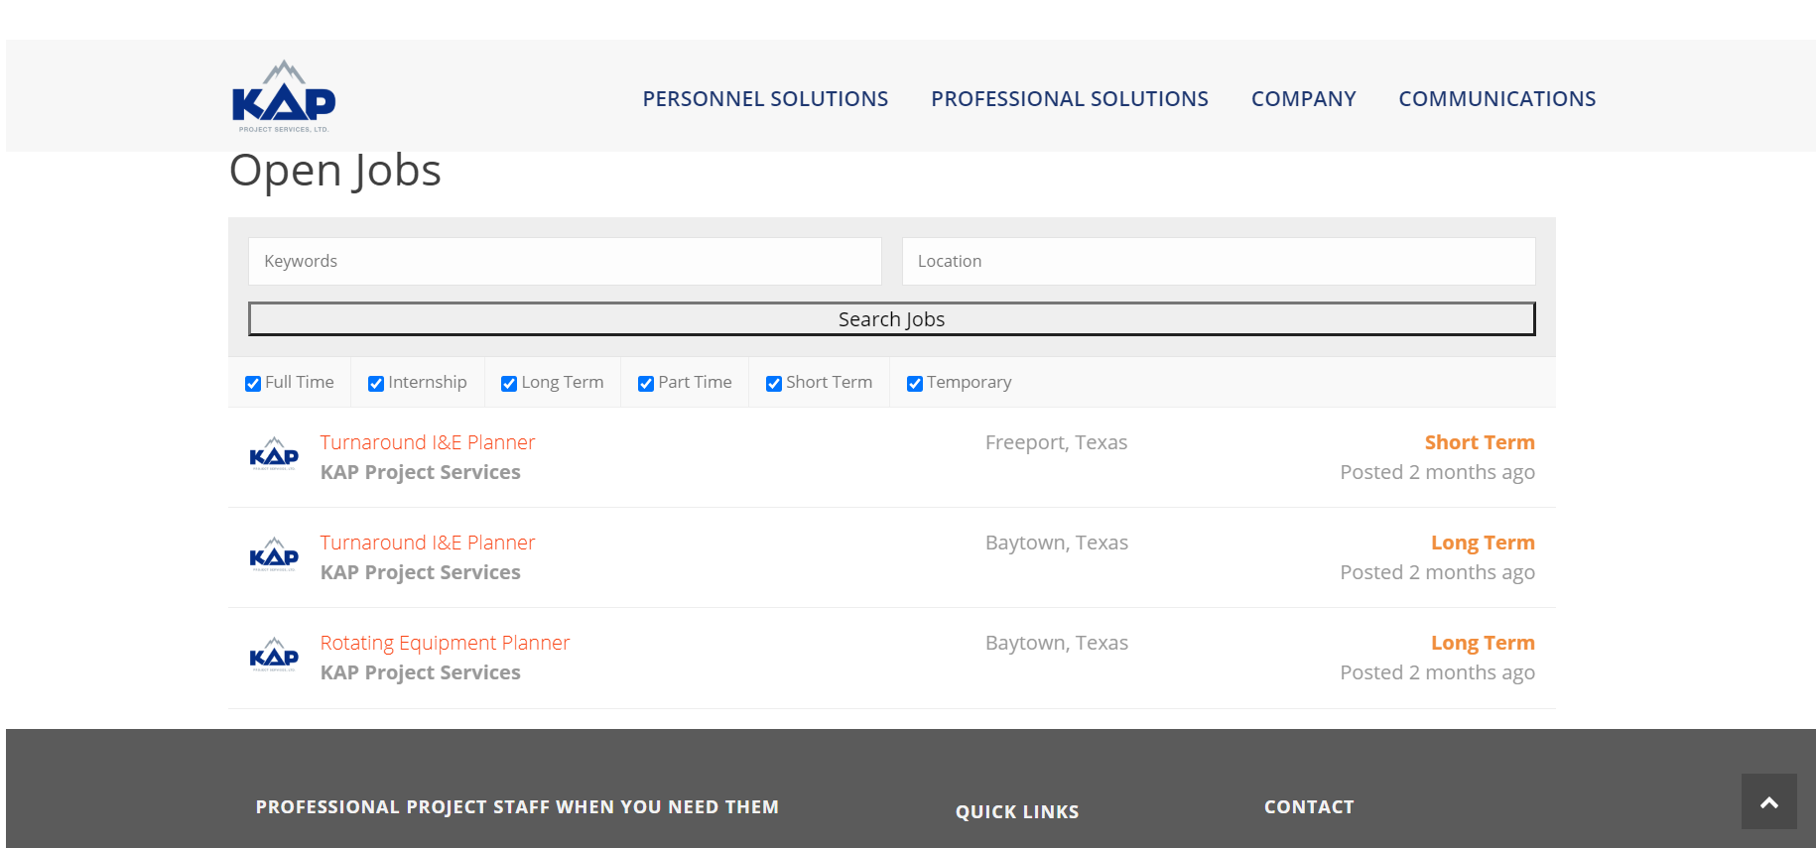



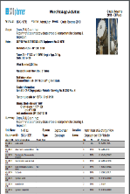
RPS Flow Process
Keeping Everyone Connected
Your Site
KAP’s Office
Client Leadership Team
KAP’s Leadership
Team
Package Acceptance
Manage Resources
Develop Budgets
Quality Control
Level 1 Schedule
Share with Stakeholders
Review Content
Track FEL Assignments
Monitor Progress
Level 3 Schedule
Action Items
Level 2 Schedule
Monitor Progress
RPS@KAP.US.COM
Notes:
RPS breaks down the process and perform some of the functions remotely creating the opportunity for savings. On the left you can see the items that need to be done on site. collecting the worklist, reviewing the scope, developing the planning premise, and so on. These items are typically done by members of a Core Team or Scope Development team prior to any planners are truly needed. It’s important that this team has access to all the necessary information, documents, and are able to share with the remote team. Also they will need to be able to support getting the answers to any field question that the remote team may have. By saying that, this is an area where if in house resources (not KAP employees) are used to perform these duties you could take advantage of additional savings.
Once the items are collected and a backlog is created, a planning team located at KAP’s home office under the direction of KAP’s RPS Management team will start developing the detail plans, job packages, and schedule. The Planning & Scheduling Premise will be the guiding document for the RPS team to follow throughout the development of the job plans and or schedules.
Current technology allows us to stay connected through out the entire process. Whether it’s KAP software STOplanner with P6, or some other tools. We will be able to track performance, keep up with action items, and collaborate throughout the entire process. RPS is not changing the process for turnaround planning and scheduling, its simply providing a customizable, more economical, with less risk option.

Slide 7

Customizable Solutions
Timing
Package Contents, Job Templates
Planning Tools
On Site Team
KPI Reports
Still Photos or Interactive Digital Images
RPS@KAP.US.COM
Notes:
RPS is not a 1 size fit all solution, its customizable to fit your situation. If you only want step outs and not a full job package, just a schedule, you are able to provide the resources to handle the on site duties, or even provide your own planning tools. RPS can figure out a way to provide you with what you need and still reap the benefits of working remotely. If you are willing to support it we can deliver it.
Package Content, Job Templates – we can use your templates, we can use KAP’s templates, or we can work together to create job specific templates.
On Site Team - This can be KAP resources, Company resources, or a mix bag.
Still Photos or Interactive Digital Images – still photos are digital photos. Interactive Digital Images is using new technology that generates a virtual images of your process unit that can be viewed as a virtual reality tour. Scope items are marked by using a box around the process equipment, when you click in the box a pop up appears with all the appropriate documents and information regarding that scope item. Still photos can also be captured from the scan to generate photos for the job package.
KPI Reports (Key Performance Indicators) – If you have specific reports other than the out of the box reports for planning and scheduling we can generate what you are looking for.
Planning & Scheduling Tool –STOlogix’s® planning suite is the preferred planning software and Primavera for scheduling, but we are capable of using any of the industries current planning and scheduling tools.
Timing – with in reason we should be able to adjust to your planning dates. We have the ability to scale our workforce with minimum effort. By working at our home office this provides RPS the flexibility to staff up or down with little to no onboarding time.

Slide 8
Shifting Accountability
Personnel Performance
Vacations
RPS allow for the accountability of the workforce to shift back to KAP
KAP Management Oversite
Let us take the worries of planning & scheduling
Holidays
Leverage our planning & scheduling
Workforce
Ownership
Hiring
experts & tools
Training
Attendance
Timeline
KAP’s Leadership Team Experience
With KAP | Total
Sick days
Total | 105 Yrs. | 236 Yrs.
Average | 9 Yrs. | 20 Yrs.
Life Distractions
Planning Quality
RPS@KAP.US.COM
Notes:
Managing a Planning Work Force has a lot of peripheral issues that have to be managed on a day to day bases that can easily distract you from moving the overall progress of project forward.

Slide 9

Mitigated Risks
Safety
Planning Cost (fixed price)
COVID - 19 / Pandemic
Plant Upsets and Site Disruptions
Facility Issues (parking lots, offices, etc..)
Human Resource and Co-employment
Onboarding Delays (IT, Training, Certification, etc.….)
RPS@KAP.US.COM

Slide 10

Improves Quality
Reduced Cost
Create Opportunities
Shift Focus
Reduced Cost
Lighten Workload
Shift Focus
KAP’s Experience
Lighten Workload
Quality Personnel
Consistent Results
Working Environment
Quality Personnel
RPS@KAP.US.COM

Slide 11
RPS@KAP.US.COM

