Slide 1
Roots BrewSpace, Ltd.
Business Floor Plan and Components Summary
Sam@rootsbrewspace.co.uk

Slide 2
About Roots BrewSpace
As Oxford’s only craft brewery and coworking space, Roots BrewSpace will take advantage of two market opportunities: high demand for craft beer in an underserved market and an immense shortage of working space to support 151,000 students and professionals. Roots BrewSpace is passionate about working with local partners to address these challenges and bring people together around quality beer. Our core pillars are:
Great beer - Our sustainably sourced beer and cider options are inspired by top beer flavors across the globe, while catering to the local Oxford palate.
Great atmosphere Our bright and open tasting room is conducive for both collaborating with colleagues through work and simply grabbing a pint with friends to unwind.
Great impact – We will use of CO2 recapture technology to minimize our carbon footprint. Additionally, tour ingredients, packaging, and merchandise will all be sourced from eco-conscious suppliers that, whenever possible, are based locally.

Slide 3
Brewery/Coworking Space Elements (Part 1)
Front Room (Tasting Room and Co-working Space):
Open room with high ceilings; warehouse feel
Includes some closed off rooms for quiet study/meetings
During the day, high tables retrofitted with monitors for screenshare
Bar serves local coffee
High speed WIFI; many tables retrofitted with outlets
Stretch goal: A rotating food truck can drive into the warehouse to provide lunch/dinner
Considerations: outlets/tech tools (waterproof), adequate lighting and bathrooms based on capacity
Brewery Space:
The brewery is closed off from the tasting room, separated by a glass panel so customers can view the equipment
Customers can also pay to tour the brewery and view operations from a platform on the second floor during certain times
Ideally have access to a loading dock or ground level street access
Consists of brewing area, six fermentation tanks, cold and dry storage, and a kegging/canning station
Considerations: dock location, drainage, floor load capacity, effluent, water supply

Slide 4
Brewery/Coworking Space Elements (Part 2)
Second floor (brewery-side):
Contains a small lab space above the brewery kegging/canning section, accessible by a catwalk connected to the viewing platform for tourists
Viewing platform also host a small office (both are above the cool storage)
Considerations: electrical, mechanical, plumbing needed for lab and office, sanitary concerns with tour access
Second floor (tasting room side):
Open hallway and small coworking space over the bathrooms with additional tables and chairs
Balcony style, customers can still see the floor below

Slide 5

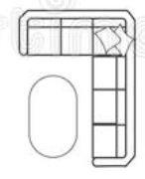
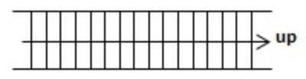


Main Floor
LOADING DOCK
WASTE
MALT STORAGE
STUDY ROOM
STUDY ROOM
CONFERENCE ROOM
GRAIN STORAGE
MILL
STORAGE
TABLE
BRITE TANK
TABLE
TABLE
HOT LIQUOR TANK
MASH TUN
HOP STORAGE
BRITE TANK
COLD STORAGE
BAR AREA
ELECTRIC HEAT SOURCE
KEG STORAGE
BREW KETTLE
BRITE TANK
TABLE
TABLE
GLYCOL SYSTEM
BRITE TANK
HEAT EXCHANGER
CAN/ KEG AREA
FERMTANK
FERMTANK
FERMTANK
FOOD TRUCK
FERMTANK
FERMTANK
FERMTANK
BATHROOM
BATHROOM
COUNTER
CHEM STORARGE
SINK
COUNTER
CO2 CAPTURE SYSTEM
STEAM BOILER

Slide 6

Second Floor
SMALL OFFICE
TOURIST VIEWING ARE
HALLWAY
CAT WALK
STUDY SPACE
LAB

Slide 7
APPENDIX: IMAGES OF SIMILAR BREWERY STYLES

Slide 8
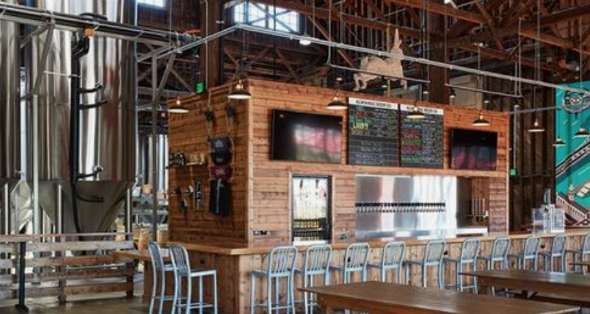
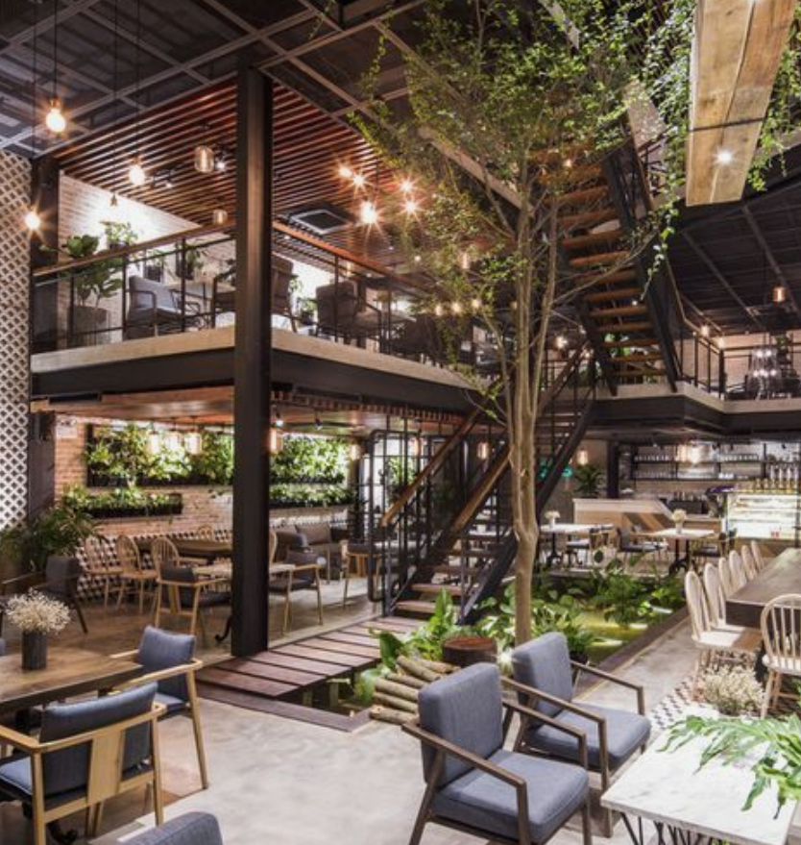
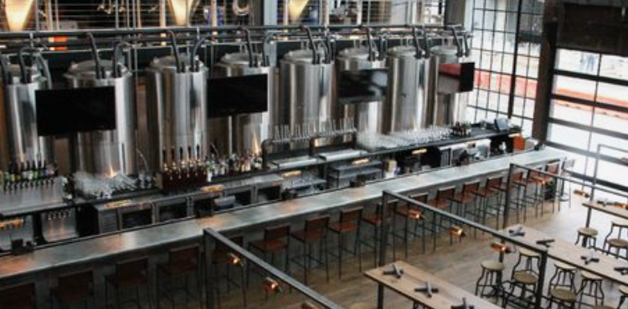

Slide 9
