Slide 1

BRIEF LOGO O2C BENCHMARKING LAB

Slide 2
WHO ARE WE ?
Losam Agency, marketing agency specializing in the creation and animation of communities.
Losam Agency created “O2C BENCHMARKING LAB” for the company Esker, the first think tank dedicated to the digitalization of processes Order-to-Cash and customer accounting
The “O2C BENCHMARKING LAB” what is it :
5 meetings a year (1 dinner + 4 breakfasts meeting)
1 founding committee composed of 8/10 leaders which will define the themes of the different meetings

Slide 3
WHO IS ESKER ?
Esker is a the cloud platform for your cash conversion cycle.
Built with industry AI and RPA technology, Esker's intuitive, cloud-based platform allows businesses to power their digital transformation across procure-to-pay (P2P) and order-to-cash (O2C) processes and unite customers and suppliers like never before.
Whether it’s providing a 360° view over your customers’ behaviours through customer management or improving global speed and accuracy via AI and RPA technology, Esker’s integrated end-to-end platform is the digital foundation for all your O2C needs.

Slide 4
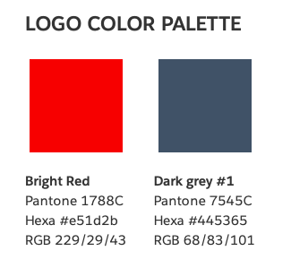
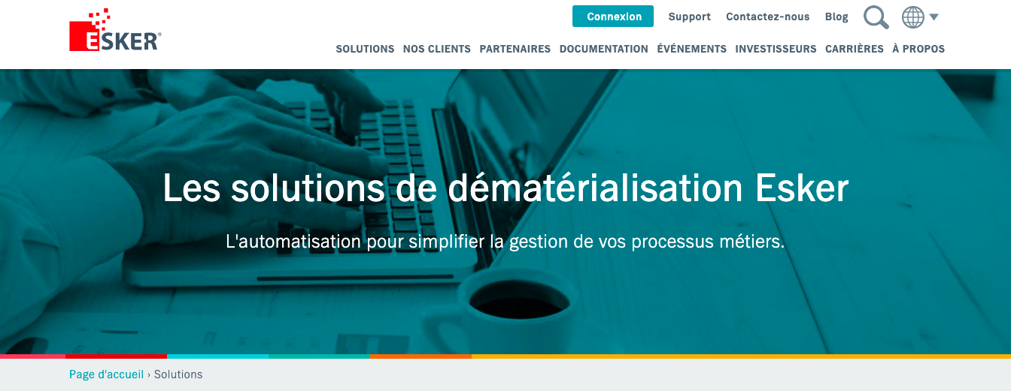
ESKER BRAND GUIDELINE
https://www.esker.co.uk/ https://www.esker.fr/

Slide 5
O2C BENCHMARKING LAB’
Target :
client accounting director / Accounting Director
Director of OTC (order-to-cash)
Director of Customer Service
Head of risk management and financial analysis
Positioning :
- High-end, we address a target group of corporate decision-makers
- Accounting, customer relations and digitalization - the theme of the focus group
As professionals, we address exclusively to companies
Baseline:
“The first think tank dedicated to the digitization of order-to-cash processes”

Slide 6
BRIEF
What : Creating a logo
Sector : Marketing
Logo text : O2C Benchmarking Lab
Elégant
Amusant
Traditionnel
Personnel
Féminin
Coloré
Bas de gamme
Audacieux
Sérieux
Moderne
Professionnel
Masculin
Noir et Blanc
Haut de Gamme

Slide 7
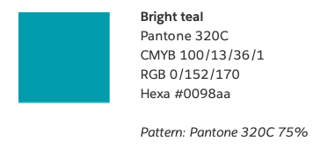
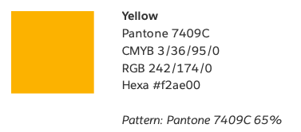
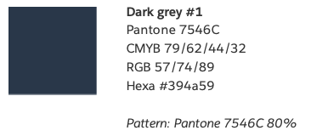
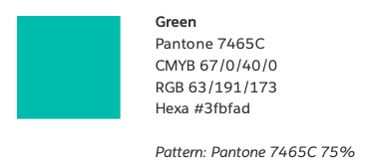
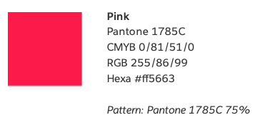


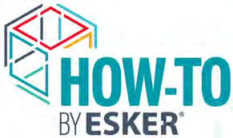

DNA OF ESKER
We want to keep the DNA of our partner Esker
ESKER MARKETING LOGOS
Esker Marketing logos are all the logos designed to promote regular events, webinars etc. They are composed of an icon cut on a side and incorporated to the name of the logo. The style of the icon is a multi color outlined draw with some cut lines in it. Text is a combination of dark grey/bright green and light/bold fonts. Colors are always from Esker Palette.

Slide 8
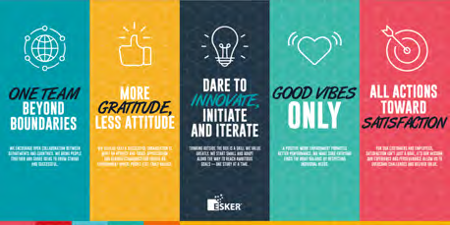

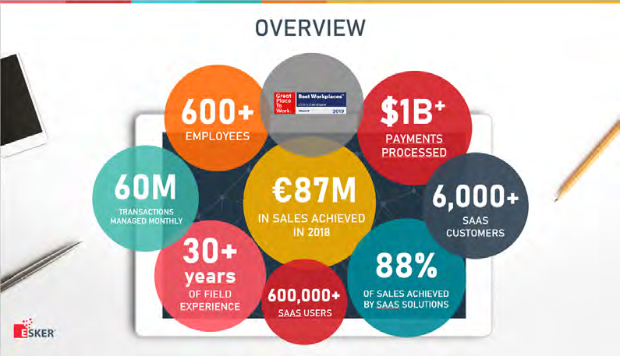
INSPIRATION

