Slide 1
OUTDOOR LIVING INSPIRATION
Mood Board - Directions

Slide 2

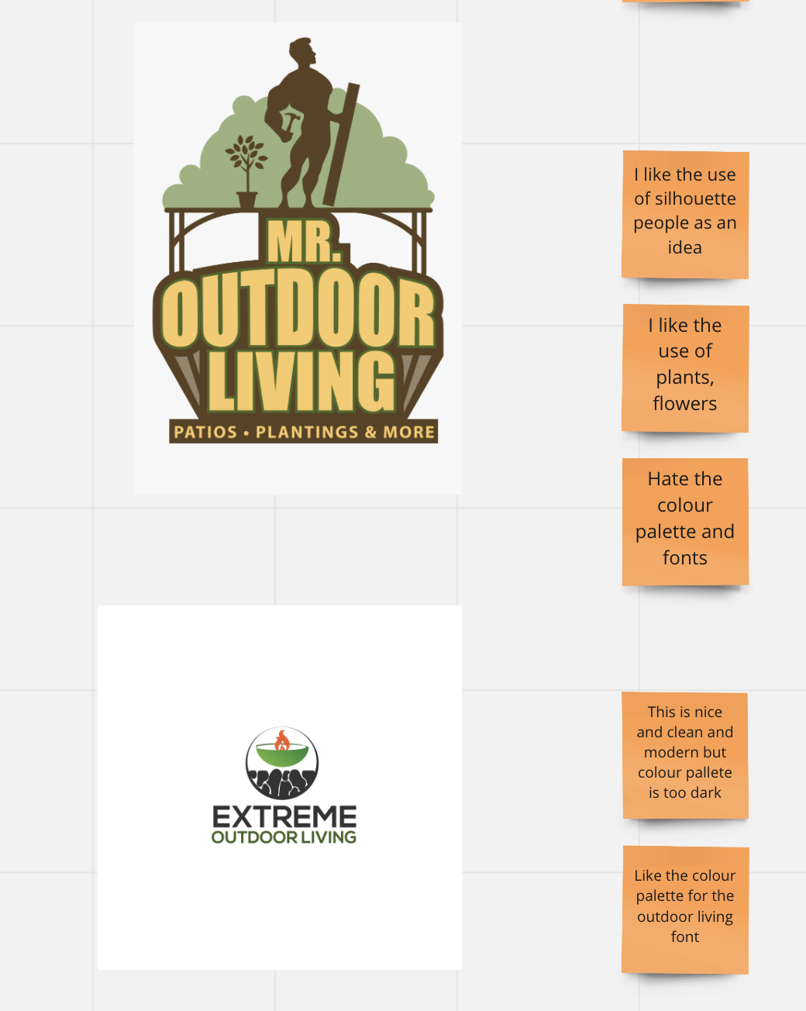

Slide 3
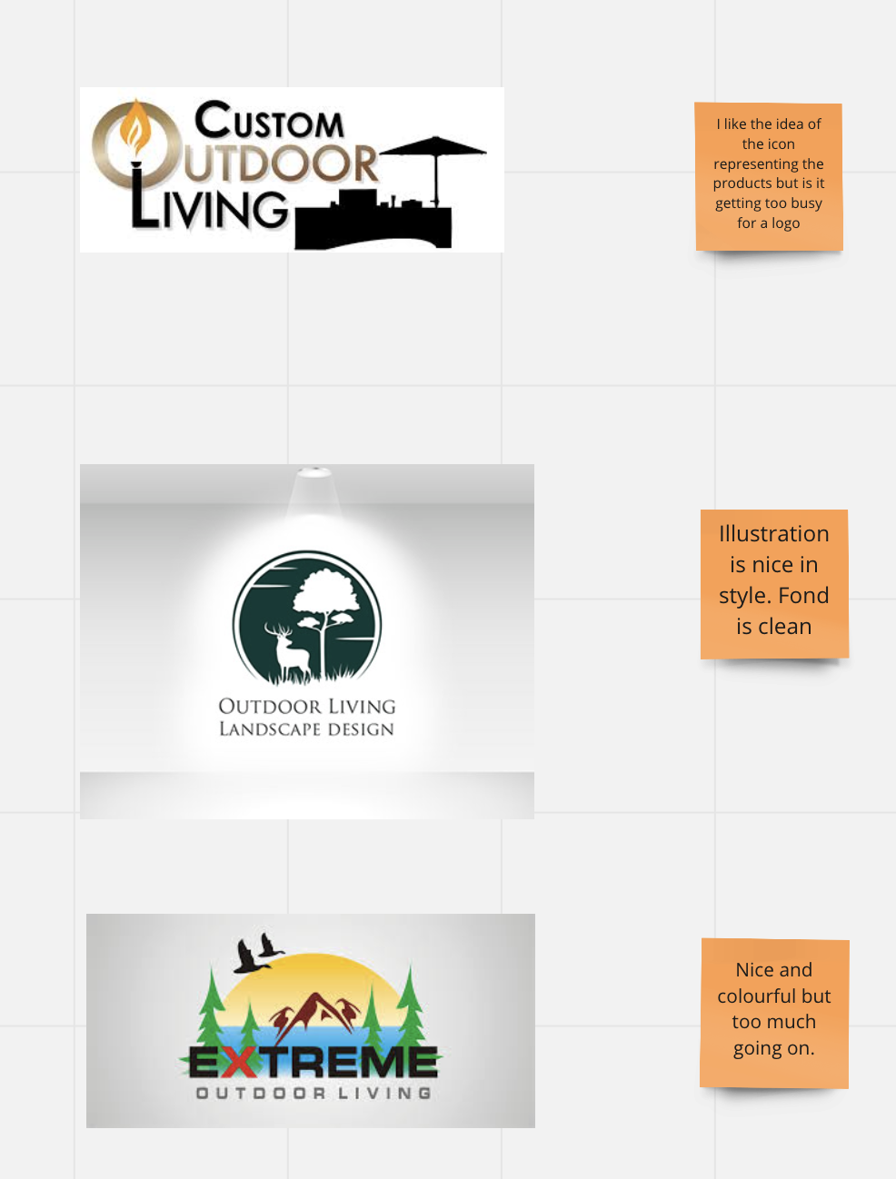
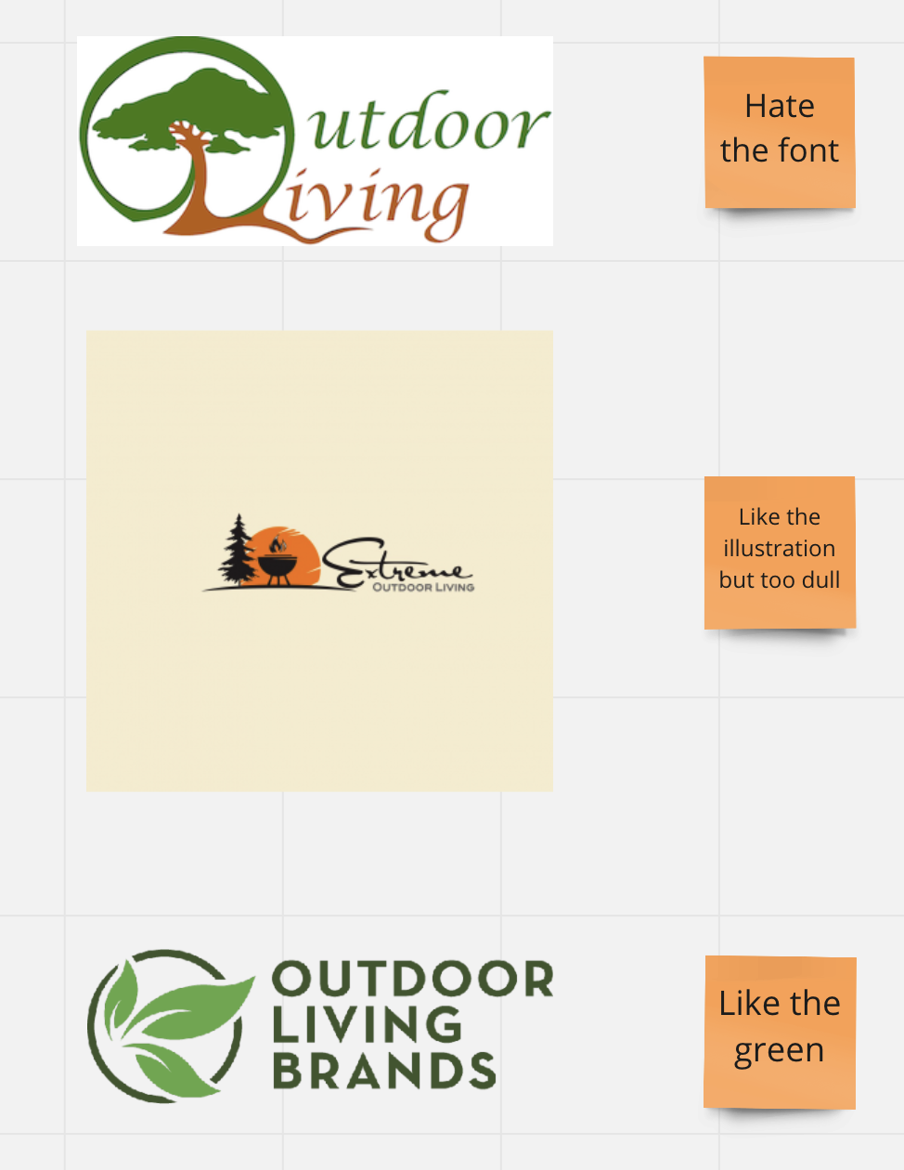

Slide 4
