Slide 1
Real Estate Questions?
- How much is my home worth?
- Best neighborhoods?
- Are you aware of anything off-market?
- Montecito or Hope Ranch?
- Los Olivos, Santa Ynez or Solvang?
- Can we really swing this?
- How Long will this take?
ASK
Yo
AskYo . com
Real Estate

Slide 2
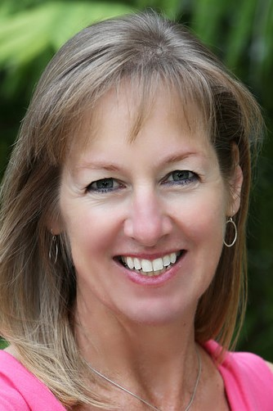
ASK
Yo
Yolanda Van Wingerden
●
Deeper Roots Better Answers Faster Results
●
AskYo . com
Real Estate
ASK
Yo
Yolanda Van Wingerden
Deeper Roots Better Answers Faster Results
AskYo . com
●
●
Real Estate

