Slide 1

INTRODUCTION TO
Uflex & THE Uflex PORTFOLIO
OF PRODUCTS
NOVEMBER 2020
PROPRIETARY & CONFIDENTIAL |

Slide 2
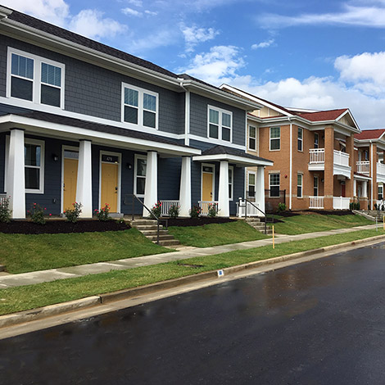
THE Uflex PHILOSOPHY
A business model does not have to be predatory to be profitable.
Our goal is to remove the barriers to online commerce and enable Housing Authorities to streamline payments and manage more of their business activities online.
Develop an efficient technology platform created with state-of-the-art tools and resources and with a goal of making transactions simple, available and inexpensive as possible.
PROPRIETARY & CONFIDENTIAL |

Slide 3
Uflex RENT PAY
“I can pay my utility bills online, why can’t I pay my rent online.”
Residents who have an active checking account can access Uflex Rent Pay and make their monthly rental payment online.
Residents receive a confirmation of payments made and Housing Authorities receive immediate notice of rental payments.
The process is simple, efficient and only costs residents $1 per month. The housing authority incurs no costs.
Many of the accounting software providers have an online rent pay solution.
However, that solution is based on a percentage of rent, ranging from 2% to 3% of total rent, that either the Housing Authority or resident must pay.
For a $150 rent payment, the fees range from $3 to $4.50. If rent is higher, the fees are higher. We think this is unreasonably expensive.
PROPRIETARY & CONFIDENTIAL |

Slide 4
NEXT STEPS
01
02
03
QUESTIONS
COMMENTS
NEXT STEPS
PROPRIETARY & CONFIDENTIAL |

