Slide 1
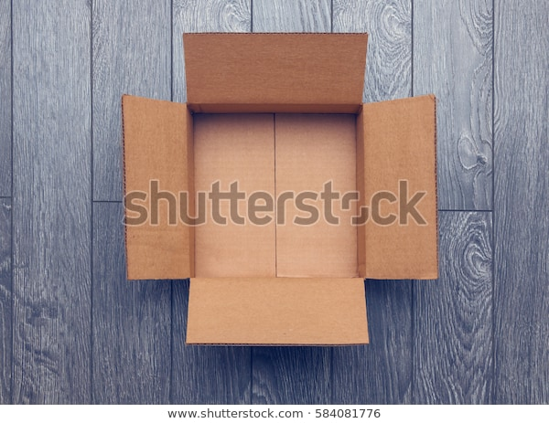
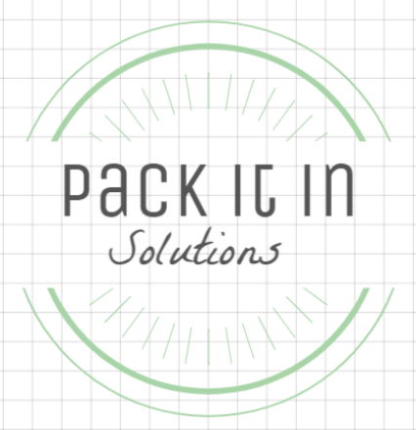
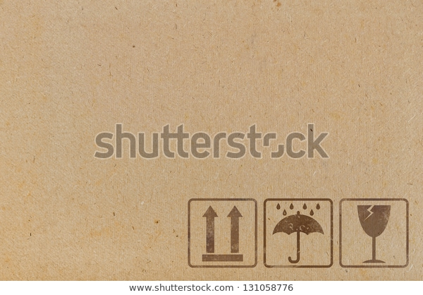

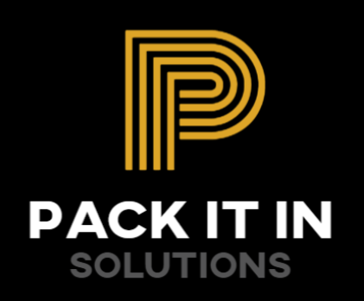
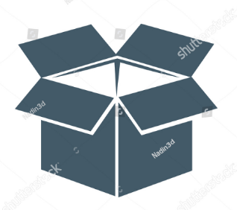
solutions
Notes:
Like the logo popping out of the box
Similar webpage to ana lui maybe
Perhaps better for a web page
A corrugated ‘P’
Logo pops out of the box
Another take on a corrugated P size

Slide 2
