Slide 1
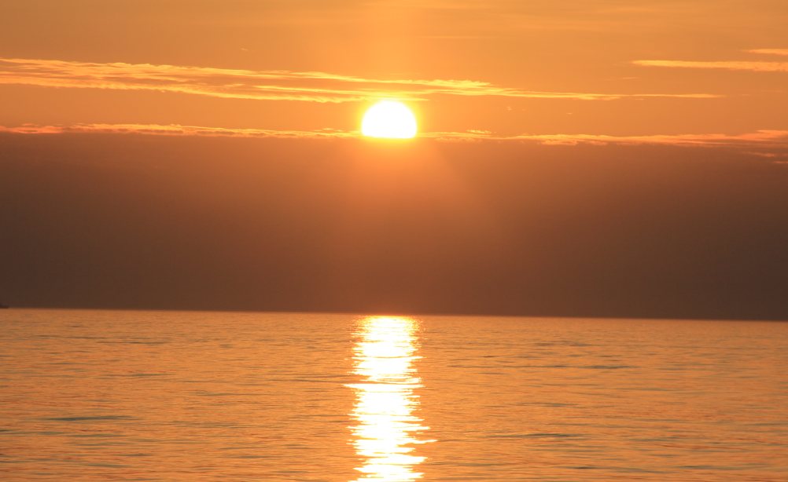
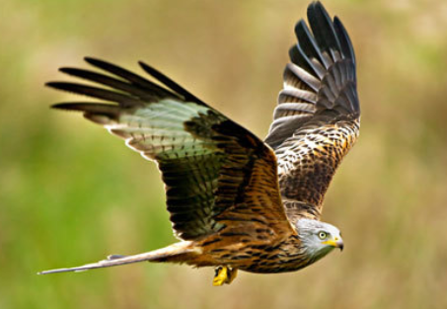
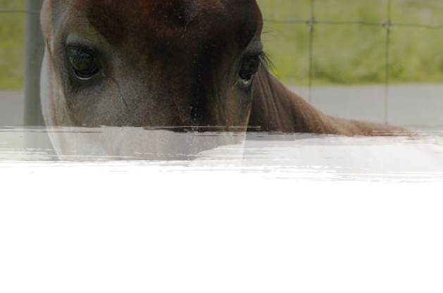
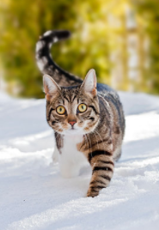
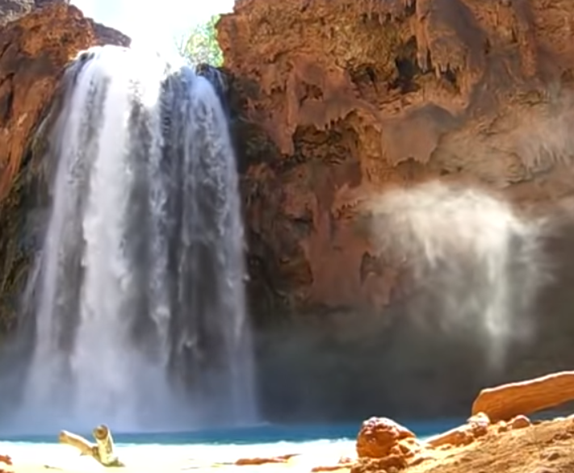
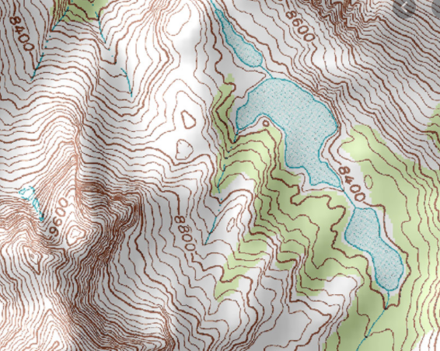


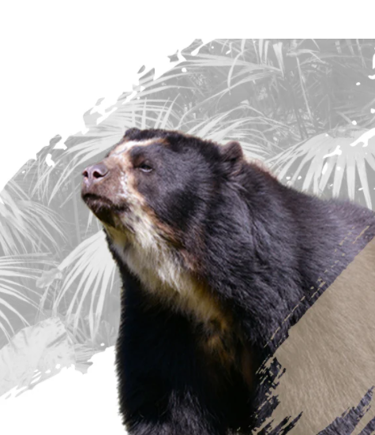
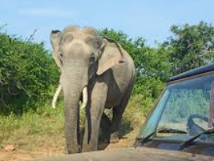
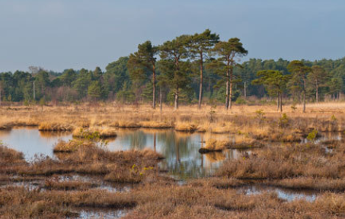
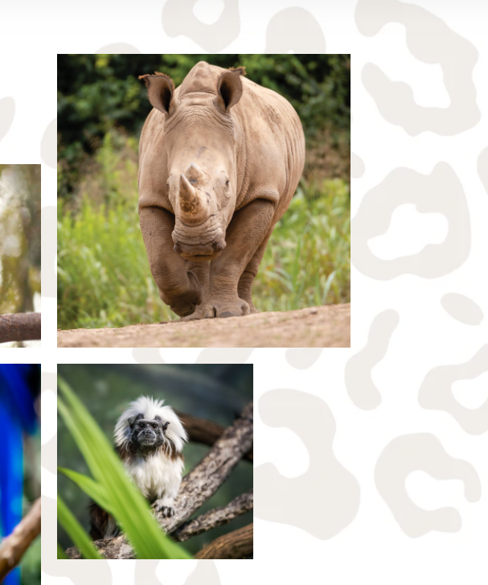
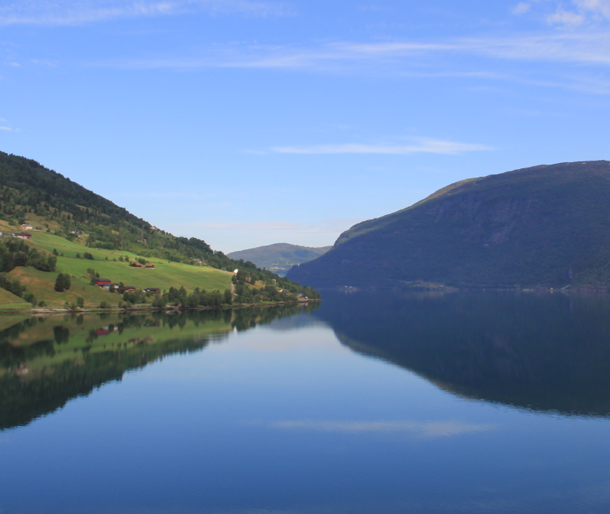
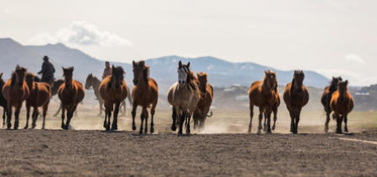
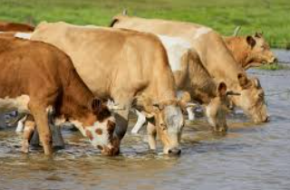
A design that is natural, dynamic and a little rugged. Here’s some pictures for inspiration.
Representing land, water, animals wild and domestic. Would like interest in the background, for examples see speech bubbles, use your creativity with this. With thanks.
Blurred edges
Background
Pattern example

Slide 2
Navigation (Home, What We Do, Who We Are, Success Stories, What You Can Do, Donate and Join.)
HELP RAISE WORLD VIBRATION
Text…..
Image to stretch into text
ANIMATED IF POSSIBLE
MAKE A DIFFERENCE (click button)
Environment
(title with image)
Animal
(title with image)
HUMAN
(Title with image)
FIND OUT MORE (click)
FIND OUT MORE (click)
FIND OUT MORE (click)
The next page adds to the bottom of this!

Slide 3
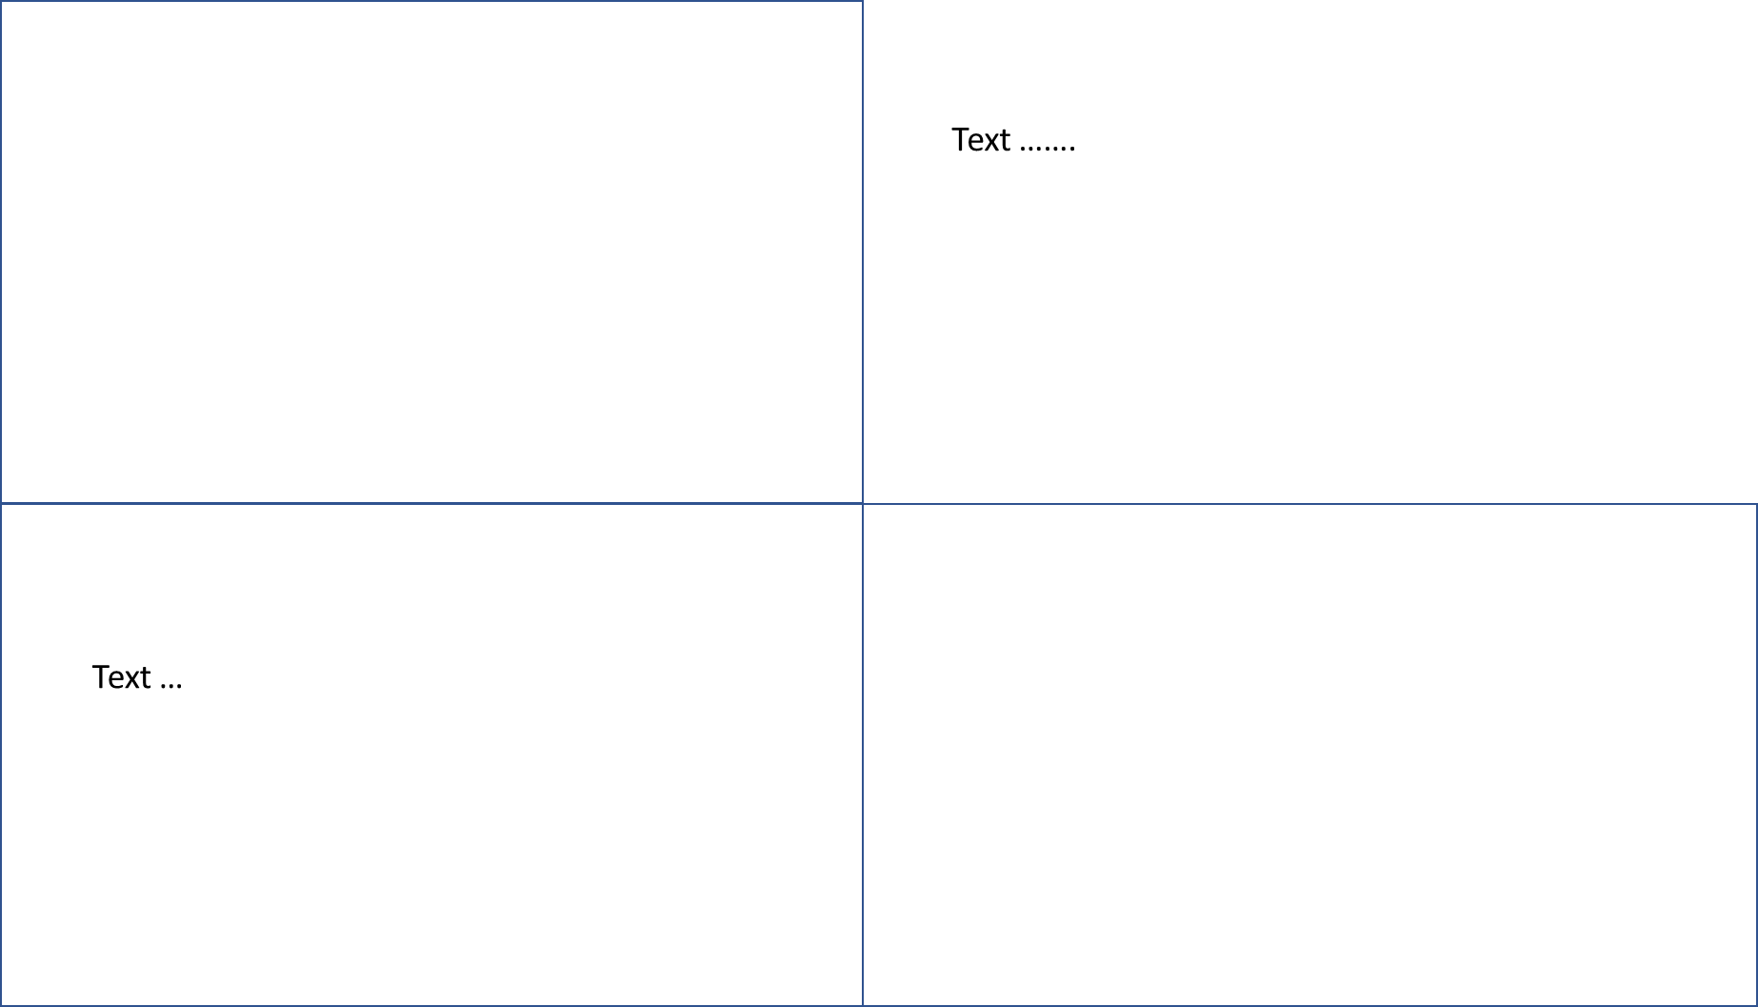
ENVIRONMENT
(Title and image as above for Environment)
ANIMAL
(Title and image same as above for Animal)
Scroll down to Human same format

Slide 4
Navigation (Home, What We Do, Who We Are, Success Stories, What You Can Do, Donate and Join.
ACHIEVING VIBRATIONAL EQUILIBRUM
Text ……
Image
(to stretch into text)
Healing the World
(image and text)
Life Force
(image and text)
The Science of Sound
(image and text)
FIND OUT MORE (click)
FIND OUT MORE (click)
FIND OUT MORE (click)
Vision Statement

Slide 5
(Title + Same image as above)
Text …….
Text …
(Title and same image as above)
(Scroll down to Science of Sound same format)

Slide 6
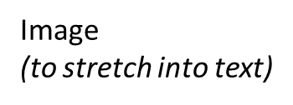
Navigation (Home, What We Do, Who We Are, Success Stories, What You Can Do, Donate and Join.
THE VISION
Text …
Success Stories (click)
Text …..
Working from the UK
(Title and Image)
This box and boxes below need to be bigger as big as one above and scroll down
Text
Working with Others
(Title and Image)
Contact Us (Title & Image)
Text

Slide 7
Navigation (Home, What We Do, Who We Are, Success Stories, What You Can Do, Donate and Join.
WHAT WE’VE ACHIEVED TOGETHER
Text …..
(Text to be within image)
IMAGE
Image of Environment
& Text
(Click)
Image of Wild Animal
& Text
(click)
Image of human and pet
& Text
(click)

Slide 8
ENVIRONMENT
(Title and image as above for environment)
Text …….
WILD ANIMALS
(Title and wild animal image same as above)
Text …
Scroll down for Humans and Pets same format

Slide 9
Navigation (Home, What We Do, Who We Are, Success Stories, What You Can Do, Donate and Join.
WHAT YOU CAN DO
Text …..
Image
Raise your Vibration and the
Vibration of others
Champion Wildlife
Champion the Environment

Slide 10
RAISING YOUR VIBRATIONS AND THE VIBRATIONS OF OTHERS
(Title and same image as page above with text)
GOOD VIBES OR BAD VIBES
WHICH DO YOU PREFER?
(Title and image)
Text
Blog style page scroll down to more articles

Slide 11
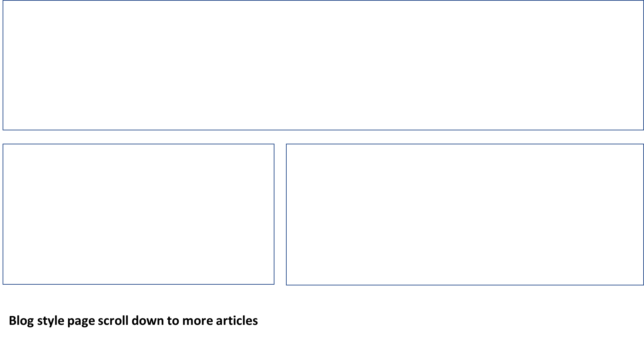
WILD LIFE CHAMPIONS
(Image as above and title and text)
Text
Taking Responsibility
(Image and title)

Slide 12
ENVIRONMENTAL CHAMPIONS
Blog style page scroll down to more articles

Slide 13

Navigation (Home, What We Do, Who We Are, Success Stories, What You Can Do, Donate and Join.
MAKE A DONATION TO PSYNCHRONICITY TODAY
Text …..
Make a Donation
Text ….
Support Wildlife
Support People
Three more boxes underneath= Fundraising, Major Donors, Shop for Change

Slide 14
Navigation (Home, What We Do, Who We Are, Success Stories, What You Can Do, Donate and Join.
JOIN US
Text …
Become a Member
Text …
Sign Up
Text…….
Be a Psynchronicity Hero
Text ….

Slide 15
Footer for each page
Get Involved
Join Us
Fundraise
Donate
Shop
….
Get Help
Contact Us
Media
….
Legal
Terms and Conditions
Cookies
Privacy Policy
…
Our Logo
Charity Number etc.

