Slide 1


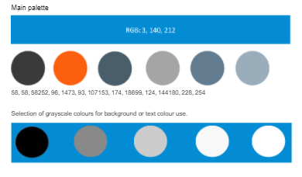
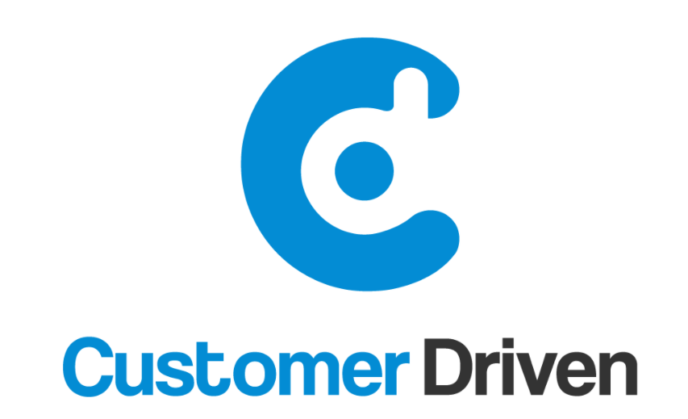

Brand Positioning 2020: Messaging House
Vision | Asia Pacific’s most Trusted Advisor in Customer Experience and Service Operations
Values
Brand
Tagline | Creating Customer Experience Heroes
Positioning | Everyone in the team at Customer Driven solutions have been accountable for delivering results within some of the most reputable Australian businesses. Our team are highly experienced practitioners.
Services | Customer Management Consulting; Knowledge Management; Training and Organisational Development, Contact Centre Optimisation
Purpose | We create Customer Experience Heroes
Channels
Get Shit Done | No dickheads | Have fun | Don’t piss before your pants are down | Seek to understand | Know your worth
1300 724 524 | www.customerdriven.com.au | contact@customerdriven.com.au | https://twitter.com/driven_customer | www.linkedin.com/company/customerdrivensolutions/
Notes:
Discussion:
Vision has moved from x to above – check where this is represented e.g. website
@
Brand: Squares – where is this used?
Tagline is on email signatures – anywhere else – does this speak to the target markets?
Name: customer driven versus customer driven solutions? Any other channels?
Personality: tone of the brand ….at the moment very official / corporate / buildings….images aligned to values?
Always on organic social
Content to support EDMs, Always On, Website)
Greg: Think Tank. Do Tank.
Think. Do.

