Slide 1



Is there a way to add bubbles as the program is a catalyst for energy. It is used in their powerpoint template (see next slide
Make sure to respect brand color list and have the blue become one of the purple proposed
Is the font avenir?
Can you respect the bubble transition like in the logo in term of size
Performance eXcellence
Respect color for this PX and shape outline should not be in a different color
Is there a way to add the Performance excellence in a more clear way. This is an idea.. But you might have more
Avoid text in black

Slide 2
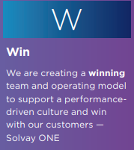
A program to bring out the full potential of the Sales organisation by enabling the sales management and their leadership to better coach the performance of their team.
Key facts to remember:
A coaching approach vs. a teaching approach to implement a long lasting shift of mindsets and behaviors
Every layers of Sales Management are involved
Progress and behavioral shift are measured at the macro level (overall program) and micro level (individual shift)
This program is required before starting the sales academy

