Slide 1

AGENDA
What is CSG Sales Intelligence
How CSG Si supports Marketing Organizations
How CSG Si supports Sales Organizations
How CSG Si supports SDR Velocity
How to Engage with CSG Sales Intelligence

Slide 2

What is CSG Sales Intelligence?
CSG Sales Intelligence (CSGSi) is an Ai Driven Business Intelligence and Revenue Generation Solution for large enterprise companies. Our solution is a blend of decades of experience addressing our client's business needs through outsourced sales and marketing teams blended with todays very latest Artificial Intelligence Solutions.
salesintel.ai

Slide 3
How CSGSi supports Marketing Organizations?
Need Copy
salesintel.ai

Slide 4

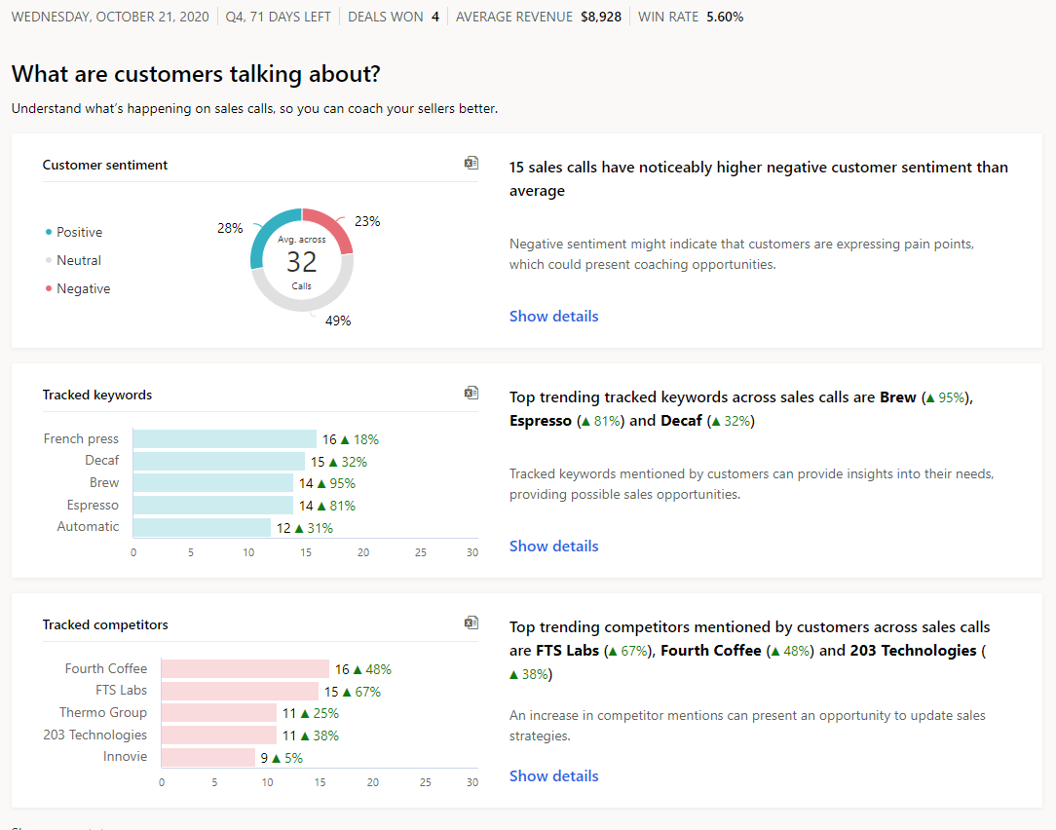
CONVERSATION INTELLIGENCE
1
2
1: Ai Business Intelligence
2: Sentiment
3: Keywords
4: Competitors
5: Trends
3
5
4
5
salesintel.ai

Slide 5
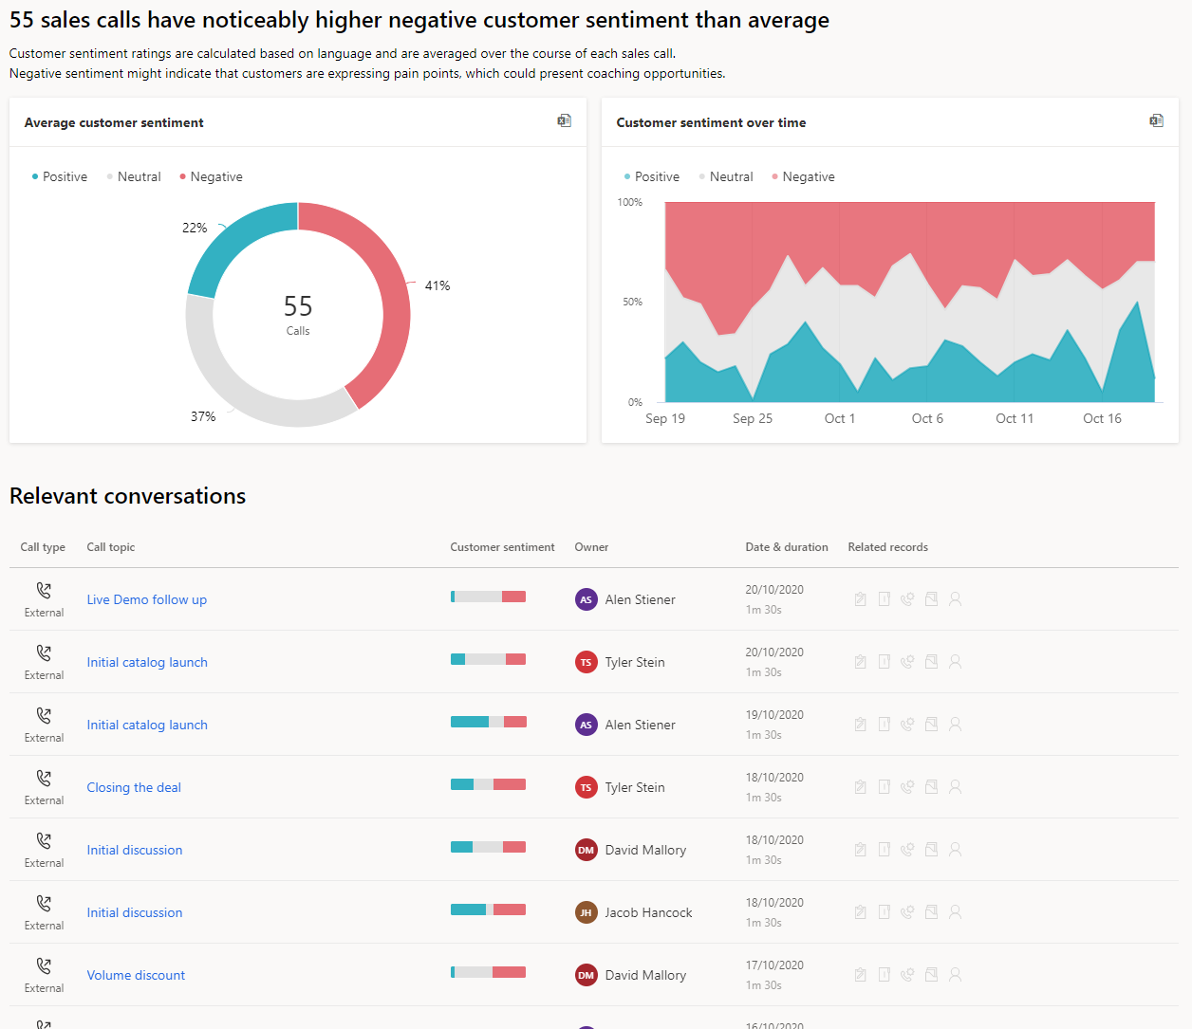
CONVERSATION INTELLIGENCE: sentiment
1
1: Ai based Sentiment Detail
2: Individual Call Intelligence
2
salesintel.ai

Slide 6
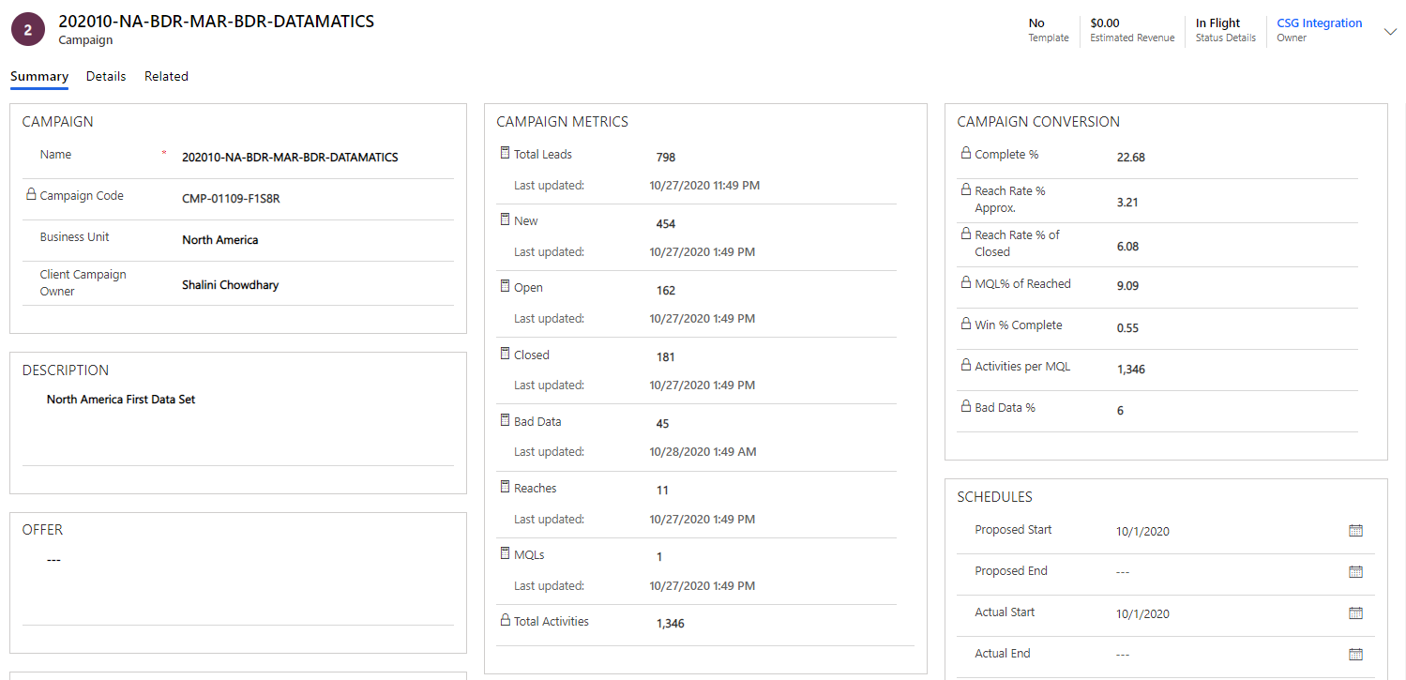
CAMPAIGN DETAILS
1: Reach Rate %
2: MQL % of Reach
3: Win % of Complete
4: Activities per MQL
5: Bad Data %
1
2
3
4
5
salesintel.ai

Slide 7
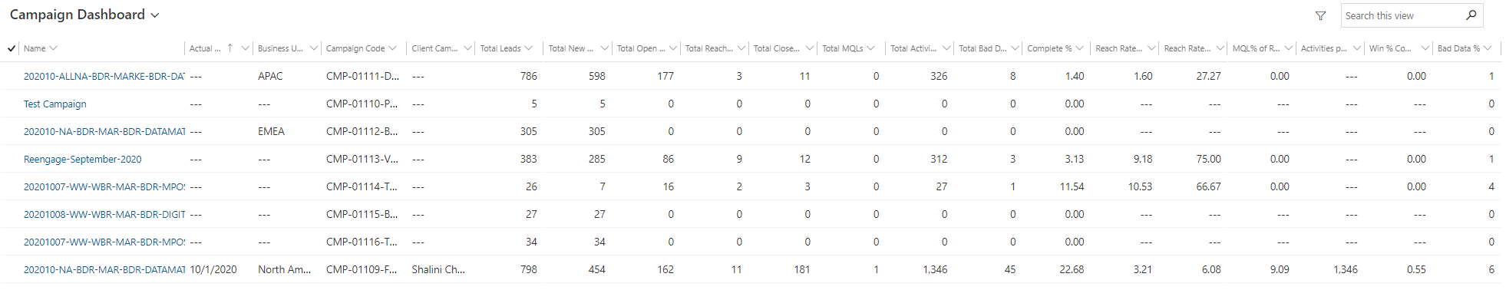
CAMPAING DASHBOARD
CSGs Campaign Dashboard allows for quick comparison of all campaigns for performance KPIs. This intelligence allows for making decisions to maximize your marketing spend.
salesintel.ai

Slide 8
How CSGSi supports Sales Organizations?
We understand the complex relationship between Sales and Marketing.
Our CSGSi solution is developed to help bridge that gap and provide both organizations maximum value. Our experience has shown Sales organizations require fully developed Sales Insights when receiving leads. CSGSi produces leads with the intelligence required for sellers to act quickly and intelligently to maximize the value of their leads and increase conversion to opportunities. CSGSi produces recordings with prospect Sentiment, fully transcribed conversations and Ai driven Key insights into the buyer accessible from any web interface.
salesintel.ai

Slide 9
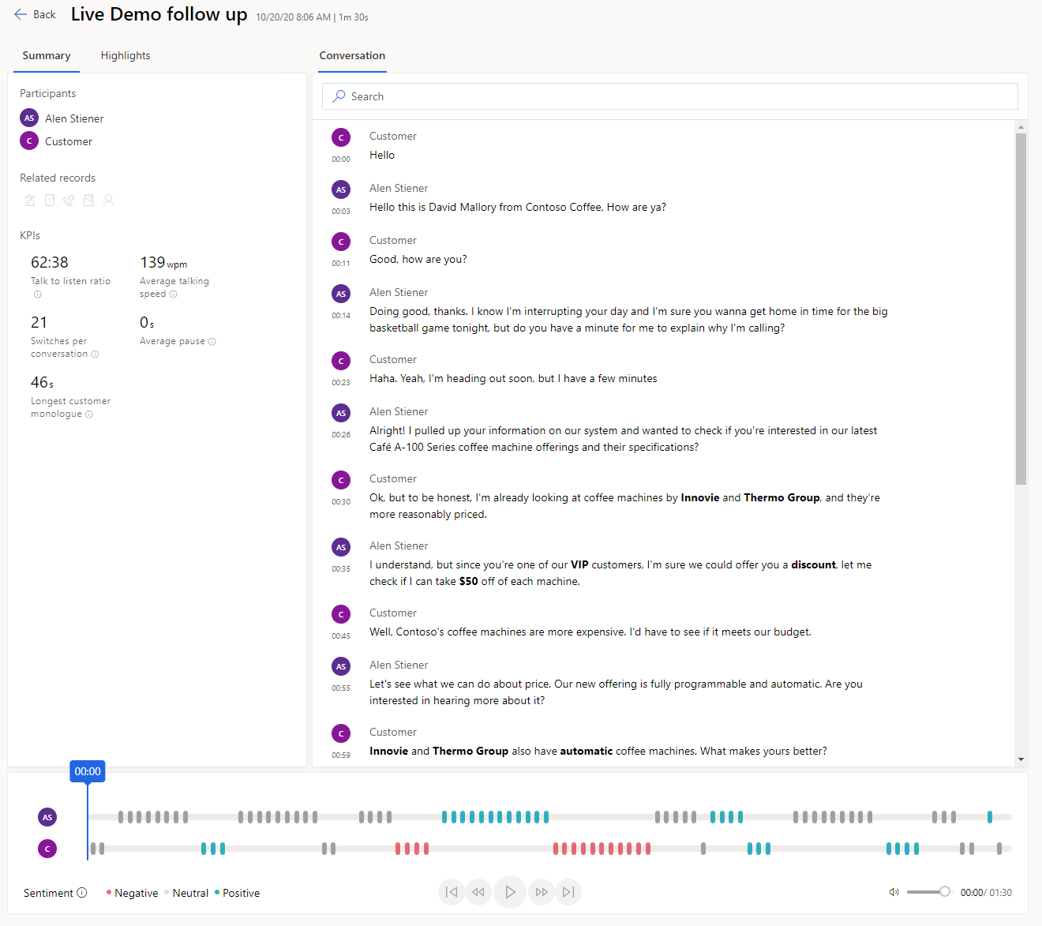
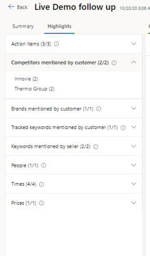
CALL INTELLIGENCE
1
1: Ai driven Call intelligence
2: Call transcription
3: Call Recording with Sentiment
4: KPIs
5: Call Highlights
2
4
5
3
salesintel.ai

Slide 10
How CSGSi supports SDR Velocity and Results?
Sales teams in organizations must focus on high-velocity selling.
To overcome this challenge, the CSGSi provides a tailored experience for our SDR teams by minimizing the time they spend on their search for the best next customer to reach out to. The CSGSi App gathers information from multiple sources and lets sellers focus on how to best approach their customers. It helps sellers to sell smartly, by building a strong and prioritized Ai driven pipeline, offering context, and surfacing automated recommendations throughout a sales sequence that helps to speed the sales process.
salesintel.ai

Slide 11
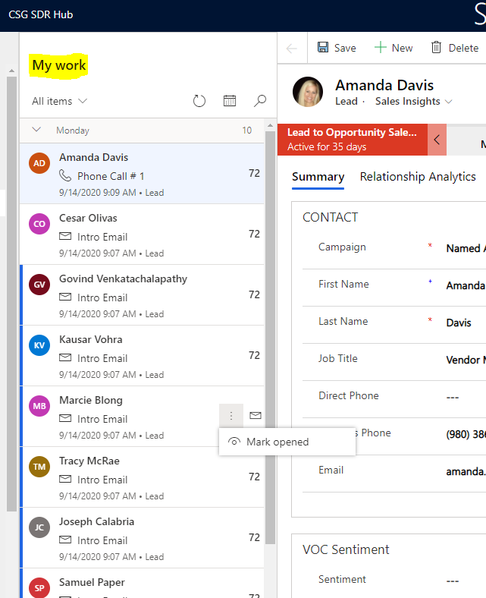
SALES ACCELERATOR: Velocity
The sellers who are part of these sales teams spend valuable time identifying the best customer in their customer list, navigating across multiple sources to identify who they need to engage with, when, and how.
salesintel.ai

Slide 12
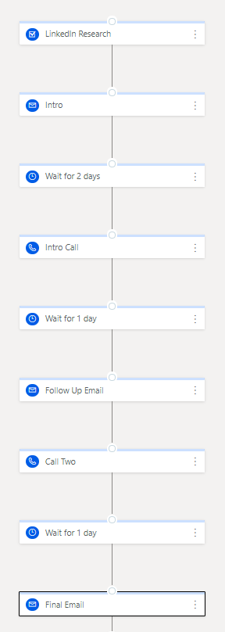
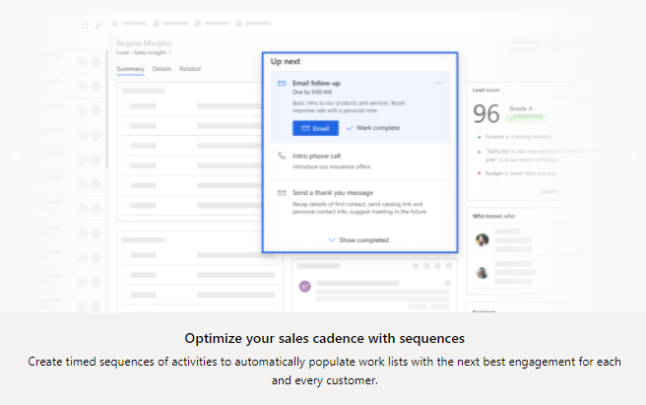
SALES ACCELERATOR: Sequences
1: Timed Sequences of Activities
2: Optimize Sales Cadence
3: Sequence Result Comparison
4: Templatize Email Touches
salesintel.ai

Slide 13
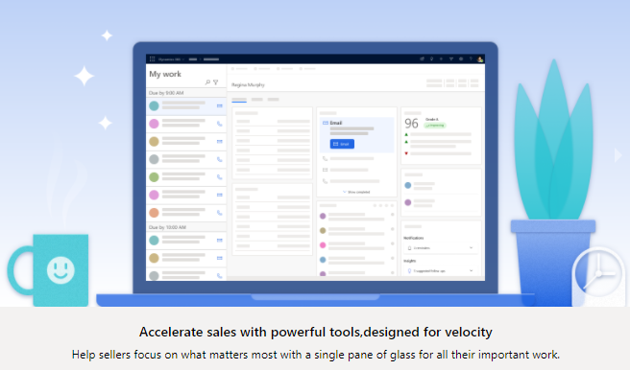
SALES ACCELERATOR: Velocity
salesintel.ai

Slide 14
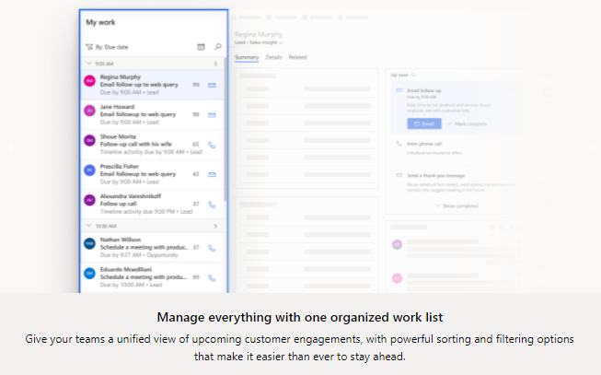
SALES ACCELERATOR: Velocity
salesintel.ai

Slide 15
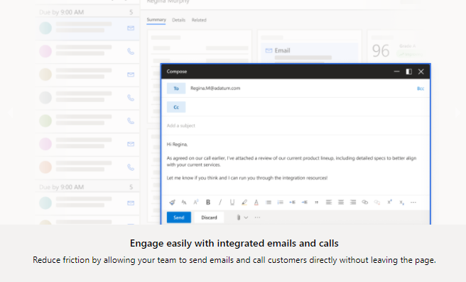
SALES ACCELERATOR: Velocity
salesintel.ai

Slide 16
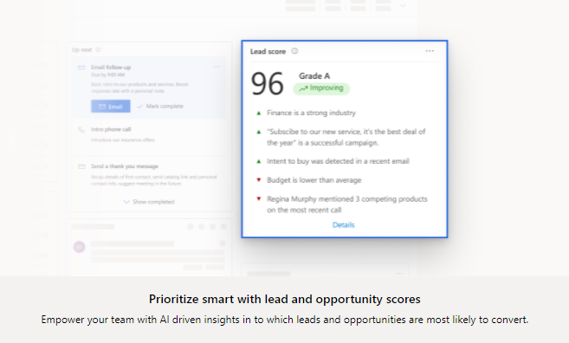
SALES ACCELERATOR: Velocity
salesintel.ai

Slide 17
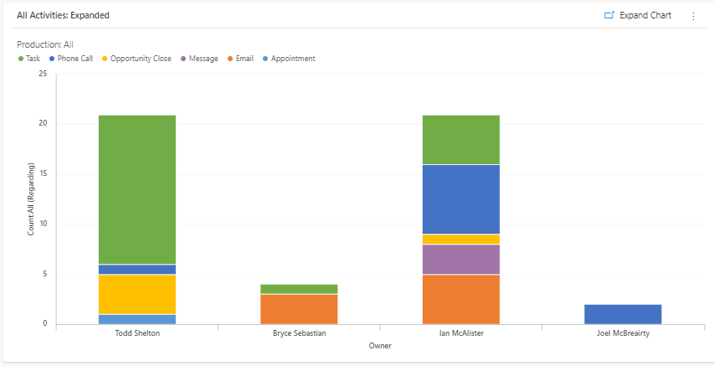
SALES ACCELERATOR: Activity
Activity Tracking:
Phone Calls
Tasks
Emails
In Mails (messages)
Appointments
Each record in ‘My Work’ will be organized into these areas
salesintel.ai

Slide 18
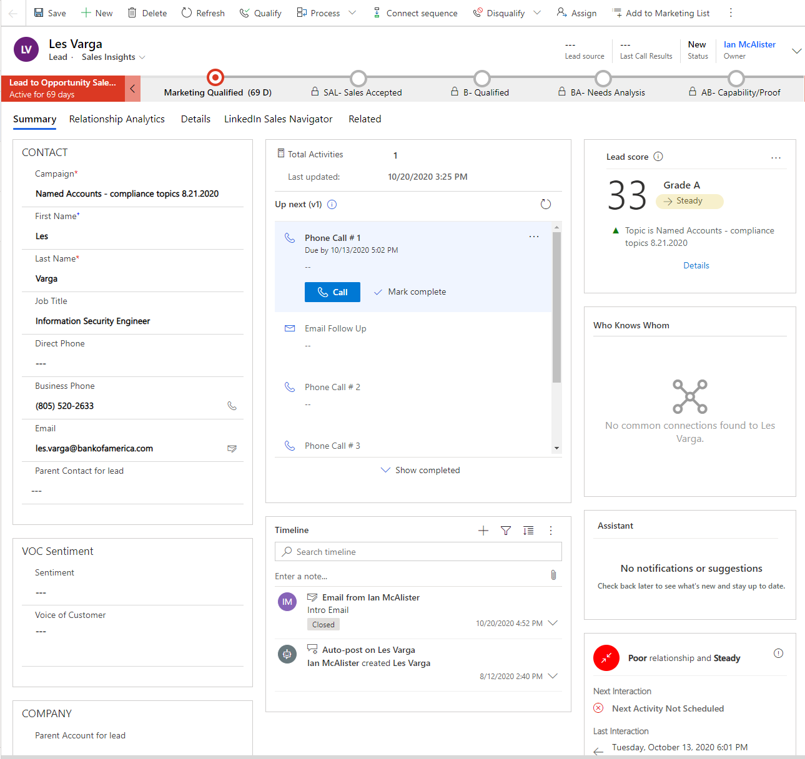
LEADS
1
1: Ai based lead scoring
2: Sequence tracking
3: Activity Timeline
4: Ai Driven Relationship Score
2
3
4
salesintel.ai

Slide 19
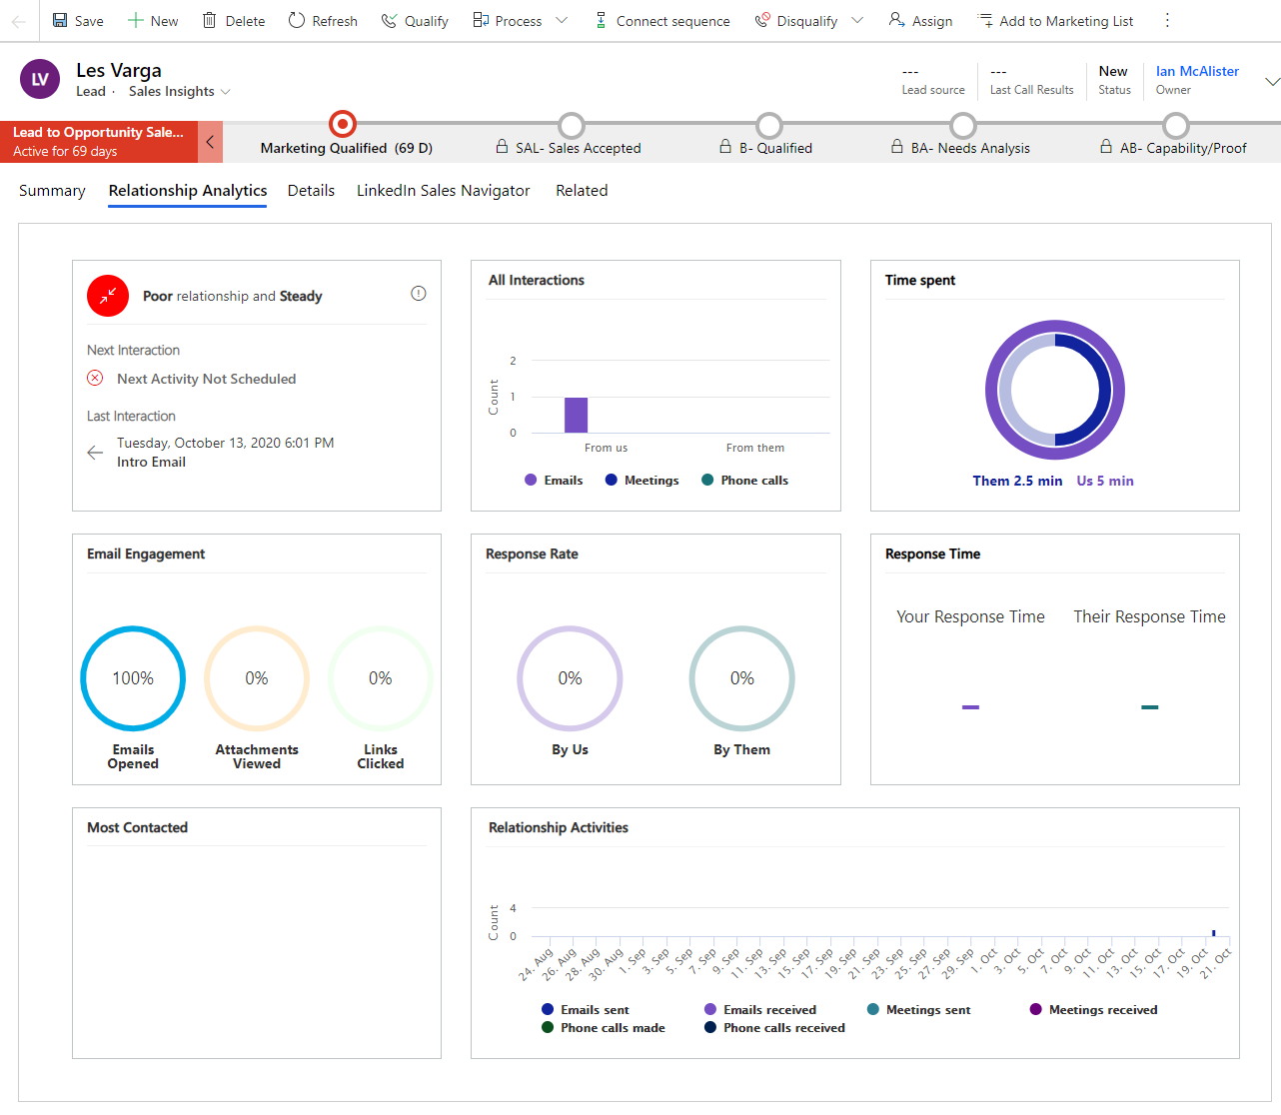
REALTIONSHIP ANALYTICS
1
1: Ai based Interaction Time
2: Email Tracking
3: Email Engagement
4: Activity History
3
2
4
salesintel.ai

Slide 20
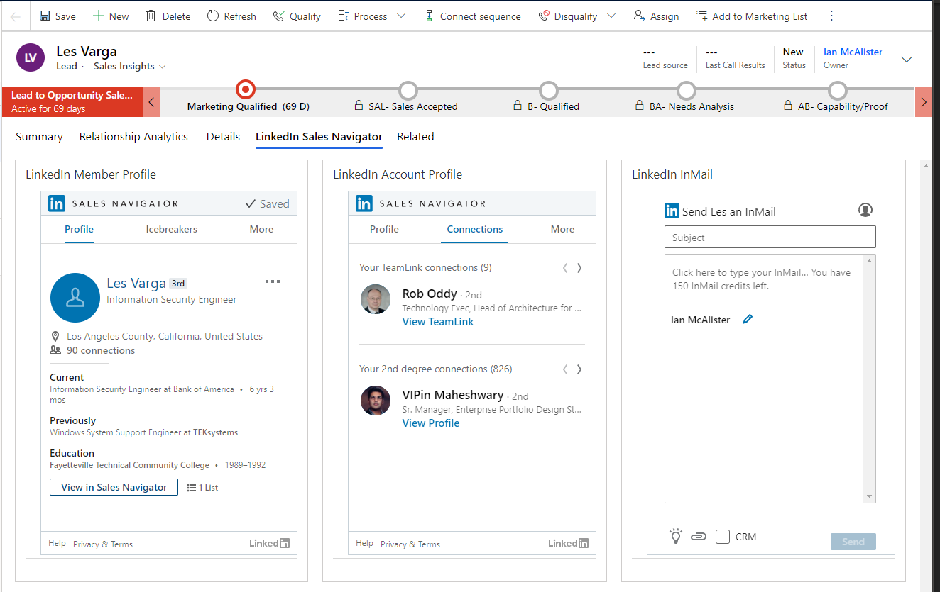
SALES NAVIGATOR
1
1: Sales Navigator Integration
2: Icebreakers
3: Company Connections
4: InMail Activity Tracking
2
3
4
salesintel.ai

Slide 21
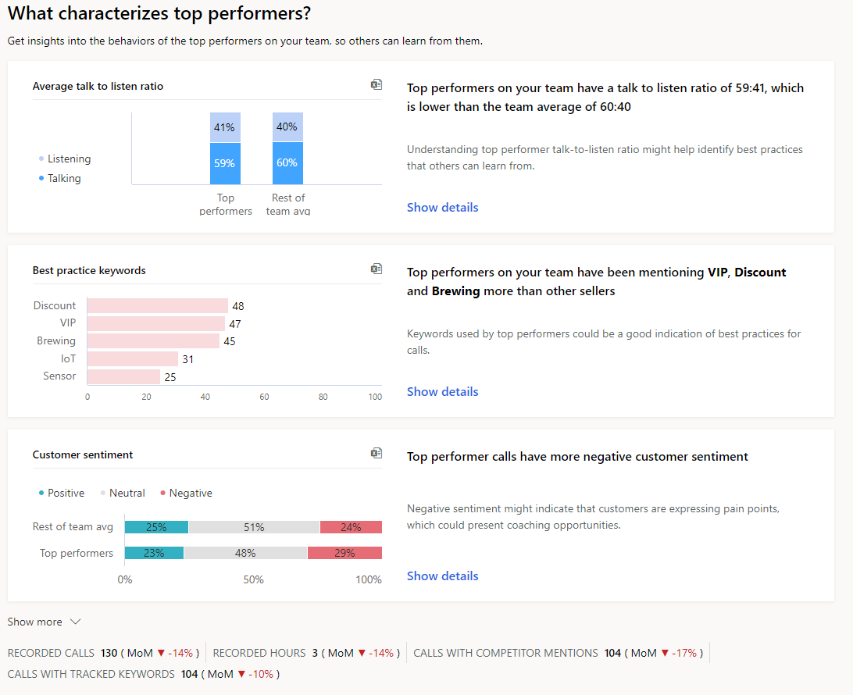
TEAM PERFOMANCE
1
2
1: Insights and Behavior of Top Performers
2: KPIs
3: Keywords
4: Sentiment
3
4
salesintel.ai

Slide 22
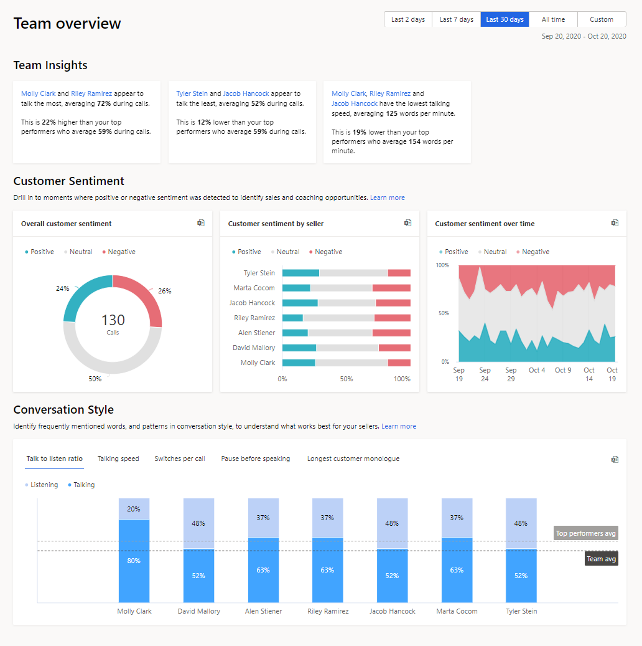
TEAM PERFOMANCE OVERVIEW
1
4
2
1: Ai Driven Team Performance
2: Team Insights
3: Conversation Style
4: Ai Driven Coaching Opportunities
3
salesintel.ai

Slide 23
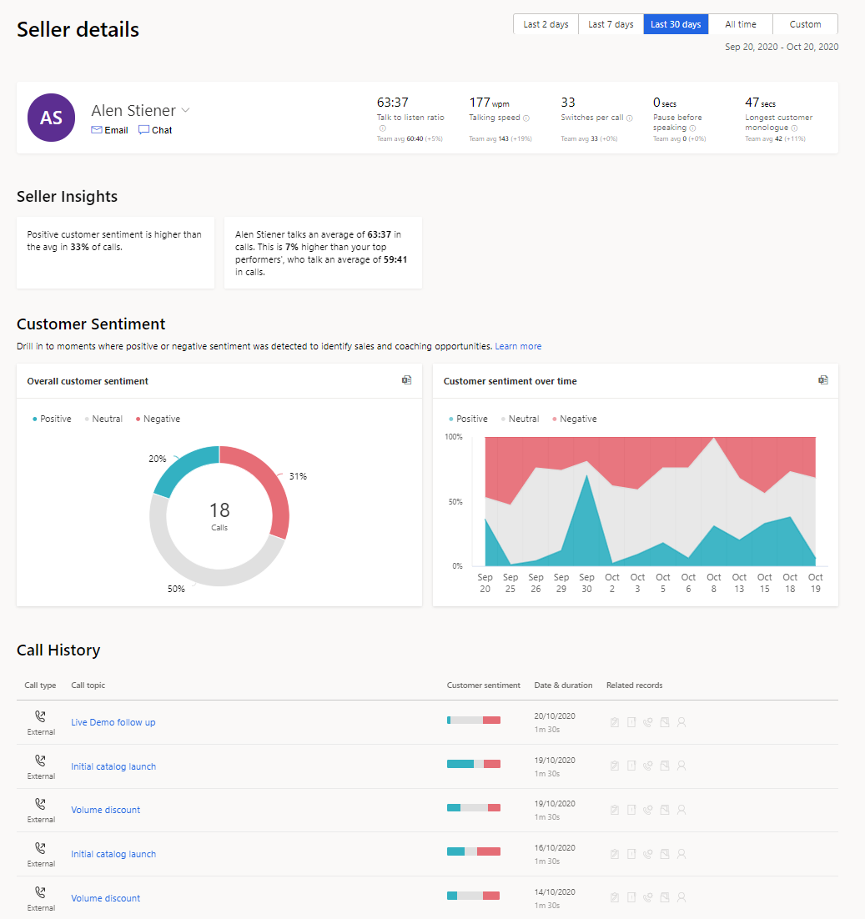
SELLER PERFORMANCE
1
2
3
1: Ai based Seller Performance
2: KPIs
3: Coaching
4: Call Details with Recordings
4
salesintel.ai

Slide 24
How to Engage with CSG Sales Intelligence?
Our CSGSi Solution provides programs for both Marketing Intelligence initiatives and Sales and Marketing Revenue Generation programs.
salesintel.ai

Slide 25
Marketing Intelligence Programs
CSG xxx
salesintel.ai

Slide 26
Sales and Marketing Revenue Generation Programs
CSG xxx
salesintel.ai

Slide 27

salesintel.ai

Slide 28
CSG Sales Intelligence
salesintel.ai

