Slide 1


2020 Central Regional Conference
Stephen Bufton Memorial Educational Fund (SBMEF)
Notes:
Presiding Officer introduces presiding DVPs and Reviews Agenda
Housekeeping
If you have any questions, we ask that you write them down so we can get through all of the material. And at the end of this session, we will answer your questions.
Remind them that the learning materials for this session are located in the r-pocket. And a more detail description of the SBMEF scholarship is also included in the SBMEF Guide. (hold it up and show it to them)
There will be 3 surveys throughout the session…where we will ask you to Work with the members at your table to determine the correct answer.
Suggested Ice Breaker
Ask for a show of hands on how many members in the room have been a recipient of a national scholarship? Keep your hands up. How many members have been awarded an Impact Scholarship? Keep your hands up! Now of you have been awarded an Outright Grant Scholarship? And a BSTR scholarship?
You can reverse the order too…

Slide 2
AGENDA
Ways You can Support SBMEF
SBMEF Resources and Where to Find Them
General Policies for Administering SBMEF
SBMEF Scholarship Programs for 2020-2021
Responsibilities of Trustees
Mission, Facts, and Contributions by District and the Business Case for SBMEF in 2020

Slide 3
Mission, Facts, Contributions by District and the Business Case for SBMEF in 2020

Slide 4

SBMEF’S MISSION STATEMENT
The Stephen Bufton Memorial Educational Fund exists to provide educational grants and scholarships to women pursuing post secondary educational goals as well as ongoing professional development in order to support their career advancement and to help them become the role models, mentors and leaders of the future.
Notes:
The mission statement was crafted by the 2011-2012 Board of Trustees…the president of the trustees at that time was Tina Duncan (you may recognize her by her name, Tina Gandy).

Slide 5

Facts About SBMEF
In 1953, SBMEF was established by Anne Hayes (the first honorary member of ABWA) in memory of Stephen Bufton, a son of ABWA’s founder, Mr. Hilary Bufton Jr.
SBMEF is a public foundation and is classified as a 501c3, a charitable organization.
  - Because SBMEF is a charitable organization, all contributions to the fund are tax-exempt.
Trustees award about $120,000 in scholarships annually.

Slide 6


Facts About SBMEF
The majority of contributions to SBMEF are made by ABWA members
Notes:
The majority of the contributions made to SBMEF are made by ABWA members/leagues and that’s why the fund has been sustainable.

Slide 7

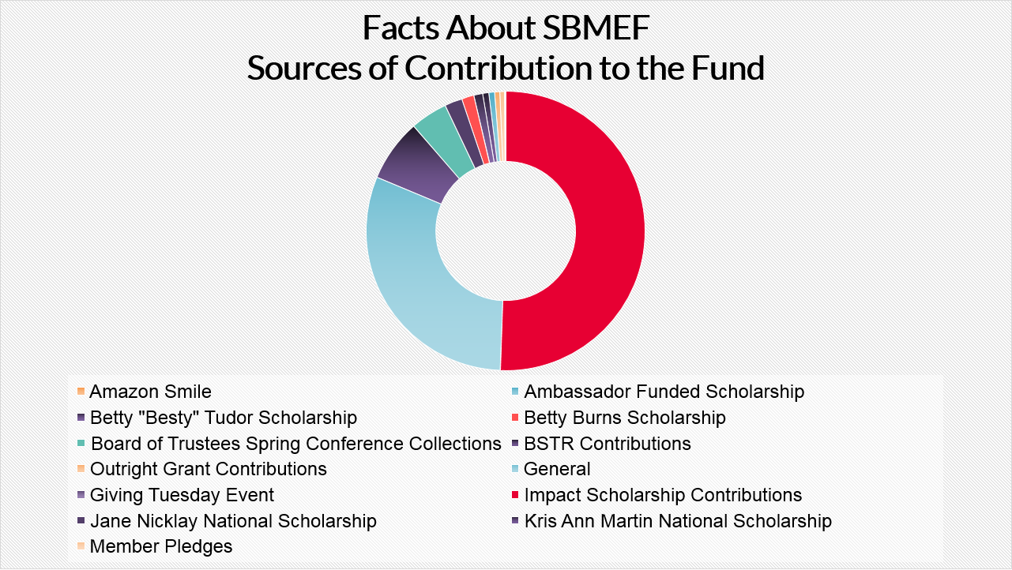
Total Contributions $240,651.12
The majority of contributions made are to fund Impact Scholarships
Notes:
A good chunk of change comes from members who attend regional conference events…

Slide 8
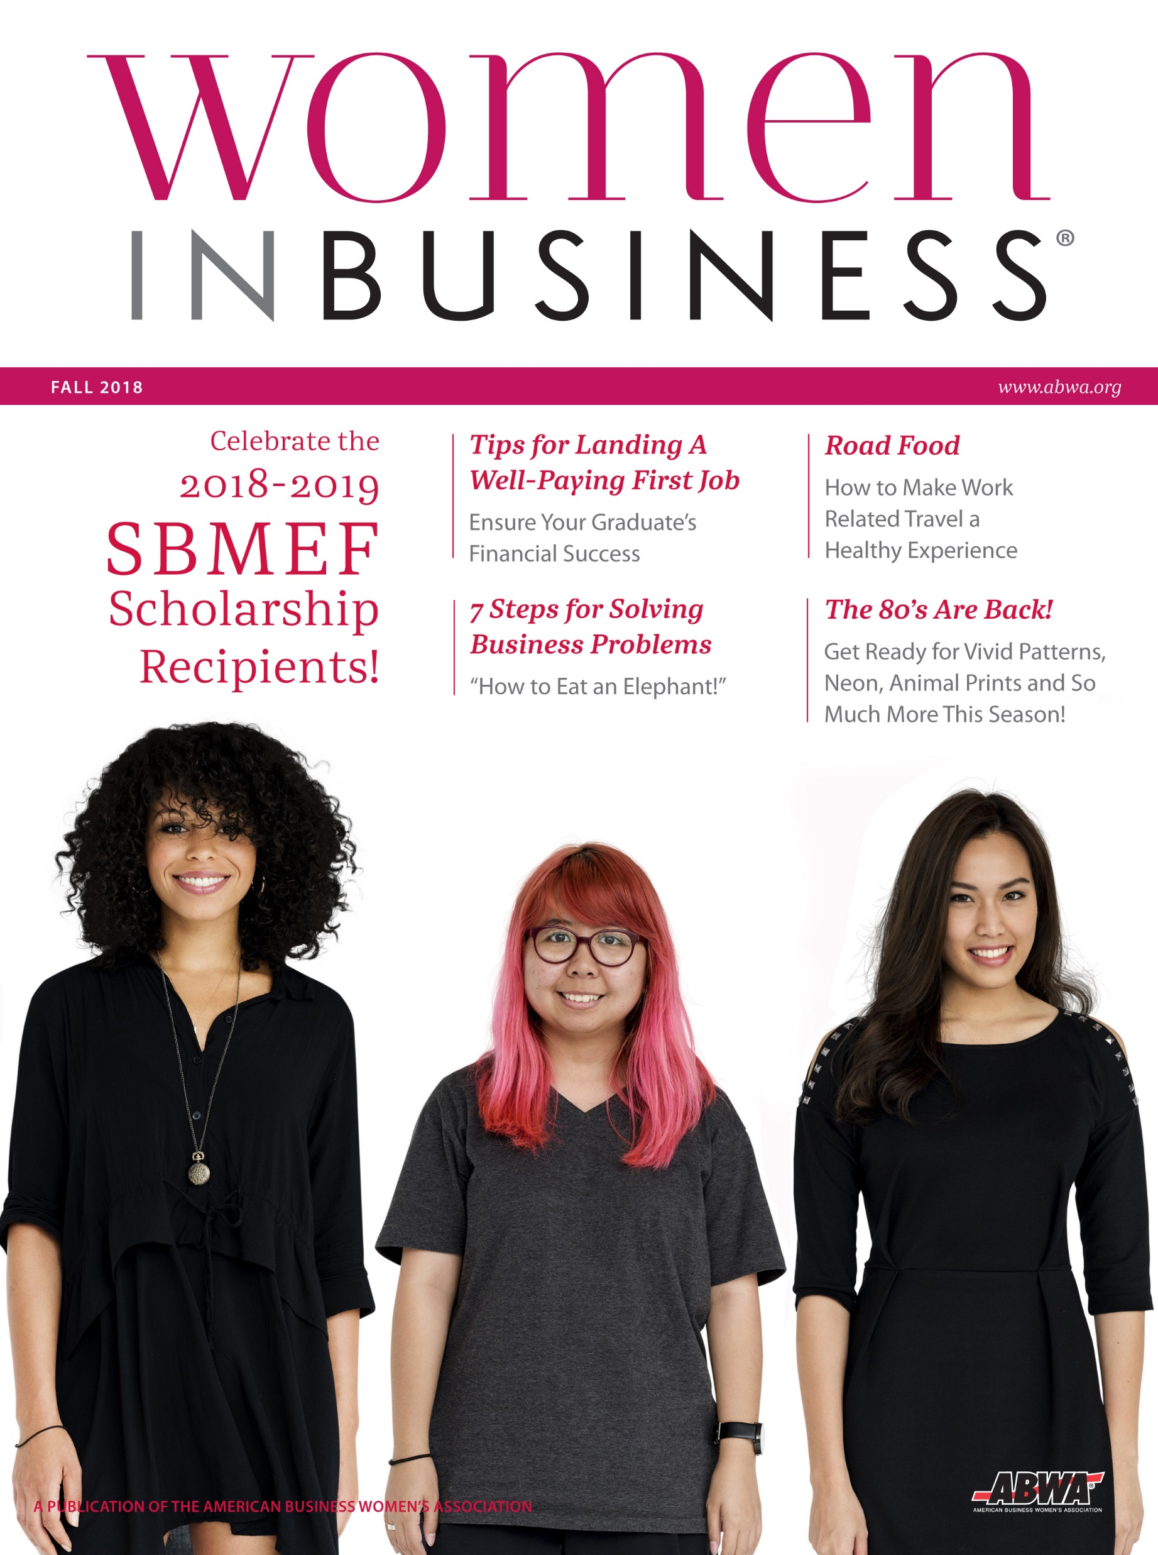
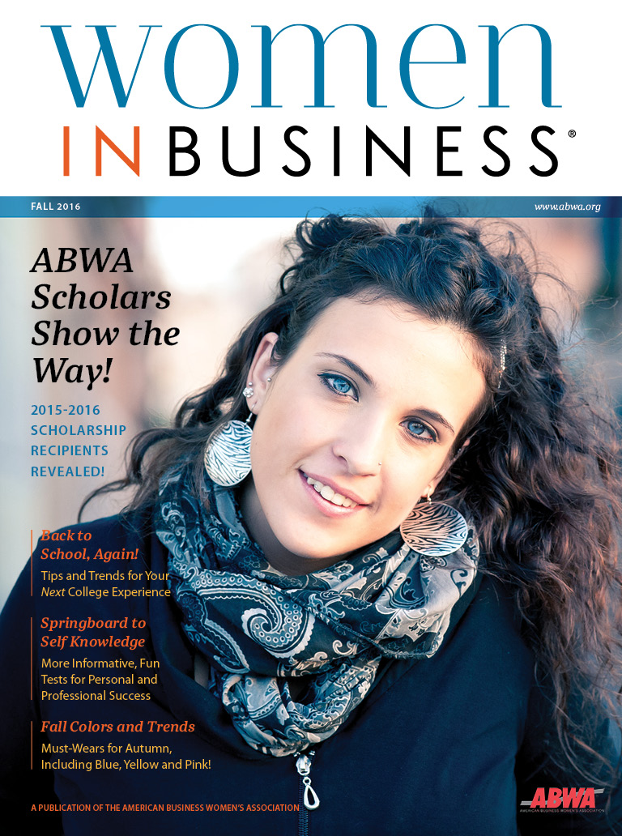
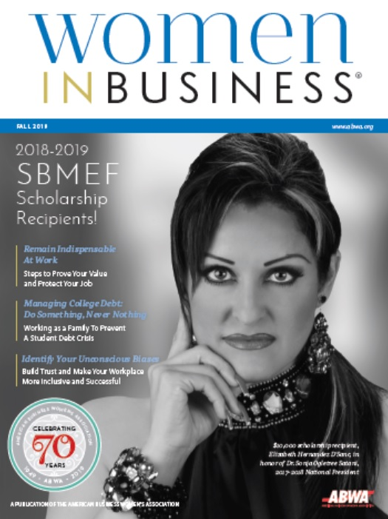


Facts About SBMEF
Scholarships Awarded in 2018-2019
National Scholarships Awarded: 4 ($17,500)
Impact Scholarships Awarded: 52 ($89,000)
BSTR Scholarships Awarded: 38 ($3,772)
R
Scholarships awarded are generally listed in the fall issue of Women In Business Magazine
This Photo by Unknown Author is licensed under CC BY-NC
Notes:
All scholarships awarded are published in the Fall issue of Women in Business Magazine. Last year’s cover was one of the national scholarship recipients…
Felicia loves to share the story about her conversation…Remember, if you ask Felicia, make sure you have time for hear her response. It’s a good one!

Slide 10
Facts About SBMEF
Impact and BSTR Disbursements by District
2018-2019

Slide 11

1
In 2019, the average annual earnings for women without a college education were:
$28K
$36K
$41K
In 2019, women with at least a bachelor’s (or greater) earned:
$20K more
$15K more
$10K more
The average cost of one year of instate tuition for a public school (college/university) is:
$15K
$20K
$25K

Slide 12

The Business Case for SBMEF in 2020
Education and Impact on Earnings
Educational attainment for both women and men is directly correlated with greater earning potential, thus more money saved at retirement.
* Pew Research Center
Notes:
Donna Summers’ 1983 hit “She Works Hard for The Money” resounded loud and clear with a generation of women on the threshold of breaking a decades-old stereotype of gender roles. Summers was right. Women do work hard for the money, and they’re working harder than ever today.
In 2019, the majority of women in the workforce, 50.2% (of the 29.5 million women) have college degrees (slightly higher than their male counterparts)

Slide 13


The Business Case for SBMEF in 2020
Education and Impact on Earnings for Women
  Typical female employee in 2019 earned $41,900 whereas a female employee with a bachelor’s degree (or greater) earned $61,300.
  Typical male employee in 2019 earned $50,200 whereas a male employee with a bachelor’s degree (or higher) earned $74,900.
* Pew Research Center
Notes:
Donna Summers’ 1983 hit “She Works Hard for The Money” resounded loud and clear with a generation of women on the threshold of breaking a decades-old stereotype of gender roles. Summers was right. Women do work hard for the money, and they’re working harder than ever today.
In 2019, the majority of women in the workforce, 50.2% (of the 29.5 million women) have college degrees (slightly higher than their male counterparts)…while the pay gap still exists, education makes a positive difference for women.

Slide 14

2
In the last three decades, in-state public schools, tuition has increased by:
100%
44%
200%
Can a league that is fund-raising to sponsor a scholarship represent themselves as a 501c3 (charitable) organization?
Absolutely YES!
Absolutely NO!
Notes:
The Bylaws National and League state that all leagues under the ABWA umbrella should be organized as a not-for profit- tax exempt organization 501c6.
National Bylaws, Article VI, Section 2
Article IX, Section 1 – Chapter or Express Network shall be organized as a not-for-profit (501c6).

Slide 15


The Business Case for SBMEF in 2020?
College Debt for Women
The cost for public in-state tuition is about $25,290/year.
The average college graduate leaves school $30K in debt.
Women hold nearly two-thirds of the outstanding student debt in the United States.

Slide 16

The Business Case for SBMEF in 2020?
College Debt and Impact on Women in Retirement
Because of the gender pay gap, women have less disposable income after graduation which contributes to the fact that women take longer — and face greater difficulty than men do when paying off debt.
In retirement, women have a greater chance of exhausting other sources of income, making them more dependent on Social Security, and more likely to be impoverished.
Notes:
Because of the gender pay gap, women have less disposable income after graduation which contributes to the fact that women take longer — and face greater difficulty than men do when paying off debt.

Slide 17
SBMEF Resources and Where to Find Them

Slide 18


Resources for Members, Applicants, and Leagues
SBMEF Guide and Forms may be downloaded from the www.sbmef.org website
SBMEF Guide and Forms may be downloaded from the SBMEF Folder in the National Resources (Community Connections)
Online at www.SBMEF.org
ABWA National Office or email Jill Miller, SBMEF Administrator, jmiller@abwa.org

Slide 19
Responsibilities of SBMEF Trustee

Slide 20
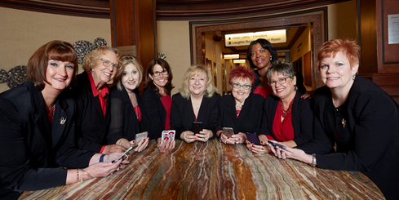
Responsibilities of the Board of Trustees
Our Great Team…
Determines the number, value and type of scholarships awarded each year.
Determines the field of study, institution and GPA for all national scholarships.
Meets at least 2x per year.
Has fiduciary responsibility for the fund.
Responsible for perpetuating the fund.
Reviews applications and awards scholarships.
Notes:
On an average, district vice presidents review 300 scholarship applications whereas the officers review 400-500.

Slide 21
Ways You Can Support SBMEF

Slide 22

Ways You Can Support SBMEF
Make a contribution to SBMEF - If you donate $25 or more TODAY, you will receive a
I DONATED TO SBMEF
Ribbon and a picture with the board of trustees at the end of today’s session.

Slide 23
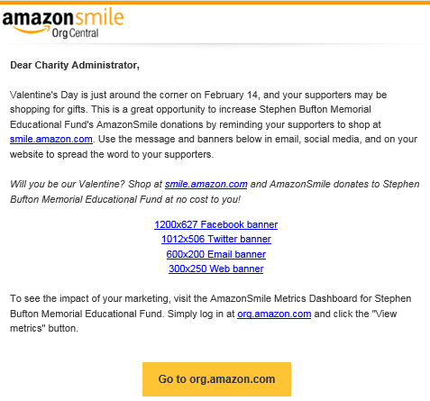
Ways You Can Support SBMEF
When shopping on Amazon, use Amazon Smile and select the Stephen Bufton Memorial Educational Fund as your charity!
If you are an employer, consider implementing an employer match program.
If you are an employee, consider participating in your employer’s match program.

Slide 24

Ways You Can Support SBMEF
“Love” or Like the Stephen Bufton Memorial Educational Fund Facebook page OR link SBMEF to your website.
Notes:
Also host a fund-raising event on FB for any celebration, birthdays, etc.

Slide 25

Ways You Can Support SBMEF
ORGANIZE A FUND-RAISING EVENT ON FACEBOOK
Notes:
ASKING YOUR FRIENDS, COLLEAGUES, AND RELATIVES TO DONATE TO SBMEF INSTEAD OF CARDS AND PRESENTS!

Slide 26
If a “business” or an individual underwrites a BSTR or an Impact Scholarship on behalf of the league, they must:
Make the contribution check payable to SBMEF (not the league).
The league must submit the contribution along with specific instructions as to how the contribution will be used (i.e., Impact or BSTR)
Both A and B
SBMEF scholarships awarded to the applicant must be cashed:
Within 2 months of issuance
Within 4 months of issuance
Within 6 months of issuance
The courses offered online in the Apex Campus do not qualify for BSTR because they are not licensed or accredited for CEUs.
True
False
3

Slide 27
General Policies For Administering SBMEF

Slide 28

General Scholarship Policies for Administering SBMEF
Scholarship applicants must be female, U.S. citizens and attending a U.S. based institution that is licensed, accredited or state approved. Members and/or non-members may apply.
Scholarship applicants are never guaranteed a scholarship.
Scholarship checks are made payable to the applicant and the learning institution (with the exception of BSTR) and, must be used for tuition, books and fees.
Scholarship checks must be cashed within 6 months of issuance and unused scholarships do not roll over.
The funds for Business Skills Tuition Reimbursement are generally dispersed within two weeks after receipt.
Notes:
The highlighted bullets are the most important to review….
You may also reference that the 6 months is also highlighted in the SBMEF guide.

Slide 29
SBMEF Scholarship Programs for 2020-2021
and Eligibility Requirements for Leagues and Applicants

Slide 30

SBMEF’s Scholarship Programs
National Scholarships
Impact Scholarship
Business Skills Tuition Reimbursement Program (BSTR)
Outright Grant (ORG)

Slide 31
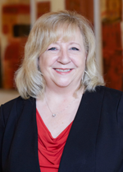
National Scholarship
In Honor of 2019-2020 National President, Sharon Godbee
Scholarship Value: $10,000
Field of Study: Education or Nursing
GPA: 3.0 or higher
Institution: University of North Carolina/Greensboro
Level: Undergraduate to doctorate

Slide 32
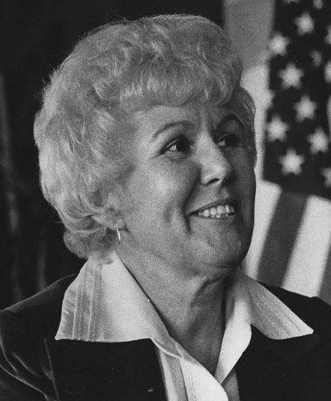
National Scholarship
In Memory of Member, Leona Schneck
Scholarship Value: $5,000
Field of Study: Open
GPA: 3.0 or higher
Institution: A College or University in the State of California
Level: Freshman to Graduate
Notes:
This was sent to us by Amy…My recommendation is that you pick and choose info that you think would be most interesting but not spend more time on this scholarship than you do highlighting other scholarships.
Leona Schneck was a 30+ year member before her passing in 2005. (I believe she joined between 1973-1974). She was very active in the Pathfinder Chapter, Fremont, CA and served as their President in 1976 and 1992, was recognized as their Woman of the Year in 1977 and 1996 and attended most National and Regional conferences.
She founded the Northern California Bay Area Council with
Cecilia Harris in 1983 and served in most of BAC officer positions over the years. She was also the Council’s Parliamentarian, educating the members and leagues in Robert’s Rules of Order.
In Leon’s professional career she was a bookkeeper, office manager and legal secretary.
In addition to being very active in the American Business Women's Assoc, she was very involved in the community and other business associations including the National Association of Parliamentarians, International Training in Communications, and was a board member on several local organizations including the ACS Relay for Life, homeless coalition and free dining organizations.
She loved playing cards and games and traveled extensively, in all states except Alaska, plus 20 foreign countries. Her walk on the Great Wall of China and her boat ride down the Amazon River were two of her biggest highlights.

Slide 33
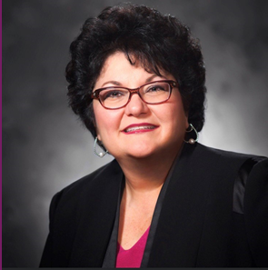
National Scholarship
Darlene Hajduk Friendship Scholarship
Scholarship Value: $5,000
Field of Study: Business
GPA: 3.0 or higher
Institution: University or College in the state of Texas
Level: Freshman to Graduate

Slide 34

National Scholarship
Women of Vision Ambassador
Scholarship Value: $2,500
Field of Study: Open
GPA: 3.0 or higher
Institution: Open
Level: Undergraduate to Doctorate

Slide 35
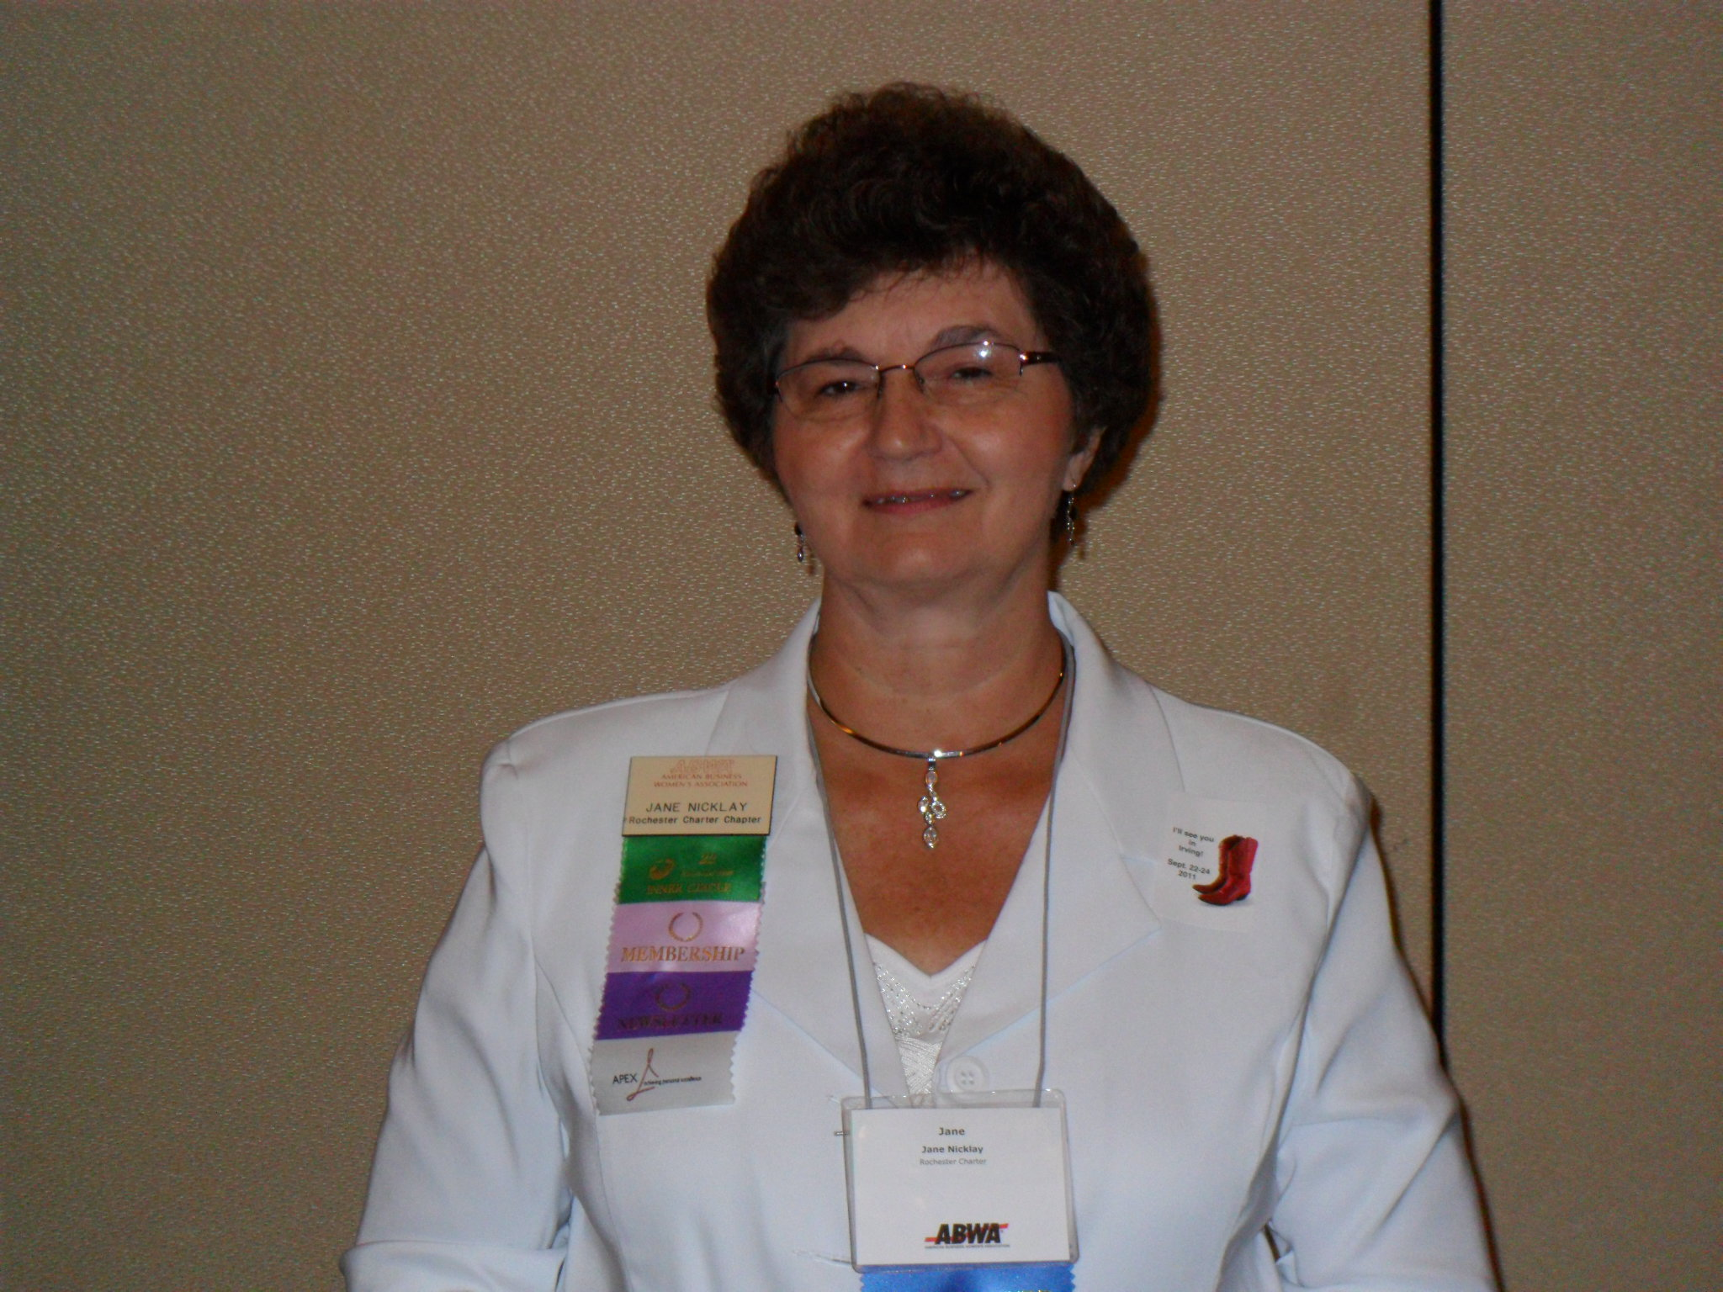
National Scholarship
In Memory of Beloved Member, Jane Nicklay
Scholarship Value: $2,500
Field of Study: Teaching
GPA: 3.0 or higher
Institution: Open
Level: Freshman to Graduate
Notes:
Jane Nicklay – member of Rochester Charter Chapter for 26 years (joined in 1989) was a teacher. Upon her death, her husband and his company funded the scholarship for 4 years at $2500 each year.

Slide 36
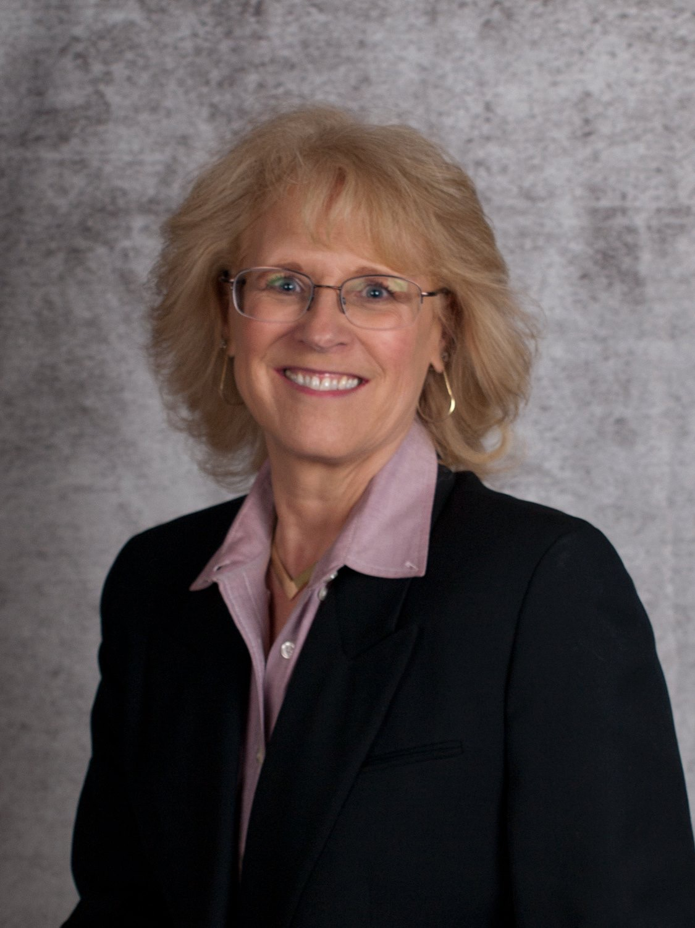
National Scholarship
Nancy Griffin Legacy Endowment
Scholarship Value: $2,000
Field of Study: Open
GPA: 3.0 or higher
Institution: Open
Level: Undergraduate to Doctorate

Slide 37
Impact Scholarship Program
Overview
An Impact Scholarship program provides leagues an opportunity to customize the scholarship they fund.
Two Types of Impact Scholarships
A $1,000 Impact Scholarship is intended for applicants attending a community college, vocational or technical schools.
A $2,000 Impact Scholarship is intended for applicants enrolled in an academic institution that offers a minimum baccalaureate degree.
Notes:
Eligibility criteria depends on the established criteria.
A pre-cursor to this particular program was referred to as the Chapter Special Scholarship.

Slide 38

Impact Scholarship
Criteria for Leagues
To participate in this SBMEF Scholarship Program, a league must:
    Be willing to fund an Impact Scholarship ($1,000 or $2,000).
      Plus, pay an additional $100 to cover administrative costs.
      Plus, purchase a student membership.
      Plus, define the eligibility requirements for each scholarship funded…all of the above actions must be completed by January 31, 2021.
    A league must also have a minimum of three qualified applicants that have completed the process prior to the deadline May 15, 2021 deadline.
    And be a chartered league of ABWA in good standing.

Slide 39

Impact Scholarship
Criteria for Applicant
An applicant must meet the specific eligibility criteria defined by the league that is funding the Impact Scholarship.

Slide 40
SBMEF - Business Skills Tuition Reimbursement (BSTR)
Overview
As of 2020-2021, 70% of the funds contributed are available for a league to offer a member/non-member a BSTR.
A league may sponsor multiple BSTRs each year.
The minimum amount of any BSTR scholarship is $50 and the maximum amount awarded to a single applicant in a given Award Year is $500.
A BSTR is intended to be used for fees associated with professional development (non-degree) including licenses. For example, CPA or real estate would be covered as long as the other criteria is met (i.e., female, completion and payment of the course in advance of application, and the credentialing organization must meet the qualification).
Apex Courses do not qualify for BSTR however, KU classes do.
Notes:
Ask why KU courses or any institution that offers CEUs generally qualify.
Answer: Because they are an accredited, licensed and/or state approved organization.

Slide 41

Business Skills Tuition Reimbursement (BSTR)
Criteria for Leagues
A league must contribute a minimum of $500 to SBMEF by June 1, 2020 to be eligible to sponsor a BSTR in the 2020-2021 Award Year.
The money contributed by June 1, 2020 can be used to fund BSTR scholarships as early as August 1, 2020.
A league must be in good standing.

Slide 42

Business Skills Tuition Reimbursement (BSTR)
Eligibility Criteria for Applicant
The applicant must pay for the course in advance, have proof of payment, complete the course, and submit her BSTR application within 90 days post course completion (or before June 1).

Slide 43
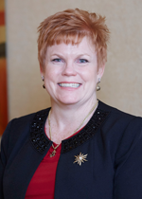
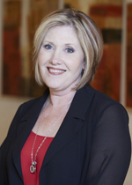
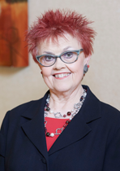
Thanks for Attending Today’s SBMEF Session!
Anne O’Neill
National Secretary-Treasurer
Kathy Schooley
District III Vice President
Cheryl Blair
District V Vice President

