Slide 1
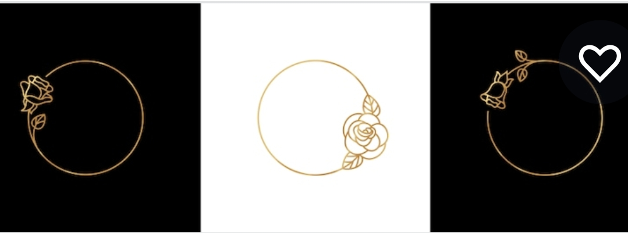

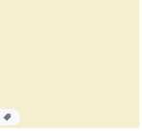
Background 1
ROSE 1
Background 2
ROSE 2
Font 1
Font 2
ANTIQUE GOLD

Slide 2

STYLE
DE R SE

Slide 3
STYLE
DE R SE

Slide 4
Style
Style
Style
DE R SE

Slide 5
STYLE
DE R SE

Slide 6
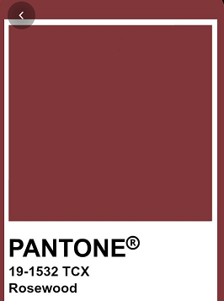
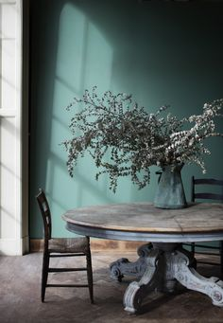
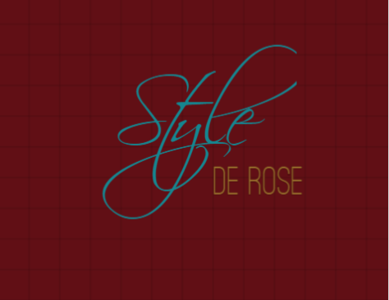
Background 2
Elegant
Independent
Learning
Abundant
Ambitious
Nature
Passionate
Unusual
Self-confident
Background 1

