Slide 1
Zero Waste Paste (ZWP)
Company and Product Overview
ZWP aims to be a key player in the revolution of the minimal waste market for personal hygiene products
ZWP provides personal beauty/hygiene products with zero packaging (i.e. consumers provide their own container to be refilled time and again)
ZWP’s initial product is an all-natural, refillable deodorant/underarm paste
All purchases must happen in-store across a variety of different locations (i.e. wholefoods/bulk-foods stores, hip cafes, providores etc)
ZWP has a unique dispensing methodology that is eye-catching and provides an “experience” to the consumer

Slide 2
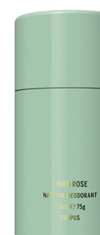
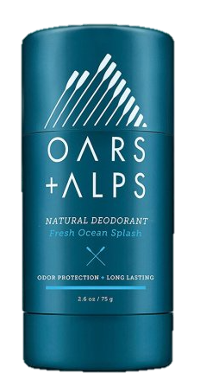

ZWP Range
The products shown are not our products, they are just acting as a place holder trying to express the color associated with ZWP’s different scents.
Calm, like Buddha
“Your energy introduces you before you even speak”
Live Wild, Live Free
‘Wild is my favorite color’
There is no packaging associated with ZWP. Consumers re-fill a container of their own and the product is dispensed out of a ‘dispensing gun’ that is labeled with the scent name, quote and colored
This is ME
‘BiCarb free, subtle scent
“Self-confidence is the best outfit – Rock it!”

Slide 3
How we want customers to feel about our Brand
Brand Personality
Like they are taking a stand for a healthier environment
That being sustainable is hip, cool and trendy
That they are part of a like-minded community
BOLD
Empowered
Committed
Like they are leaders & trend setters
Trust in the product & in the brand
Proud of their conscious consumerism behavior

Slide 4
What we want our image to say:
Brand Personality
We are edgy/trendy
We are trustworthy
We are bold
We are leaders
We create community
We have respect
We are responsible
We are empowering people
We are compassionate
This is a fun & exciting brand
Healthier people, healthier planet
All natural products
Inspiring
Try something new
Feel Alive, be alive!
NO to waste! & NO to BO!

Slide 5

Traits for the ZWP logo
Clean
Simple
The name as the logo and maybe just a small, clean emblem
Striking yet with elegant simplicity
Bold – needs to stand out
Unique
Legible
Create a feel of confidence and trust
Professional feel - not too ‘playful’
“Sukin’ – I like the emblem built into the name

Slide 6



Design Concepts
1
2
I like the use of the numeral “0”
3
I like that this incorporates the numeral “0” and the word Zero. I feel it has a bit more edge to it than #3. I like the extended Z.
You are welcome to use your creative expertise to develop something different if you see it delivering the ‘image/feel’ we are trying to achieve with ZWP
Or
You are welcome to use any of these concepts as a starting point.
I do like this but I think it’s a bit ‘fluffy’ & not hip/edgy enough for the brand image. It needs more kick or a slightly more bold/strong image.

Slide 7
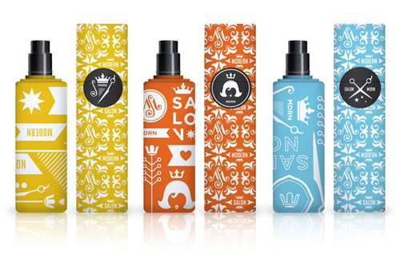
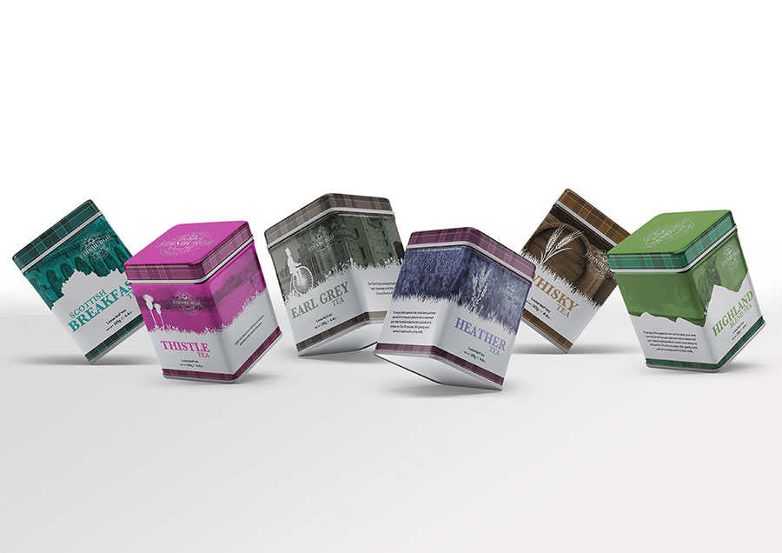
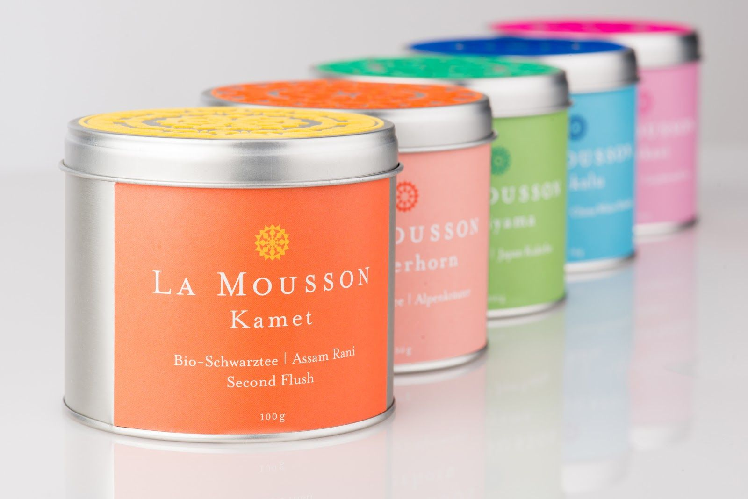
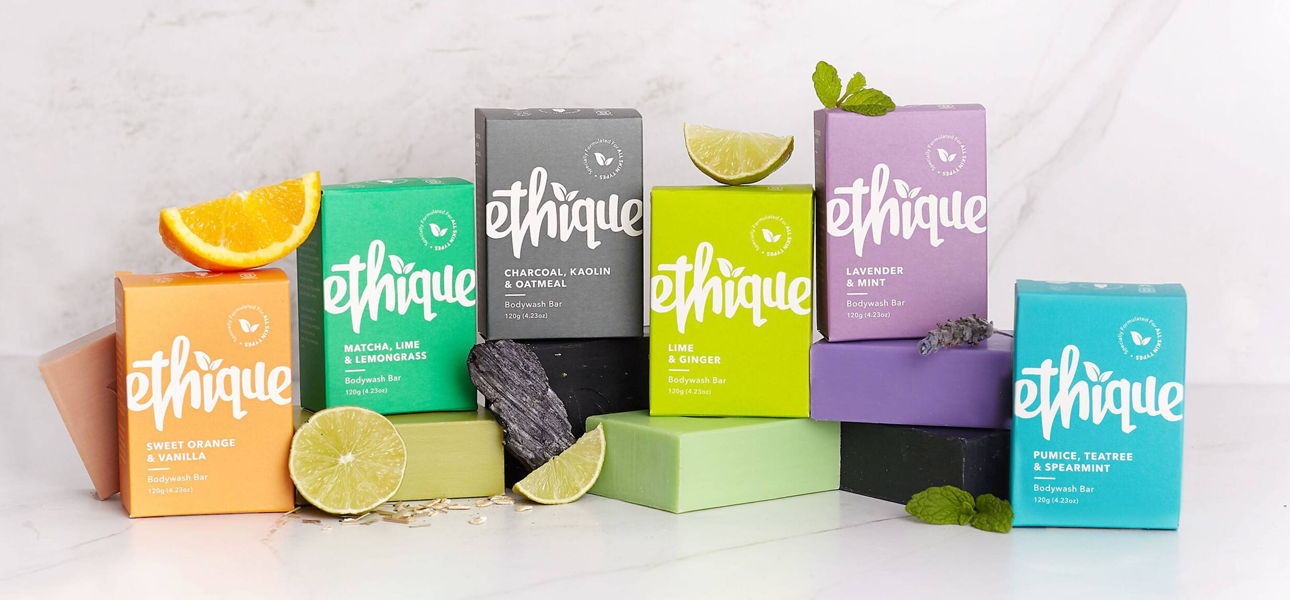
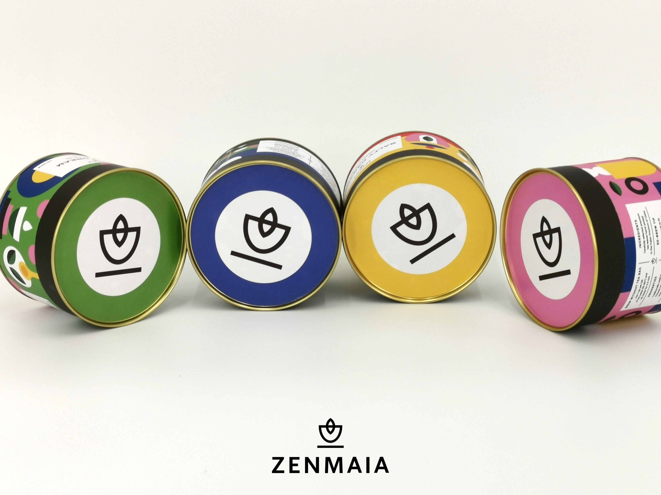
Examples of Brands with multiple products and the recognition of each
ZWP has 3 deodorant/Under Arm Paste scents. Their name/logos all need to be recognisable as ZWP products however have their own identify as a unique scent/product.
Examples below show brands with their product range and how they are unique yet apart of the brand
How they do this?
Strong color differentiation
Patterns
Different emblem for each product

Slide 8
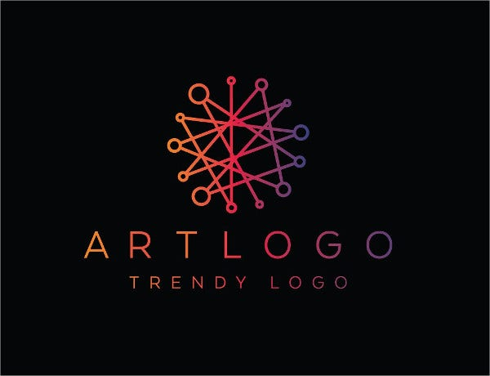

I want to replicate a similar feel to these brands
(a blend of them all & not one in particular)
Although I have said the preferred color pallet is black and white for the logo, I will have bold colors that match each product (i.e. a color for each scent).
Here are some products/brands that give a similar feel to what ZWP will give.
The overall feel is fun & funky. I feel like this is an exciting new product. It’s edgy, hip and out-there
These are ‘nice’ – but ‘nice’ isn’t exactly what we are going for. We want to stand out more, be more bold in our image, turn more heads
This feels new age, trendy, hip and fun – more like what we are looking for with ZWP
I like the logo on the black background – it pops, feels bold, and grabs attention – that’s what we are looking to do with ZWP

Slide 9
Design Deliverables
A logo for Zero Waste Paste
(incorporating the numeral “0” or the word “Zero” or both)
A logo/emblem for Zero Waste Paste
(no words)
#1 & #2 combined in some manner
The logo as per #1 but including “Underarm”
(such that it reads “Zero Waste Underarm Paste”)
Individual product name, product quote and the Zero Waste Paste logo/emblem
Keep the scent name font in theme with the overall logo of ZWP
These three labels will include the ZWP emblem, the scent name and associated quote
Each in Rectangular format

Slide 10
Design Deliverables
Files to be provided:
design file (i.e. *.ai etc)
high-res image file (i.e. *.jpg, *.bmp etc)
font file (if applicable)
Black and white is the preferred colour palette
Each deliverable to be provided in:
Black text/image on white background
Black text/image on transparent background
White text/image on black background
White text/image on transparent background

