Slide 1


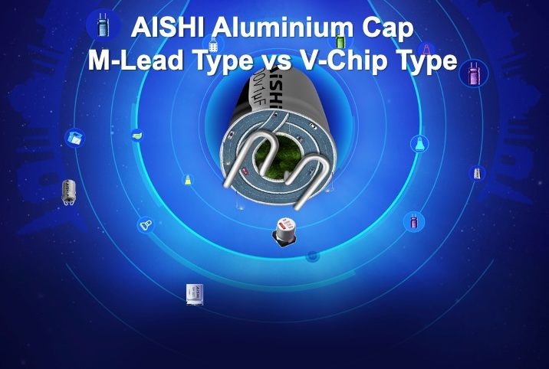
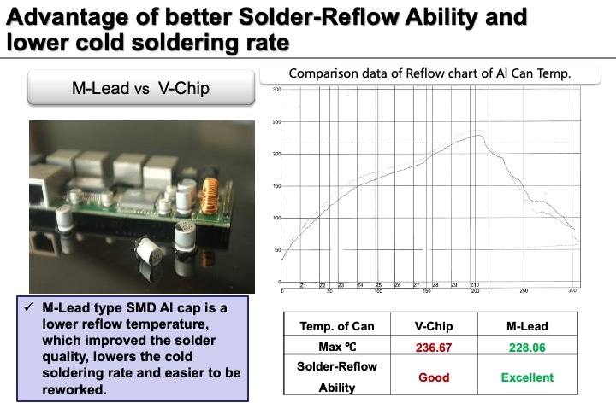
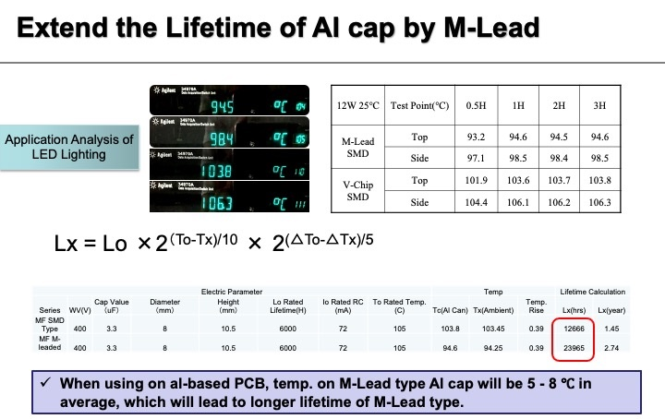
www.aishi.us
• Cost Savings
• Long Life
• Better Solderability
• 16V-450V
• Available Series:
MA, MF, MH, MK
for more information, contact nick.visic@aishi.us mobile: 281-235-0294

Slide 2
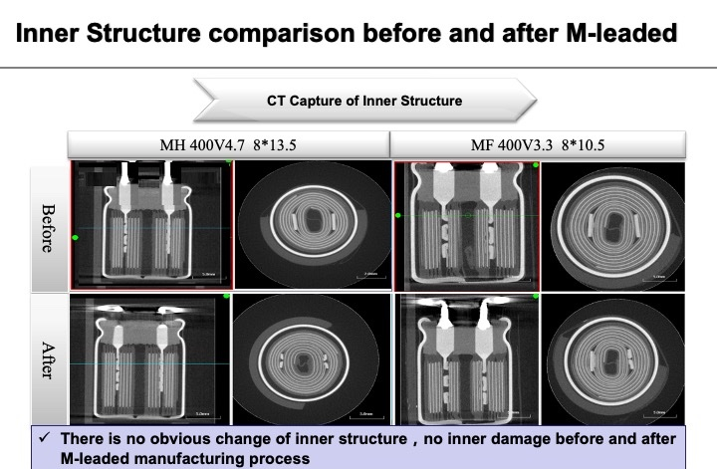
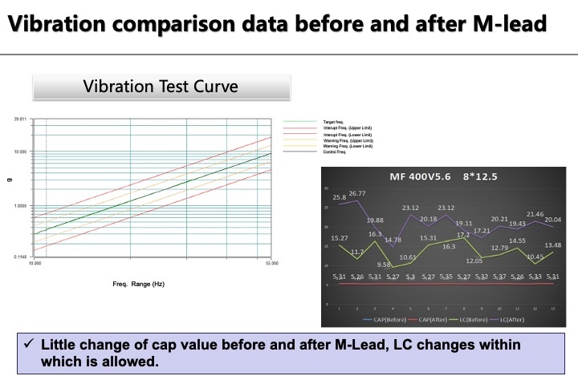
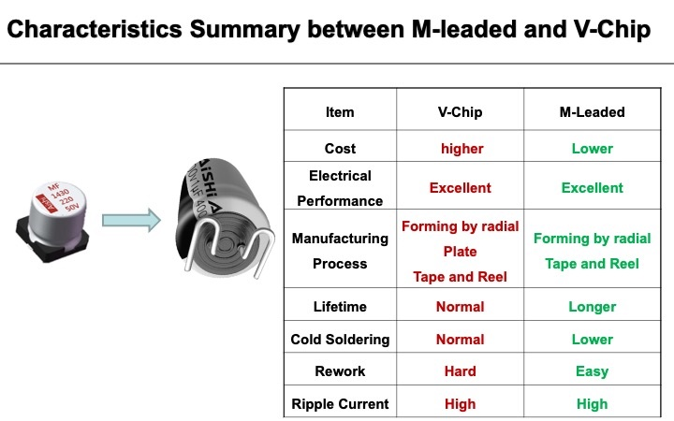
www.aishi.us
for more information, contact nick.visic@aishi.us mobile: 281-235-0294

