Slide 1


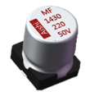
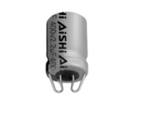

AISHI Aluminium Cap
M-Lead Type vs V chip Type
Proprietary and Confidential – Do not distribute without written permission
COPYRIGHT © 2018 The Hunan Aihua Group, Ltd. ALL RIGHTS RESERVED

Slide 2
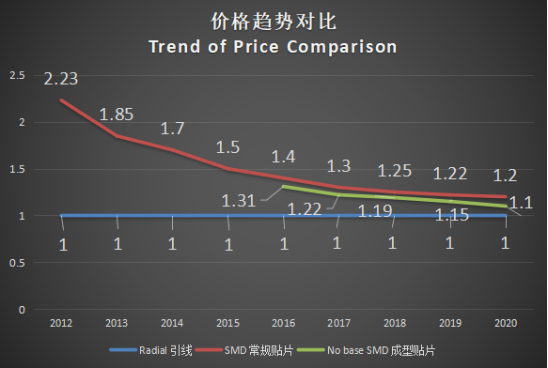
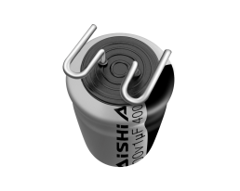
Cost Advantage
M-Leaded vs Radial Leaded vs V-Chip
With the improvement of automation level and labor costs, there are more and more SMD products, but the price of SMD products is still much higher than that of conventional products. Aishi group has been considering to reduce costs for customers and achieve a win-win situation.
M Type
V Chip
V-chip. M-Type

Slide 3
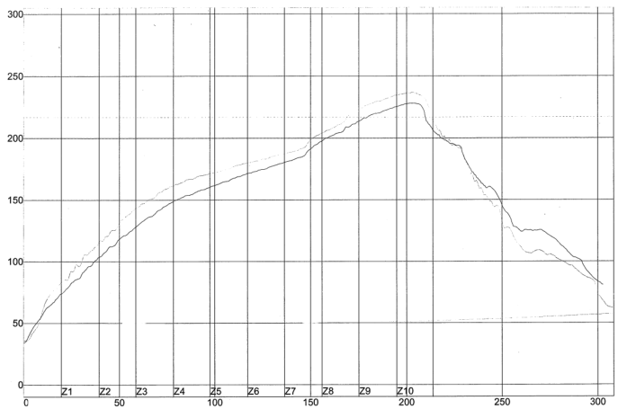
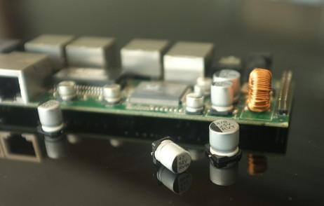
Advantage of better Solder-Reflow Ability and lower cold soldering rate
M-lead vs V Chip
Comparison data of Reflow chart of Al Can Temp.
M-leaded type SMD Al cap is a lower reflow temperature, which improved the solder quality, lower the cold soldering rate and easier to be reworked.
Temp. of Can | V-Chip | M-lead
Max ℃ | 236.67 | 228.06
Solder-Reflow Ability | Good | Excellent

Slide 4
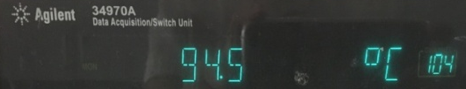
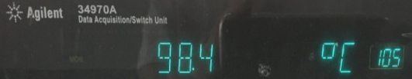
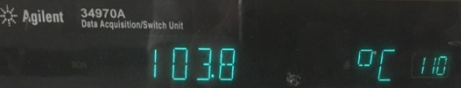
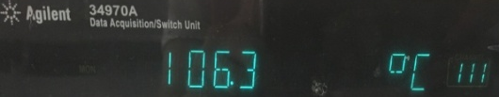
Extent the Lifetime of Al cap by M-lead
Application Analysis of LED Lighting
12W 25℃ | Test Point(℃) | 0.5H | 1H | 2H | 3H
M-Lead SMD | Top | 93.2 | 94.6 | 94.5 | 94.6
 | Side | 97.1 | 98.5 | 98.4 | 98.5
V-Chip SMD | Top | 101.9 | 103.6 | 103.7 | 103.8
 | Side | 104.4 | 106.1 | 106.2 | 106.3
Lx = Lo ×2^{（To-Tx)/10} × 2^{(△To-△Tx)/5}
Electric Parameter |  |  |  |  |  |  |  | Temp |  |  | Lifetime Calculation
Series | WV(V) | Cap Value （uF） | Diameter （mm） | Height （mm） | Lo Rated Lifetime(H) | Io Rated RC (mA) | To Rated Temp. (C) | Tc(Al Can) | Tx(Ambient) | Temp. Rise | Lx(hrs) | Lx(year)
MF SMD Type | 400 | 3.3 | 8 | 10.5 | 6000 | 72 | 105 | 103.8 | 103.45 | 0.39 | 12666 | 1.45
MF M-leaded | 400 | 3.3 | 8 | 10.5 | 6000 | 72 | 105 | 94.6 | 94.25 | 0.39 | 23965 | 2.74
When using on al-based PCB, temp. on M-leaded type Al cap will be 5 - 8 ℃ in average, which will lead to longer lifetime of M-leaded type.

Slide 5
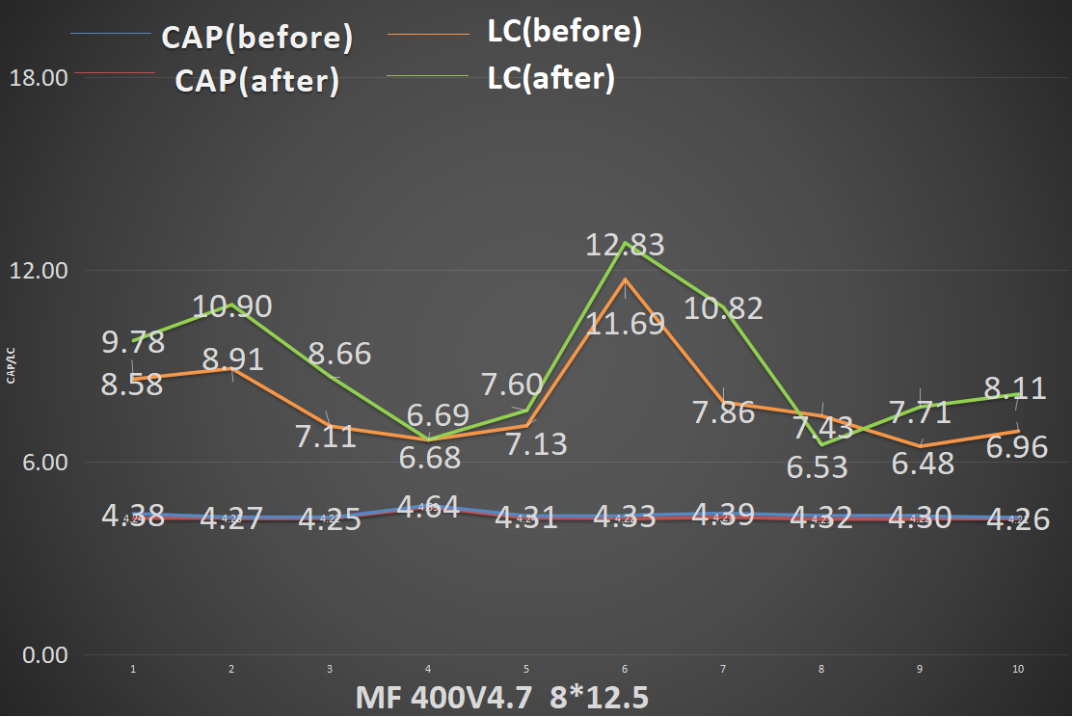
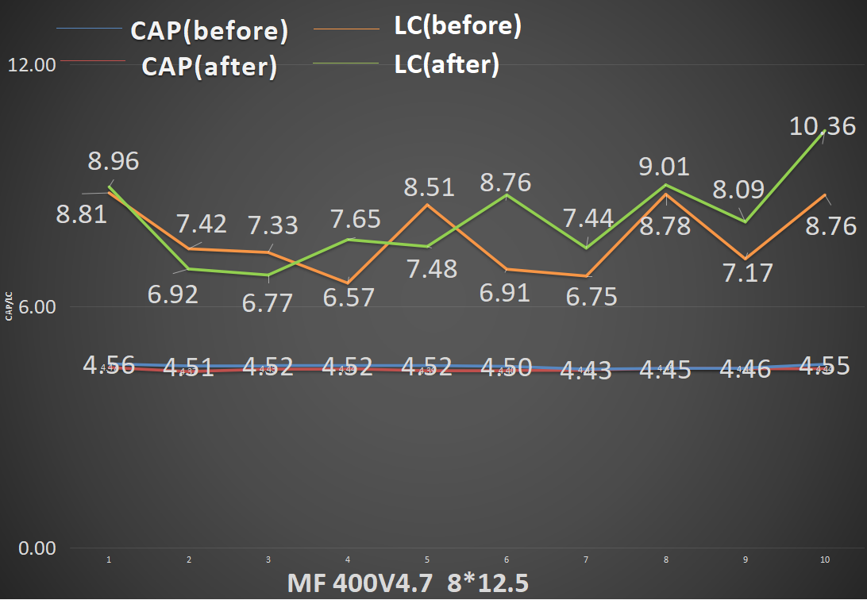
LC Characteristics comparison before and after M-leaded
Characteristics Comparison
NOT ENOUGH INORMATION
What is X axis??? What is before and after mean?????
Little change of cap value before and after M-leaded, LC changes within which is allowed.

Slide 6
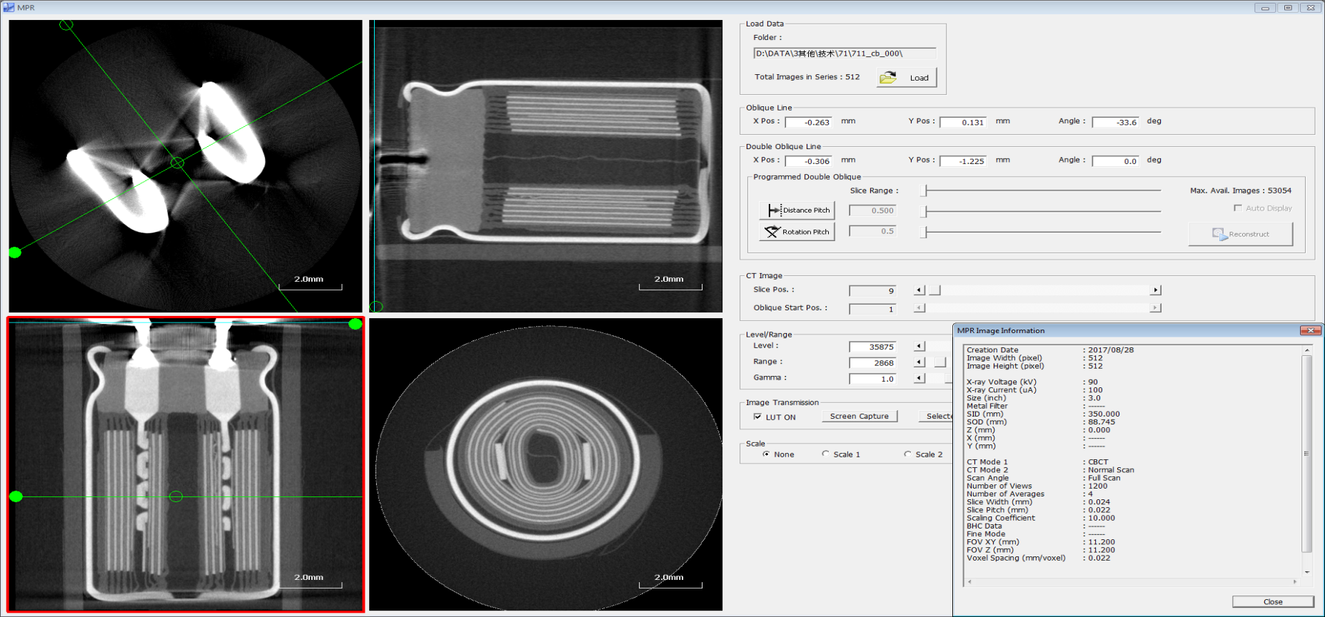
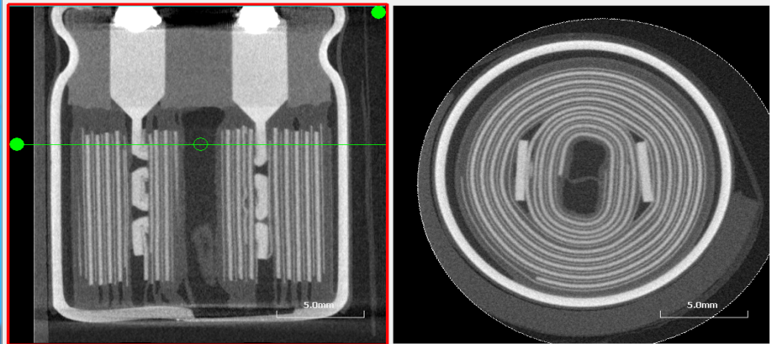
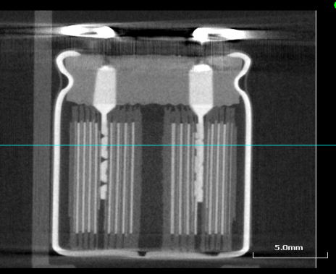
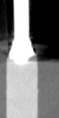

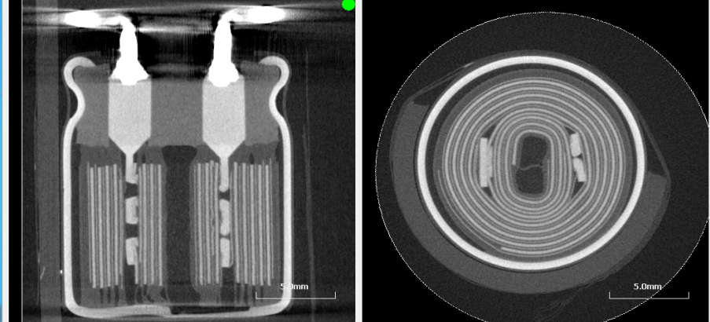
Inner Structure comparison before and after M-leaded
CT Capture of Inner Structure
MH 400V4.7 8*13.5
MF 400V3.3 8*10.5
Before
After
There is no obvious change of inner structure，no inner damage before and after M-leaded manufacturing process

Slide 7
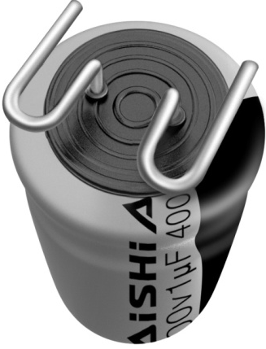
Characteristics Summary between M-leaded and V-Chip
Item | V-Chip | M-Leaded
Cost | higher | Lower
Electrical Performance | Excellent | Excellent
Manufacturing Process | Forming by radial Plate Tape and Reel | Forming by radial Tape and Reel
Lifetime | Normal | Longer
Cold Soldering | Normal | Lower
Rework | Hard | Easy
Ripple Current | High | High

Slide 8

THANK YOU
Thank You For Being Our Trusted Partner.

