Slide 1
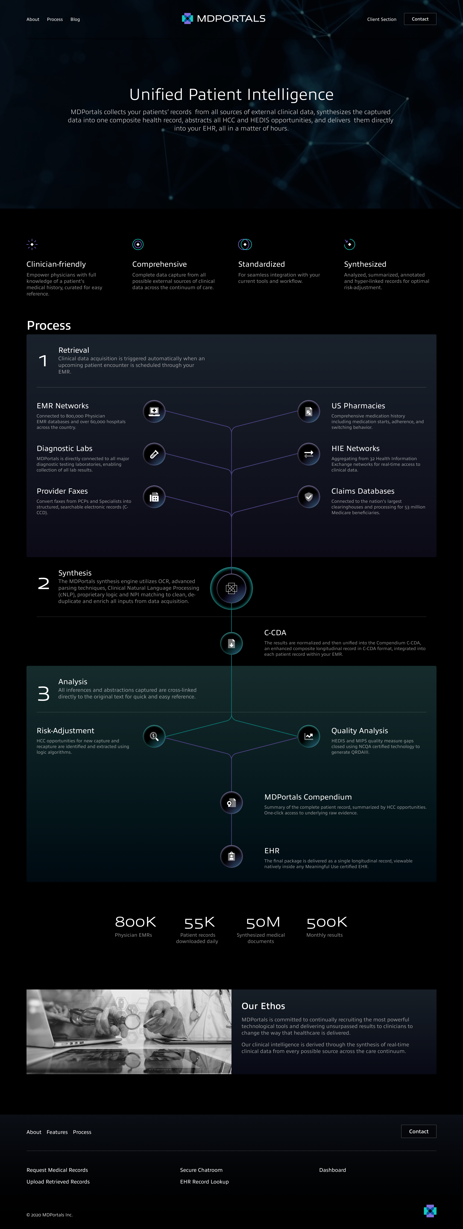
x
YOUR PATIENTS’ FULL MEDICAL HISTORY FROM ALL SOURCES
Section 1
LAYOUT
MDPORTALS CLINICAL DATA NETWORK
Header
Move to Section 5
X
Sections 1-4 - see close-up
Section 2
x
TRANSFORMED INTO 1 COMPOSITE C-CDA HEATH RECORD
x
C-CDA Screenshot
x
Section 3
x
SUMMARIZED AND LINKED TO KEY INSIGHTS
Fax
x
x
x
C-CDA Screenshot
Summary Screenshot
Summary Detail Screenshot
Lab Report
Section 5
X (delete)
Section 6
Medication List
Replace with Blog Posts
Section 4
DELIVERED DIRECTLY INTO YOUR EHR FOR NATIVE VIEWING
Footer
EHR Screenshot
x

Slide 2
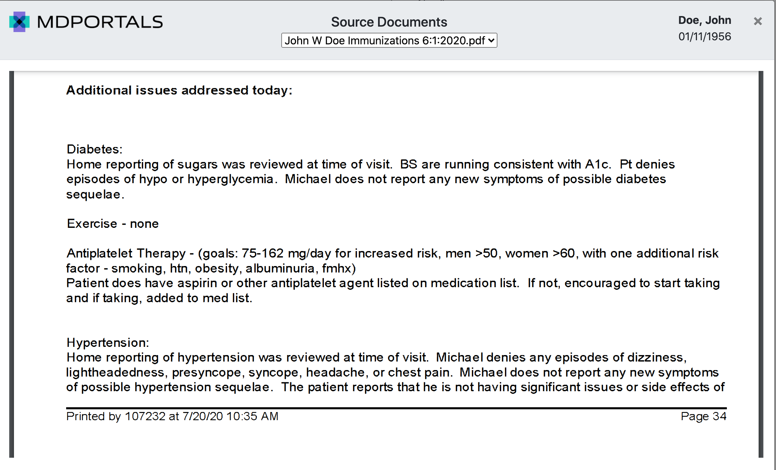
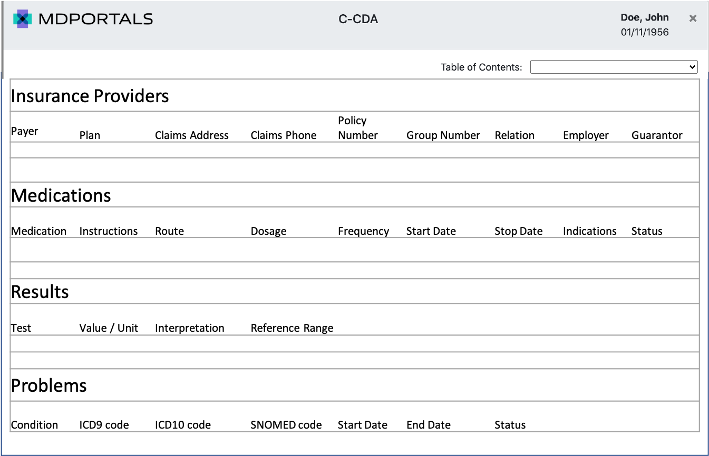
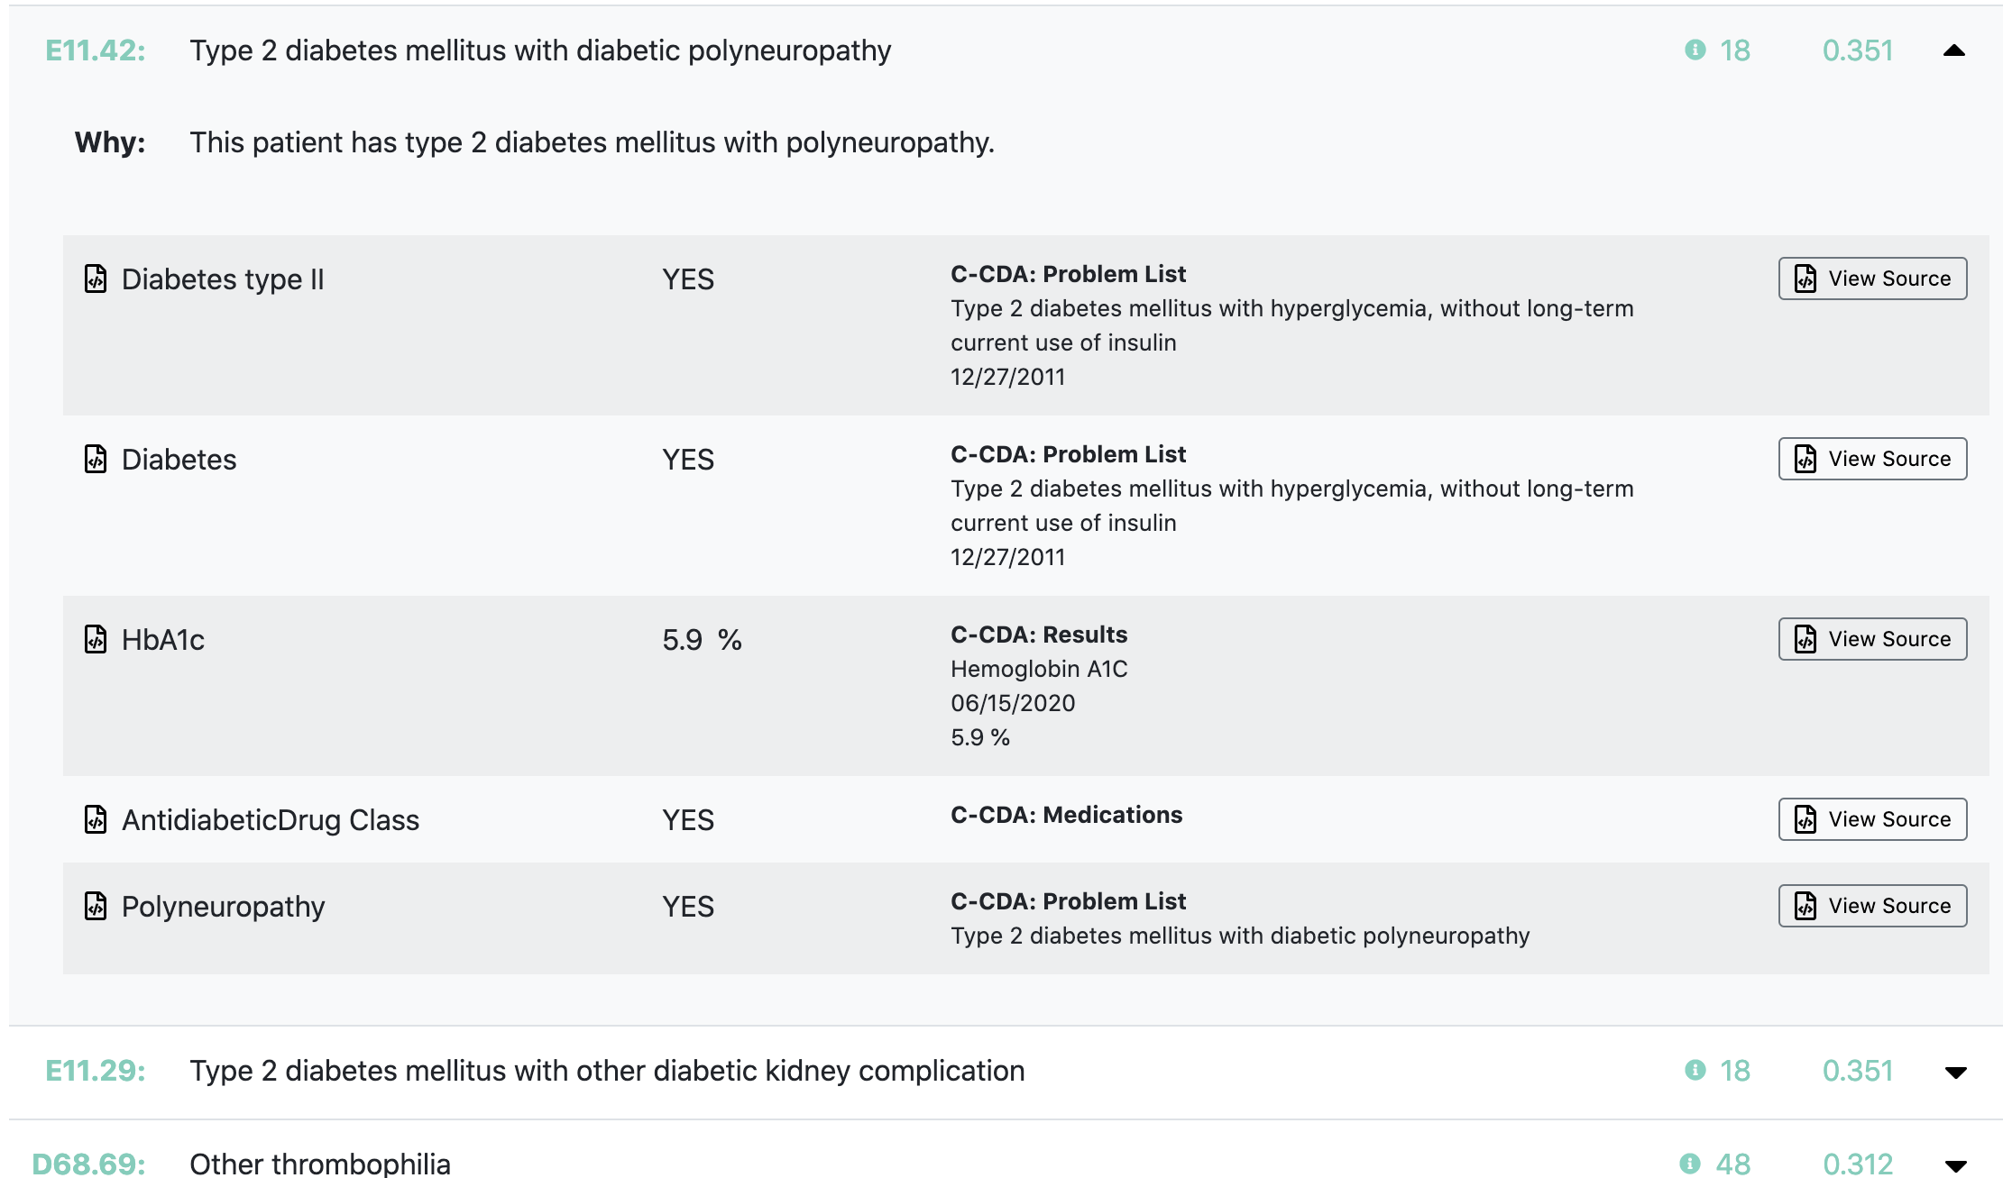
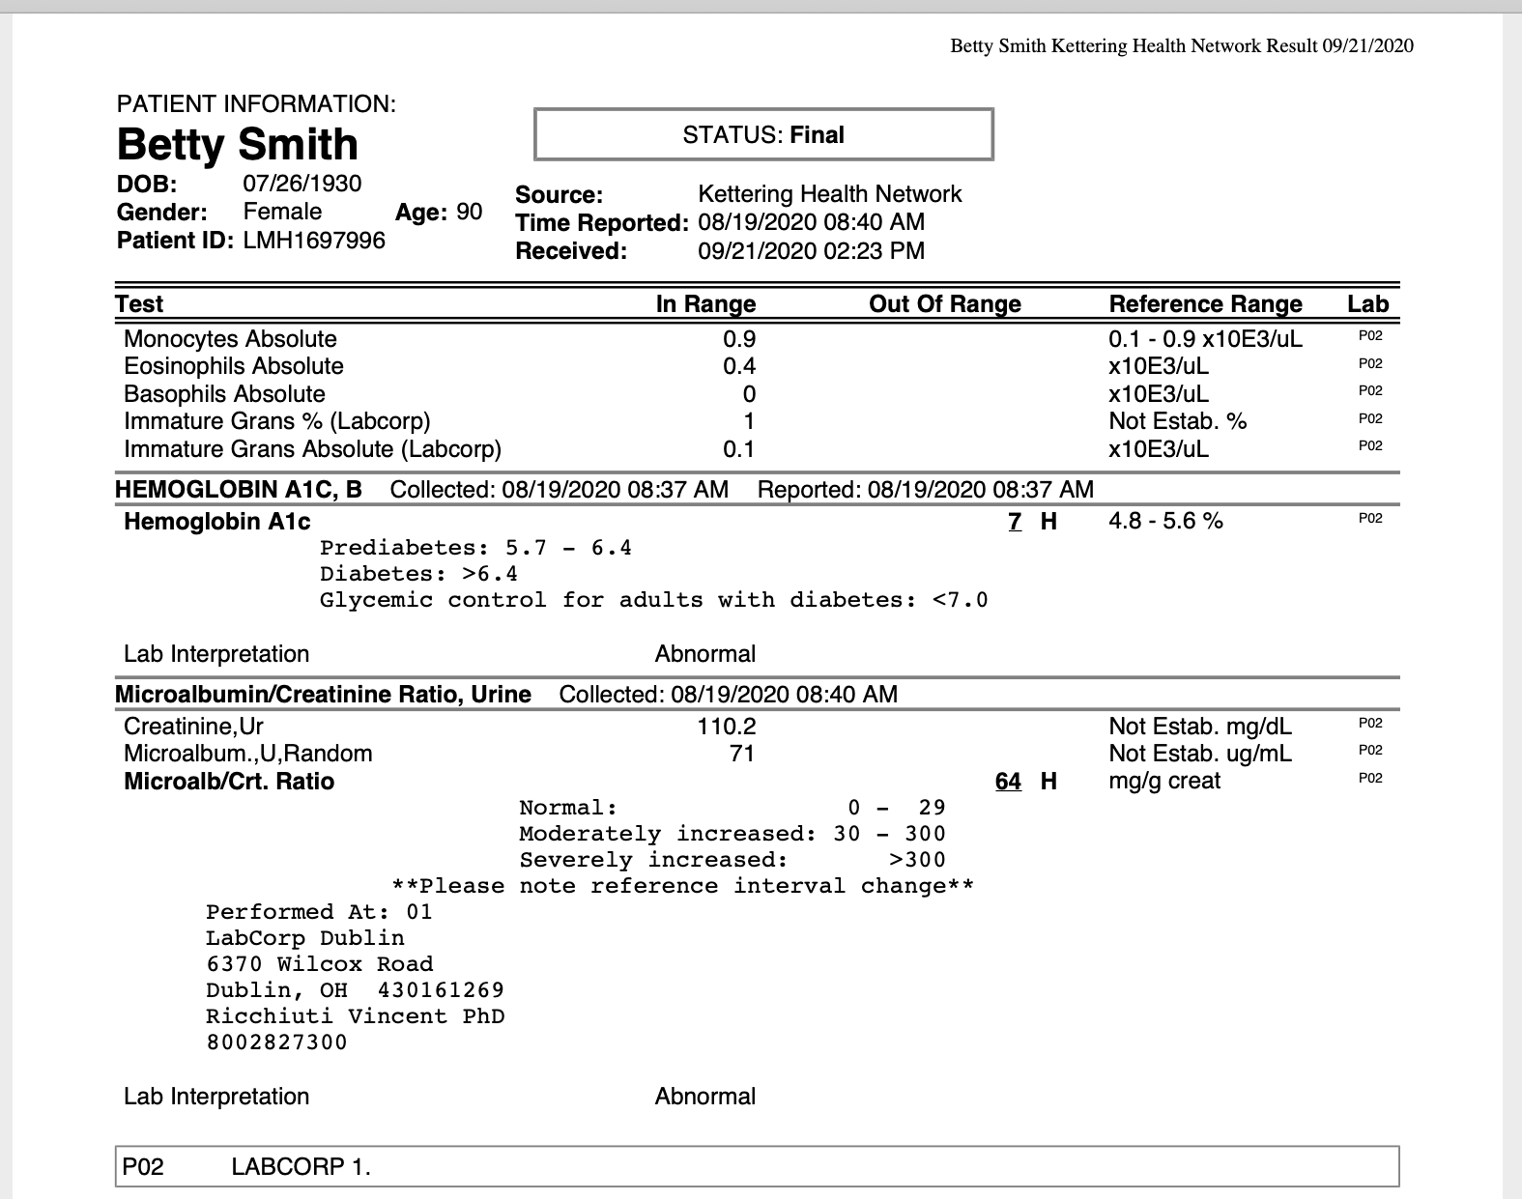
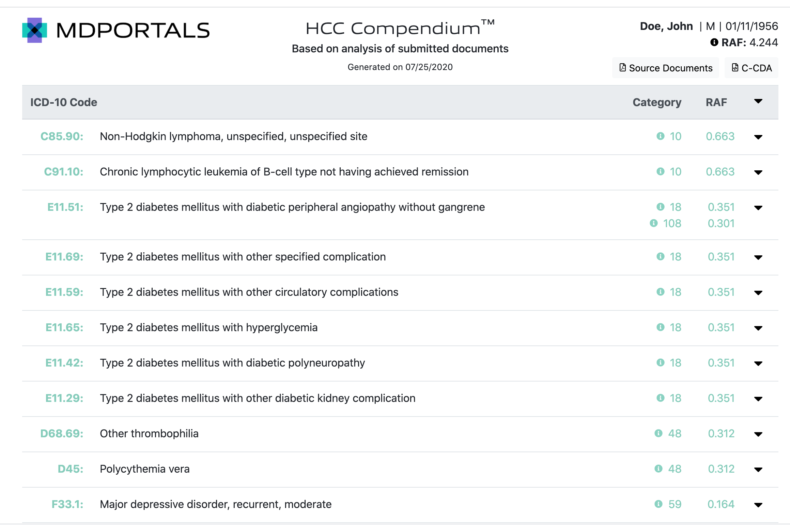
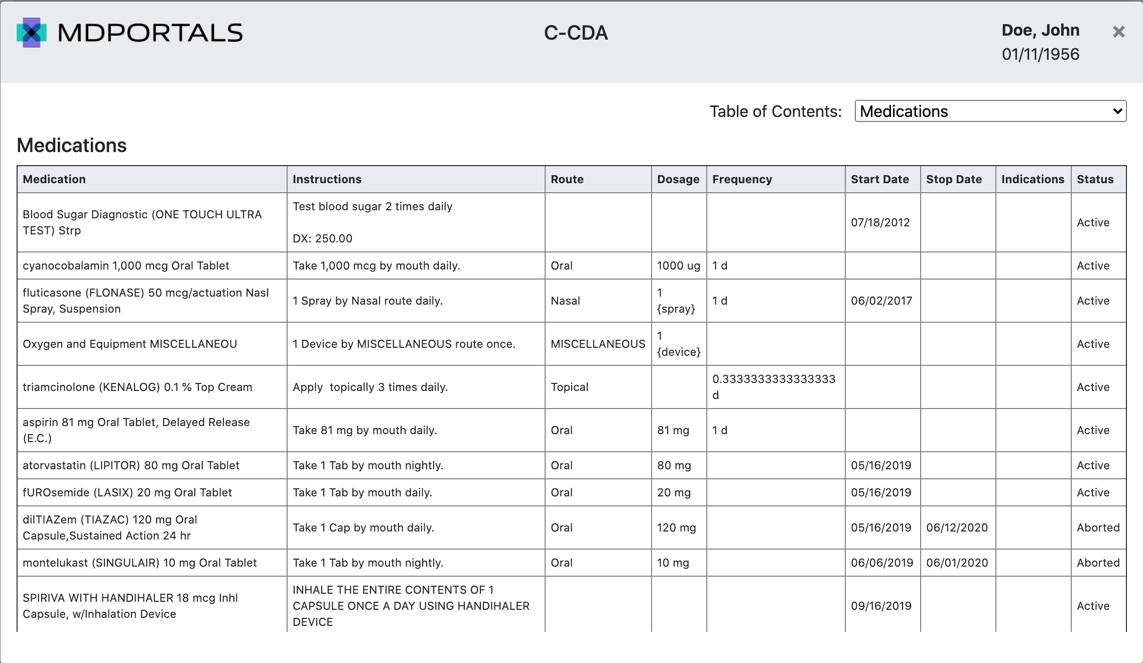
Layout Closeup of Section 3 -
SUMMARIZED AND LINKED TO KEY INSIGHTS
Screenshot 4 - Fax
C-CDA Screenshot in background
(only need to see gray header shown here)
Screenshot 1 - C-CDA
Screenshot 3 - Summary Detail
Screenshot 5 - Lab Report
Screenshot 2 - Summary
View Source Buttons, which are linked
to each source document
Screenshot 6 - Medication List

Slide 3
x
YOUR PATIENTS’ FULL MEDICAL HISTORY FROM ALL SOURCES
Section 1
MDPortals clinical data network has unprecedented reach across the continuum of care.
MDPORTALS CLINICAL DATA NETWORK
TEXT PLACEMENT
Don’t include numbers on actual webpage
Section 2
TRANSFORMED INTO 1 COMPOSITE C-CDA HEATH RECORD
x
The MDPortals synthesis engine utilizes OCR, advanced parsing techniques, Clinical Natural Language Processing (cNLP), proprietary logic and NPI matching to clean, de-duplicate, structure and enrich all inputs from data acquisition.
The normalized data is unified into the Compendium C-CDA, an enhanced composite longitudinal record in C-CDA format, the industry standard for all interoperability initiatives
x
C-CDA Screenshot
SUMMARIZED AND LINKED TO KEY INSIGHTS
Section 3
x
Insights are presented in a concise summary with direct links to supporting evidence. HCC, HEDIS and MIPS opportunities are abstracted and cross-linked directly to the original text in the underlying record for quick and easy reference.
Fax
x
x
Move this Quality Analysis text under
Risk-Adjustment
x
C-CDA Screenshot
Summary Screenshot
Summary Detail Screenshot
Lab Report
Medication List
Section 4
DELIVERED DIRECTLY INTO YOUR EHR FOR NATIVE VIEWING
x
The final package is delivered as a single longitudinal record into each patient’s chart within your EHR, viewable natively inside any Meaningful Use certified EHR.
EHR Screenshot
x
x

Slide 4
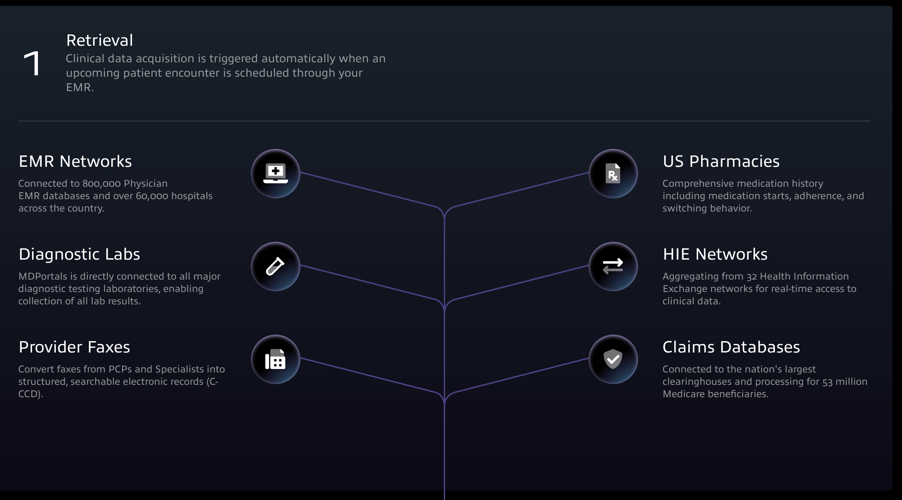

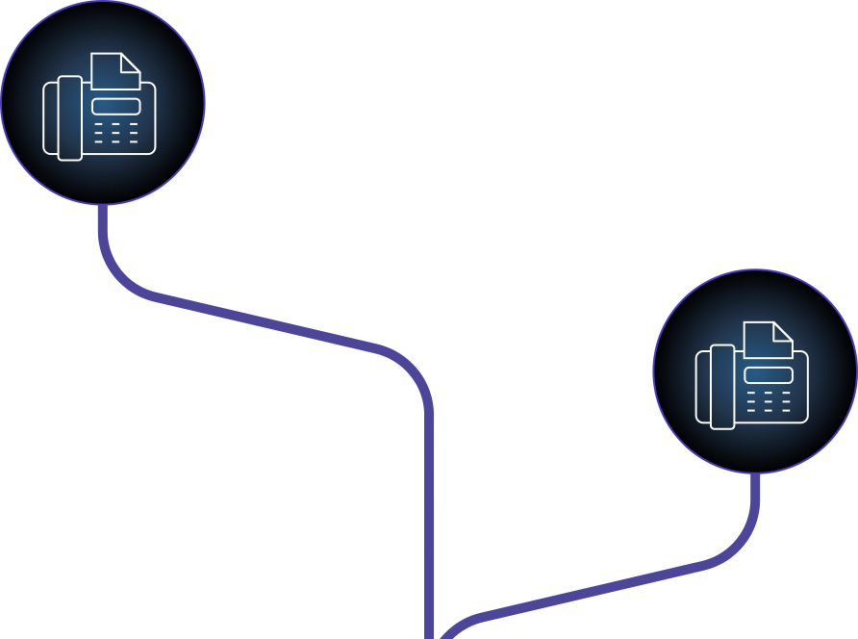
Glowing
nodes
SECTION 1
Not exactly like this, but shape should be more up than out.

Slide 5







If not, some kind of data network lines
HEADER
Preferred Option - Dispersion effect to our logo, like this
Superimposed over an image of a
doctor with an elderly patient like this
Examples

