Slide 1

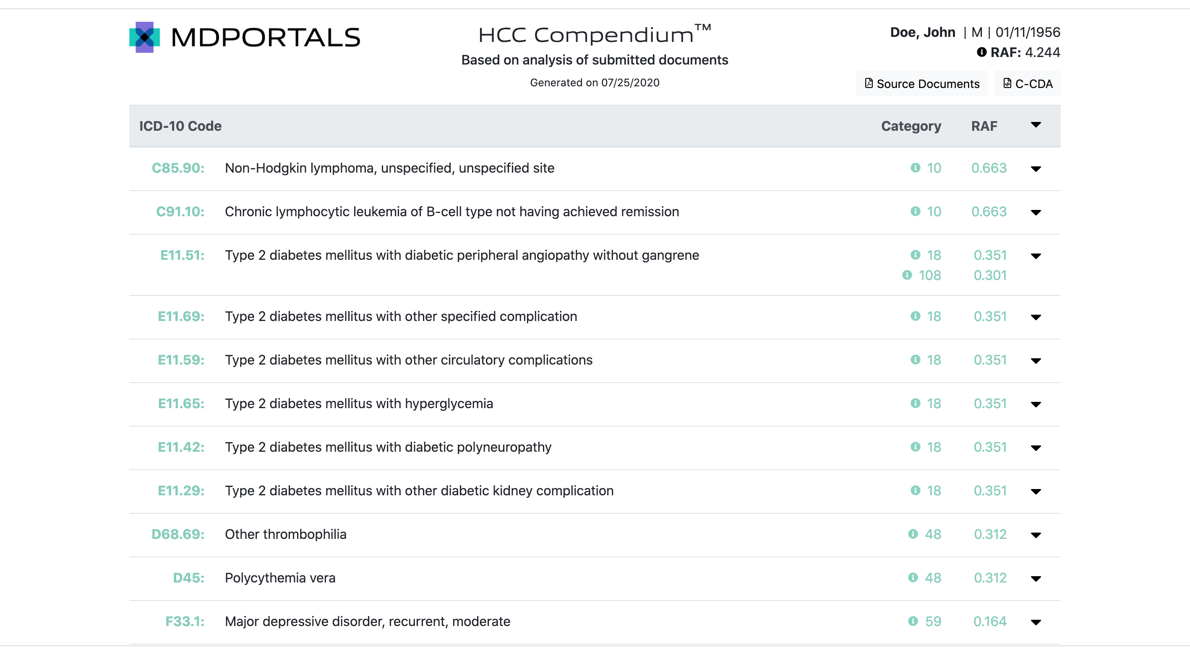

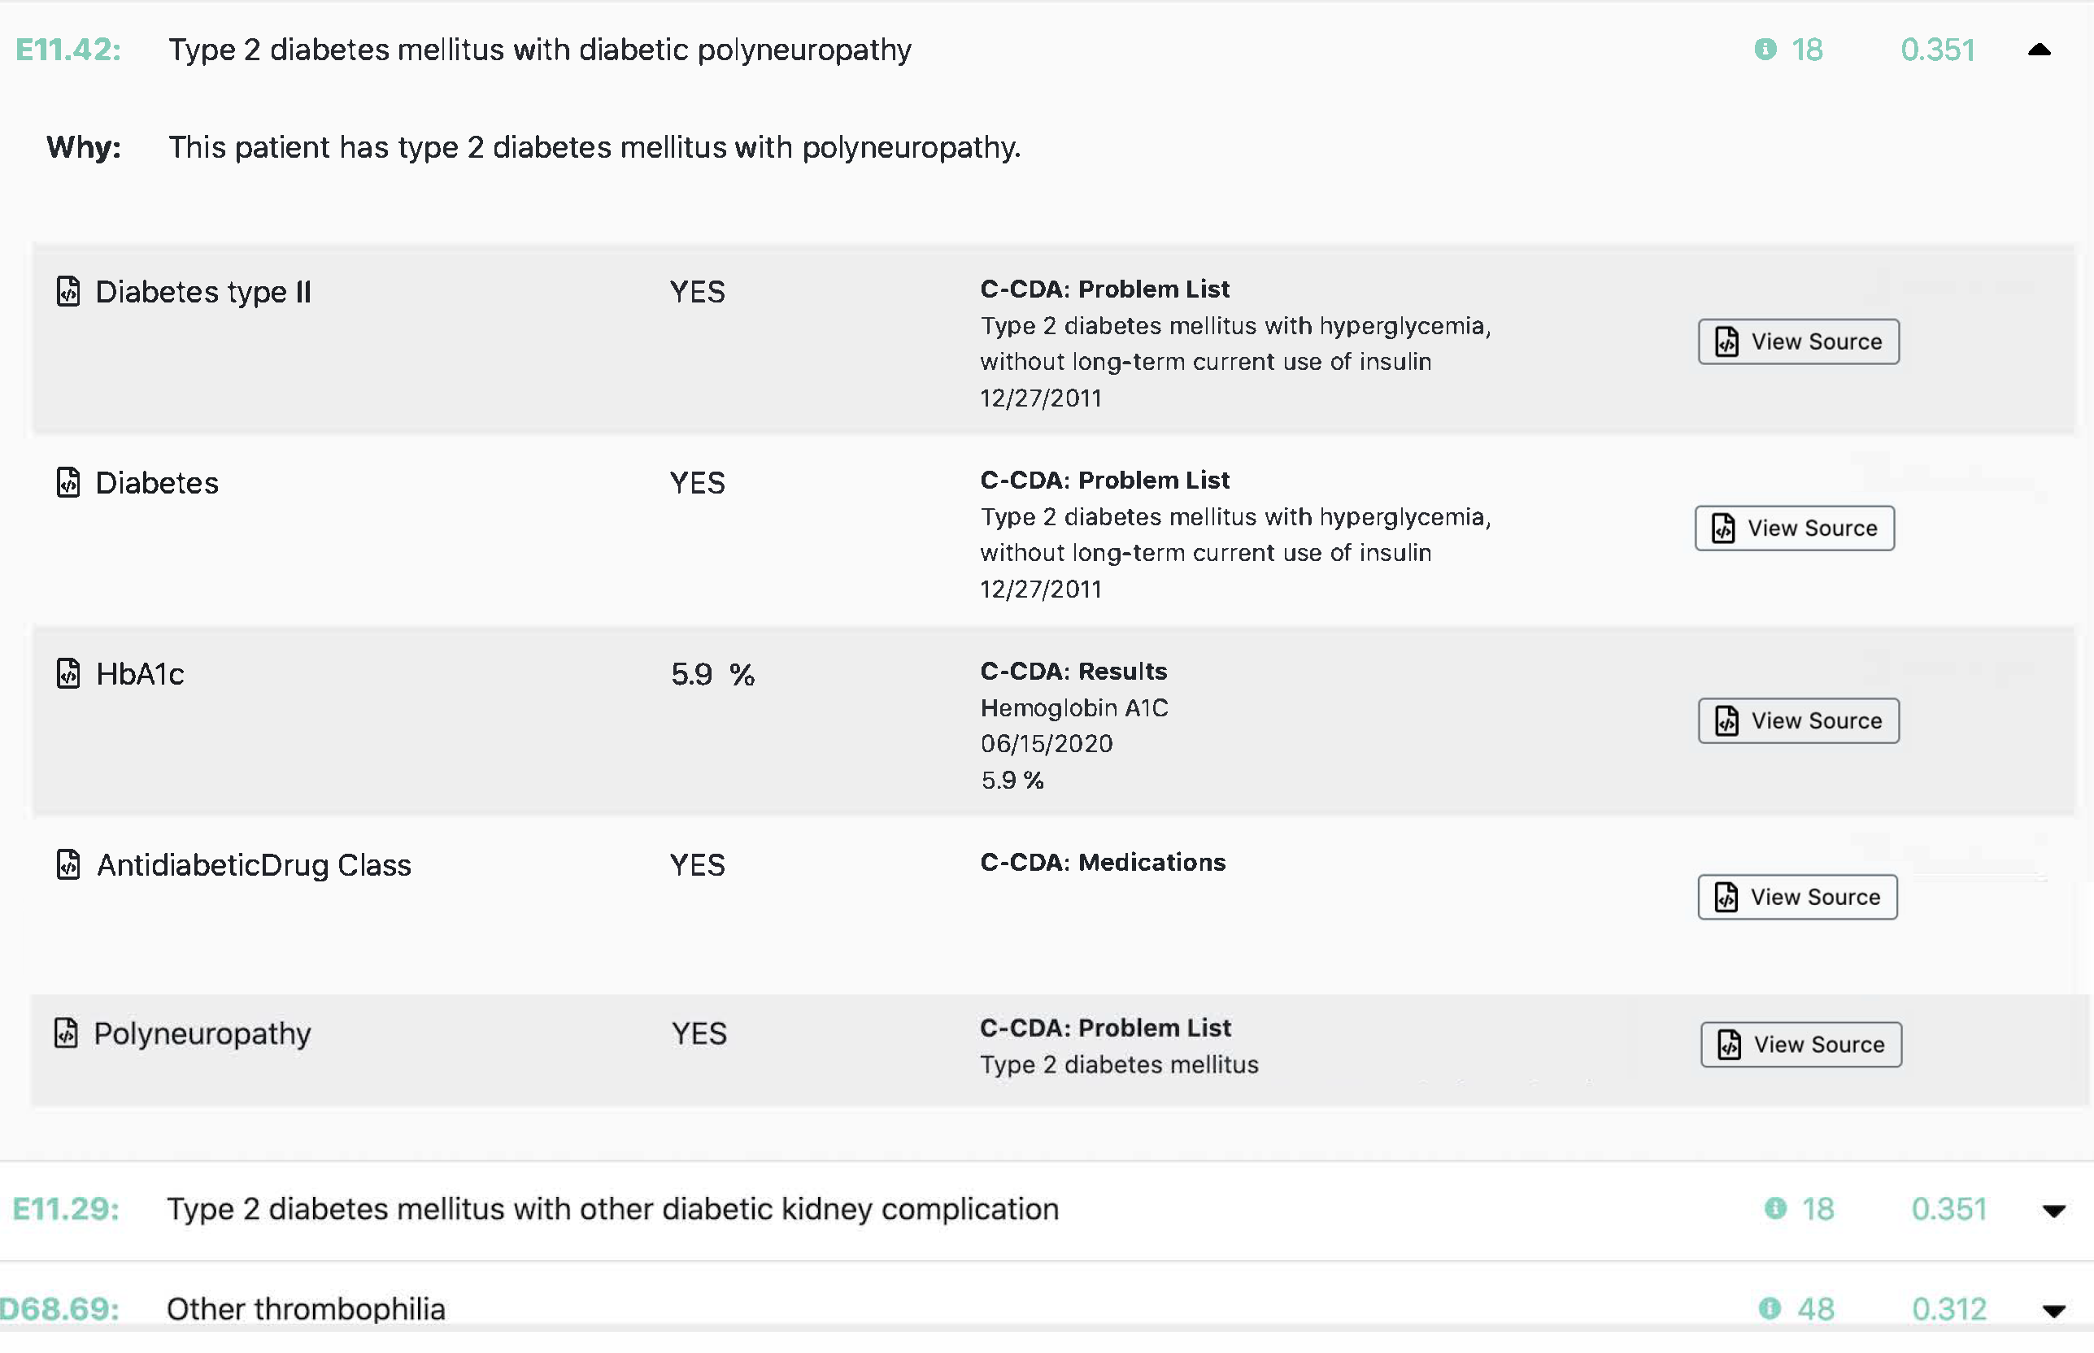
SUMMARIZED AND LINKED
SECTION - PART 1
C-CDA
Doe, John 01/11/1956
Screenshot 1, 2, 3 – CCDA, Summary, Summary Detail
Doesnt have to have purple background just thought it might look good
You can use this as is or change to look better or fit your theme
Notes:
SUMMARIZED AND LINKED SECTION

Slide 2
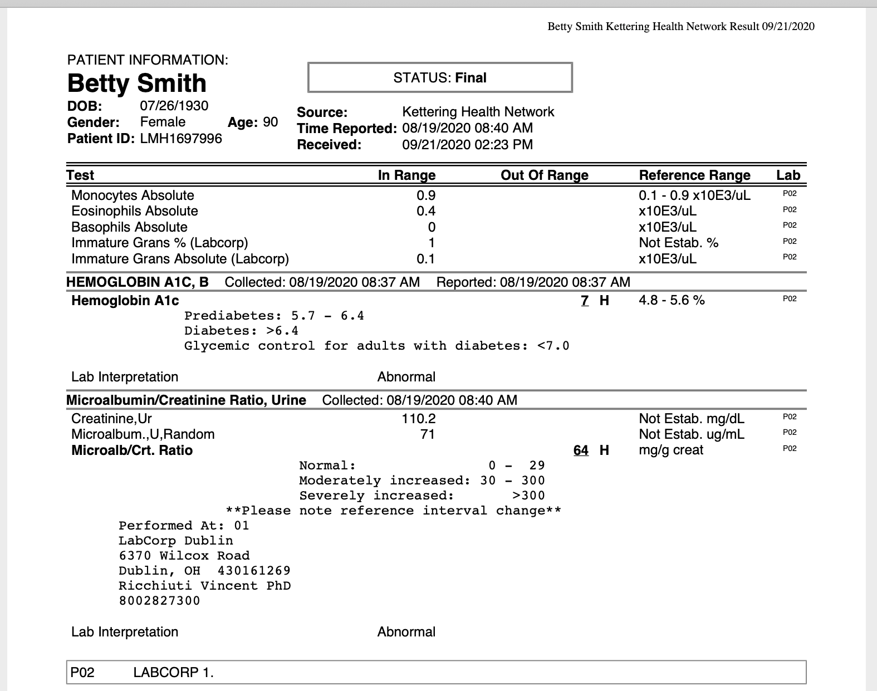


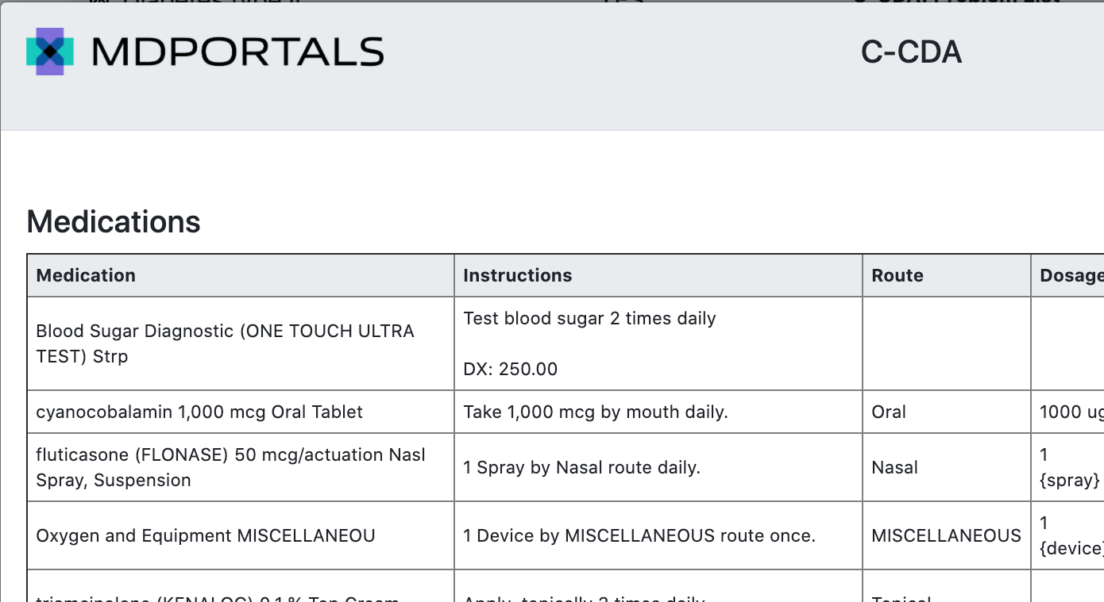

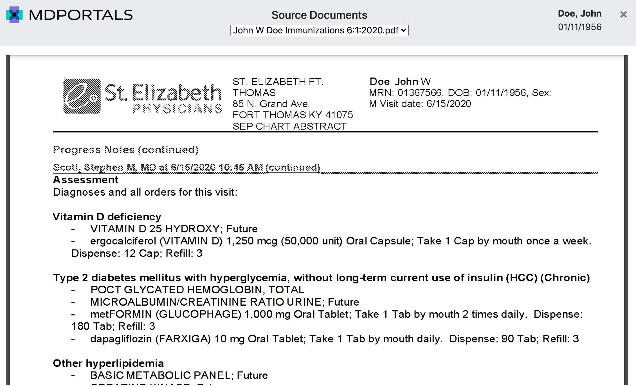

View Source closeup
with 3 source documents
SUMMARIZED AND LINKED
SECTION - PART 2
You can use the 4 “screenshots” as is BUT these need to separate on page-not 1 all in one screenshot and the connecting lines and icons need to be created as part of webpage
not copied and pasted from here.
The lines and icon placement and style need to look much better than these (actual icons are ok - referring to style/framing
Lab Results
Hemoglobin A1C
06/15/20
5.9%
View Source
Medications
View Source
Clinical Note: Assessment
Chronic stable angina (HCC)
View Source
Clinical Note: Assessment
Chronic stable angina (HCC)
View Source Buttons can be used as is or changed if needed
Notes:
SUMMARIZED AND LINKED SECTION

Slide 3


Alternative Data Network Ideas

Would need to be recreated (so it looks right and so source type icons can line up with Source Types text) not copied and pasted from here
Notes:
CCDA ICON

Slide 4
General idea I created, needs to be recreated and enhanced
not copied from here

C-CDA
Insurance Providers
Problems
This is instead of previous C-CDA Screenshot, that is no longer needed
Results
Procedures
Encounters
Medications
Vital Signs
Immunizations
Social History
Family History
Plan of Care
Notes:
CCDA ICON

