Slide 1
Notes
I like the concept of a ghost holding a guitar
  But if you have a different/better idea, by all means!
  I initially tried to place the ghost & guitar on a balcony, and have a bunch of those green things dancing and holding wine in the streets below… but I couldn’t make that work.
The song title is “MY SAD GUITAR & ME”, please place song title somewhere (in ALL CAPS).
Artist name “Theory of G” – please place that somewhere in the art (in sentence case).

Slide 2
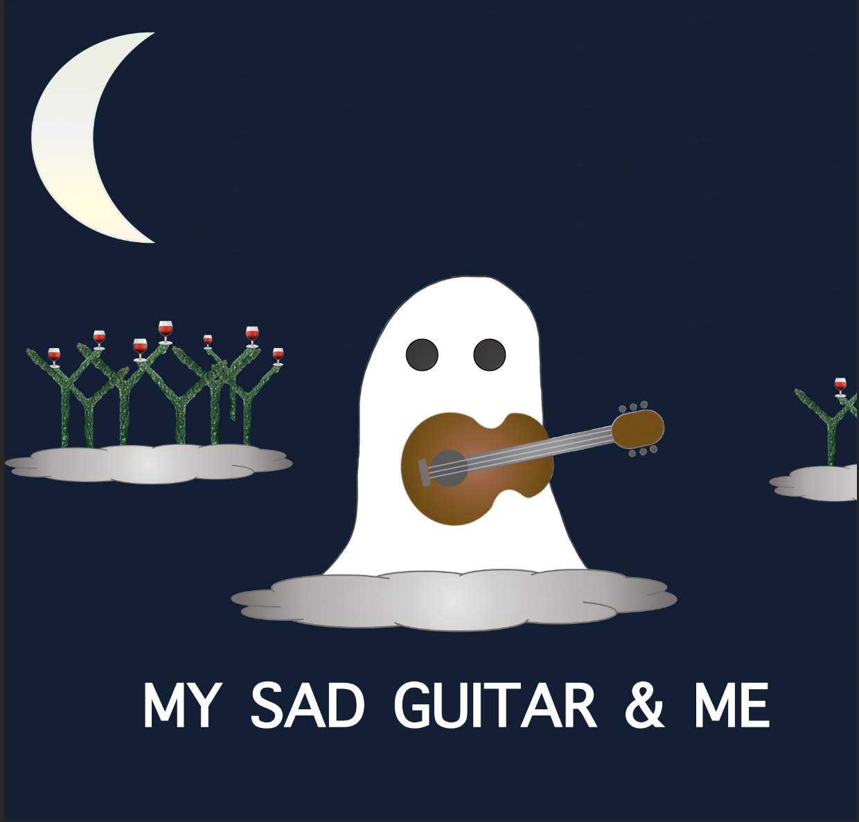

Slide 3
