Slide 1
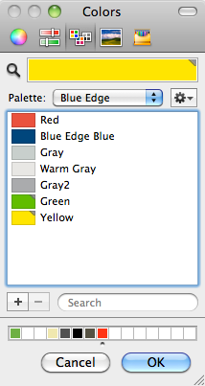
Color Palette
Use these color swatches for charts and other graphics. To access the color palette, click on the “Swatches” area of the color menu.
R=226 G=57 B=48
R=0 G=52 B=104
R=102 G=188 B=41
R=255 G=228 B=0
R=188 G=197 B=193
R=226 G=225 B=221
R=154 G=155 B=157

