Slide 1
Blinking Xmas Tree

Slide 2
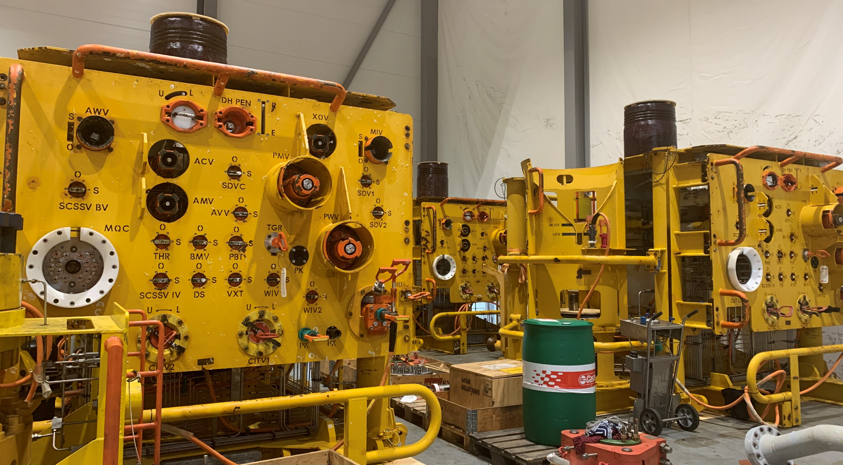

Slide 3
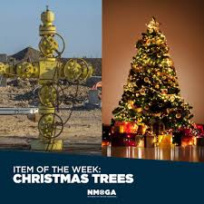
Info
The attached photo, on slide 2, is of a subsea Xmas tree. The Xmas tree stems from earlier designs of well control equipment on oil and gas wells that looked like a Christmas tree. See picture right.
The design has evolved but the name has stayed, hence a square Xmas tree.
We would like to make a fun animation of our XMT that makes them come alive. A re-playable gif or anything similar to make sure that we can put a smile on our oil and gas clients face.
See some proposed ideas in the following slides.

Slide 4
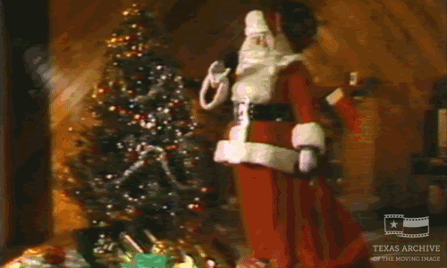





Slide 6
Key Requirments
It needs to look neat and well thought through
Less is more if it holds a high standard
  Humour
  Positioning
  Elegant / tidy
The Xmas tree are the main focus so the extra features should only create a beautiful addition to that. Hidden and smart details are most appreciated.
We plan to put this onto our website and LinkedIn. Our logo should also be embedded.

