Slide 1
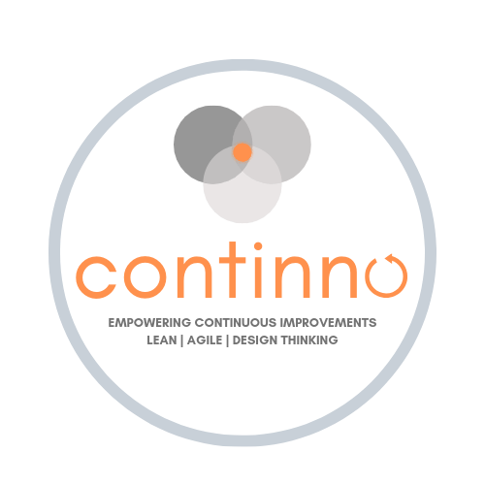

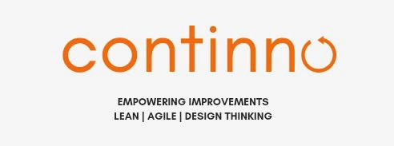
Logo Design Ideas
Idea of 3 circles: each solution consists of the sweet spot of desirability (is it desired by customers,
viability (can we make money?) and feasability (can we make it)
Like the colour orange as it stands for results

Slide 2
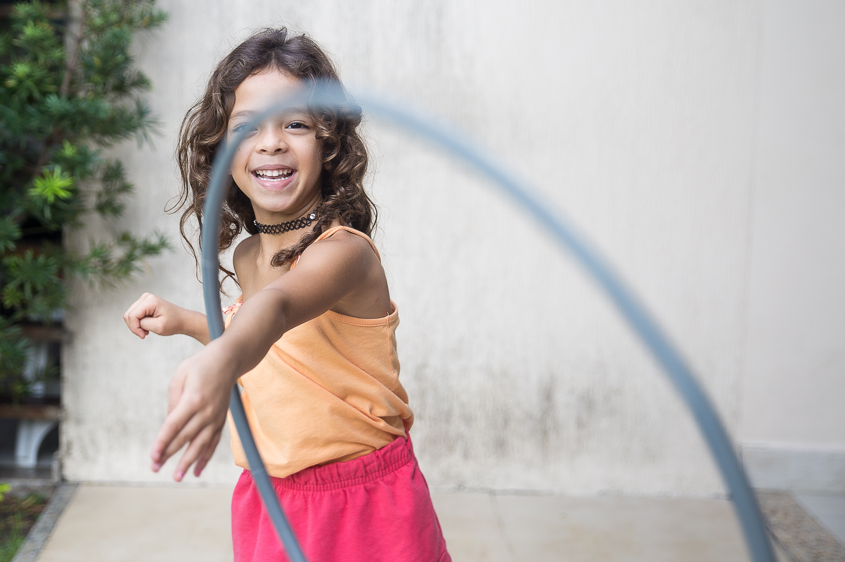
Let’s Continno.
Continiously learn & adapt with
Agile | Lean | Design Thinking

Slide 3

Let’s Continno.
Continiously innovate & learn with
Agile | Lean | Design Thinking

Slide 4
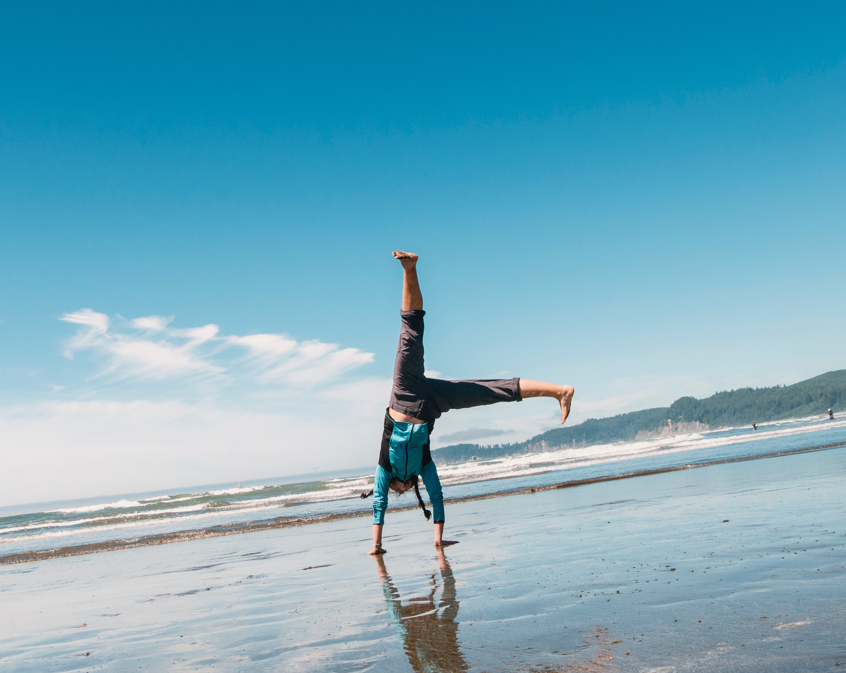
Let’s Continno.
Continiously learn & adapt with
Agile | Lean | Design Thinking

Slide 5
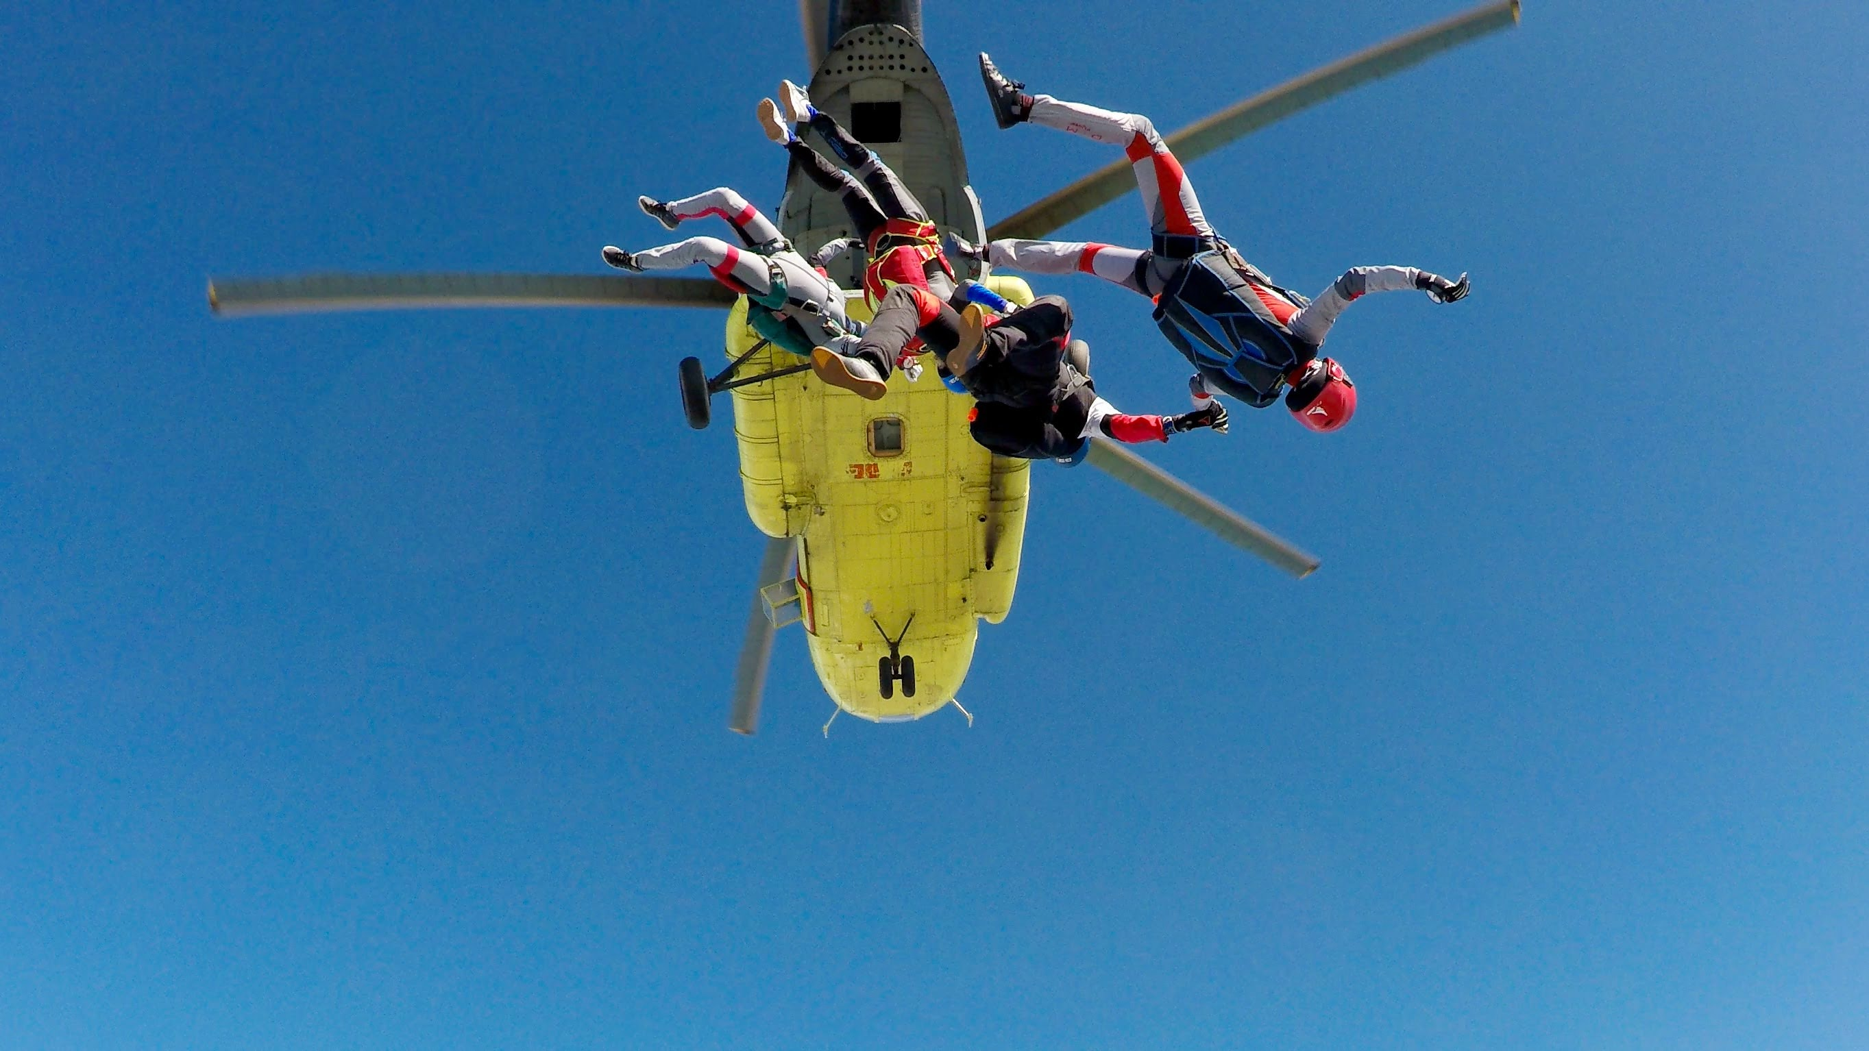
Let’s Continno.
Continiously learn & grow with
Agile | Lean | Design Thinking

Slide 6
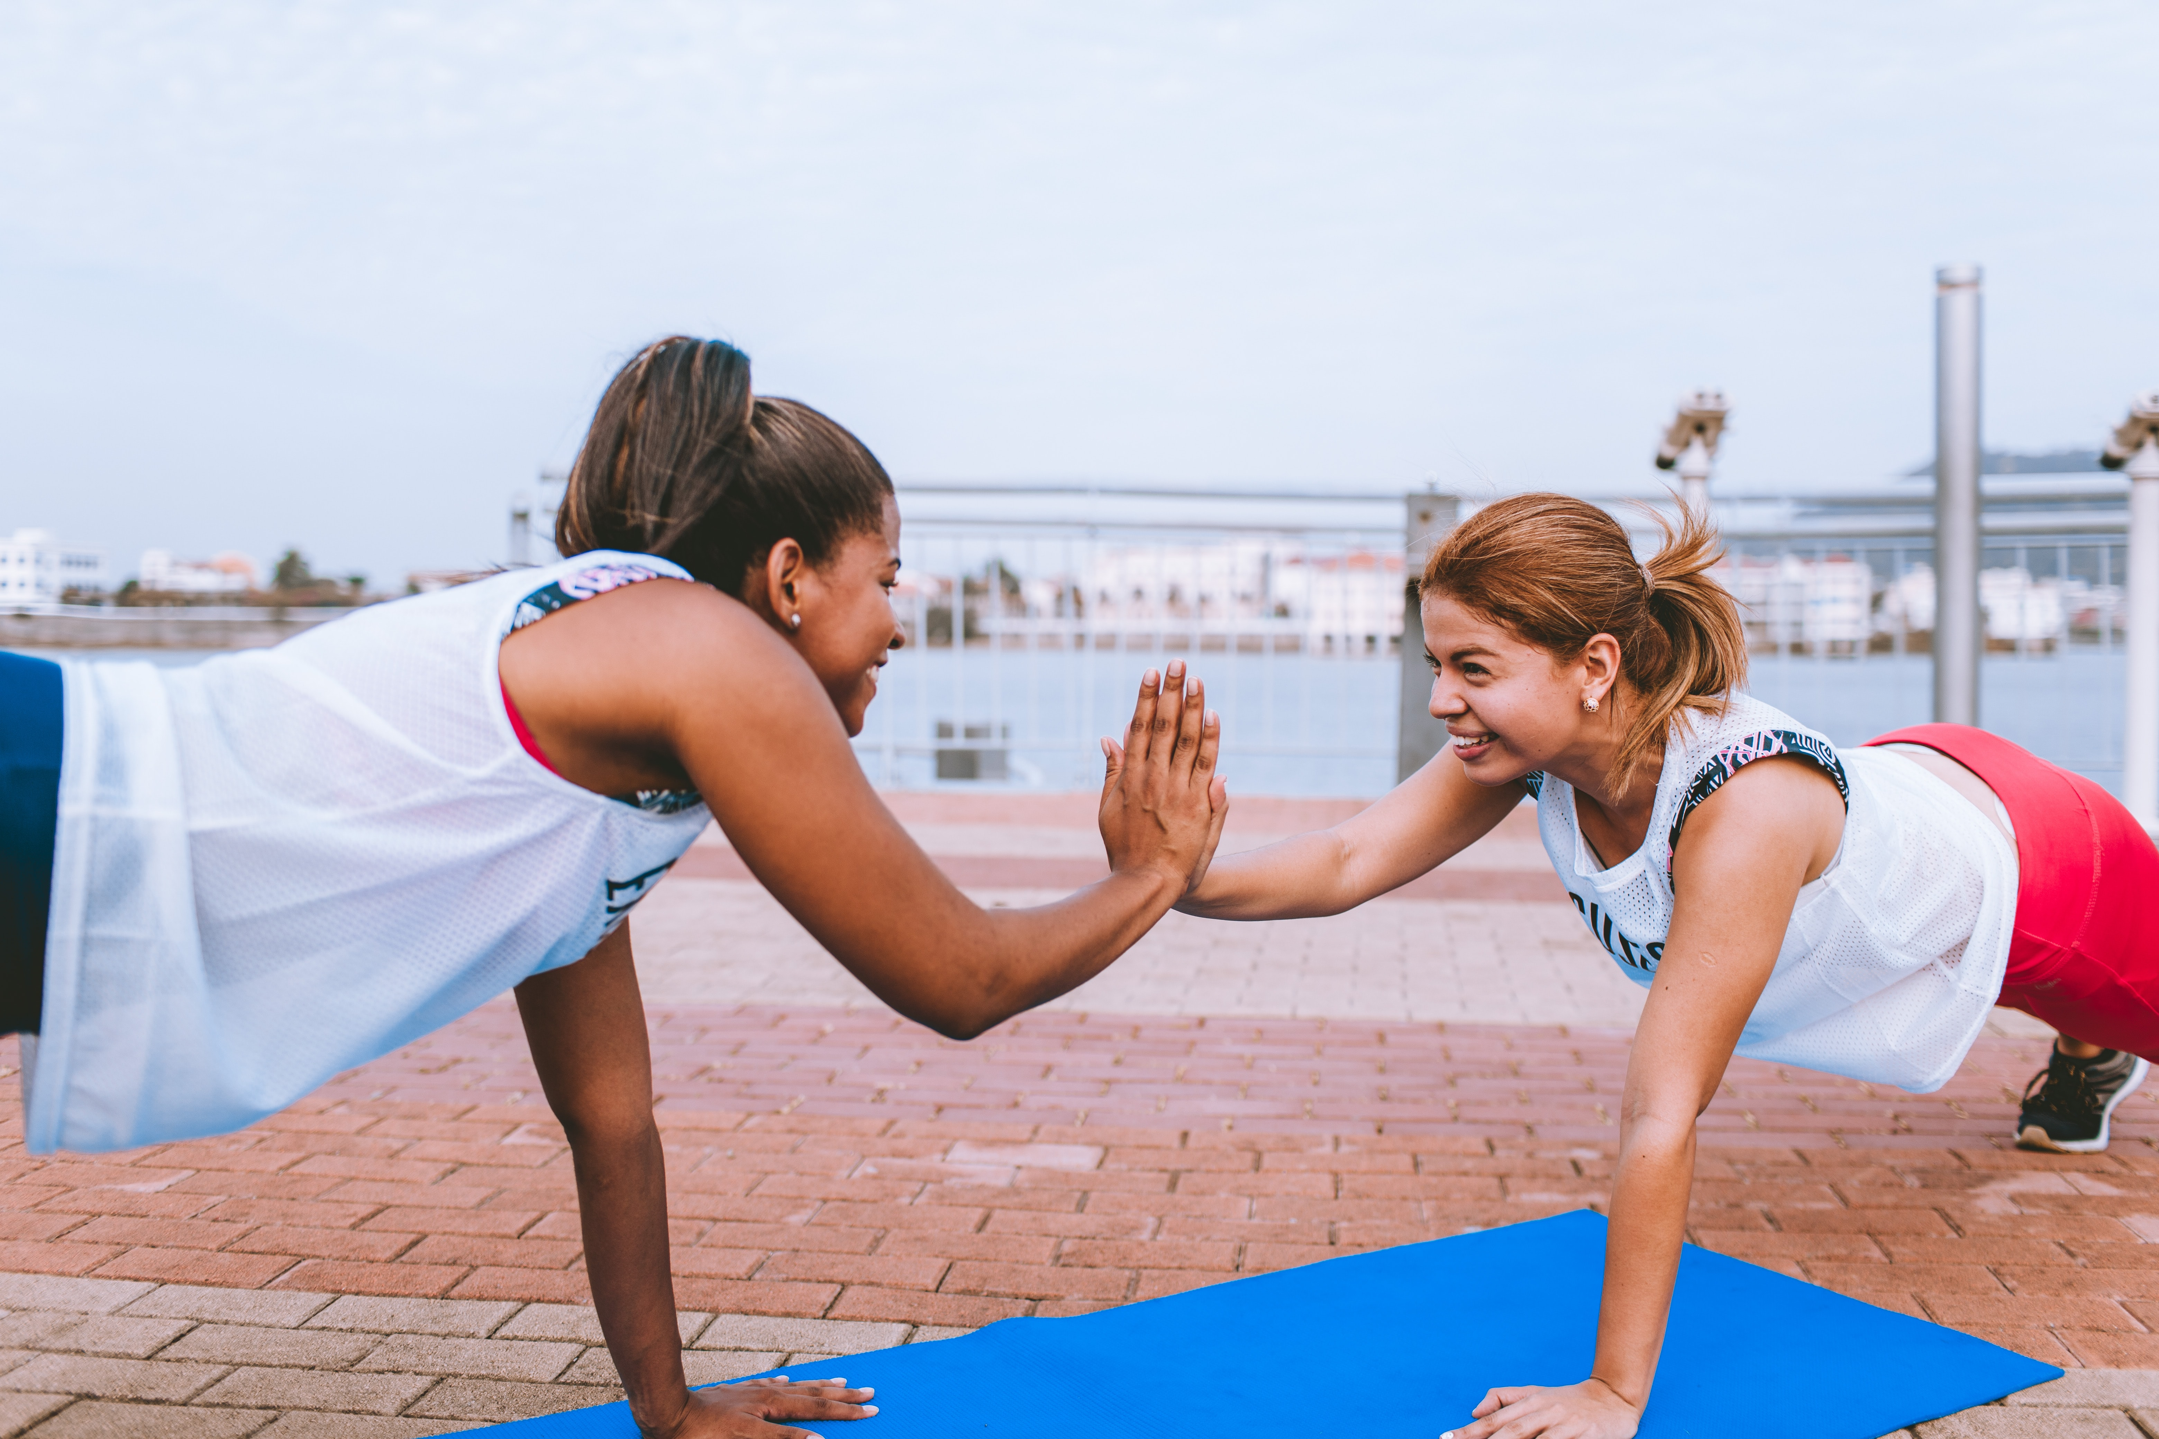
Let’s Continno.
Continiously connect & learn with
Agile | Lean | Design Thinking

Slide 7
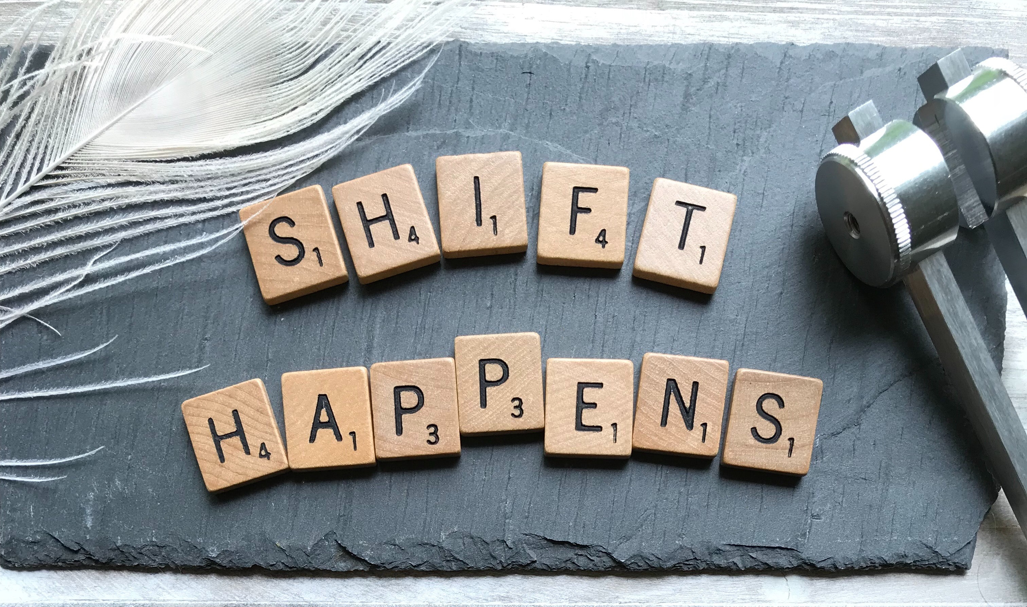
Let’s Continno!

Slide 8

Let’s Continno!

Slide 9
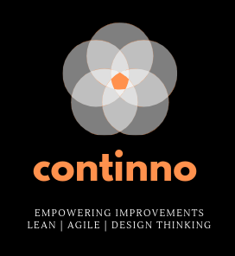
Hello improvements
Hello Continno

