Slide 1

Clusters, Pathways, and
High-Value Careers

Slide 2
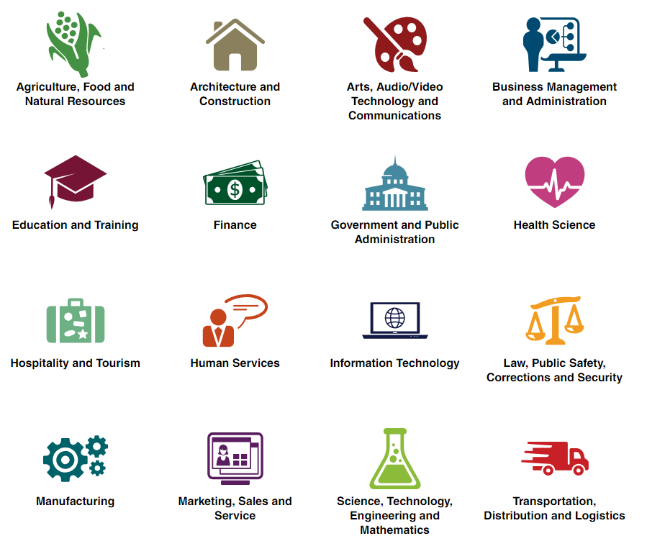
Career Clusters
What are career clusters?
National Career Clusters Framework
  careertech.org/career-clusters
Occupations are grouped into sixteen different clusters based on similarities in foundational knowledge and skills.
Notes:
When grouping and organizing occupations, there are numerous classification systems.
The classification system most commonly used in education is the National Career Clusters Framework.
Occupations are grouped into sixteen different clusters based on similarities in foundational knowledge and skills.
These core skills are viewed as the foundation on which students develop more advanced industry-specific skills.
Detailed descriptions of the knowledge and skills for each cluster can be found at the web address displayed here

Slide 3
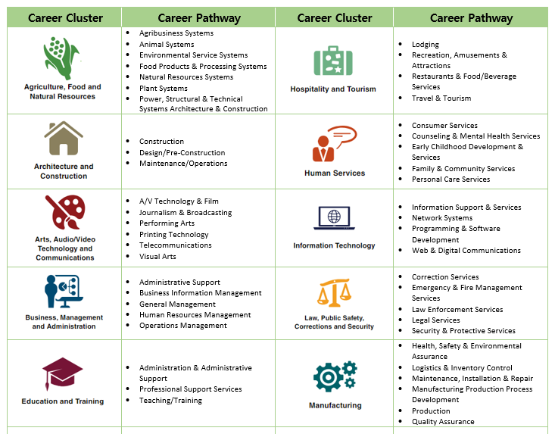
Career Clusters
What are career pathways?
Within each cluster, pathways have been identified that focus on smaller subsets of related occupations.
Courses and training programs are outlined that can guide students as they progress toward career goals.
Notes:
Within each cluster, pathways have been identified that focus on smaller subsets of related occupations.
For each pathway, courses and training programs are outlined that can guide students as they progress toward career goals.
Career pathways have their own knowledge and skill requirements.

Slide 4
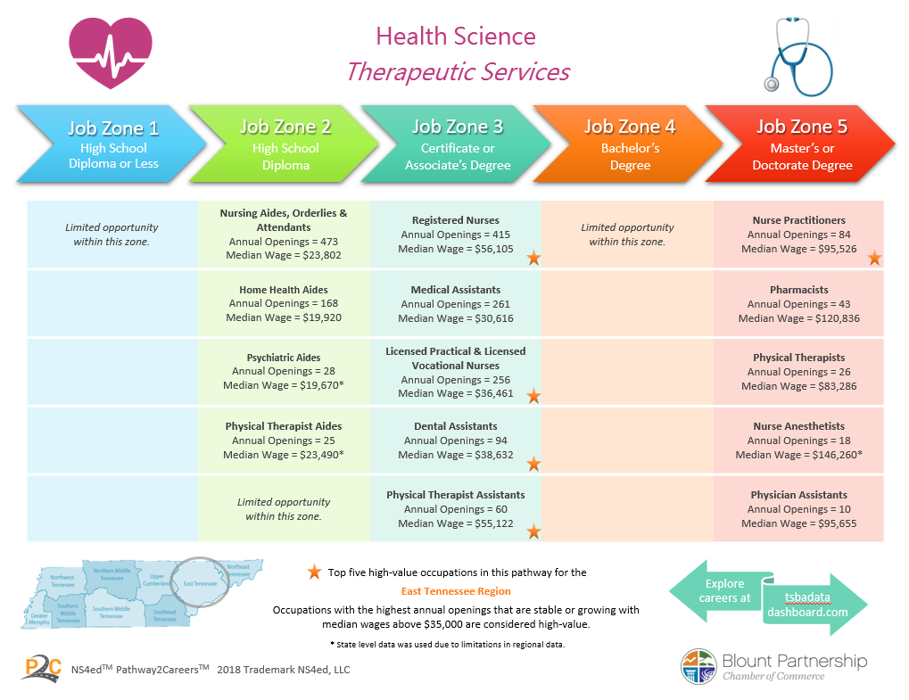
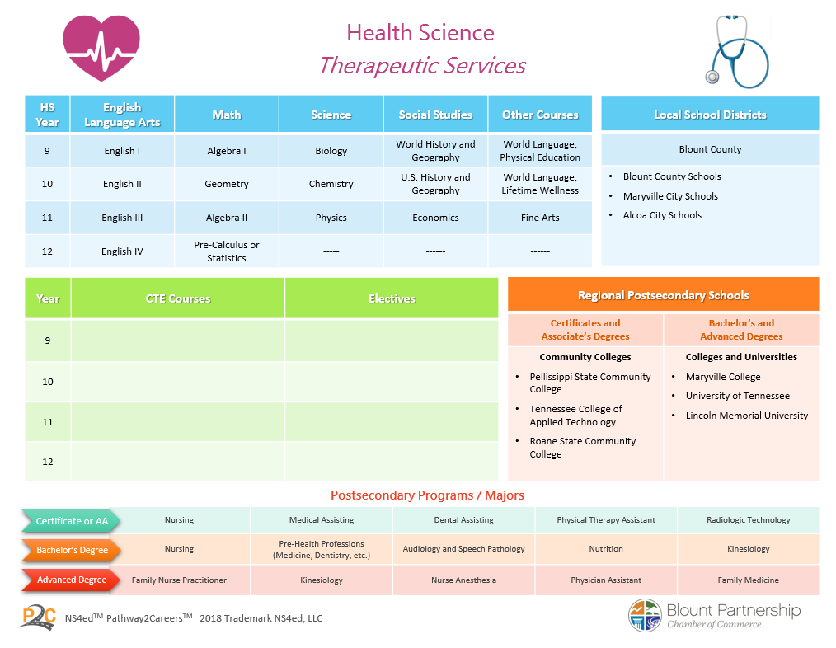
Career Pathways for Students

Slide 5
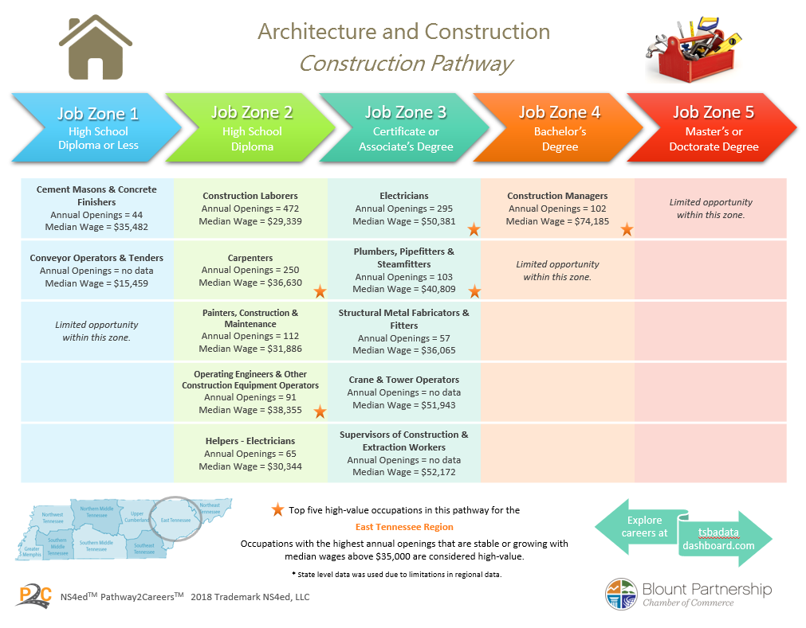
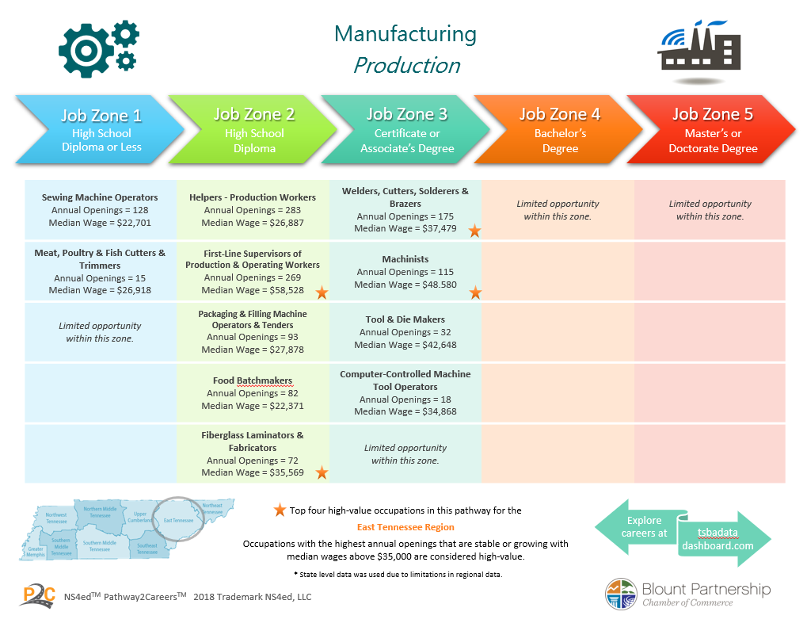
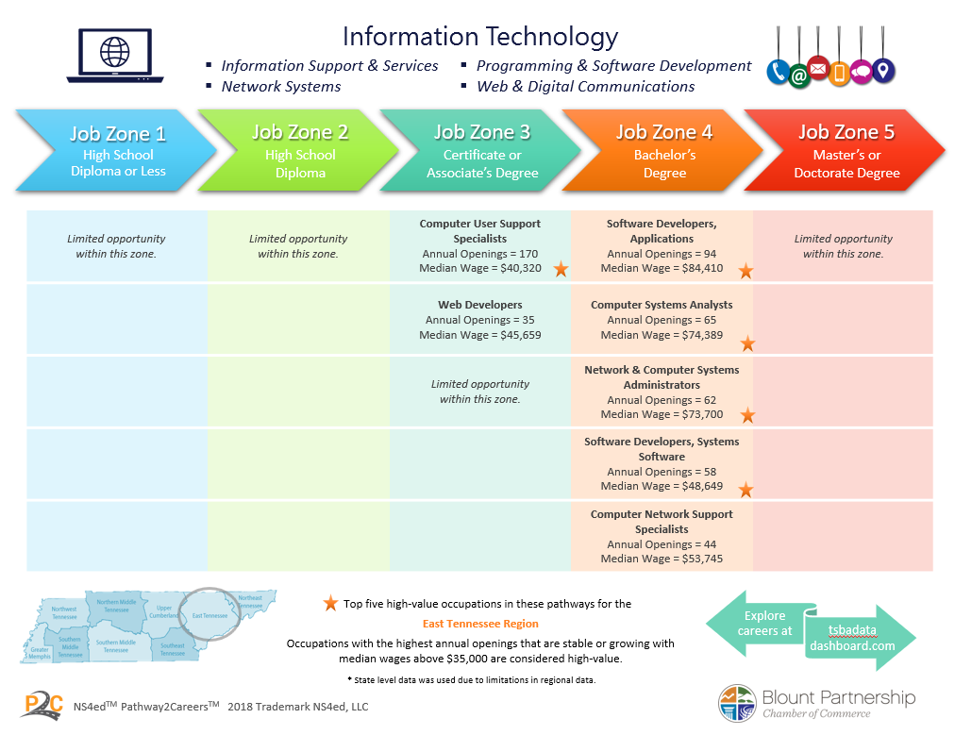

Slide 6

Career Engaged

Slide 7

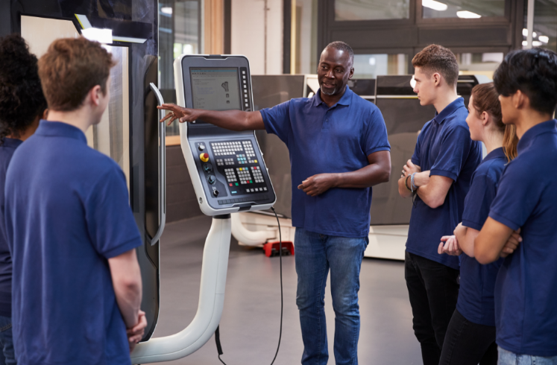
Data-Informed Career Education
Employer Relationships
Build Education-Industry Connections
Establish connections with local employers
Gain insight into valued workplace skills
Bridge students’ transition to work
Promote work-based learning
Align programs with good jobs
Process for Initiating Education-Industry Connections
Explore Occupations
Identity top career clusters and high-value occupations in the area. Examine where most people are traveling to work.
Identify Employers
Review top career cluster, occupations, and popular work locations. Conduct a search to identify employers related to these categories.
Establish Employer Relationships
Reach out to employers and facilitate educator-employer discussions and meetings. Develop work-based learning opportunities for students.

Slide 8

Additional Research and Services
Early College High Schools
Support for Early College High Schools
Resource Center K12 Survey Business Survey HED Survey Consolidated Reports Career Lesson Plans | Policy Manuals Leadership Meetings Leadership Podcast Series Work+Ed Podcast Series Quarterly / Regional Analyses

Slide 9


Slide 10
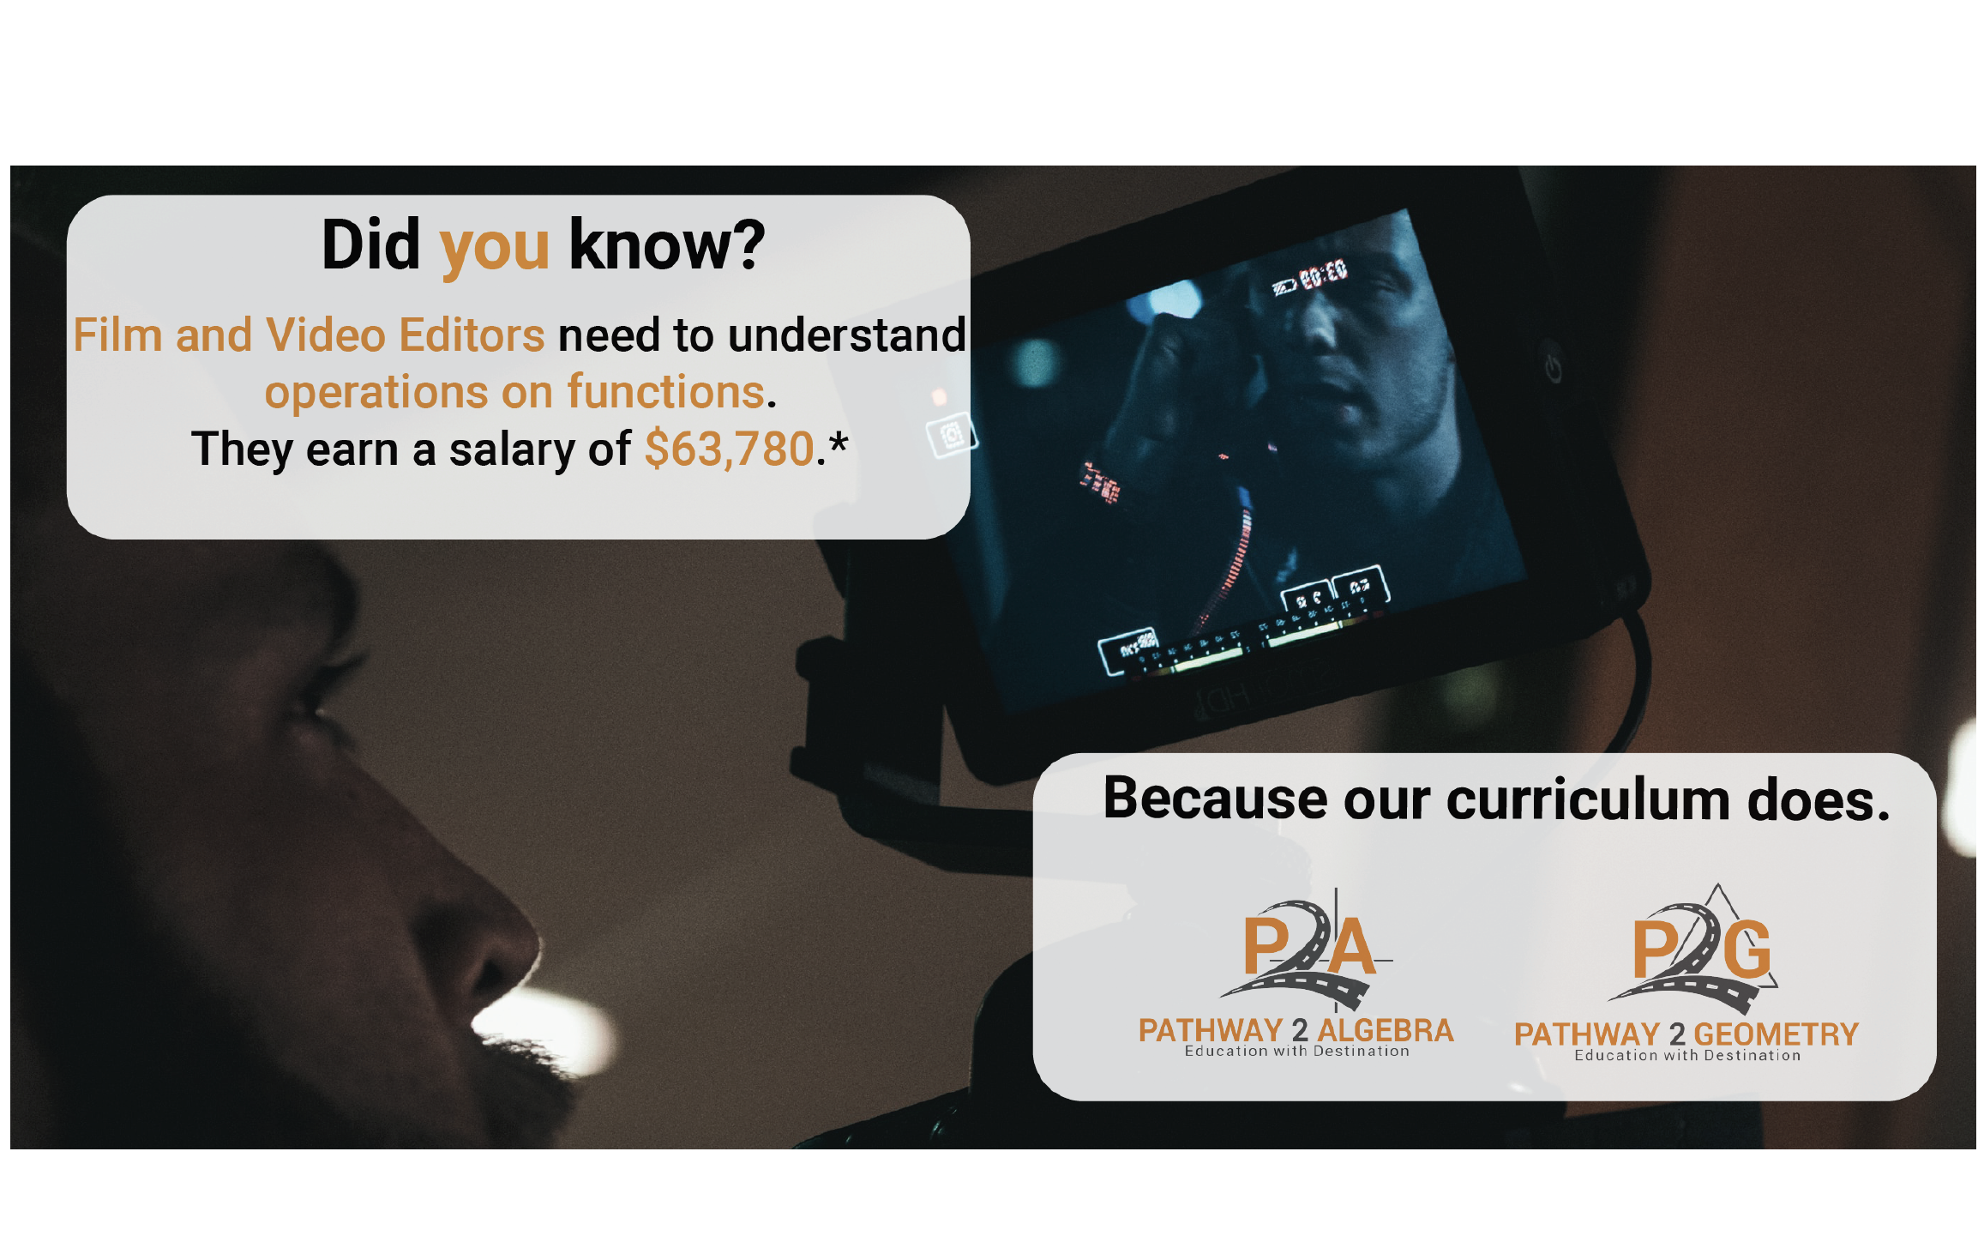

Slide 11
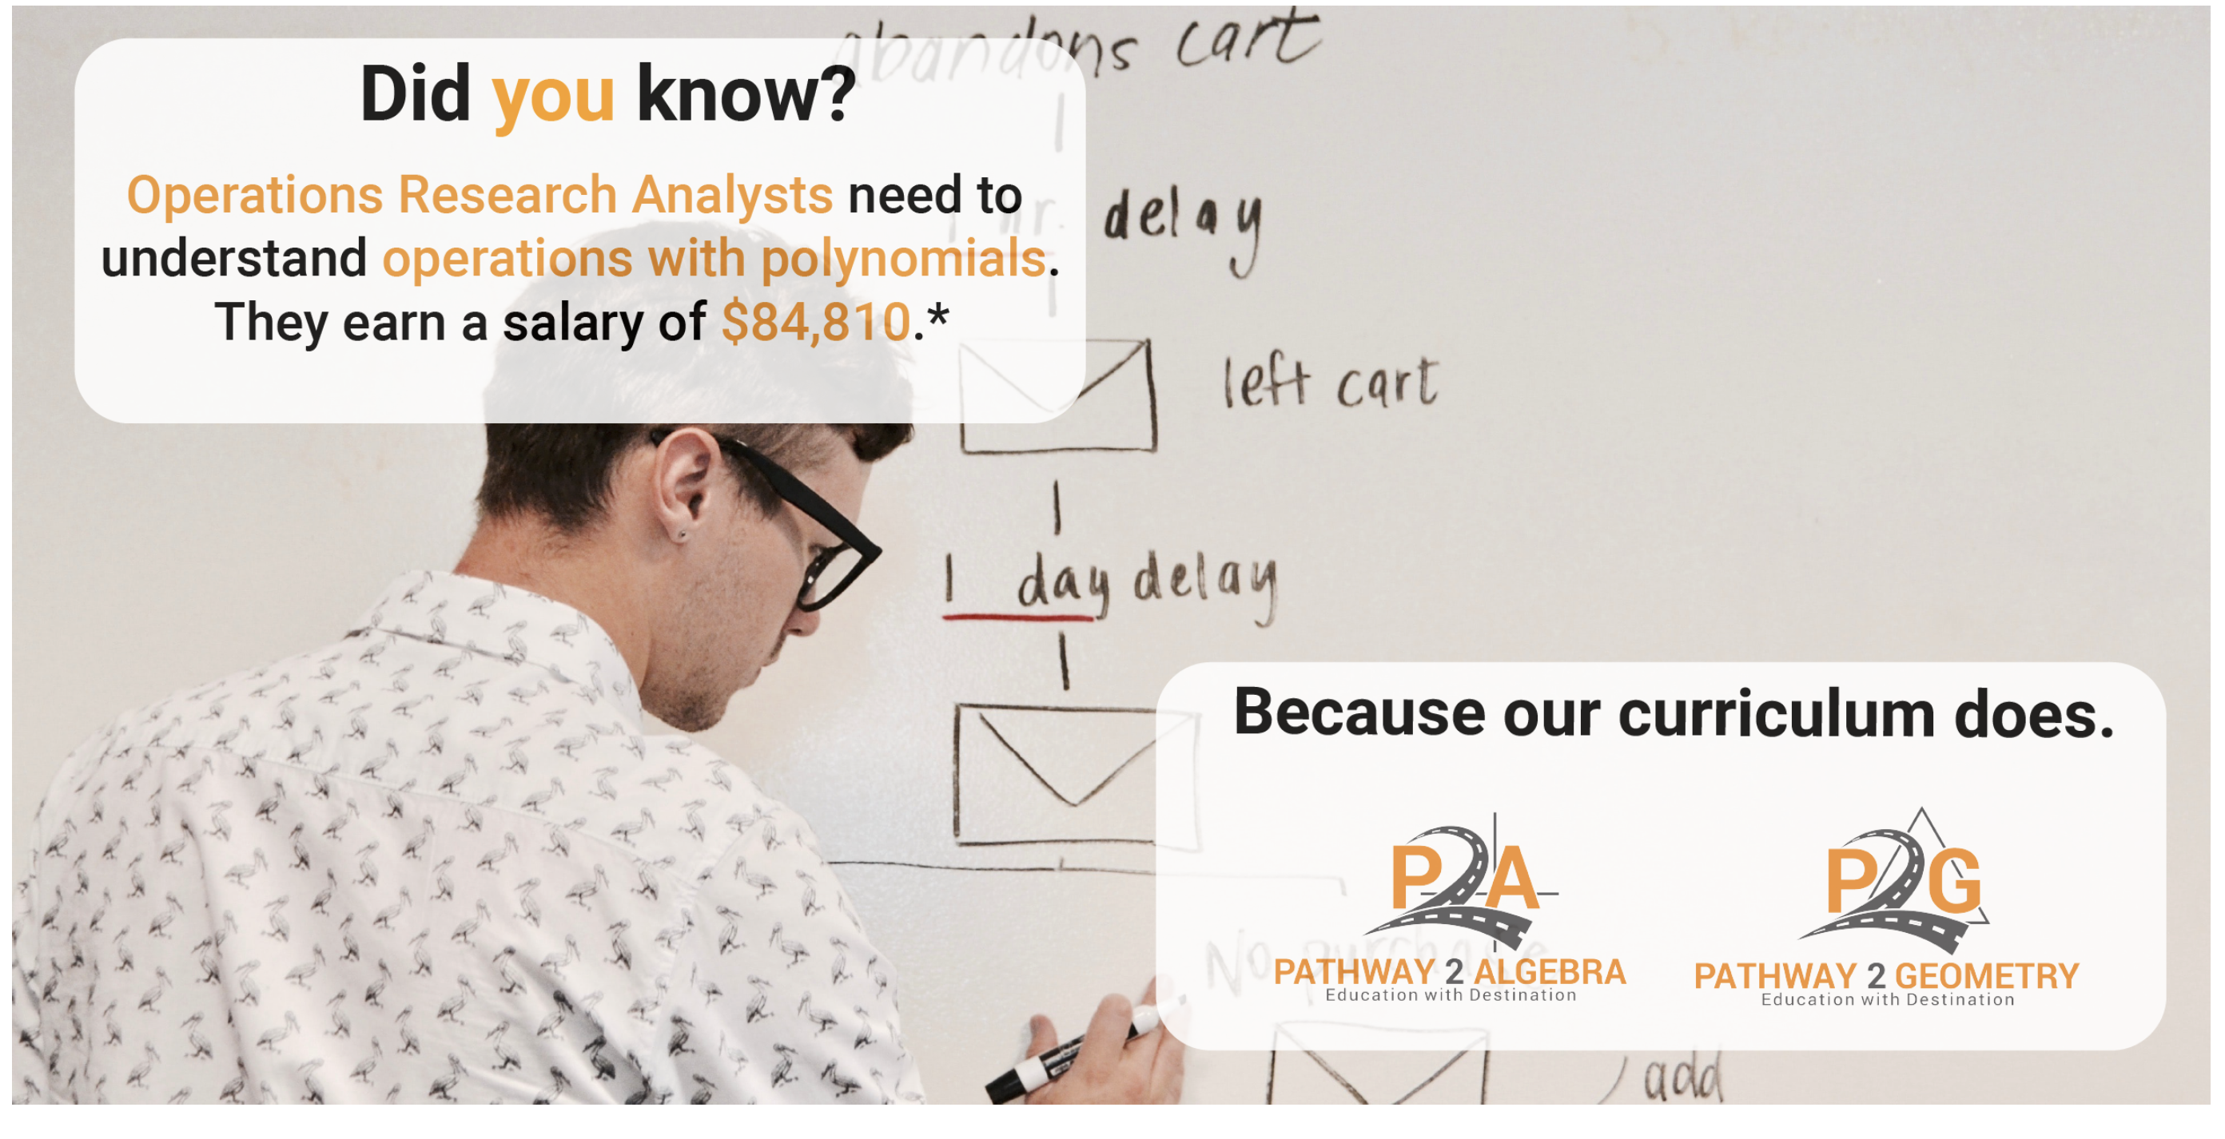

Slide 12


Slide 13
