Slide 1


B E R L I N
M D E G B E R T H Ü N E W A L D T
huenewaldt@gbd.green
https://www.green-venture.net/
„Company X Logo“
SMART CITY & SUSTAINABLE MOBILITY IN
F O U N D E D I N 2 0 0 4

Slide 2




Value Proposition
NEW MOBILITY
ASSESS KINTO
START UP SCREENING
Evaluate new/existing opportunities in new mobility
Strategically assess Kinto Service, Kinto Leasing and Kinto Join in post corona times
Screen startups that would be strategically important for you

Slide 3



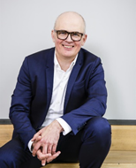




Egbert Hunewaldt
CONTACT
FOUNDER AND MANAGING DIRECTOR
Green Business Development, GmbH, Zelterstrasse 8
D-10439, Berlin
huenewaldt@gbd.green
+49/151/64619411
EDUCATION
  02/95 Masters in Media & Communication, Ludwig Maximillians University, Munich
  07/93 Diplome d'information, IFP French Press Institute, University of Paris II Pantheon Assas
  07/04 Essec Mannheim Executive MBA, Paris Mannheim
ADD A DESIGN HERE
WORK EXPERIENCE
  1997-00 Publishing Director COSMOPOLITAN MAGAZINE
  2001-03 Managing Director Eco - Test Publishing House
  2004- To date, Founder & MD GBG
ADD A DESIGN HERE
  2017-20, Toyota, Germany
  2018-20 GRDF, France
  2018 KIC Inno Energy Incubator, Sweden
  2016-18 EU New Mobility Expert Survey, Paris
  2012-15 Multicity E car Sharing, Berlin
  2008-10 Ridesharing, Berlin
PROJECTS
ADD A DESIGN HERE

Slide 4



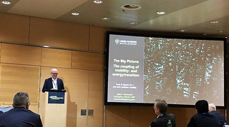


Egbert Hunewaldt
CONTACT
FOUNDER AND MANAGING DIRECTOR
Green Business Development, GmbH, Zelterstrasse 8
D-10439, Berlin
huenewaldt@gbd.green
+49/151/64619411
HONORARY
  2019-To Date Member of DIN consortium
  2018-To Date Rhein Main University Wiesbaden
  2014-To Date Member of Federal Association of Green Business
SPEAKER
  2019 FTWC, "Energy Transition" Vienna, Austria
  2019 HSBA, Guest Lecture, Zero Emission Mobility
  2018 Eurobike, "Financing Start Ups" Friedrichshafen Germany

Slide 5
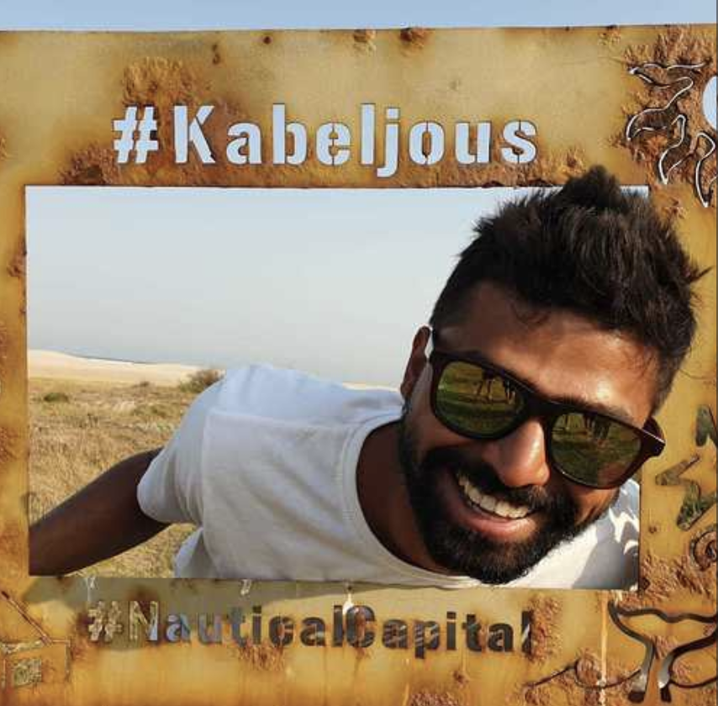
Hitesh Kar
CONTACT
PARTNER
Green Business Development, GmbH, Zelterstrasse 8
D-10439, Berlin
huenewaldt@gbd.green
+49/151/64619411
WORK EXPERIENCE
  Product Manager, FREE NOW
  -Help build Multi modality platform with Car sharing/Scooter sharing
  -Worked with Daimler Autonomous services to bring optimization and routing for autonomous vehicles
  Product Manager, FRESH ENERGY
  -Leading product decisions in a team of 7 engineers, 3 data scientists, 2 designers
  -Growing from 0 to~3 Million contracted German households through partners
  Venture Associate, ASIMOV VENTURE CAPITAL
  -Focusing on startups with futuristic visions in Automotive and mobility
ADD A DESIGN HERE
PROJECTS
EDUCATION
  Masters in Economic and Management Sciences, Humboldt University Berlin
  Bachelors in Electronics Engineering, NIT Calicut
ADD A DESIGN HERE

Slide 6
Hitesh Kar
CONTACT
PARTNER
Green Business Development, GmbH, Zelterstrasse 8
D-10439, Berlin
huenewaldt@gbd.green
+49/151/64619411
Started with the autonomous industry 10 years ago with defence research
Built out car sharing tech stack from inception to final implementation with a focus on building multi modality platform at Free Now
Involved with Mobility and Energy since 5 years
Worked for Autonomous services at Daimler
As VC, focused on startups with futuristic visions in automotive, energy, mobility
Retail Investor in the ongoing Electric revolution

