Slide 1
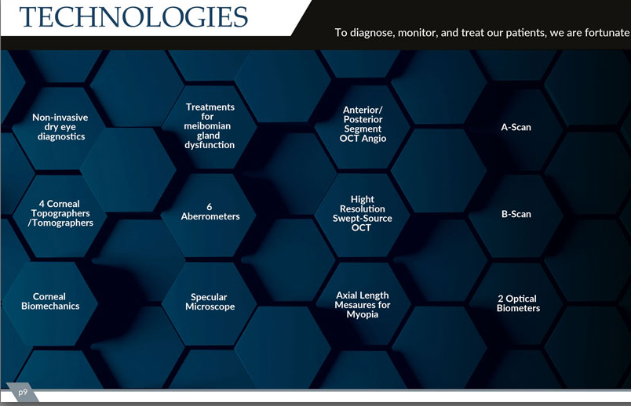
3 Femtosecond Lasers
Topography-Guided Excimer Laser
Nd:YAG Laser
Intraoperative Aberrometry
Ultrasound Biomicroscopy (UBM)
Wavefront-Guided Excimer Laser

