Slide 1

Shoulder Workshop
Sutton Place Physical & Aquatic Therapy
Crystal Eubanks, PT

Slide 2
What you will learn in this workshop
Shoulder Anatomy
Common shoulder problems
Treatment – a few stretches and strengthening
Q & A
Shoulder pain
Previous shoulder injury
Age related issues, arthritis, tendinitis, bursitis
Occupation – repetitive motion jobs, laborers, hairdressers, computer work, excessive keyboard work
Weekend warriors – doing weekend sports and not doing much to prepare for the weekend activity
History of sports – can wear down joints

Slide 3
Common Shoulder Diagnosis
Tendinitis
Bursitis
Frozen shoulder
Impingement
Labral tears
Rotator cuff tear
Arthritis
When to see a doctor about shoulder pain
Sudden loss of motion
Progressive weakness
Numbness, burning, tingling below the elbow
Recent trauma onto the shoulder, leading to shoulder pain
Severe chest pain, radiating arm pain
Difficulty with speech, chest pain or shortness of breath

Slide 4
Common Shoulder pain themes
Likely your shoulder problem has been an insidious and ongoing issue, and you may not have noticed it until it has gotten bad enough that you now feel pain or an “ouch” when making a movement.
It is possible that the pain is a cumulative result of dysfunction or improper movement of the shoulder joint over time.
Let’s then first talk about shoulder anatomy

Slide 5
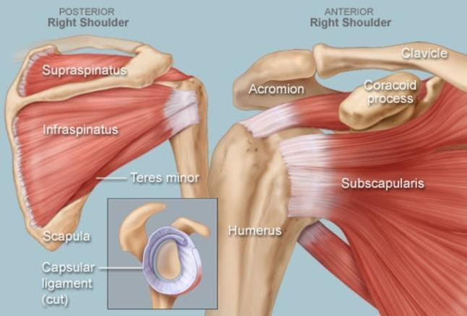
Shoulder Anatomy

Slide 6
Lets talk about the areas that are often the cause of shoulder dysfunction:
Tight tissue of the back of the shoulder
The posterior part of the shoulder is a fibrous tissue called the posterior capsule, this helps with the stability of the shoulder joint. One common theme with individuals that have shoulder issues is poor shoulder posture. Common shoulder posture is forward rounded shoulders and with the help of gravity pulling down on the arm, the posterior capsule gets pulled on and stretched and over time it stiffens up to cope with this abnormal demand(strain).
Weak posterior shoulder muscles
Similar to a stiff posterior shoulder, and with similar causes, the muscles at the back of the shoulder can also become tight because of the demand on them from poor shoulder posture. This tightness caused by increased demand on the muscles will prevent the muscles from functioning correctly and will also lead to weak muscles

Slide 7
Tight structures at the front of the shoulder
The muscles at the front of the shoulder can also become tight from hanging out in the poor posture of rounded shoulders. This is too commonly a typical posture in our current culture, we are often sitting at the computer or on a device that is held down and in front of us, causing our shoulders to slump forward, and often we are in these positions for hours a time leading to tight pectoral muscles.
All of these issues above can lead to poor shoulder mechanics, which over time leads to pain, and if left unchecked can lead to injury.
So how do I make changes and address my shoulder pain and issues?

Slide 8
Be safe and listen to your pain.
If you are experiencing severe pain with any of these exercises, you should stop. That may be an indicator that you may have a more severe shoulder injury and we recommend you come in and see a physical therapist.
Ideally, you would just be able to tell yourself to fix your posture, and you would do it, but that isn’t realistic.
Where we need to start is addressing the 3 problem areas above.
Next, we will talk about a few exercises/stretches that are general and help most people with their shoulder pain.

Slide 9

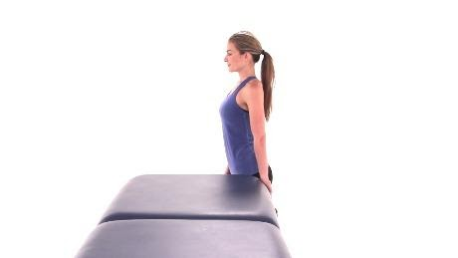
Exercises / Stretches
Anterior shoulder stretch
Before this stretch I would like you to reach above your head with both arms and pay attention to at what point you have pain.
Anterior shoulder stretch at a door vs. table stretch.
vs.
Now reassess your shoulder movement again, reach above you head with both arms. You should be able to reach up higher with less pain.

Slide 10
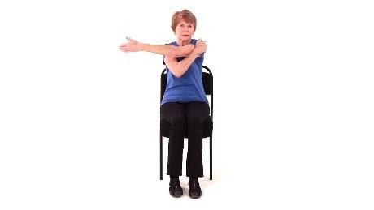
Posterior Shoulder Stretch
Bring one arm across your chest and place your other hand on your opposite shoulder. Pull your arm further toward your chest and hold.

Slide 11
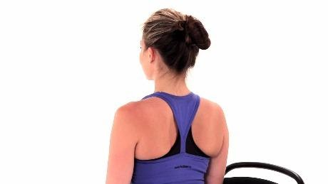

Scapular retraction
This will address the weakness in the posterior aspect of your shoulder and will help support those posterior structures that are being strained.
Begin sitting in an upright position.
Movement
Gently squeeze your shoulder blades together, relax, and then repeat.

Slide 12
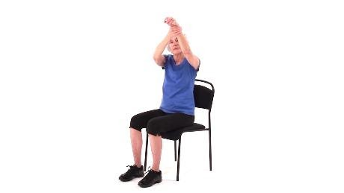
Active assistive shoulder flexion
Working on increasing your range of motion

Slide 13
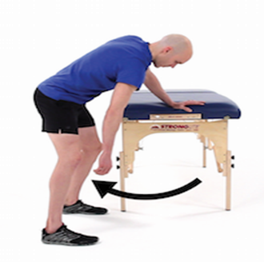
Shoulder pain due to Sleeping
Sometimes shoulder pain is caused by issues with your shoulder while sleeping.
Doing pendulums prior to going to bed

Slide 14
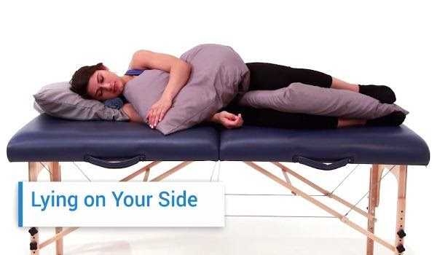
Sleeping on your side – is an alternate sleeping position
The best way to sleep on your side is to hug a pillow
This is a general suggestion for comfortable sleep for a person with shoulder pain. A physical therapist can help you find good sleeping positions specifically for your issues.

Slide 15
Thank You! But wait, I have a question. Call us at 212-317-1600 or visit us at suttonplacept.com
Sutton Place Physical & Aquatic Therapy
Crystal Eubanks, PT

