Slide 1


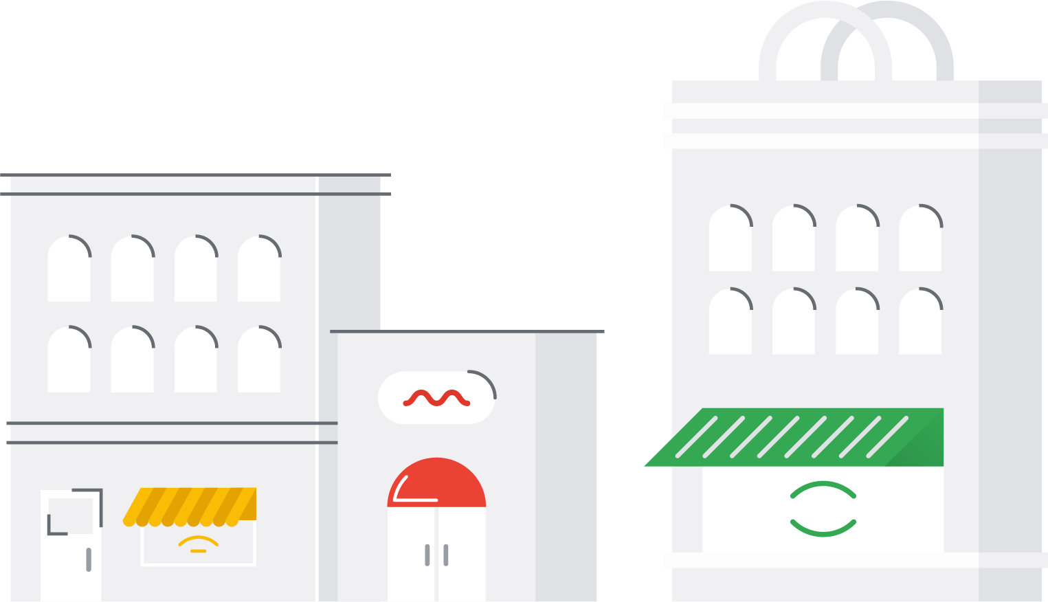

Google Cloud for retail overview
January, 2020

Slide 2

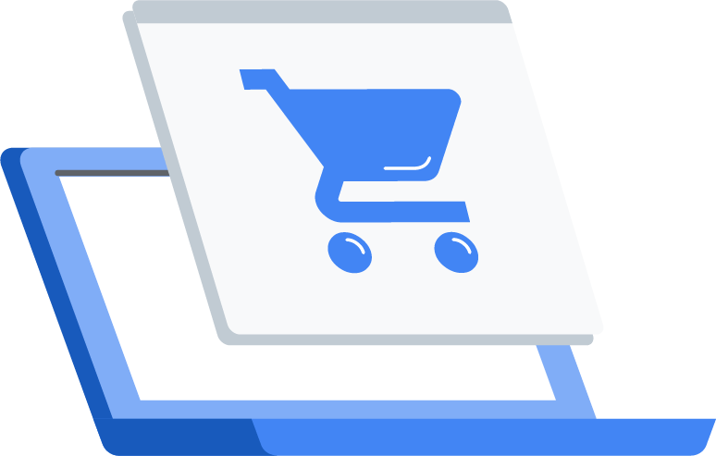




US retail sales are growing at ~3% YOY, with online sales offsetting slowing in-store sales
11%
14%
5%
3%
Online
Store (digitally-influenced)
-.7%
-.1%
Store (non digitally-influenced)
2019F
2023F

Slide 3
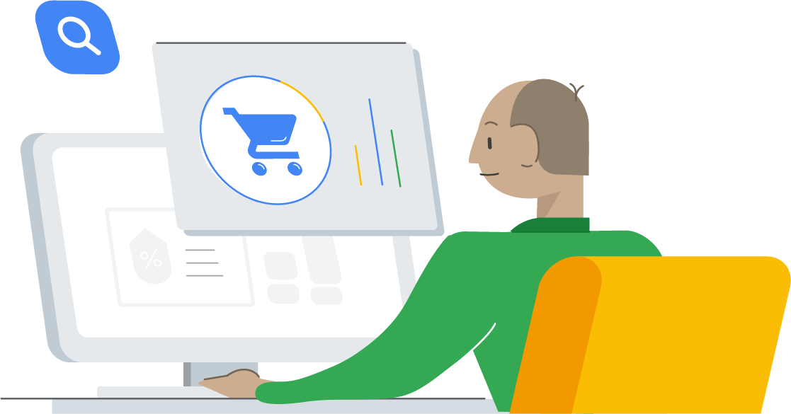
Customers shifting to online…
Online (ship from store)

Slide 4
Creates challenges for retailers
This dynamic is driving higher utilization of costly sales channels
SGA and A expenses (est.)
In-store
25%
Online (ship from warehouse)
30%
Online (BOPIS)
35%
Online (ship from store)
50%
Online (ship from store)
Source: Forrester; McKinsey; CNBC

Slide 5
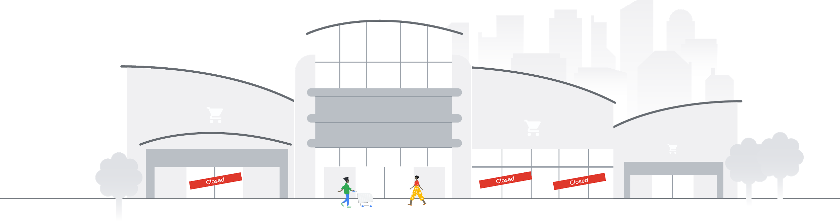
Stores have to evolve
35%
29%
28%

Slide 6

Retail Transformation with Google Cloud
Presenter Name Date

Slide 7

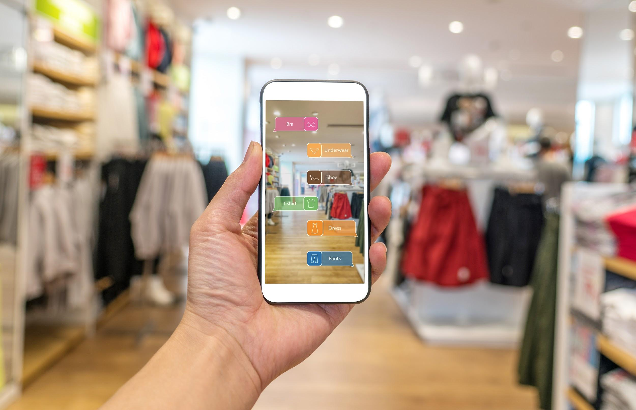
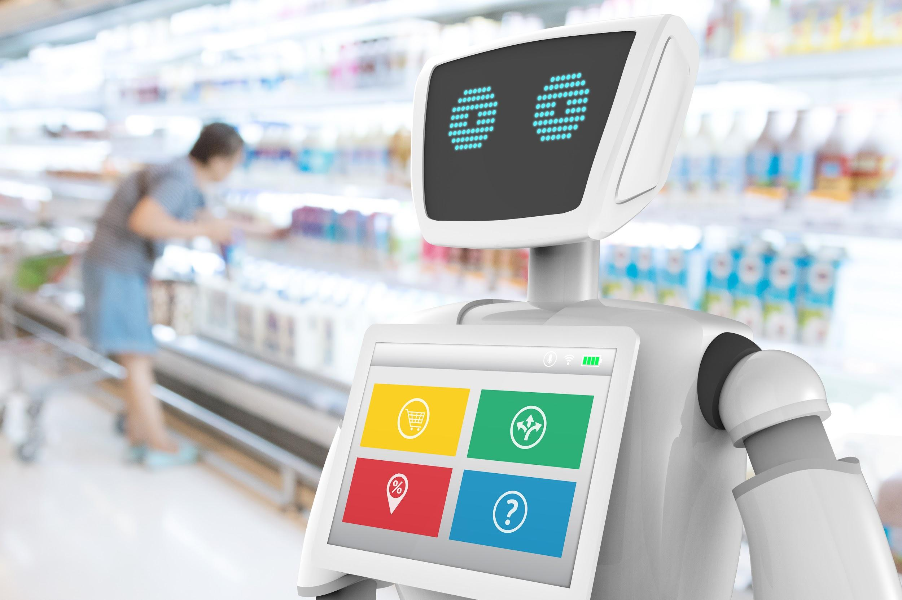



Retail continues to advance digitally
Global digital retail sales will increase to 17% of
all B2C sales by 2022, up from 12% today*
2 in 3 consumers now expect personalization
as a standard of service**
Artificial intelligence/machine learning is recognized as the top game-changing technology in retail, but is not yet in retailers’ top five spending priorities***
Source: *Forbes, Global Digital Commerce Sales To Near $6 Trillion By 2022, September 2018,
**Retail Customer Experience, Consumers expect personalization, reveals report, April 2019, ***Gartner, 2019 CIO Agenda: Retail Industry Insights, October 2018, Figures 3 and 4.,
Notes:
[Short]:
The retail industry is going through a transformation driven by customers who expect a seamless experience between online and in store. These customers are looking for tools that can make recommendations or better help them find what they need. In fact, 2 in 3 consumers now expect personalization as a standard of service.
[Long]:
The retail industry is going through a transformation driven by customers who expect a seamless experience between online and in store. These customers are looking for services that can make recommendations or better help them find what they need.
Consumers are increasingly turning to online and mobile channels to make purchases that they traditionally would have made in brick-and-mortar stores in years past.
Consumers are also expecting the entire retail experience to be faster and more personalized than ever. Almost 2 in 3 consumers now expect personalization as a standard of service, and believe they are recognized as individuals presented with tailored offers, discounts, and product suggestions. With these higher consumer expectations, there’s a greater risk in disappointing your consumers and weakening a loyal consumer base. Interactions consumers label as "very frustrating" include being sent an offer for a recently purchased item (34%), offers that aren't relevant (33%), or when a brand fails to recognize them as an existing customer (31%).
To meet these customer expectations, retail CIOs see AI/ML, data analytics, and mobile as the top three technologies that will enable retailers to deliver a seamless, personalized customer experience, despite the fact that AI/ML is not in retailers’ top five spending priorities. AI/ML is paramount to keeping up with consumer demands, as it allows you to glean deeper insights within each individual consumer and predict their next step in the customer journey. Today, many retailers are turning to cloud technologies to deliver on these AI/ML expectations.

Slide 8
Retailers need to transform all areas of their business, powered by cloud
Product Lifecycle Management
Extensive data analysis to drive visibility and efficiency into all areas of the supply chain
Omnichannel Commerce
Ecommerce hosting, AI -powered experiences, and digital shopping assistants
Store Operations
Frictionless checkout, empowered associates, and on-shelf inventory tracking
Merchandising and Assortment
Modernize systems, understand inventory allocation, and evolve dynamic assortment planning
Logistics, Fulfillment and Delivery
Real-time inventory management and intelligent analytics tools
Customer Acquisition and Retention
Unify data, personalize marketing, and provide superior support to convert unknown visitors into loyal customers
Notes:
[Short]:
Customer expectations are high and disrupting the entire retail value chain. Not one or two parts of it, but the entire value chain, and retailers have to reimagine, adapt, and transform all parts of their business in order to stay competitive.
Google Cloud for Retail offers a robust set of solutions that enable retailers to quickly take advantage of cloud capabilities for specific use cases—from store operations to merchandising to customer acquisition and retention.
[Long]:
Customer expectations are high and disrupting the entire retail value chain. Not one or two parts of it, but the entire value chain, and retailers have to reimagine, adapt, and transform all parts of their business in order to stay competitive.
To meet customer expectations and stay competitive, retailers need to undergo a large-scale transformation, and the only way to do that is with a enterprise-wide technology-driven strategy. At the heart of every retailer’s technology-driven strategy is cloud, as you prepare to build, modernize, and scale your entire business for the future.
Cloud is at the forefront of revolutionizing the entire retail value chain, enabling retailers to scale infrastructure automatically, get deeper insights faster, and work more collaboratively, so you can focus on what matters most - delivering a delightful, personalized, seamless customer experience.
Google Cloud for Retail offers a robust set of solutions that enable retailers to quickly take advantage of cloud capabilities for specific use cases—from store operations to merchandising to customer acquisition and retention. Google Cloud solutions are focused around six core pillars in the retail value chain and aim to help companies apply cloud technology to get the most from each.

Slide 9
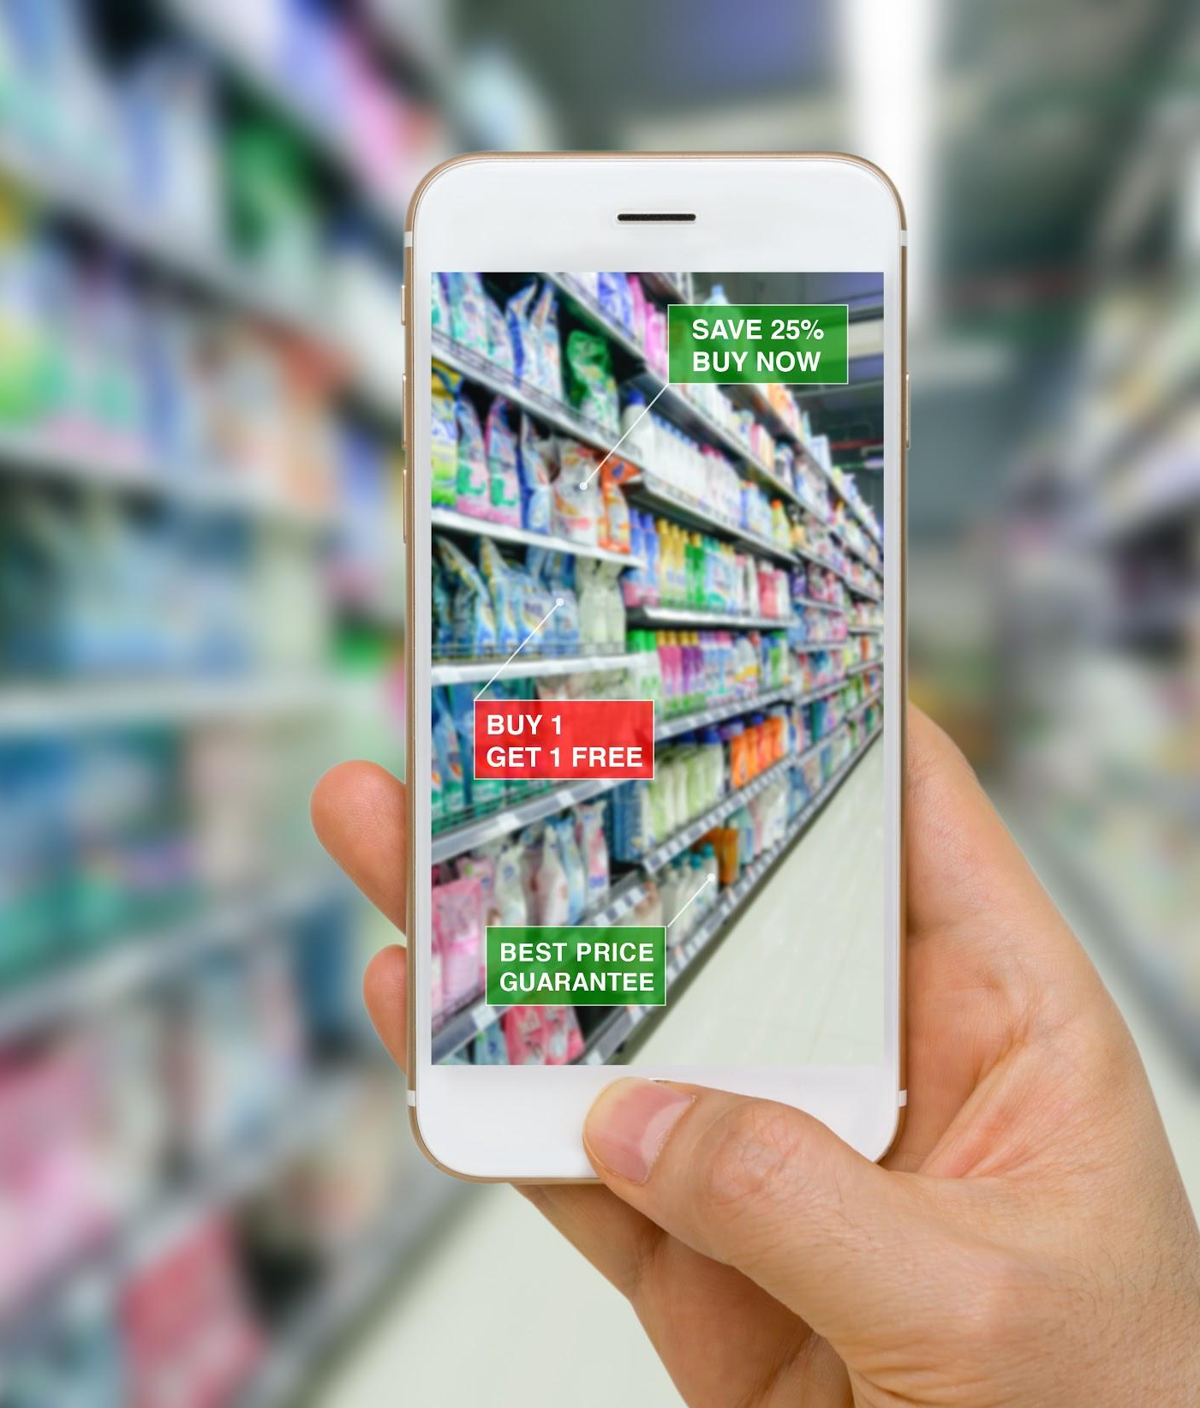
What makes Google Cloud different
Best-in-class security
Protect customer and
credit card data
Hybrid and multi-cloud
Operate across on-premise, stores, and multiple clouds
Fully managed no ops
Scale automatically for Black Friday to meet demand
Embedded AI and ML
Drive customer loyalty and optimize supply chain
Best of Google
Create new digital shopping experiences
Notes:
Let’s dive into more about what makes Google Cloud different:
Delivering end-to-end security solutions from the data center all the way to the device with a purpose-built infrastructure and security by default to protect your business and customer data.
Designing for an open cloud to support whatever system best suits your needs whether hybrid or multi-cloud or something in between.
Striving to make cloud easy to use and scalable, so your business can meet peak demand periods like Black Friday, instead of facing IT downtime and missing out on sales.
Embedding intelligence in everything, making it easy for you to apply artificial intelligence and machine learning in your own organization to drive customer loyalty and optimize your supply chain.
Lastly, they bring you the best of Google in all of their solutions, and can help you create a more innovative, digital shopping experience for your customers and a culture of collaboration in your organization.

Slide 10

Hybrid and Multi-Cloud solutions to enable choice
Write once, run anywhere
Only Anthos enables development teams to deploy and manage containers on-premises and across cloud, accelerating application modernization and development
Connect legacy applications across clouds
Google Cloud’s Apigee API management platform easily connects legacy and modern workloads across hybrid and multi-cloud, helping create connected customer experiences
Avoid lock-in with open source
#1 contributor to Cloud Native Computing Foundation and creator of Kubernetes - adopted by AWS and Azure
Anthos' multi-cloud capabilities are so far unique in the industry.
Forbes, April 2019
Notes:
[Short]:
In addition to best-in-class security, Google Cloud is committed to an open cloud that enables retailers to set up the optimal solution, spanning on-premise and multiple clouds, without being locked into a single provider. Google Cloud offers tools that operate across systems and vendors and allow you to monitor your systems from a single place.
[Long]:
Google Cloud is committed to an open cloud that enables retailers to set up the optimal solution, spanning on-premise and multiple clouds, without being locked into a single provider. Google Cloud offers tools that operate across systems and vendors and allow you to monitor your system from a single place.
Anthos provides a single platform for multi-cloud management, allowing you to deploy applications across hybrid and multi cloud without changing the underlying code. Anthos’ full suite of features, including Migration and Configuration Management, enable you to migrate and modernize your VMs to your container and cloud provider of choice in one streamlined motion, without upfront modifications to the original VMs or applications. This means that you don’t have to jump through hoops or learn a new language - you can run all your container workloads on one consistent platform. Anthos is also a 100% software solution that works on your existing hardware, whereas AWS Outposts and Azure Stack depend on custom-built hardware.
Google Cloud’s versatility extends across the portfolio.
Google Cloud's Apigee API management platform can also be an important multi-cloud enabler. With Apigee’s cross-platform capabilities, you can securely connect both legacy and cloud-native workloads across on premises and multiple clouds with APIs. Industry analysts like Forrester (The Forrester Wave: API Management Solutions, Q4 2018) have consistently recognized Apigee as a leader in its space.
Google Cloud believes in the power of open-source to give customers the freedom to choose where to deploy their workloads and avoid vendor lock-in. Google is the #1 contributor to the Cloud Native Computing Foundation, an open source development community, with 50%+ of code commits. Furthermore, industry leading solutions, Kubernetes and Tensorflow, both originated at Google as open source projects and they are now supported by AWS and Azure.
Sources: Proof Points
Analyst Call-Out: “Anthos' multi-cloud capabilities are so far unique in the industry and could well be the killer product Google needs to finally break into the enterprise cloud market…” - Jean Baptiste Su, Contributor (Forbes, April 15, 2019)
Write once, run anywhere - Innovative hybrid and multi-cloud solutions: Anthos is a 100% software solution that works on customer’s existing hardware. In contrast, AWS Outposts will be delivered as an AWS or VMware managed appliance, while Azure Stack is delivered via certified hardware partners.
Connect legacy apps across clouds: Apigee Edge is available both on-premises and across multiple clouds, and allows customers to design, secure, deploy, and monitor APIs everywhere with a cross-cloud API management platform. AWS (AWS API Gateway) and Azure (Azure API Management) can only be used on their respective platform. Per Gartner (April 2018), Apigee is the leader in the Magic Quadrant for Full Life Cycle API Management.
Avoid lock-in with open source:
Google is the #1 contributor to the Cloud Native Computing Foundation with 50%+ of code commits (TechCrunch)
Open source enables choice - “Open clouds matter more than ever…Open source is an enabler of open clouds because open source in the cloud preserves your control over where you deploy your IT investments. For example, customers are using Kubernetes to manage containers and TensorFlow to build machine learning models on-premises and on multiple clouds.” (Google blog)
Several technologies that have gone on to become industry standards for cloud solutions - Kubernetes and Tensorflow (e.g. Tensorflow on AWS, Azure) are major examples. Both enable customers to port their applications across clouds.
While providing this flexibility, Google Cloud continues to lead in advancing these technologies and staying ahead of the competition (e.g, GKE went GA 2 years ahead of AKS and EKS)

Slide 11
Apply Google Cloud’s expertise to build retail solutions...
Ecommerce hosting service
Delivers a seamless omnichannel customer experience and accelerates time to market with a scalable platform
Recommendations AI
Provides personalized recommendations for each customer’s tastes and preferences across all touchpoints
Cloud Vision Product Search
Creates an engaging mobile experience by enabling customers to take a photo of an item and instantly scans your product catalogue to find a similar item
Contact Center AI
Integrates Google AI solutions with popular contact center software, improving customer experience and operational efficiency
Notes:
Google Cloud has invested deeply in solutions for retailers and many take full advantage of their expertise and innovation in areas like data analytics and AI. This will help retailers transform their businesses and meet the growing expectations of their customers.
For example, Vision Product Search, which uses Cloud Vision technology, helps retailers create engaging new mobile experiences by integrating Google Lens-type capabilities. Customers can take photos and screenshots from their phone of products they like, and the mobile experience will provide real-time results of similar or complementary items from the retailer’s product catalog. Customers can find what they want instantly, and experience less friction in the product search and purchase process.

Slide 12
Omnichannel Commerce
Digital Shopping Assistant helps customers navigate stores & Recommendations AI delivers product suggestions based customer preferences
Google has off-the-shelf
retail solutions that are not offered by Azure
Logistics, Fulfillment & Delivery
Smart Supply Chain brings customers end-to-end visibility into their supply chain
Merchandising & Assortment
Intelligent Inventory enables retailers to track inventory across the store with IoT sensors
Customer Acquisition & Retention
Contact Center AI uses AI to deliver recommendations to agents in real-time based on customer conversations
Notes:
From Digital Shopping Assistant to Contact Center AI, Google Cloud delivers off-the-shelf retail-specific solutions to transform your business across the entire value chain.

