Slide 1
Final Identity Concept

Slide 2
When smart people connect through pioneering technology, insights emerge—in and across teams. The result is accelerated value—for everyone, especially patients. It’s intelligent asset management that goes beyond a single study and spans the drug development and delivery spectrum.
“
“
Illustrative quote inspired by workshop insights

Slide 3


[Name Here]
Insights to Accelerate Value for Patients

Slide 4

[Name Here]
Insights to Accelerate Value for Patients

Slide 5
CAVALYST
BVILD-R
MAVRIC
SEAKS
(Study Engagement & Asset Knowledge System)
COGNIV
Insights to Accelerate Value for Patients

Slide 6
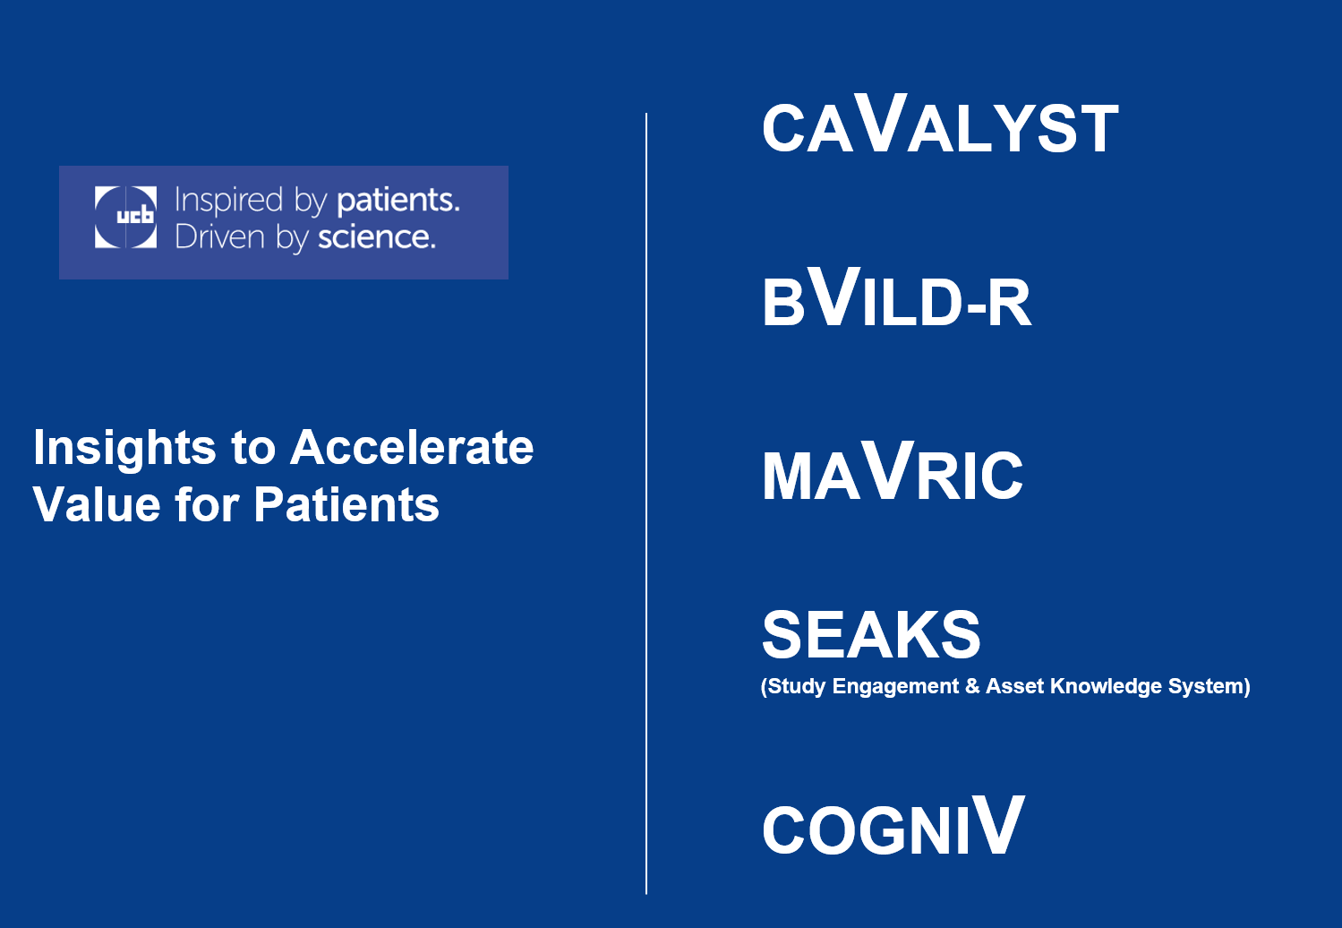

Addressing the “V” and other thoughts
V is for value (and victory)
makes connections
Innovation
SEAKS = Seeking
Tagline speaks to acceleration for the most important audience of all—patients

Slide 7
Key messages
KEY MESSAGES | Exec Stakeholders | Functional Groups | Users & Future Users | External Customers
Our investment in improving the functionality of our existing study management platform allows for an immediate and ongoing ROI, including increased productivity and efficiency for study teams.
Now we can connect content end-to-end, which takes us beyond single-study management. Our teams work together more effectively to surface insights from within and across the system for the benefit of UCB study management teams—and to create value for the patients we serve.
Our study teams across UCB need to be able to accelerate drug development and delivery while managing risk and retaining quality. With new end-to-end insights, our teams can rely on this platform and the teams who use it get the insights they need to deliver value for UCB and the patients it serves.
The revisions to the platform were developed by UCB users for UCB users. It’s like having a reliable, hard-working colleague at your side who helps improve the quality of work. From protocol development through CSRs and in-between, it delivers value all along the way.
There is no commercial system out there that has this level of functionality. It incorporates AI and machine learning to go way beyond risk management. UCB’s [platform] technology is a team member, a partner for innovation in asset development and delivery.

Slide 8
Thank you

