Slide 1

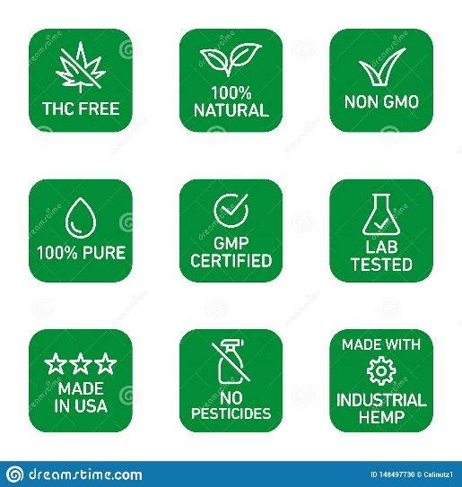
Suggested Use*
Shake well, fill dropper and place under tongue. Store away from heat, light and humidity.
Serving Size:1 Dropper(1ml)
CBD per Serving:20mg
Serving per bottle: 30
New Wave Organics
WARRNING :Consult with your healthcare provider before using
if you are nursing, pregnant or taking medication.If adverse reaction occurs, discontinue.
Ingredients: Organically grown NanoZorba* Optimized Broad Spectrum CBD Hemp Oil, NanoZorb* Melatonin, MCT oil, natural Flavours, Stvia.
Platinum
Broad Spectrum CBD Oil
30ml 1000mg
ACTUAL SIZE OF LABLE
1.625inchx 3.75 inch
41.275mmx95.25mm
These logs to be in a strait line across the bottom
www.Newwaveorganics.com.au

