Slide 1

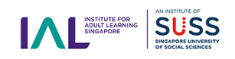


Lead logos
Partner logos

