Slide 1














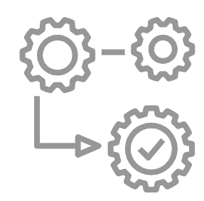








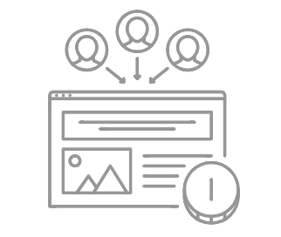
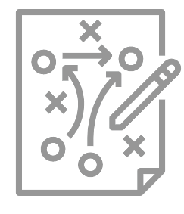




Servicios
CYBERSECURITY
DIGITAL TRANSFORMATION
TECHNOLOGICAL INFRASTRUCTURES
& SERVICES
BUSINESS SOLUTIONS
Strategic Consulting
Business
Intelligence
Data Governance
Datacenter Solutions
Cloud
Solutions
Modern
Workplace
ERP
CRM
EAM
IA
IoT
OT
Extended Reality
PLC/PAC
Managed
Services
Unified
Communications
Security Sollutions
CPM
Financial
Solutions
Additive
Manufacturing
Blockchain
Data Science
& BI
Access & Networking
SMART SOFTWARE LABS
BUSINESS CONSULTING, PROJECT & SERVICE MANAGEMENT
DIGITAL EXPERIENCE
Custom Software Solutions
Digital
Platforms
Smart
Apps
Project & Portfolio Management
IT Governance
Service Management
UX & UI
Design
Inbound Marketing
Social
Media
Quality Assurance & Testing
DevOps & Automations
SEO
Web
Analytics
Lead Nurturing
Software Maintenance Services
Change Management
Service, Operation & Automation Solutions
Project & Portfolio Management Solutions
Agile Development Cells
RPA
Online Ads
BUSINESS OPERATIONS

