Slide 1


blindnet
BEYOND TRUST TECHNOLOGY

Slide 2
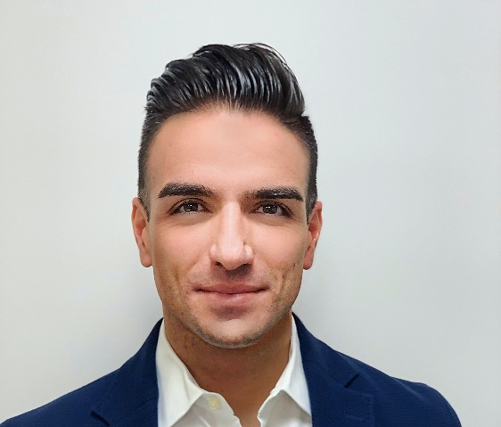



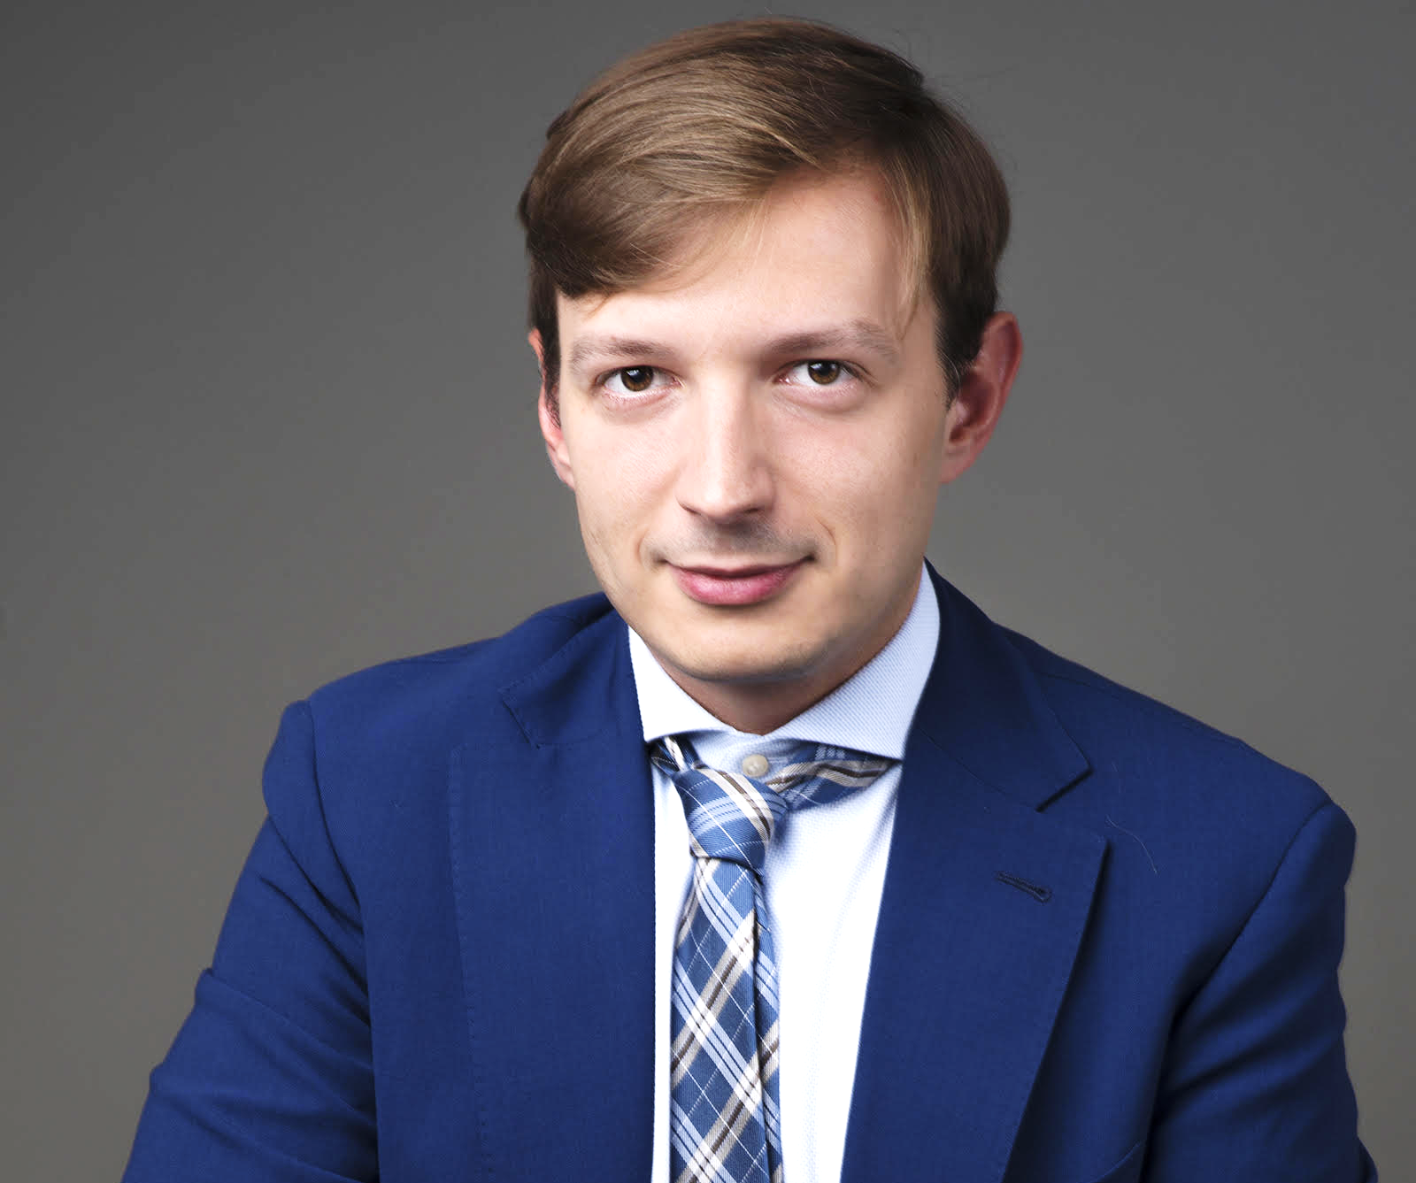

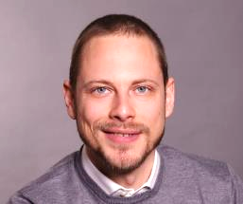
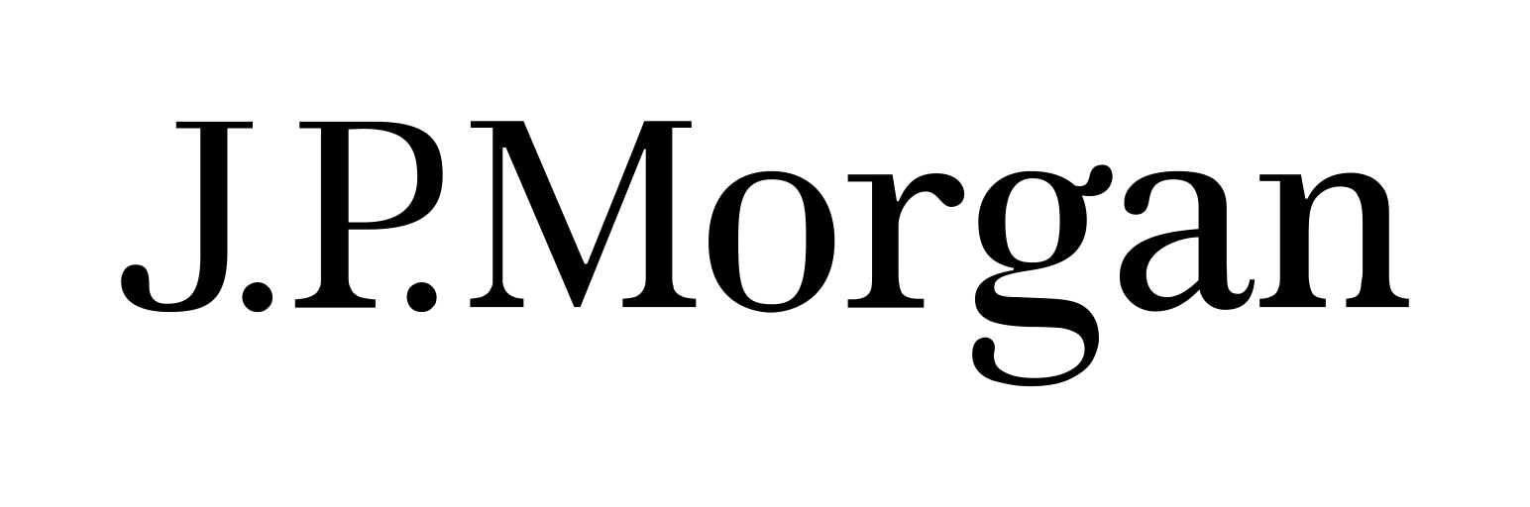
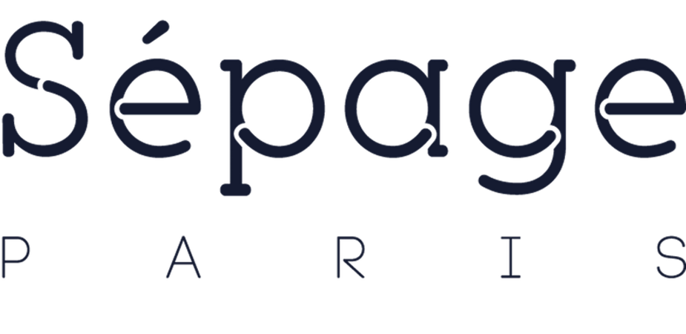
MEET THE FOUNDING TEAM: 30+ YEARS OF FRIENDSHIP!
Vuk Janosevic
CEO
Trained engineer and former developer, Vuk got his MBA at MIT. He worked at McKinsey, as well as JP Morgan, on digital transformation and cybersecurity. He has also worked for three venture-backed tech startups in product and strategy roles.
Milan Stankovic
President
After his PhD in AI from Sorbonne, Milan founded and grew an award-winning AI start-up, Sépage, which was acquired by Travelsoft in 2017 after only 4 years. He has been active in various regulatory bodies, including W3C, on user data challenges.
Filip Radulovic
CTO
PhD graduate of University of Madrid, Filip led the technology team at Sépage through computational challenges and resolved key scale issues with large clients. He implemented the highest level of data privacy in customer personalization.

Slide 3

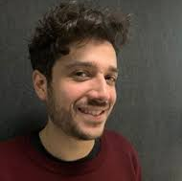
CUSTOMER TESTIMONIALS
Privacy is what everybody needs on the internet now. Blindnet offers what developers need.
Get Collective, provides teams with an efficent way to organize meetings, share documents and interact. Blindnet is a brilliant idea, and we are super excited to use it and provide our users with a zero-trust service.
Thibaut Assus
Co-Founder & CTO

Slide 4
PRODUCT: DEVELOPER TOOLS, PROFESSIONALLY MANAGED
Enable developers to build privacy-by-design software and easily overcome challenges related to data in motion
Encryption
Key agreement and management
Private Transmission
Multi-device communication

Slide 5










TECHNICAL PRODUCT VISION FOR FUTURE SOFTWARE SYSTEMS
Machine Learning on the Edge or on Encrypted Data
Encrypted cloud backups
0101110
0101110
Zero-trust data transfers
at the hearth of the new architecture

