Slide 1

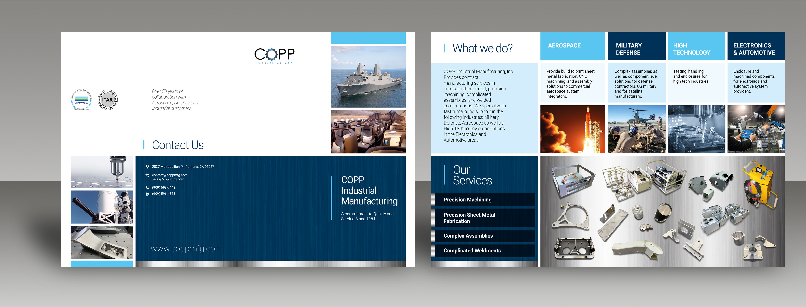
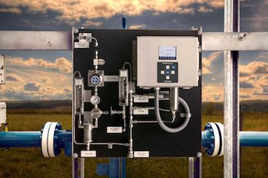

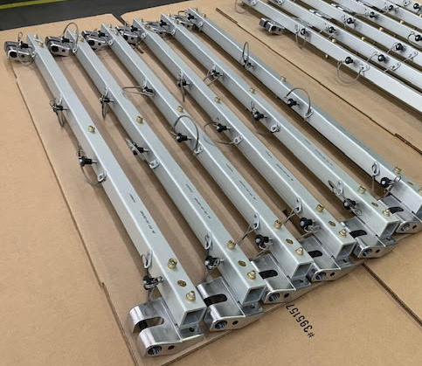
Replace pic
Make logo bigger and more visible
Left justified or centered
Hide part number & part name
We provide contract manufacturing services in precision sheet metal, precision machining, assemblies, and welding. We specialize in fast turnaround support as well as long term production runs. We are a critical part of the supply base for Military, Defense, Aerospace, High Technology, Electronics and Automotive sectors.
Build to print sheet metal fabrication, CNC machining & assembly solution for aerospace primes as well as system integrators
Complex fluid systems and assemblies for defense contractors, as well as the US Military
Move pic over
QMS per AS9100D / ISO9001 / EN9100 2016 / JISQ9100 2016
ITAR certified
NIST 800-171 compliant
Remove periods
Replace pics
Replace wording
Add this wording
If possible, remove background, crop, and integrate this pic into this collage of parts

