Slide 1
Smart Design
Powered by Avenue and LTC

Slide 2
Avenue Smart Design.pdf uploaded
USE THIS AS YOUR GUIDE MORE THAN ANYTIHNG…. I have some additional thoughts below.

Slide 3
My hope…..
Turn the uploaded “Smart Design PDF” into a website brochure with modifications listed below.

Slide 4
Overview:
We are selling turnkey solutions to make senior housing facilities safer for staff, residents and family.
It’s simply good business to implement these solutions!
The future of buildings – get a marketable advantage over the competition
Avenue has the answers (see Smart Design Concept Below)
BEYOND COVID: This temporary health crisis has been a catalyst in highlighting opportunities for improvements that can be implemented industry wide to make senior living and post-acute communities more efficient at infection control and staffing operations. Avenue Development is passionate about collaborating with our partners to implement solutions for building safe environments that encourage socialization and improve resident health outcomes.

Slide 5
Purpose
CUSTOM. TURNKEY. SOLUTIONS
Building safe environments that encourage socialization and improve resident health outcomes. Smart Design provides custom, affordable, easily installed equipment and technology to improve infection control procedures and increased safety for residents, staff, and families.
The Avenue Team has curated the latest technology and leading design ideas to transform senior living or skilled nursing buildings into healthcare havens.
Curated by Avenue, financed by LTC

Slide 6
Look / Feel
Sleek, modern – designing senior living and nursing homes for the future
Complement Avenue brand design elements (documents attached) – www.avenuedevelopment.com
Whenever possible, I prefer images instead of words

Slide 7
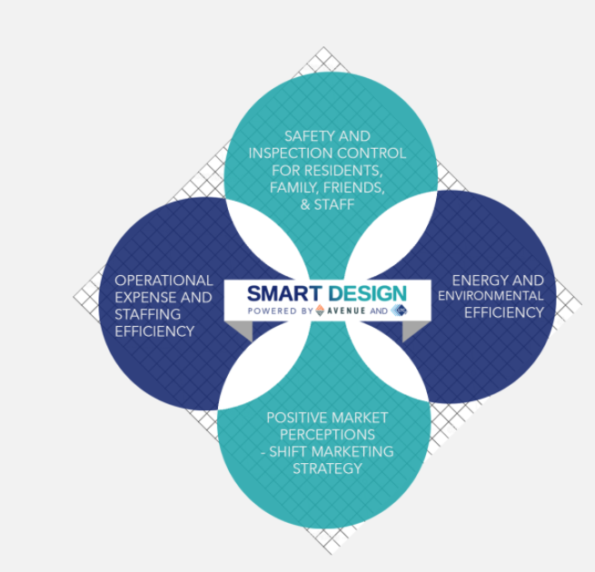
Concept: One-Stop-Shop to revolutionize your business
Update the graphic
Turnkey solution from start-to-finish
One vendor from design to install

Slide 8
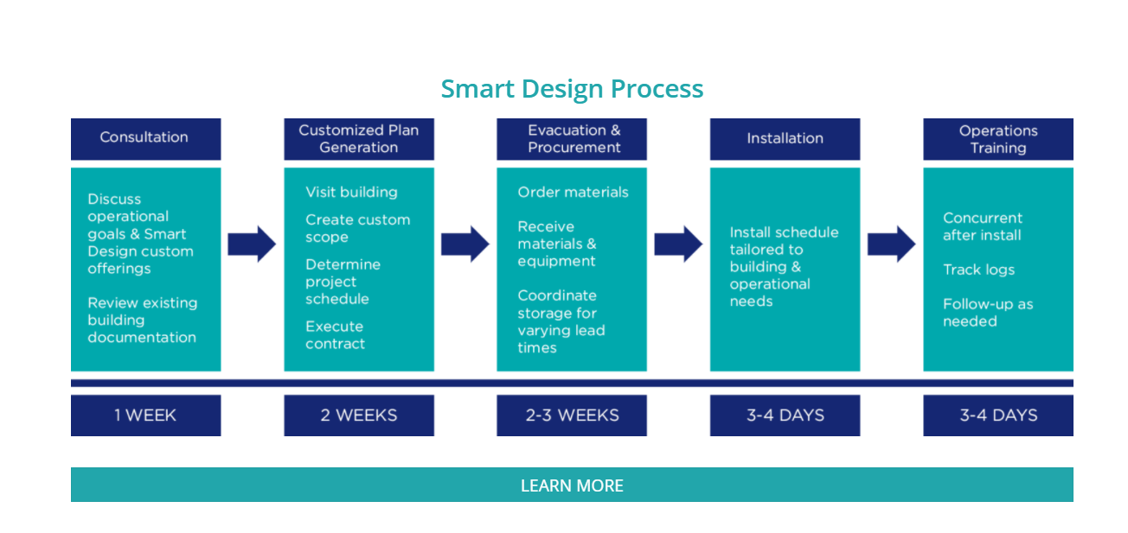
Smart Design Process: We make it easy
Please make graphic more interesting

Slide 9
Tabs
Products
Technology
Benefits
Marketing
Process
Case study
Contact

Slide 10
Smart Design Benefits
Does NOT have to be circles! Could be tabs or some other element
I am envisioning you click on each topic then the benefits appear. The benefits are on the next slide.
Family & Friends
Staff
Residents
Owners

Slide 11
Benefits
Residents | Family & Friends | Staff | Owners / Corporate
Positive impact on social determinants of health Increased ability to engage in social activities Greater sense of safety and dignity Improved health outcomes Decreased isolation & depression (from home or in congregate care without Smart Design) Ability to participate in Part B therapy & fitness activities Technology solutions for monitoring can also provide analytic tools to improve outcomes | Reduce feelings of guilt when a loved one chooses a senior living setting Peace of mind Convenience ( virtual “shopping” platform ) Promote safe & healthy visits | Improve job satisfaction & workplace safety Reduce stress (amongst co-workers and alleviate worry of spreading viruses at home) Promote confidence to sales team, expert in the market in providing a safe & social environment Create a sense of community without residents confined to their room/apartment Technology solutions create daily workflow efficiency | Potential to reduce operational expenses Energy efficient appliances & lighting Health metric monitoring technology allows staff to focus on resident need Less staff turnover due to greater job satisfaction Less overtime Reduce use of 3rd party agency Reduce sales cycle time & cost Virtual marketing platform tracks prospect’s interest Use of online forms Showcase safety features Marketing tool

Slide 12
Smart Design Technology
SEE WORD DOCUMENT: “Smart Design Technology Content Edits”
We DO NOT want to use actual product shots. What can we do instead????
Touchless Temperature Scans
Wireless Diagnostic equipment
Wearable Monitoring
Disinfectant Equipment
UV Sanitation Devices

Slide 13
Smart Design Products
SEE WORD DOCUMENT “Smart Design Products”
We DO NOT want to use actual product shots. What can we do instead????
Branded Signage
Touchless Options
Air Sanitation
Dividers

Slide 14
Smart Design In Action
See the PDF for an example. I will upload images

Slide 15
Smart Marketing
See word document “Smart Marketing” do NOT use the copy from the pdf.

Slide 16
Contact us
Create a form
Name (first, last)
Business
Email
Phone
How can we help? (box for people to type)

Slide 17
Smart Products Grid (maybe on landing page?)
See word document

