Slide 1
Smart Design
Powered by Avenue Development and LTC

Slide 2
Hero shots
Not sure this is the right image. What do you need from me?

Slide 3
Some key messages – if you can weave them throughout
Turnkey, customizable, affordable solutions for installing equipment and technology to improve infection control procedures and increase safety for residents and staff.
Implementing Smart Design will give you a competitive edge - Your residents, staff, families and friends feel safer than they would in other communities or their own homes lacking these products and technology
Beyond COVID – these products and technologies also combat the seasonal flu virus, c-diff, staph and a variety of other infectious diseases that threaten communities and healthcare environments.

Slide 4
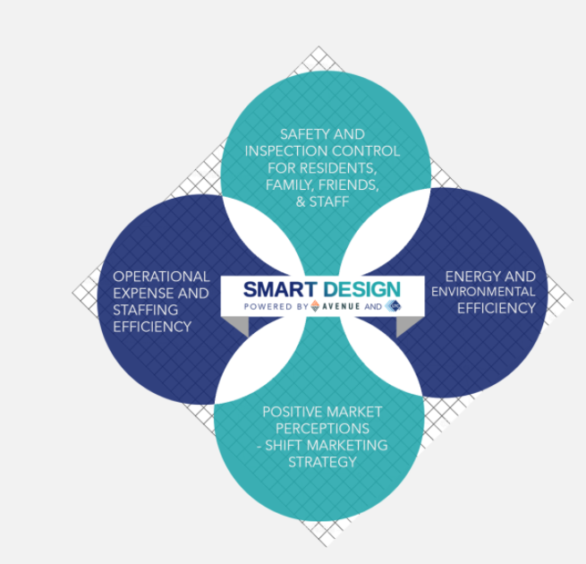
(update graphic colors)
Four key elements collided, creating one great product: Smart Design.
Creating safe environments for your residents, families and staff is simply smart business.

Slide 5
Tabs
Products
Technology
Benefits
Marketing
Process
Case study
Contact

Slide 6
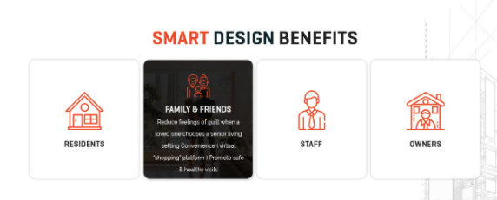
Smart Design Benefits
I love what you did. Any chance you can have more “people” under staff?

Slide 7
Benefits
Residents | Family & Friends | Staff | Owners / Corporate
Positive impact on social determinants of health Increased ability to engage in social activities Greater sense of safety and dignity Improved health Decreased isolation & depression (from home or in congregate care without Smart Design) Ability to participate in therapy & fitness activities Technology solutions for monitoring can also provide analytic tools to improve outcomes | Reduce feelings of guilt when a loved one chooses a senior living setting Peace of mind Convenience ( virtual “shopping” platform ) Promote safe & healthy visits | Improve job satisfaction & workplace safety Reduce stress (amongst co-workers and alleviate worry of spreading viruses at home) Promote confidence to sales team, expert in the market in providing a safe & social environment Create a sense of community without residents confined to their room/apartment Technology solutions create daily workflow efficiency | Potential to reduce operational expenses Energy efficient appliances & lighting Health metric monitoring technology allows staff to focus on resident need Less staff turnover due to greater job satisfaction Less overtime Reduce use of 3rd party agency Reduce sales cycle time & cost Virtual marketing platform tracks prospect’s interest Use of online forms Showcase safety features Virtual tours

Slide 8
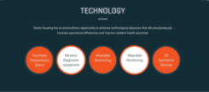
Products
Can we do something else beside showing the literal products?
Maybe something along these lines? And call it Products & Technology

Slide 9
Smart Design Technology
SEE WORD DOCUMENT: “Smart Design Technology Content Edits 2”
I updated the copy slightly from last time

Slide 10
Smart Design Products
SEE WORD DOCUMENT “Smart Design Products v.2”
Updated slightly from last time

Slide 11
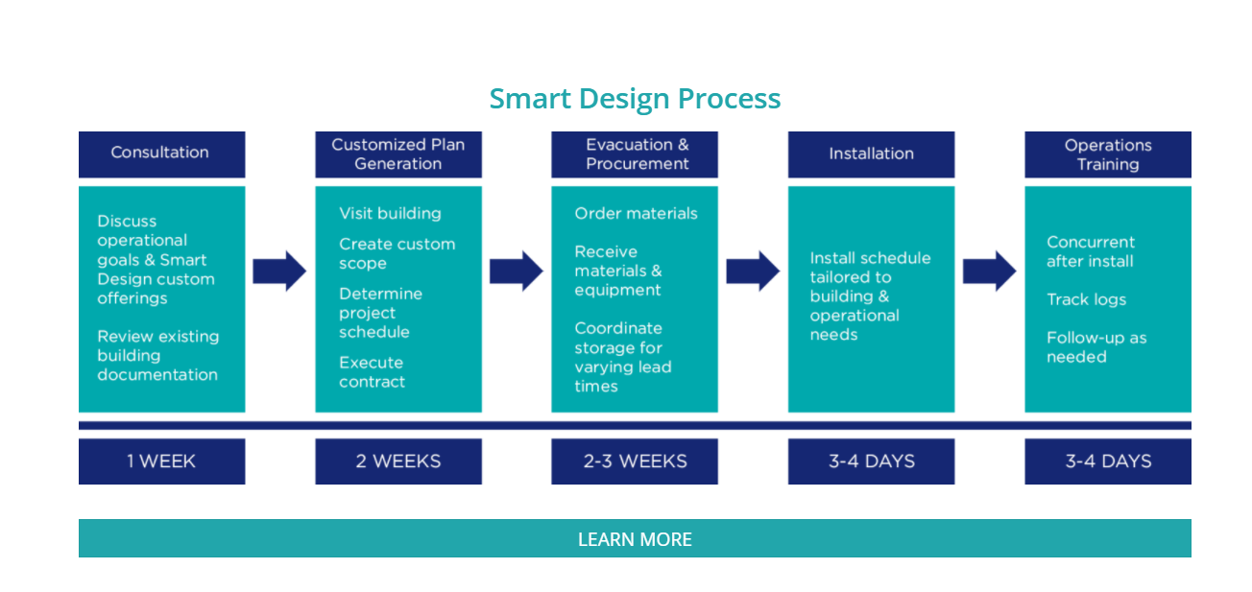
Process
From consultation to implementation, our goal is to make the process as easy as possible. Here’s an example of how it works.
Note: I like the format of a flow chart.

Slide 12
Smart Design In Action
See the PDF for an example. I will upload images

Slide 13
Smart Marketing
Get ahead of your competition by showcasing your infection control safety precautions with Smart Marketing.
State-of-the-art technology to highlight community safety features
Residents and families feel safer touring online first
Virtual tours create an online experience that’s almost as good as touring the building yourself.

Slide 14
Contact us
Create a form
  Name (first, last)
  Business
  Email
  Phone
  How can we help? (box for people to type)
  Our contact info:
    smartdesign@avenuedev.com
    317-800-0480
    We do NOT need a “login” feature

Slide 15
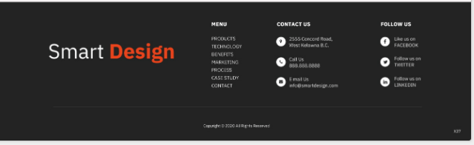
I like this footer from a different one of your designs

