Slide 2
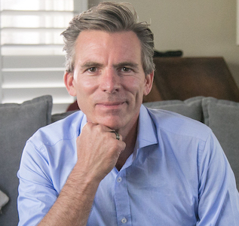
Testimonials
“Thanks to NES, my energy has skyrocketed and I am accomplishing more than I have in years” Linda Sellers
NES Health truly offers insights into the body, both mind and physical well-being, that the medical community cannot comprehend often, nor understand. It is truly a remarkable system” Dr Susan Bostian
Restore your Energy
Ken R Macleod FDN-P HPC PFC PBC
Ken is a multimodality alternative health provider with a focus in shedding light on what holds you back from excellent functional health and showing up as the best version of yourself.
He will set you up to run bioenergetic scanning at home and facilitate with you functional testing (as necessary), design supporting protocols and lifestyle frameworks to guide you on your path to wellness and beyond.
It took Ken almost 3 decades of trial and error, and false hope, for him to arrive at the same conclusion that leading experts in the field of bioenergetics had been saying since the beginning:
energy drives biochemistry, not the other way round.
This is foundational to how NES Health has become the leading provider of Bioenergetic scanning technology, and how it is helping to restore the energy and subsequent health of the world.
“in essence, NES gives you night goggles on what is going on for you, moreover what you can do about it. This is truly the future of medicine” Ken R Macleod
NES has evolved over a 20 year period, 100s of 1000s of scans and now the ability for a client to operate the software from home, to either self direct, or operated it under the professional watch of Ken and his team at theenergy.clinic
Led by Bioenergetic & Functional Diagnostic Nutrition Practitioner, Ken R Macleod, theenergy.clinic is pioneering widespread adoption of bioenergetic scanning technology, and supporting services by making the software FREE to access, for everybody
“ .. provides the signal for the body to heal itself. What’s hard to understand is it really doesn’t do anything except provide the signal. The body does everything else” Dr. David Matthews. MD
DETECT: Uncover the reasons why you feel the way you feel.
DIRECT: Find direction on what to put your energy into.
CORRECT: Enjoy the energetic support from NES Bioenergetics Infoceuticals or the Professional crew at theenergy.clinic
Lifetime access to the software & education is currently FREE to qualified applicants*.
How to Get Started
Register - theenergy.clinic/NES
Get Your Scanner - go to shop & buy
Download App – Energy4Life
Pair Scanner with your phone
Scan Away (follow instructions)
View Results & Information
Online or
On Phone
Follow guidelines within software or make an appointment to have bespoke strategy and protocol designed by Ken
* Requires a one time purchase of a scanner (can be used by multiple people
Providing Convenient Remote Service Only
e Ken@kenrmacleod.com
m 02 9116 2889
a Level 13, 109 Pitt Street, Sydney, Australia

Slide 3
