Slide 2
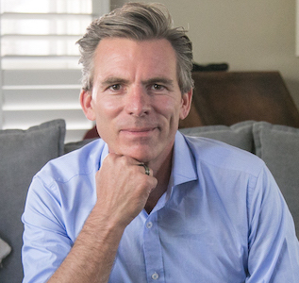

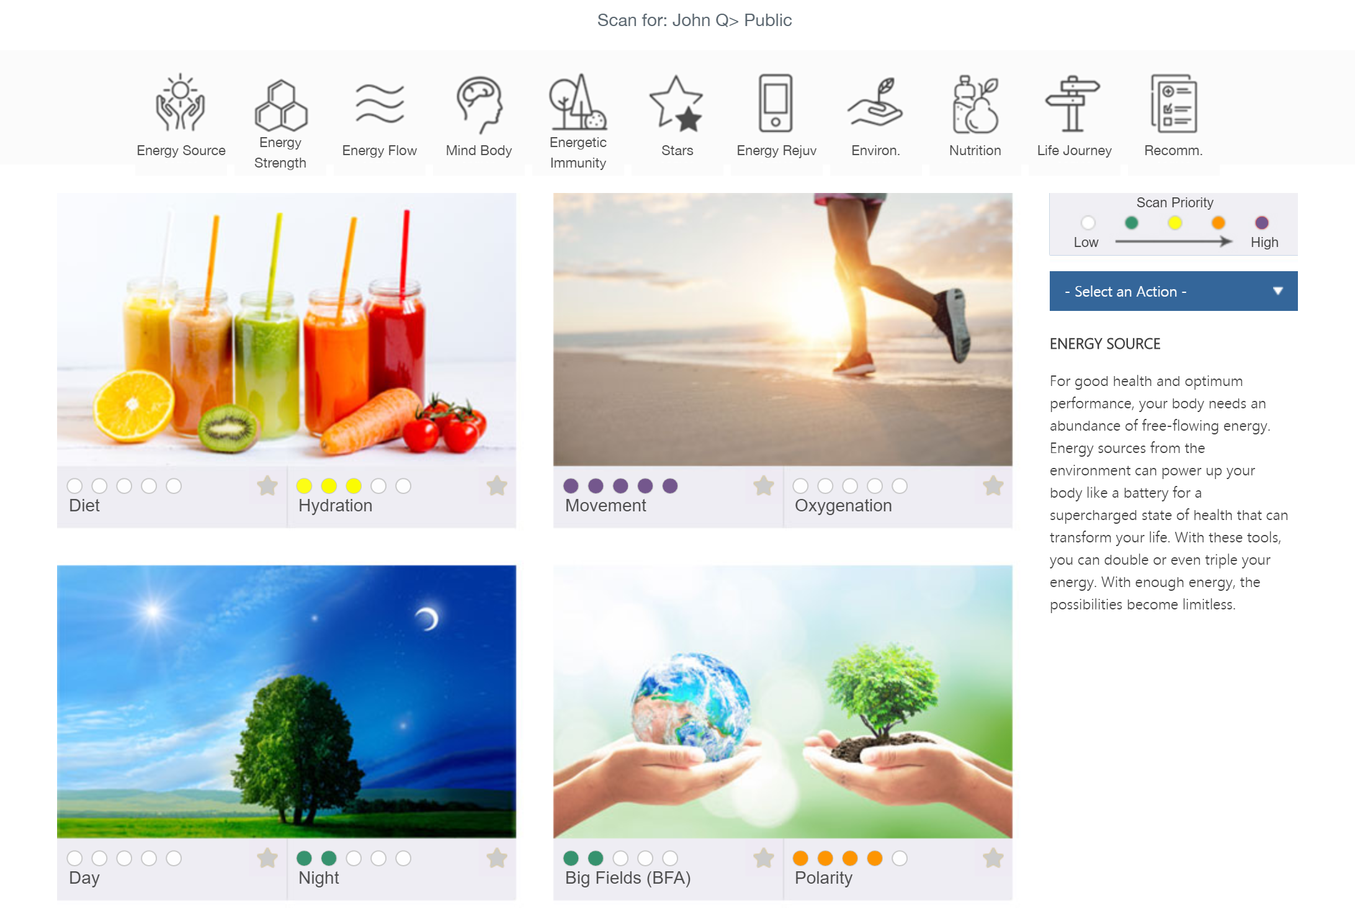
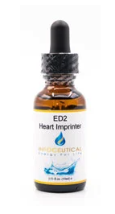

front
Back
Side
Testimonials
"NES Health truly offers insights into the body, both mind and physical well-being, that the medical community cannot comprehend often, nor understand. It is truly a remarkable system”
Dr Susan Bostian
Ken R Macleod FDN-P HPC PFC PBC
Ken is a multimodality alternative health provider with a focus in shedding light on what holds you back from being as healthy as you want.
He is a pioneer in the alterntive health care space, and has established the Energy Clinic to:
- help you understand why you feel the way you do
- be enlightened on what you can do to change your energy
- be empowered to do it yourself, or be guided by a practitioner
- to be online and accessible where ever you are in the world
- bring the cutting edge diagnostic technology into your home
- enjoy lifetime access to the software, for FREE
It took Ken almost 3 decades of trial and error, and false hope, for him to arrive at the same conclusion that leading experts in the field of bioenergetics had been saying since the beginning: energy drives biochemistry, not the other way round.
This is foundational to how NES Health has become the leading provider of bioenergetic scanning technology, and how it is helping to restore the energy and supporting health and performance seekers around the world.
“in essence, NES gives you night goggles on what is going on for you, moreover what you can do about it. This is truly the future of medicine” Ken R Macleod .
Image of woman elated woman
“provides the signal for the body to heal itself. What’s hard to understand is it really doesn’t do anything except provide the signal. The body does everything else”
Dr. David Matthews. MD
“Thanks to NES, my energy has skyrocketed and I am accomplishing more than I have in years”
Linda Sellers
Restore your Energy
Detect – using a body-field scanner, detect the quality of your energy (see overleaf)
Direct – the software ponts your attention to what you can do, to get the fastest possible results
Correct – use our infoceuticals and or follow advice in software, and or get a besopke plan of action
for exceptional health and performance
Our Process
Copy
Self-direct, get practitioner support or embark on an immersive life-transforming experience to fully restore your energy, using state of the art bioenergetic technology and solutions.
Register Your FREE Account theenergy.clinic/NES
How to Get Started
Register an Account @ theenergy.clinic/NES
Get Your Scanner from your account Shop
Download App Energy4Life (app store)
"Pair" Your Scanner (with your phone)
Scan Your Body (follow instructions)
View Results Online or On Phone
Self Direct: Follow steps
Or Get Help: Contact us
e info@theenergy.clinic
m 612 9116 2889
a Level 13, 109 Pitt Street, Sydney, Australia
Contact Us

Slide 3

