Slide 1
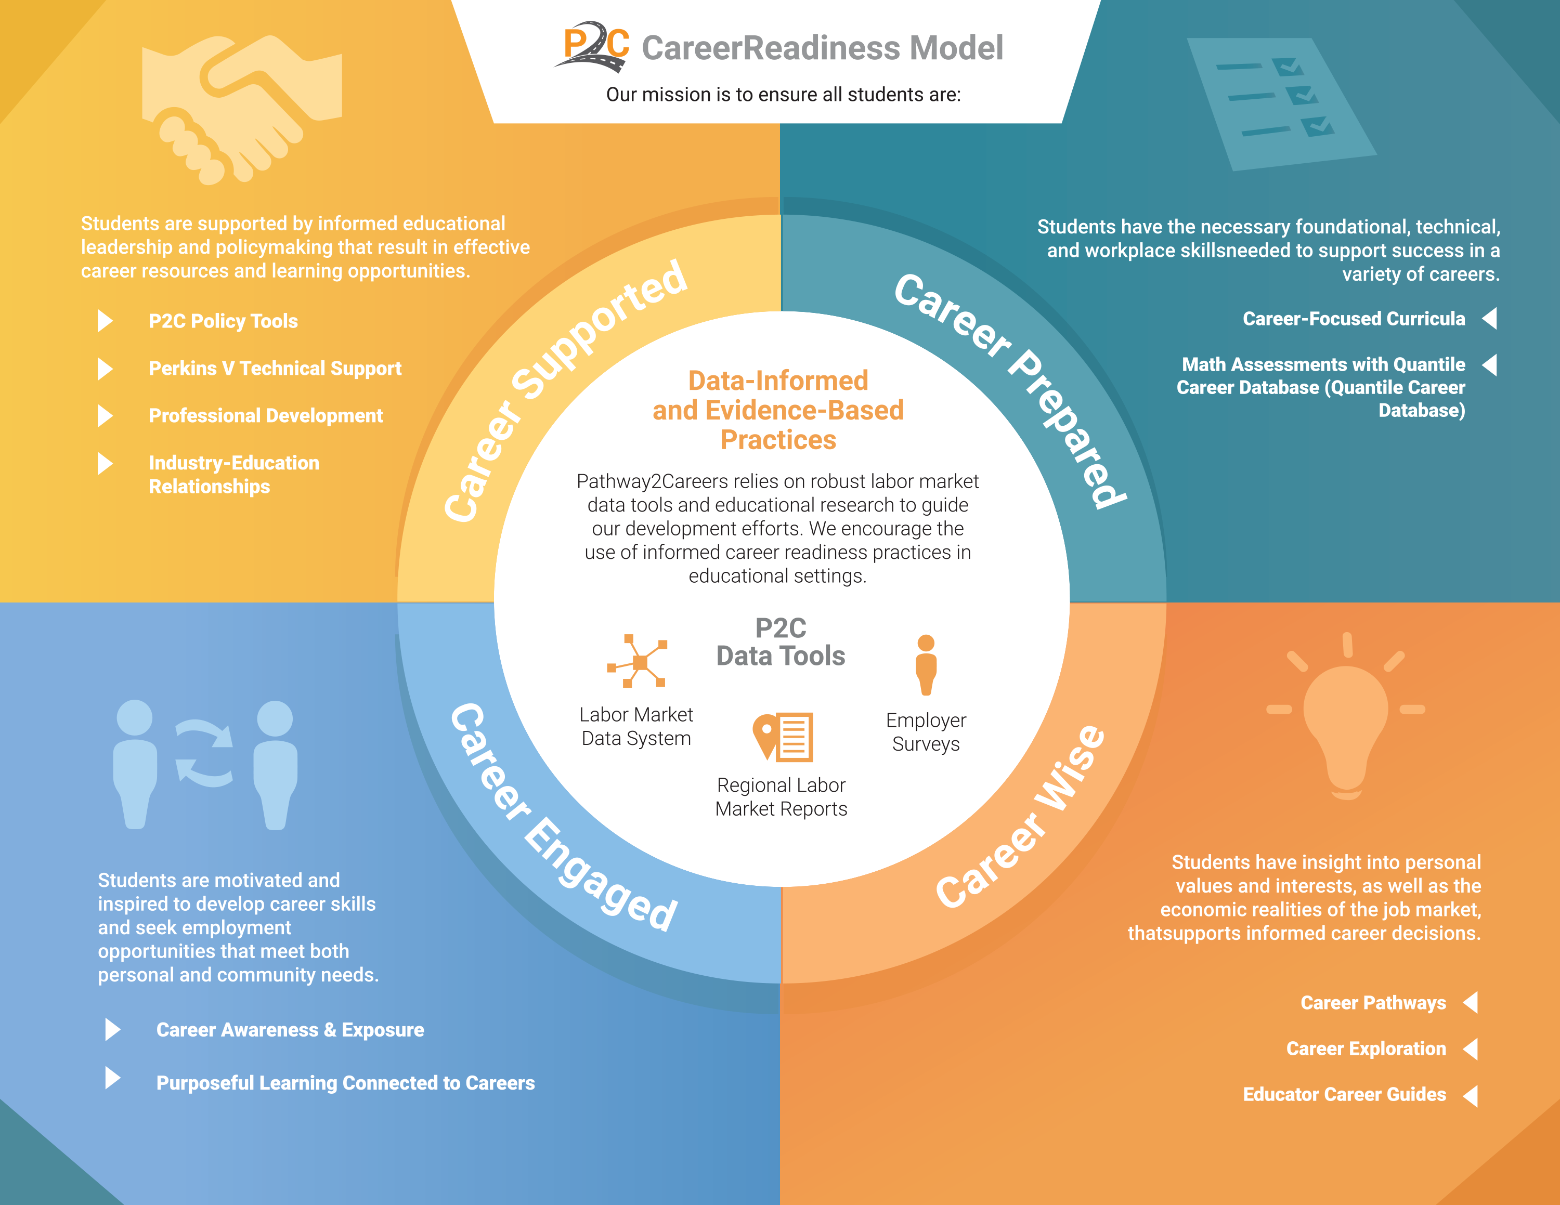

Slide 2
Career Supported

Slide 3

The Future of Work in
Our Communities

Slide 4
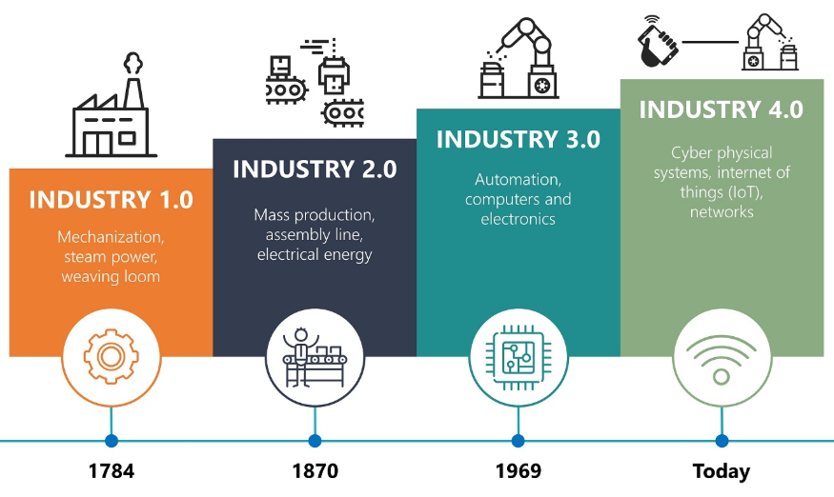
A Shifting Workforce Landscape
Fourth Industrial Revolution
  Rapid advances in automation
  Emergence of artificial intelligence
  Fusion with technology
Faster than Previous Revolutions
  Change in the past was slow.
  Change today is instant and pervasive.
  People and businesses are struggling to meet the demands of technology.

Slide 5



A Shifting Workforce Landscape
Additional Factors Affecting Jobs
  Social Factors – aging population
  Economic Factors – globalization
  Environmental Factors – green energy demands
Future Jobs Will Require Education and Skills
  Use of technology will be incorporated into most jobs.
  The unskilled jobs that paid earlier generations are decreasing.
    Automation – replacing low-skill jobs
    Globalization – relocating low-skill jobs
  Remaining low-skill jobs will be low-wage.
  Well-paying jobs will require skills.
Specific Skills Will be Valued
  Human Skills – critical thinking, problem-solving, teamwork
  Technology Skills – adaptability, digital literacy
  STEM Skills – mathematics, computing, data analysis

Slide 6

“
In today’s world, twenty-first-century skill demands are steadily increasing.
Most high-paying jobs require additional education and training beyond
a high school diploma. We must make sure that our children, particularly those who are traditionally underserved, are prepared for and have access to postsecondary education.
–Gov. Bob Wise, Alliance for Excellent Education
NS4edTM Pathway2CareersTM 2018 Trademark NS4ed, LLC

Slide 7
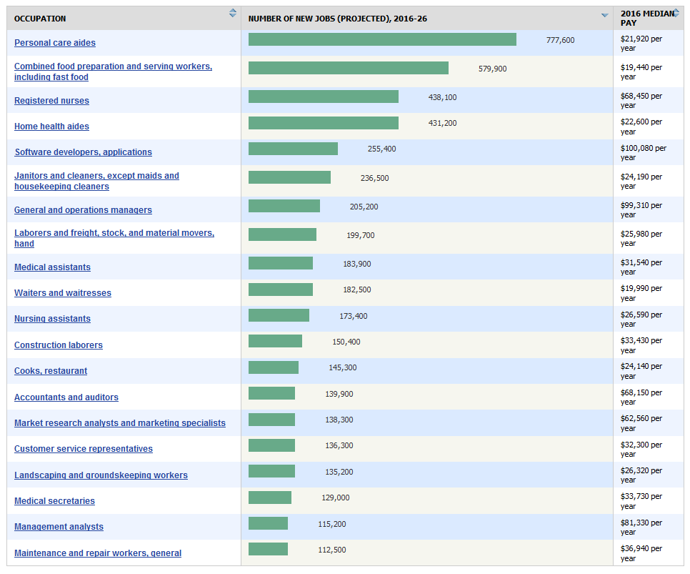

High-Demand Jobs
Occupations with the Highest Projected Numeric Change in Employment
High-demand jobs will require advanced skills, with most requiring some postsecondary education.
1970’s
Today
1 in 3 workers needed some postsecondary education
6 in 10 workers need some postsecondary education

Slide 8
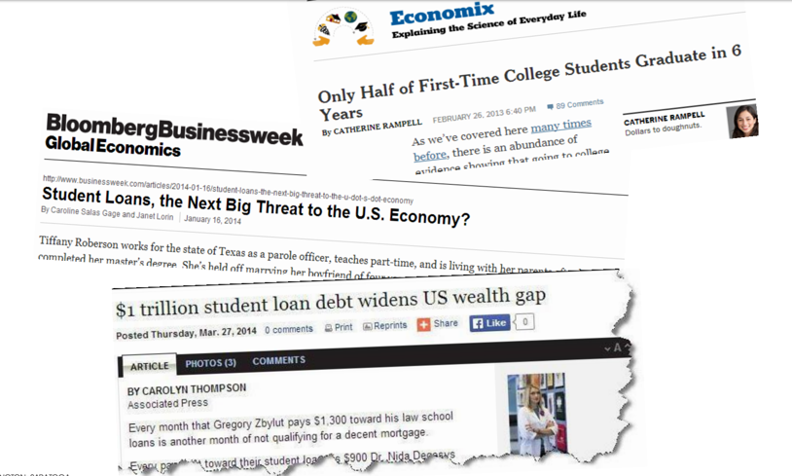
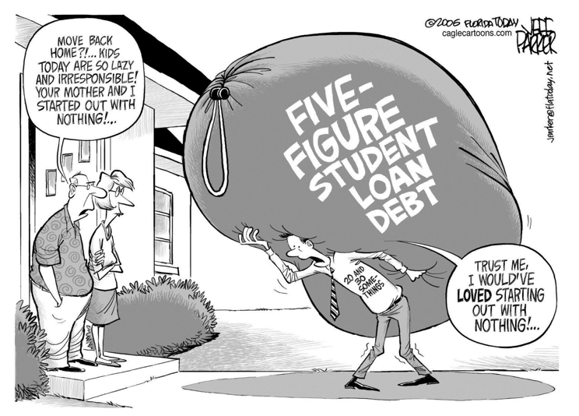
Long Term Impact of not Getting it Right
NS4edTM Pathway2CareersTM 2018 Trademark NS4ed, LLC

Slide 9


Not connecting students to their interest and career paths matter

Slide 10
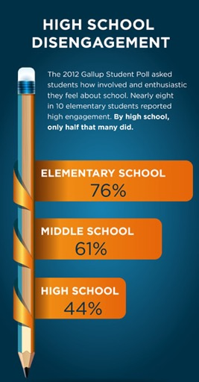

Students Not Feeling Engaged
?
How can relevance be increased while supporting the pathway to postsecondary success for all students, particularly
those traditionally underserved?
Source: http://www.ed.gov/highschool (accessed August 24, 2016)
NS4edTM Pathway2CareersTM 2018 Trademark NS4ed, LLC

Slide 11




Less than 10 percent of children born
in the bottom quartile of household incomes attain a bachelor’s degree by age 25, compared to more than 50 percent in the top quartile.
NS4edTM Pathway2CareersTM 2018 Trademark NS4ed, LLC
11

Slide 12



Disconnect between Education to the Realities of Employment
40%
80%
43%
Education
Employment
Economic Development
NS4edTM Pathway2CareersTM 2018 Trademark NS4ed, LLC
12
Notes:
45 % Educaiton
40% under employment
80% Skill Gap

Slide 13

The Problem
Employment
Economic Development
Education
Traditionally, these areas have operated independently with limited connection.
To facilitate growth and development among individuals and communities, change is needed both within and between these areas.

Slide 14
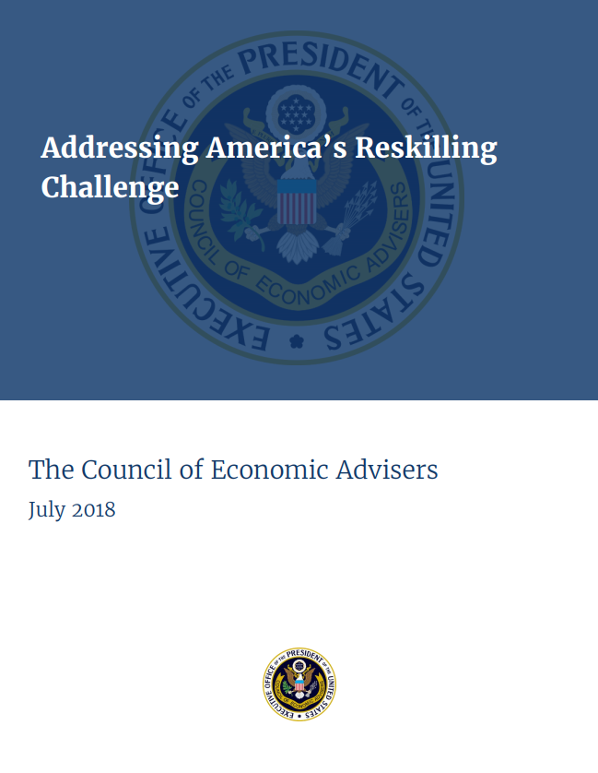
The Problem
The lack of connection between industry, education, and the workforce is resulting in significant gaps.
Information Gap = Individuals lack knowledge of their local labor market and the skills needed to promote employment success.
“There is an information gap between employers, workers, and educational institutions. While employers presumably know which skills they value in an employee, workers themselves and educational institutions have less up-to-date knowledge, and their response lags behind the changing demand.”

Slide 15
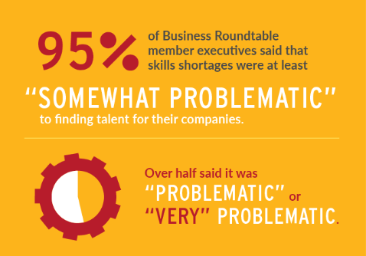
The Problem
Skills Gap = Individuals are leaving educational institutions and entering the workforce with skills that do not align with today’s jobs.
The Bureau of Labor Statistics estimates there are approximately 6.6 million job vacancies in the United States.
Employer surveys suggest that about half of employers are experiencing significant issues in locating qualified applicants.
  National Federation of Independent Businesses (NFIB) – Small Business Economic Trends 2018
  ManpowerGroup – Talent Shortage Survey 2018
  Business Roundtable – Education and Workforce Survey 2016
  Bloomberg Next and Workday – Building Tomorrow’s Talent 2018
Source: 2016 Business Roundtable Education and Workforce Survey

Slide 16

The Solution
How can we begin to fill the gaps?
Recommendations for Change
  Individuals need access to clear and accurate information about local job opportunities.
  Schools need to reevaluate learning goals and upscale efforts to teach valued skills.
  Information about good jobs and valued skills needs to be used to develop meaningful learning experiences that prepare individuals for employment success.
Connect with Employers – surveys, meetings, roundtable discussions, online portals
Promote Awareness – school activities, job fairs, printed materials, online tools
Teach and Train – career-oriented curriculum, training programs, apprenticeships, volunteer opportunities

Slide 17



Slide 18
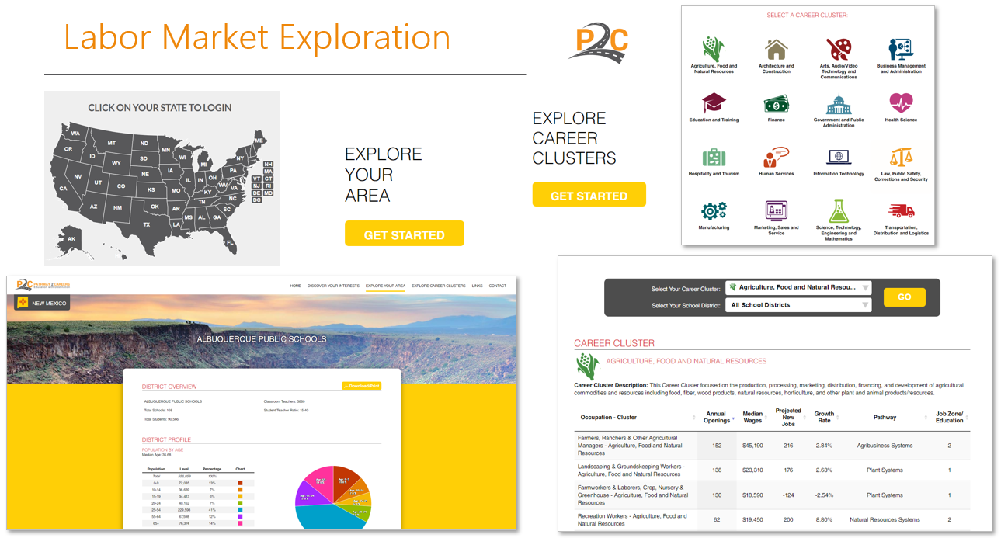
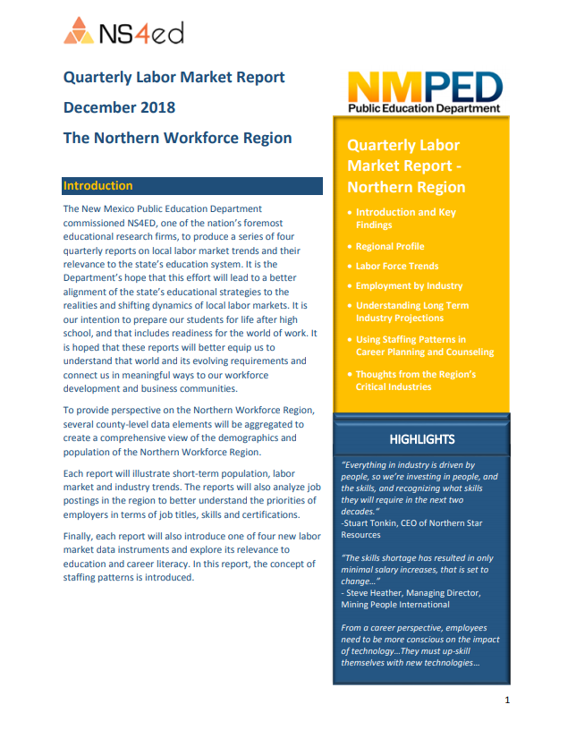
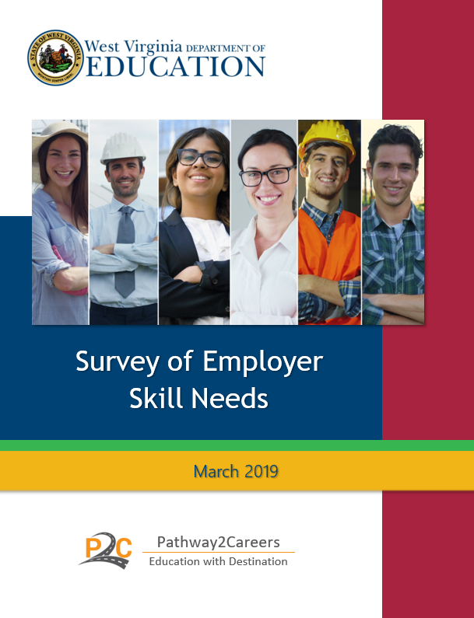
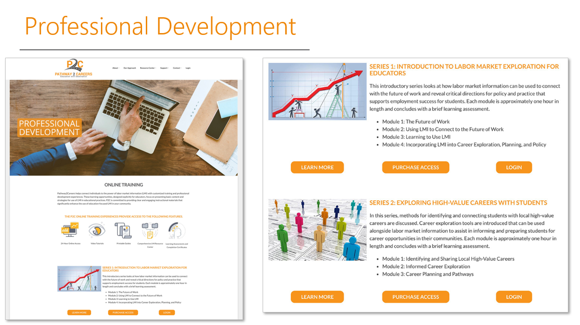
Students will have the necessary information to support informed career decisions.
Target Outputs: tools and services that support critical awareness of labor market demands, career requirements, and education pathways
Currently Available
Labor Market Exploration System
  State and Local Data
Online Professional Development
  Designed for Educators
Employer Survey Tool
State and Regional Labor Market Reports
Student Career Exploration System

Slide 19
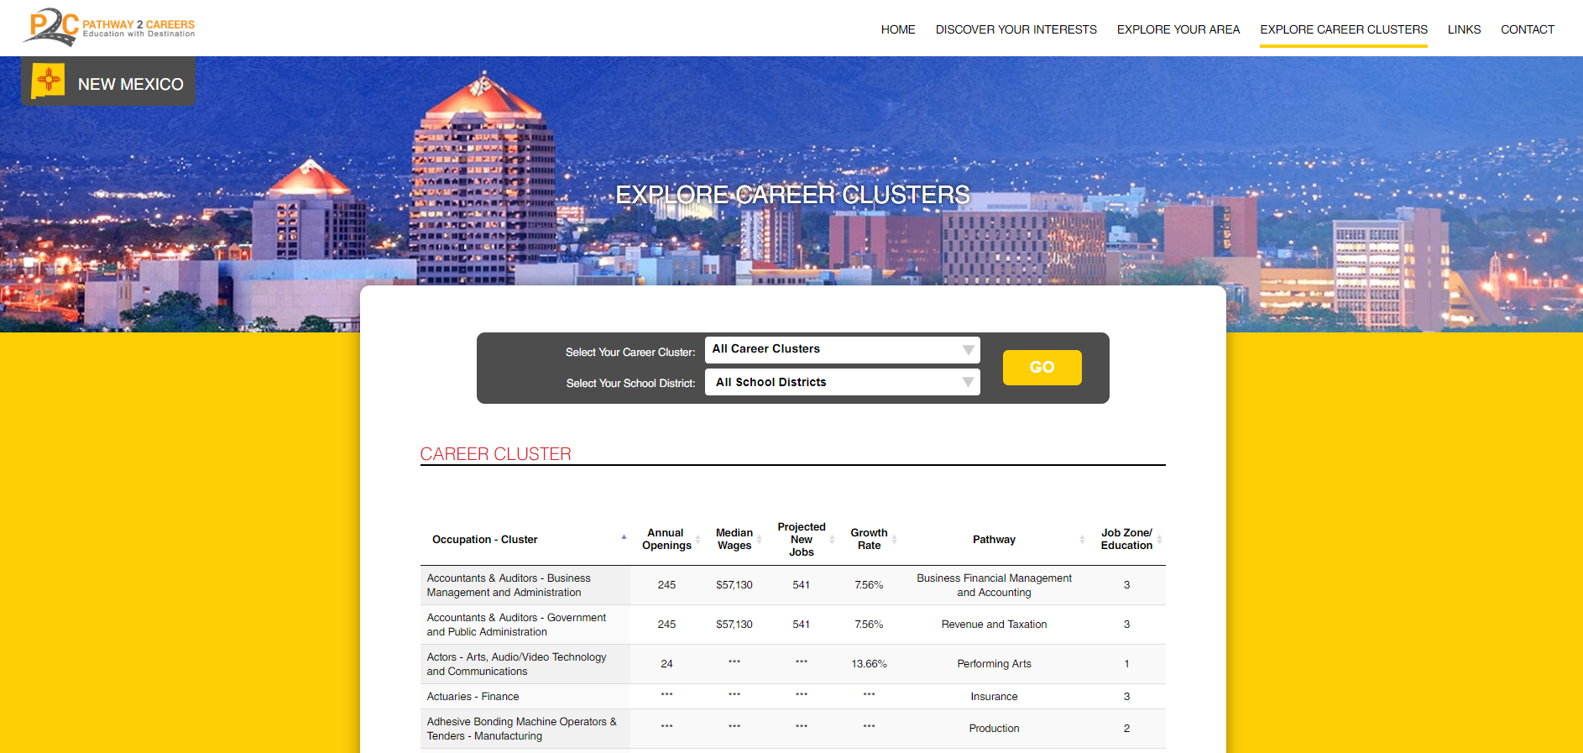

Discovering
High-Value Careers with LMI

Slide 20
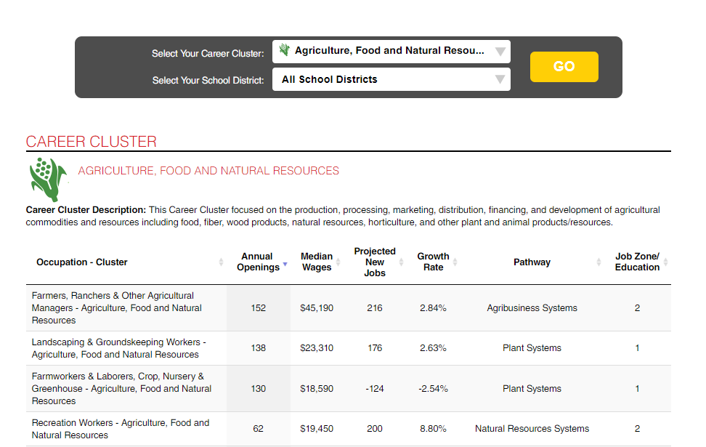
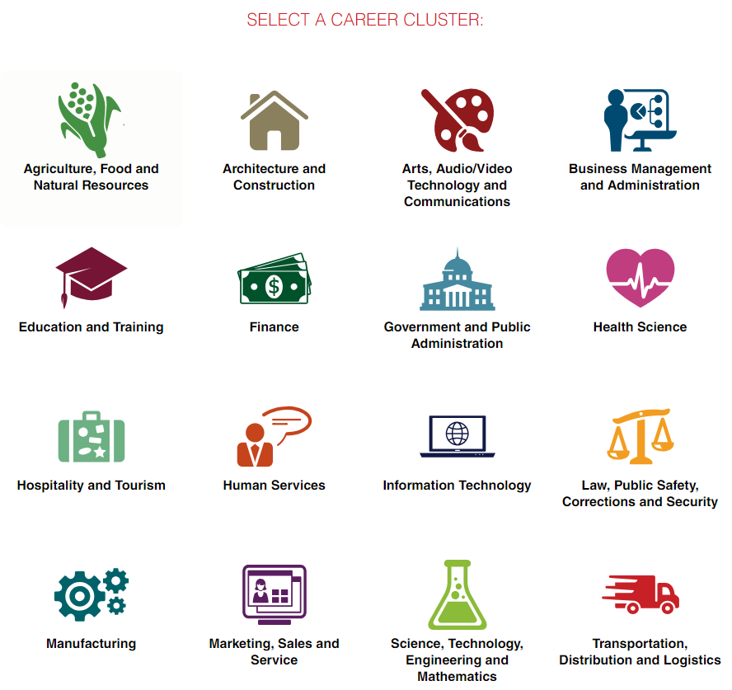
Labor Market Information
Labor market information (LMI) is a valuable resource that can be easily accessed to explore local job markets and identify high-value careers.

Slide 21




Labor Market Information
Simple statistics can reveal jobs with the
most openings, greatest growth, and highest wages.
Median Wages
Growth Rates
Annual Openings
Projected New Jobs

Slide 22

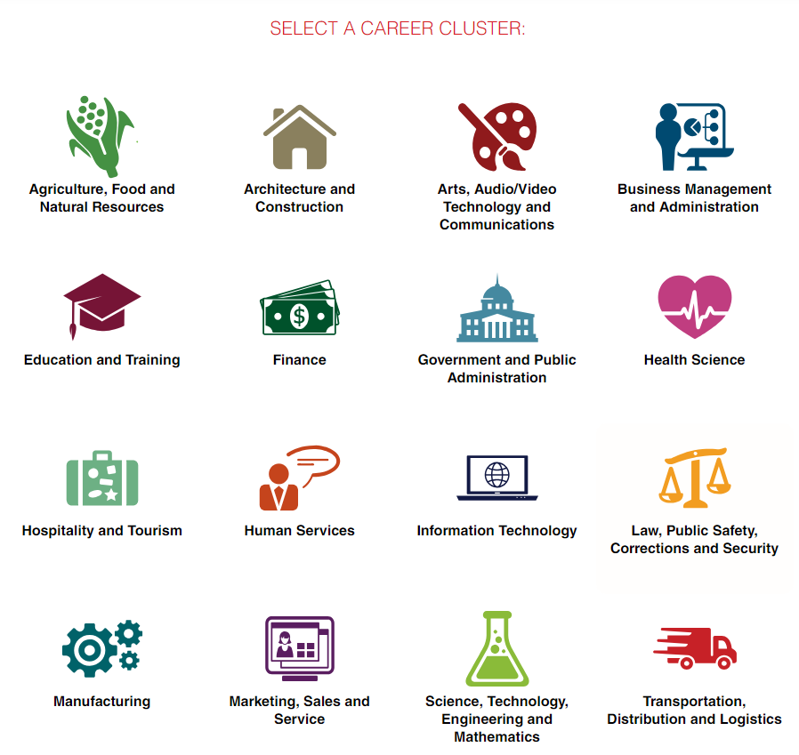

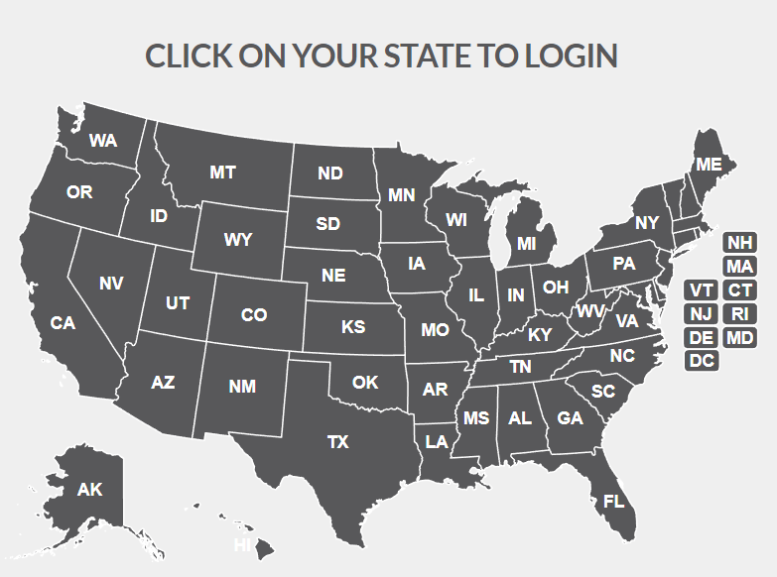


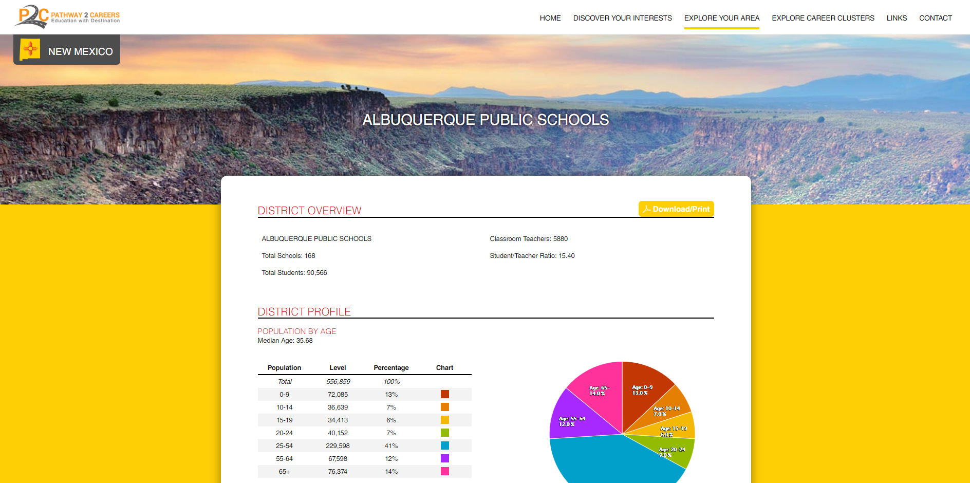
Labor Market Exploration

Slide 23



Professional Development
Module 1
The Future of Work
Factors Affecting Today’s Jobs
Module 2
Using LMI to Connect with the Future of Work
What is Labor Market Information (LMI)?
Module 3
Introduction to LMI
Basic Terms and Definitions
Using P2C to Identify High-Value Careers
Module 4
Incorporating LMI into Educational Processes
Career Exploration
The Need for a Skilled Workforce
Shifting Skill Demands
Problems and Solutions
LMI and Local High-Value Careers
The Power of Awareness to Inform and Prepare
Pathway2Careers Overview
Career Planning
Policy and Practice
Labor Market Exploration
for Educators
  Four Modules (1 hour each)
    Online Access
    Video Tutorials
    Printable Guides
    Resource Center
  Assessments
    Each module concludes with a multiple-choice assessment.

Slide 24

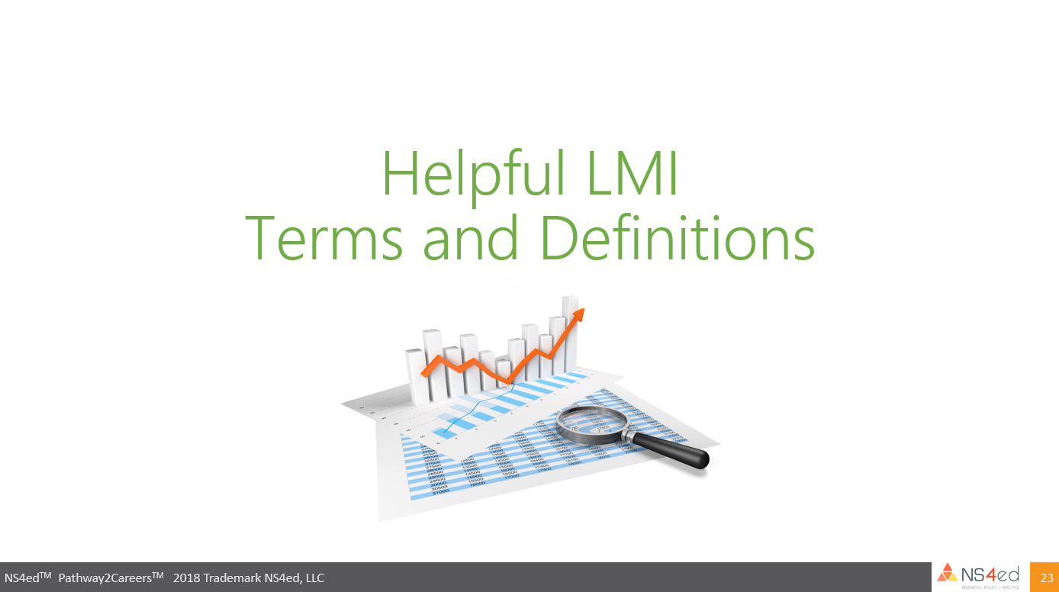

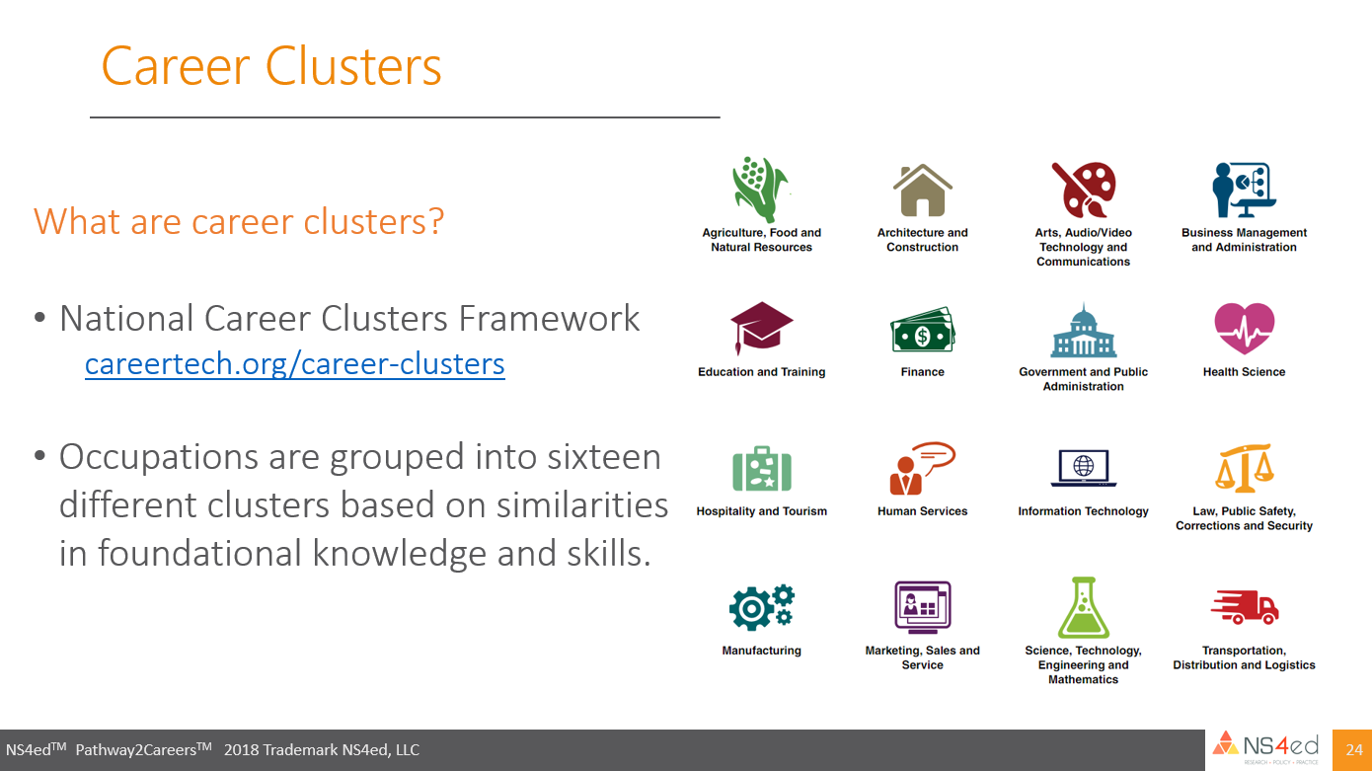
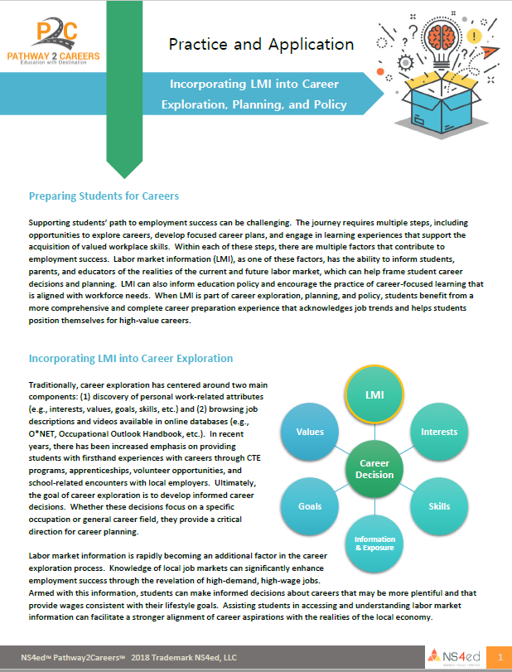
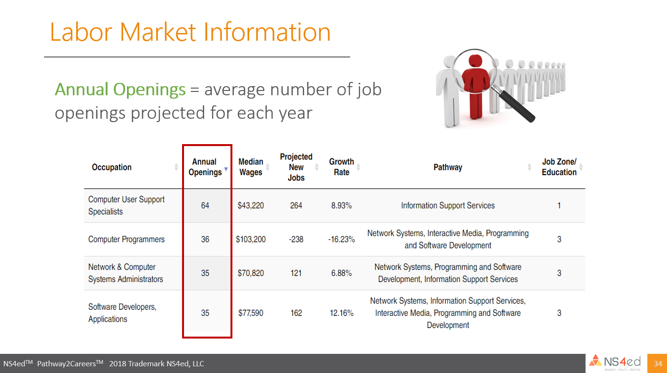
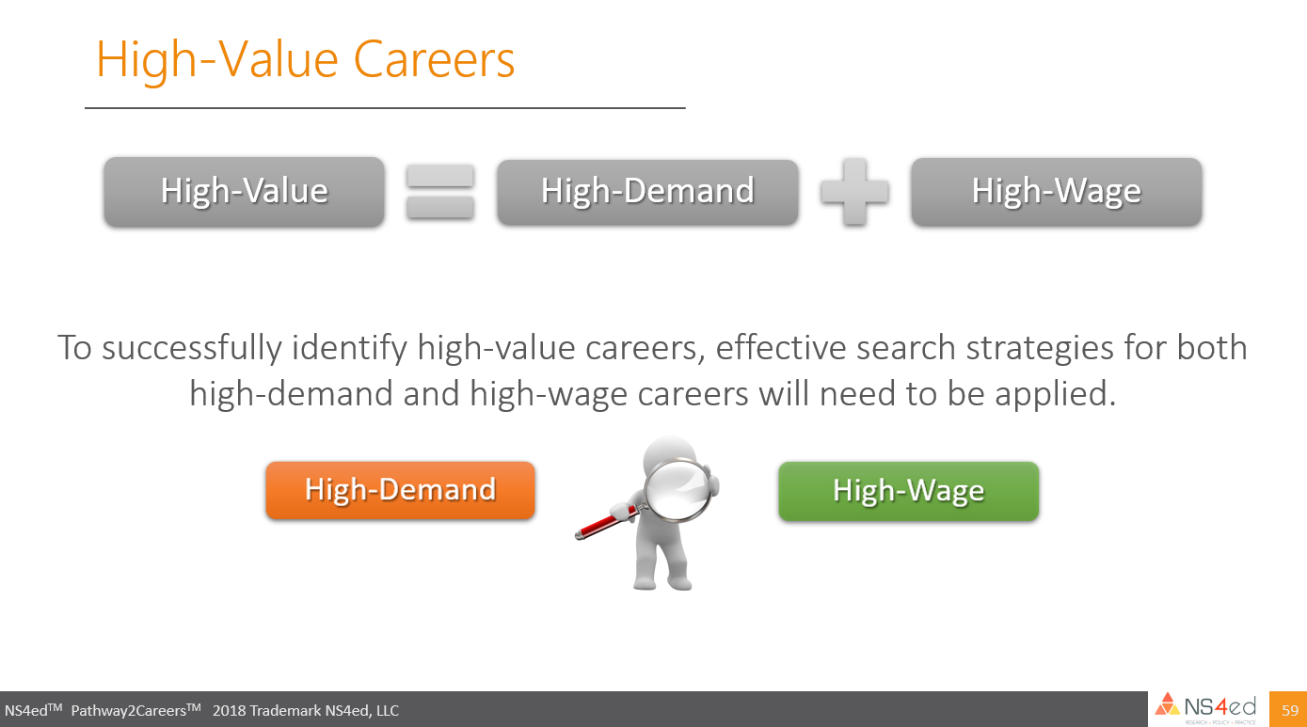
Professional Development
Online Video
Tutorials
Printable Guides

Slide 25
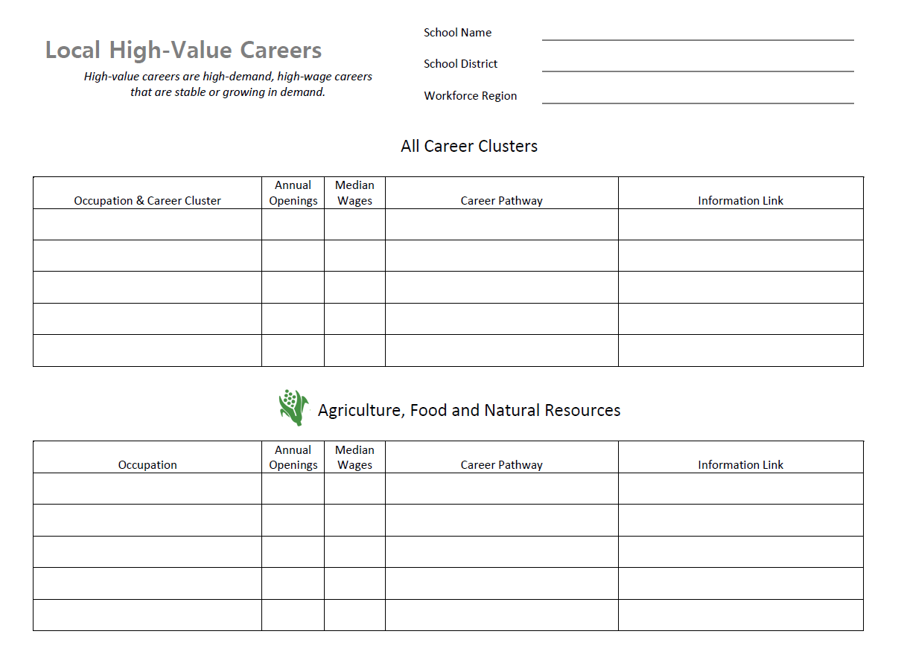
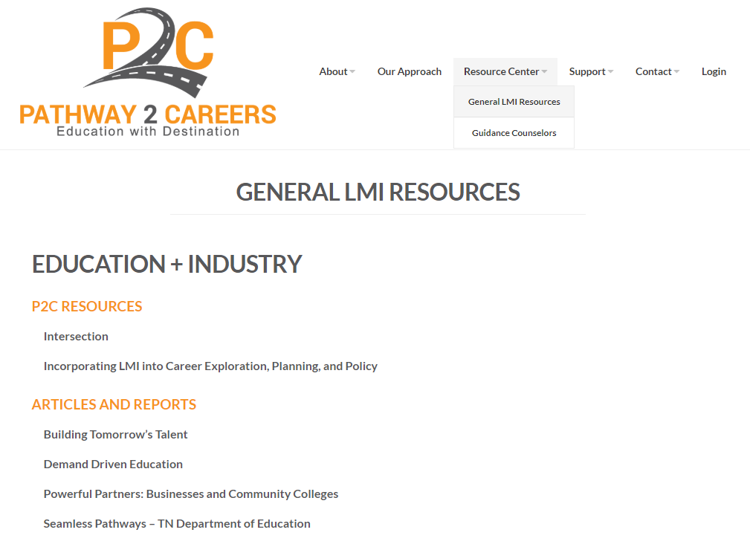

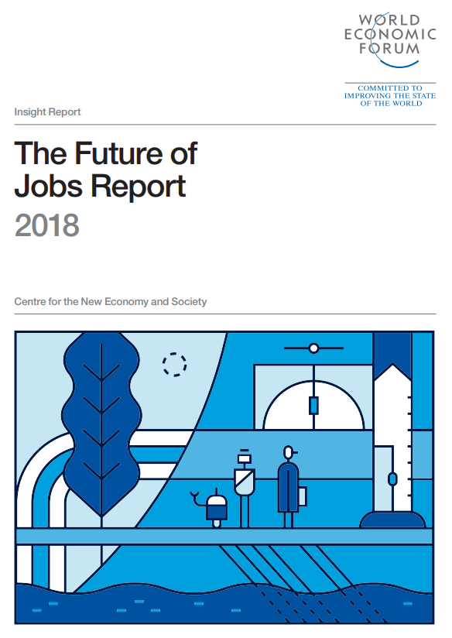

Professional Development
Online Resource Center
Templates
Websites
Reports

Slide 26

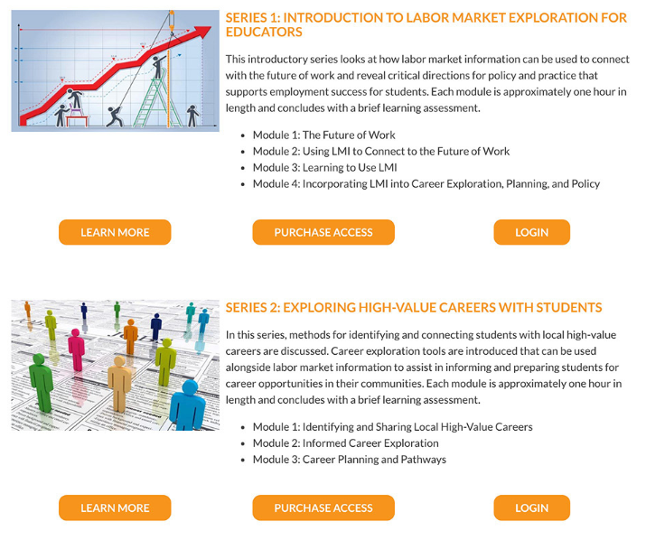
Professional Development

Slide 27
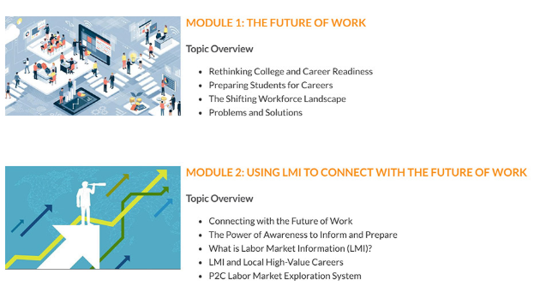
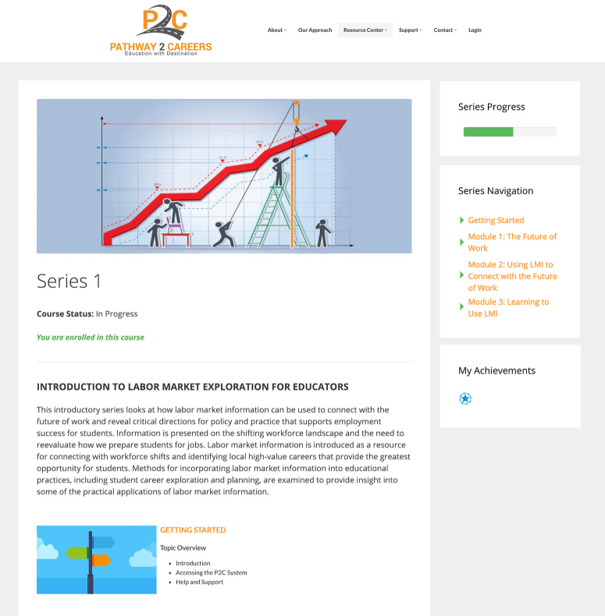
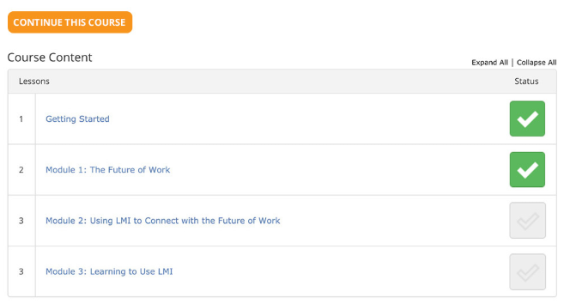
Professional Development

Slide 28
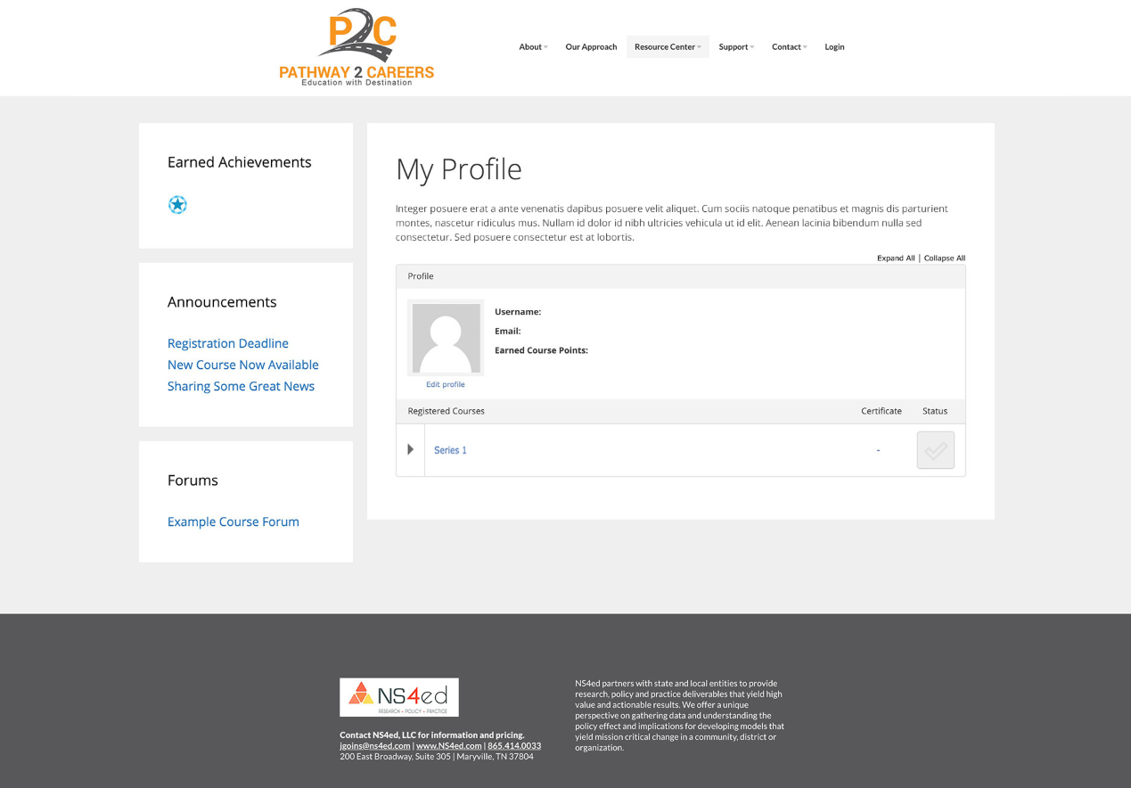
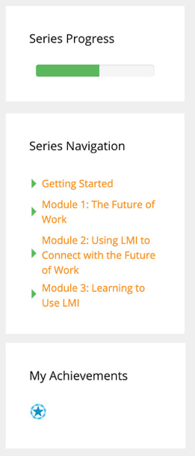
Professional Development

Slide 29

Perkins V Overview
Local Needs Assessment

Slide 30


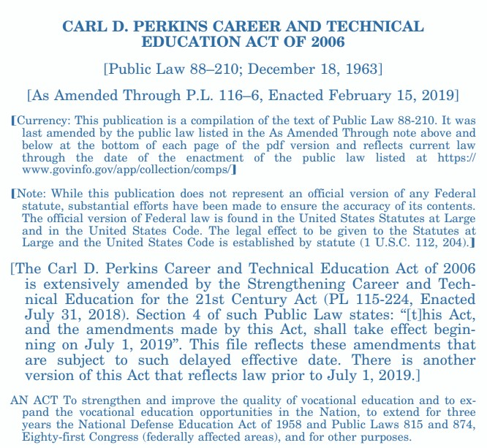



Perkins V Overview

Slide 31



Perkins V Overview
Strengthening Career and Technical Education for the 21st Century Act
New law no longer contains the name “Perkins”
Referred to as Perkins V by many for ease of
identification
Signed into law on July 31, 2018
Reauthorization of the Carl D. Perkins Career
and Technical Education Act (2006)

Slide 32


Perkins V Overview
Purpose
“To develop more fully the academic knowledge and technical and employability skills of secondary education students and postsecondary education students who elect to enroll in career and technical education programs and programs of study by…”
  Building on the efforts of states and localities
  Linking secondary and postsecondary education programs
  Increasing state and local flexibility
  Conducting and disseminating national research
  Promoting professional development
  Supporting partnerships
  Providing lifetime learning opportunities
  Increasing employment opportunities for chronically
unemployed or underemployed populations

Slide 33

Perkins V Overview
Notable Changes
Emphasis on Data-Informed Decision-Making
  Local Needs Assessment – included in the local application and used to inform local funding decisions
Reduction of the Role of the U.S. Secretary of Education
Increase in Stakeholder Involvement
  Public Comment and Review Process – state performance targets must be developed in consultation with stakeholders with an opportunity for the public to submit comments
  Local Stakeholder Involvement – stakeholders should be continuously consulted on topics related to the needs assessment, workforce needs, work-based learning, and coordination of funding

Slide 34
Perkins V Overview
Notable Changes (continued)
Revision of Accountability Indicators
  Consolidation of Non-Traditional Measures – two reduced to one
  Technical Skill Attainment Measure – replaced with “Program Quality
Enhanced Efforts to Serve Special Populations
Encouragement of Innovation
  New Priorities for Reserve Funds – need to be targeted toward fostering innovation or supporting programs aligned with high-skill, high-wage, or in-demand occupations
Inclusion of “Middle Grades”
  Restriction on Lower Grades Lifted – spending can now occur to
support CTE in grades 5-8
”

Slide 35



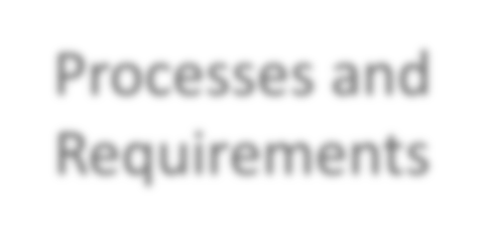
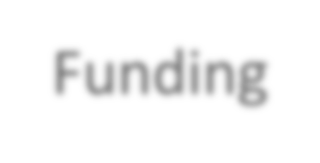


Perkins V Overview
Two Main Areas of Emphasis
Processes and
Requirements
Funding
Federal
State
Local

Slide 36







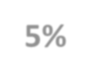









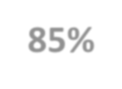
Perkins V Overview
State Allocations
States receive a “Foundational Grant” that is equal to
the amount received in 2018
Within-State Allocation
State Leadership 5%
State
Remaining funds are allotted to states by a formula
based on population aged 15-65 and per-capita income
Administration 10%
State Reserve
(up to 15%)
Within each state, funds are divided to meet state and
local needs
States can reserve up to 15% of local funds for
alternative distribution to local programs in…
  Rural areas
Local Funds 85%
Areas with high percentages/numbers of CTE students
Areas with performance gaps between groups

Slide 37
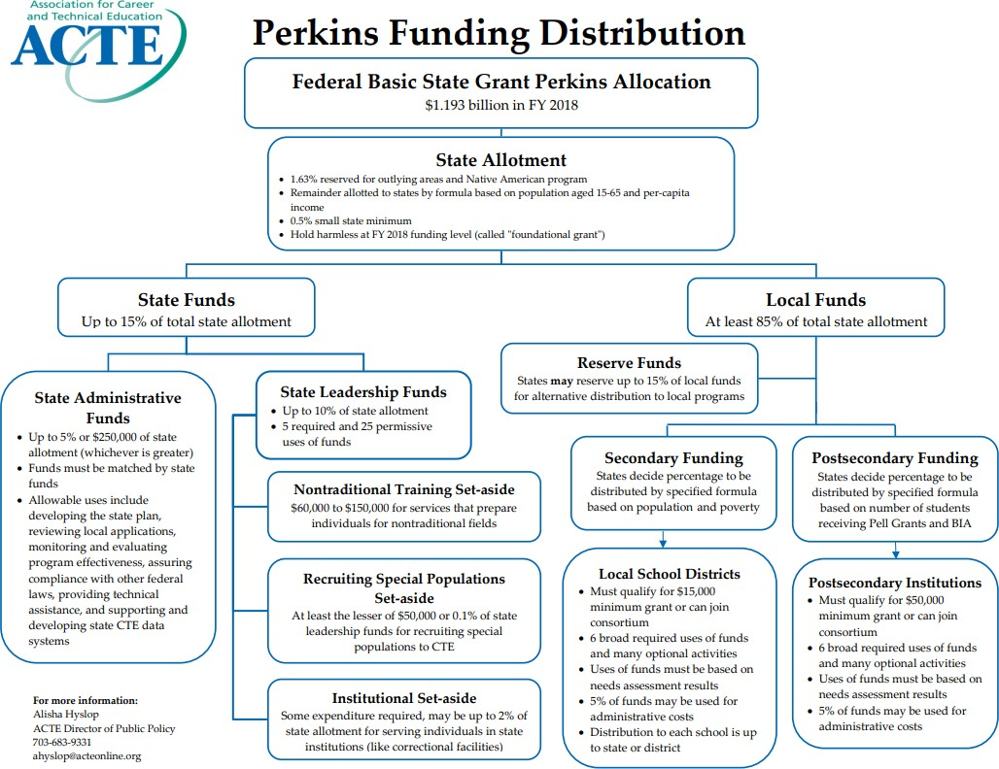

Slide 38
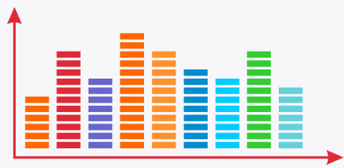
Perkins V Overview
Processes and Requirements
at the Local Level
A fair amount of attention and discussion has been focused on the Local Application (Section 134)
This is primarily due to the addition of the
Local Needs Assessment
States will often have specific procedures
for completion of the local application.
Parts of the Local Application
1 | Results of comprehensive needs assessment
2 | Information on CTE course offerings
3 | Description of how specific CTE activities will be provided in collaboration with local workforce agencies
4 | Description of the strengthening of academic and technical skills and provision of well-rounded education
5 | Description of activities related to special populations
6 | Description of work-based learning programs
7 | Description of opportunities to attain postsecondary credit
8 | Description of professional development activities
9 | Description of how performance gaps will be addressed

Slide 39
Perkins V Overview
Local Needs Assessment
Often viewed as the single biggest
change between Perkins IV and V
It is meant to serve as the foundation of
the local application
Used to determine future spending on career and technical education
Primary goal is to promote better alignment of CTE programs with state, regional, and local economic needs
Parts of the Local Needs Assessment
1 | Evaluation of student performance
2 | Description of how CTE programs are sufficient in size, scope, and quality
3 | Description of how CTE programs are aligned to in-demand industry sectors or occupations identified by state/local agencies
4 | Description of progress toward implementation of CTE programs
5 | Information on how local recipient will improve retention and training of CTE professionals
6 | Description of progress toward implementation of equal access to CTE programs for all students

Slide 40


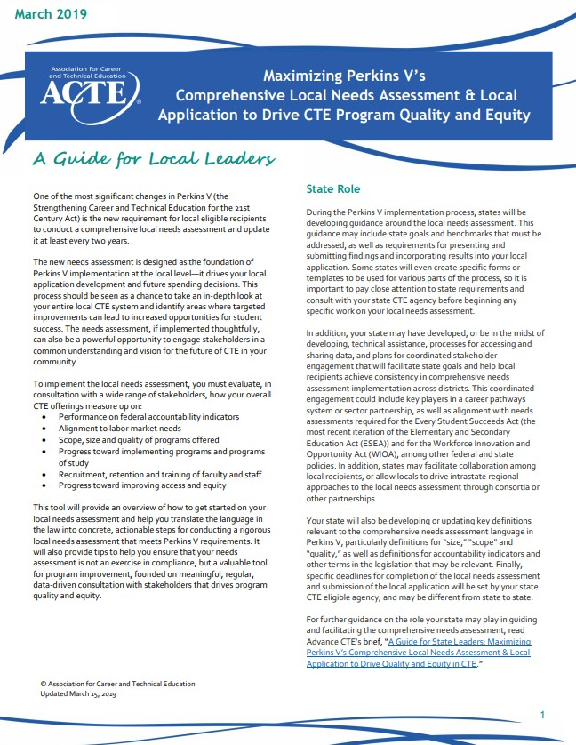
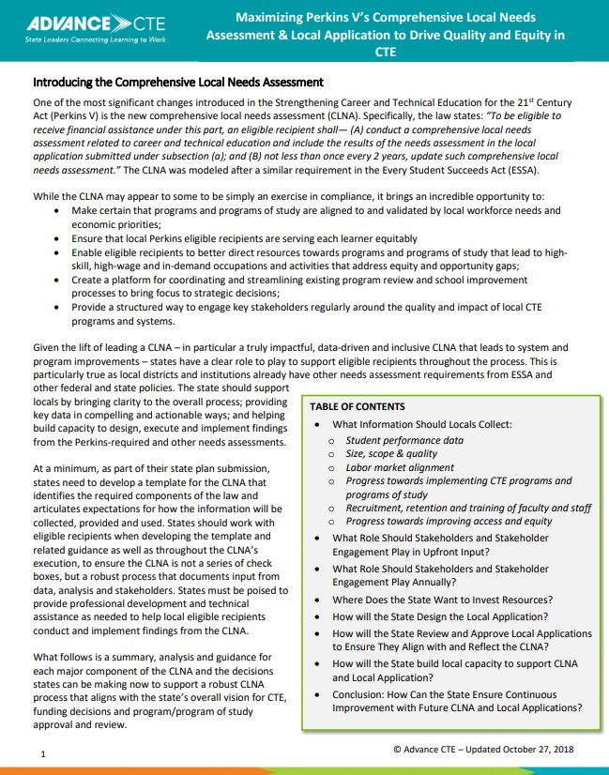
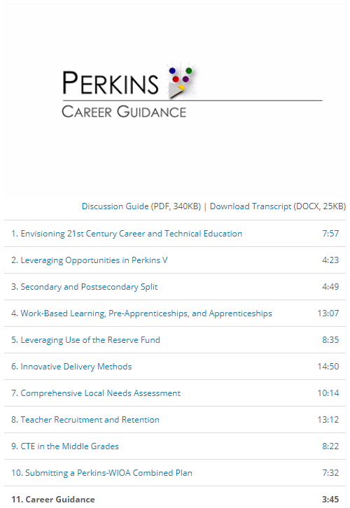

Perkins V Overview
Helpful Resources for Understanding the Local Needs Assessment

Slide 41
Perkins V Overview
How can P2C help?
One of the more challenging tasks can be evaluating alignment between CTE programs and local labor market demand
This requires knowledge of local
labor market trends
P2C offers education-based labor market data tools that are simple and easy to access
Parts of the Local Needs Assessment
1 | Evaluation of student performance
2 | Description of how CTE programs are sufficient in size, scope, and quality
3 | Description of how CTE programs are aligned to in-demand industry sectors or occupations identified by state/local agencies
4 | Description of progress toward implementation of CTE programs
5 | Information on how local recipient will improve retention and training of CTE professionals
6 | Description of progress toward implementation of equal access to CTE programs for all students

Slide 42
Career Prepared

Slide 43
Math and Real Jobs:
New Algebra and Geometry Curricula
that Put Math to Work

Slide 44

Connecting Learning to Careers
The Power of Purpose

Slide 45

Connecting Learning to Careers
As students advance through their academic journey, there is a tendency to focus on short-term outcomes (grades, test scores, diplomas, certificates, etc.).
The purpose of learning has become tied to academic achievement – “I learn to receive a diploma.”
For many students, academic achievement is not a significant motivator for learning.
As a result, students struggle to persist in learning critical skills that are necessary for employment success.

Slide 46

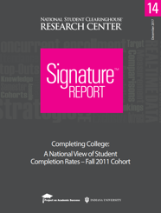


Connecting Learning to Careers
The Danger of Learning without Purpose
College Graduation Rates
  Almost half of students who attend college drop out.
  Many students attend college without a strong career goal.
  Lack of purpose and value in college education is often
  cited as a reason for dropout.

Slide 47
Connecting Learning to Careers
Purpose in Learning Can Promote Success
Career Technical Education (CTE) Graduation Rates
  CTE students are more likely to graduate from high school and postsecondary institutions.
  Education aligned with career goals is commonly reported as a motivating factor.

Slide 48
Connecting Learning to Careers
When students experience purpose in their learning…
Motivation to Learn
(Frymier & Shulman, 1995; Jang, 2008)
Interest and Engagement
(Assor, Kaplan, & Roth, 2002; Hulleman, Godes, Hendricks, & Harackiewicz, 2010; Hulleman & Harackiewicz, 2009)
Effort and Persistence
(Trautwein & Ludtke, 2007; Yeager et al., 2014)
Education
Career
Retention of New Information
(Perin, 2001; Yeager et al., 2014)
Performance
(Hulleman et al., 2010; Hulleman & Harackiewicz, 2009; Malka & Covington, 2005)
Task/Course Completion
(Fortenberry, Sullivan, Jordan, & Knight, 2007; Zusho, Pintrich, & Coppola, 2003)

Slide 49
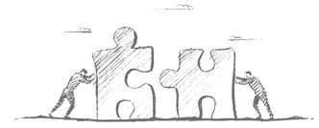
Connecting Learning to Careers
Bottom Line – Helping students understand the why behind the what can have powerful outcomes, including increased motivation, persistence, skill retention, task completion, and more.
How can we bring purpose into learning?
  We can assist students in connecting their learning to meaningful situations and experiences.
  Given that entry into a career is essential for many students, demonstrating how learning can be used in a future career can be valuable.
  Connecting learning to careers can help students see authentic application of their learning to situations they could encounter on the job.

Slide 50


Connecting Learning to Careers
Additional Benefits of Connecting Learning to Careers
Career Exposure – familiarity with various types of careers
Career Awareness – understanding of the skills needed for careers
Career Engagement – motivation to achieve specific career goals

Slide 51
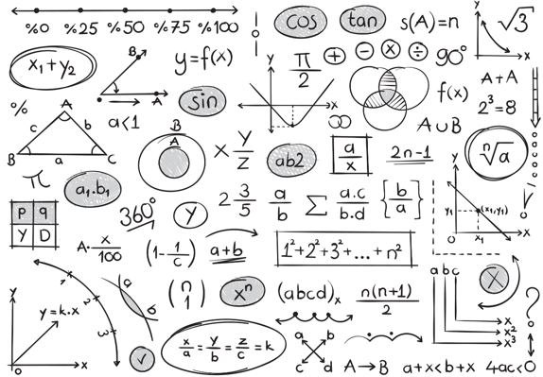
Traditional Approaches to Math Instruction
Abstract and Theoretical

Slide 52
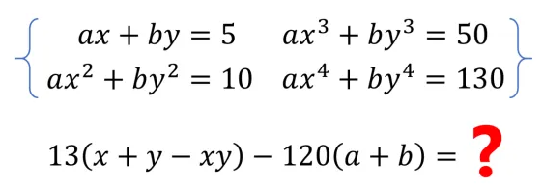
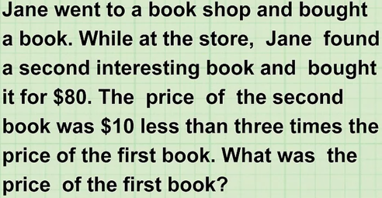
Traditional Approaches to Math Instruction
Math is often taught in the abstract with limited connection to concrete ideas or processes.
This makes it difficult for students to understand why and how math can be useful.
When application occurs, it typically involves overly simplistic examples that lack significance or importance to students.

Slide 53
Traditional Approaches to Math Instruction
Math attitudes decline as material gets more diverse and abstract.
A dislike for math is commonly reported among students.
Attitudes toward math generally decline when students enter middle school and the material gets more diverse and abstract (Hannula, 2002; Hiebert et al., 2003; Rice et al., 2012).
Negative attitudes toward math can translate into poor engagement and course failure (Akin & Kurkanoglu, 2011; Ma & Xu, 2004; Mayes, Chase, & Walker, 2008).
Students with positive attitudes toward math tend to demonstrate a higher level of achievement (Gottfried, 1985).
Negative attitudes are associated with poor engagement and course failure.
Students with positive attitudes demonstrate higher levels of achievement.

Slide 54
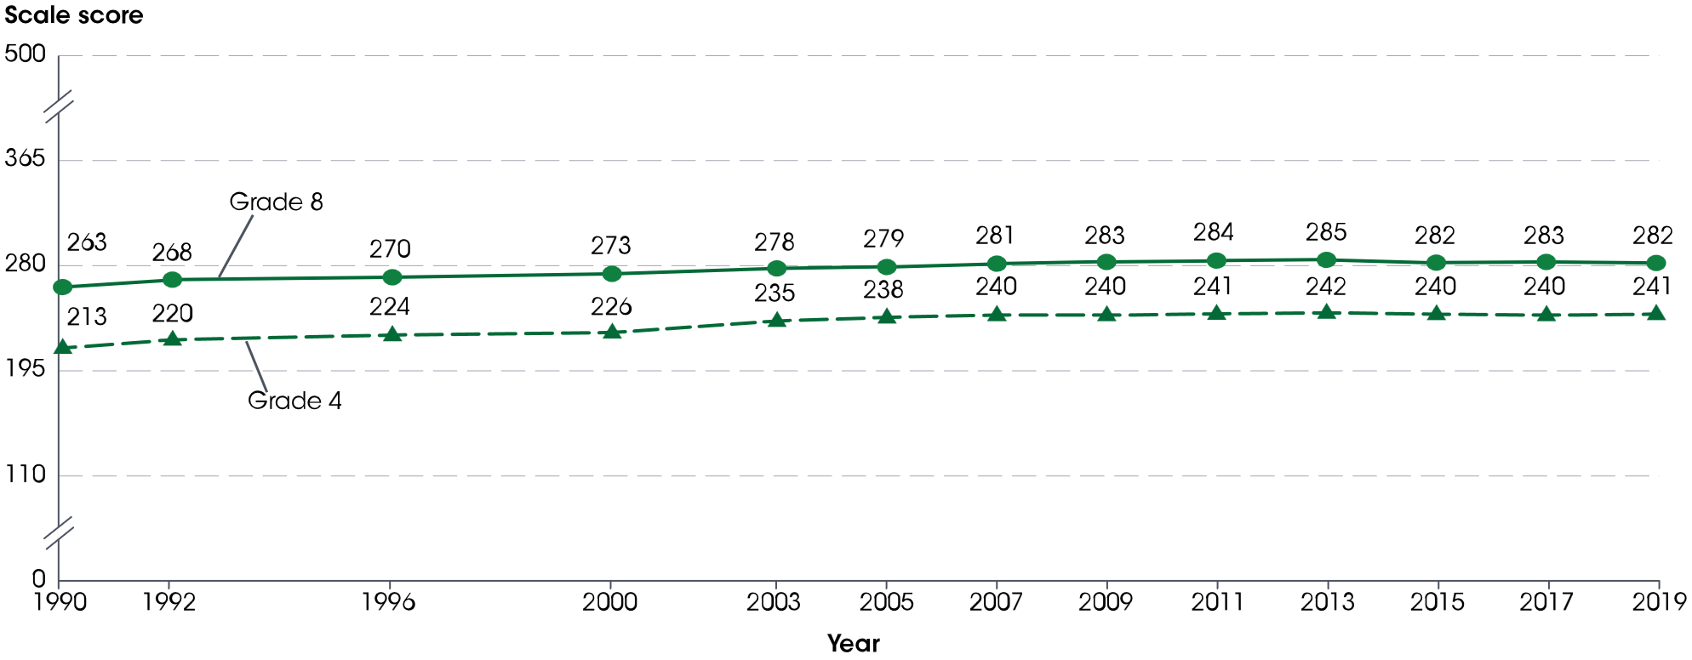
Traditional Approaches to Math Instruction
Average National Assessment of Educational Progress (NAEP) mathematics scale scores of 4th- and 8th-grade students: Selected years, 1990–2019
Note: A similar trend is observed for grade 12 results. Grade 12 mathematics scores are not shown because they are reported on a scale of 0 to 300.
Source: The Condition of Education 2020

Slide 55
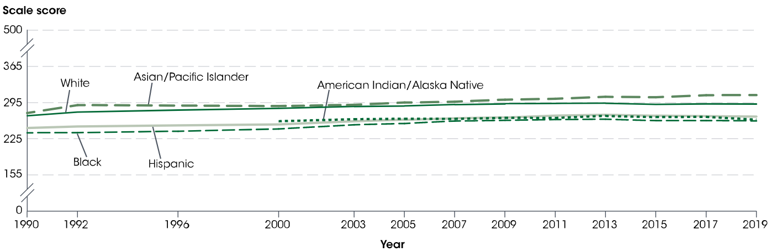
Traditional Approaches to Math Instruction
Average National Assessment of Educational Progress (NAEP) mathematics scale scores of 8th-grade students, by selected characteristics: Selected years, 1990–2019
Source: The Condition of Education 2020

Slide 56
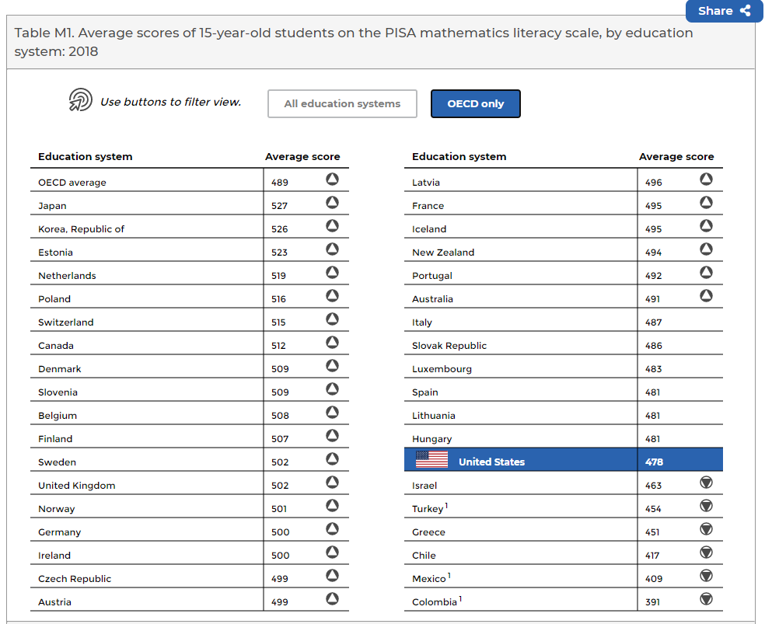
Traditional Approaches to Math Instruction
The United States is falling behind other countries in mathematics literacy.
PISA Mathematics Literacy Results
  The U.S. average score (478) was lower than the OECD average score (489).
  Compared to the 36 other OECD members, the U.S. average in mathematics literacy was lower than the average in 24 education systems.
  PISA – Program for International Student Assessment
  OECD – Organization for Economic Co-operation and Development
SOURCE: Organization for Economic Cooperation and Development (OECD), Program for International Student Assessment (PISA), 2018.

Slide 57

Traditional Approaches to Math Instruction
How can we improve students’ attitudes toward math and promote the successful acquisition of critical math skills?
  Make math less abstract and more concrete.
  Connect math to authentic, meaningful situations.
  Demonstrate how math is useful and necessary.
  Provide purpose in math learning.

Slide 58

Traditional Approaches to Math Instruction
Connecting math to careers can be a powerful approach to incorporating purpose into math learning.
When math is taught in the context of a viable career, students can see…
  how math is applied in meaningful, everyday tasks.
  the relationship between math proficiency and successful job performance.
  the value in using math to reach job-related goals.
Bottom Line – Connecting math to careers brings purpose to math learning. This has the potential to improve students’ attitudes toward math and enhance motivation to acquire the critical math skills students will need for employment success.

Slide 59



A New Approach to Algebra and Geometry
Authentic Career Application

Slide 60

A New Approach to Algebra and Geometry
Pathway2Careers has designed new math curricula for algebra and geometry.
The emphasis is on demonstrating authentic application of fundamental math concepts in meaningful on-the-job examples and exercises.
Primary Objective: Assist students in learning critical math skills and understanding the value of these skills in the workplace.

Slide 61

A New Approach to Algebra and Geometry
Over 100 different careers are featured in the curricula.
Each lesson offers in-depth exploration of specific math concepts in the context of a spotlighted career.
Occupations represent high-value careers in multiple fields.
  High-Demand (O*NET Bright Outlook)
  High-Wage (above $35,000)
  All 16 Career Clusters

Slide 62

A New Approach to Algebra and Geometry
Each student lesson begins with a comprehensive career overview that introduces students to:
  Job Duties and Responsibilities
  Education Requirements
  Types of Employers
  Career Cluster and Pathway
  Labor Market Data (wage and demand projections)
  Occupation-Related Math Concepts
  Common Work Tasks

Slide 63
A New Approach to Algebra and Geometry
Career overviews provide students with information that can help them connect with the career examples in the lessons.
These overviews also increase students’ exposure to viable occupations, which can encourage…
  awareness of a wide range of high-value occupations in various career fields.
  informed career decisions.
  interest in additional career exploration.

Slide 64

A New Approach to Algebra and Geometry
As students progress through each lesson they are shown “math at work.”
Targeted concepts are applied to several authentic work tasks.
Students work through the examples and learn how the specific algebra or geometry concepts are relevant to the work individuals do in that occupation.

Slide 65

A New Approach to Algebra and Geometry
Multiple student exercises provide opportunities to practice using algebra and geometry in the context of the career.
These exercises build upon career examples presented earlier in the lesson (i.e., similar concepts and ideas are used).
Exercises can be completed in class or during independent study.

Slide 66

A New Approach to Algebra and Geometry
Practice is available at the end of each lesson that immerses students in the career.
This offers the opportunity for students to practice using the lesson-specific algebra or geometry skills in real, work-related problems and exercises.

Slide 67

A New Approach to Algebra and Geometry
Each lesson concludes with a check for students to complete.
A variety of question formats are used to evaluate learning.
  Multiple choice, matching, equation editing, open response…
These checks can be used as a formative assessment to review students’ learning and provide feedback.

Slide 68

A New Approach to Algebra and Geometry
Common Core State Standards
  Lessons have been aligned directly with Common Core State Standards.
  Standards covered within each lesson have been clearly identified.
  This can assist with tracking skills and concepts explored in the lessons.
Best Practices and Quality Content
  All lessons were written and evaluated by experts in math curriculum development.
  Lesson content is presented using well-established methods that align with best practices in math instruction.

Slide 69

A New Approach to Algebra and Geometry
Accessing the Lessons
  Lessons are presented in the P2C LMS
  Content can be searched and viewed online
  Print/download PDF copies
Using the Lessons
  Best implemented alongside core curriculum
  Intended for use in a blended learning model where online content is combined with traditional classroom methods
Additional Features
  Teacher’s edition with guiding questions, enrichment, extension, and answer keys
  Detailed scope and sequence
  Teacher resources including videos and websites

Slide 70


A New Approach to Algebra and Geometry
Sample Teacher’s Edition Content

Slide 71

Math Skills and Career Preparedness
Linking Assessment Outcomes to Careers

Slide 72

Math Skills and Career Preparedness
Pathway2Careers Math Assessments
  Created in partnership with MetaMetrics (developer of the widely adopted Quantile® Framework for Mathematics)
  Beginning-, middle-, and end-of-year assessments provide students with a Quantile measure that represents students' mathematical achievement level and indicates the skills and concepts they are ready to learn.
  A student’s increasing Quantile measure is an indication of his or her readiness to learn progressively more complex mathematical concepts.

Slide 73




Math Skills and Career Preparedness
Student Quantile measures provided by the P2C assessments can be compared to the math demands of different careers in the Quantile Career Database.
The database lists hundreds of careers and their Quantile measures representing the math demand for entry into the career.
The purpose of the database is to provide a critical point of connection for students, allowing them to see how their learning applies to their current and future employment potential.
Sample Database Search for Computer Systems Analysts

Slide 74

Math Skills and Career Preparedness
For each occupation in the Quantile Career Database, Quantile measures were assigned to the skills necessary for entry into the career.
These skills were determined by examining the math demand of career preparation materials, such as training manuals, textbooks, and certification exams.
The career range in the database shows where the middle 50% of the assigned Quantile measures fall for that career.

Slide 75
Math Skills and Career Preparedness
The career range represents the span of Quantile measures for the mathematical demands of tasks and responsibilities related to common career training materials and early first-year job requirements.
With this information, students can gain awareness of the range of mathematics skills and concepts they will need in order to successfully complete certificate or degree programs and meet initial employment requirements for specific careers.

Slide 76

Math Skills and Career Preparedness
Key Benefits of the P2C Math Assessments
  Assessment results are not arbitrary. They are connected to meaningful career outcomes.
  Students can develop an understanding of the relationship between their learning and the careers they are ready to access.
  With this awareness, students can better prepare for the realities of today, as well gain inspiration to acquire skills for the future.

Slide 77


Visit Us Online
Lean more about our career-focused curricula and resources at
curriculum.pathway2careers.com

Slide 78
Career Wise

Slide 79

Career Pathway Mapping Project

Slide 80




About Us
Pathway2Careers is associated with NS4ed, an educational research and development company dedicated to negotiating services for schools, educators, and private institutions.
NS4ed partners with state and local entities to provide research, policy and practice deliverables that yield high value and actionable results.
We offer a unique perspective on gathering data and understanding the policy effect and implications for developing models that yield mission critical change in a community, district, or organization.

Slide 81



Pathway2Careers
Labor Market Exploration Designed for Educators
Data for local districts and regions
Education-relevant information
Simple and easy
careerpathways-nm.com
tsbadatadashboard.com

Slide 82







Pathway2Careers
Employer Skill Needs Survey
The P2C employer skill needs survey is designed to tap into employer skill demands and assess employer perceptions of career readiness within their local workforce.
Additional Labor Market Tools
Regional Labor
Market Reports
The P2C quarterly labor market reports summarize local market trends and their relevance to the nearby education systems.

Slide 83

Pathway2Careers
Data-Informed Career Education
Use labor market data to understand career destinations for students in their local areas.
Identify occupations that are expected to be high in demand and wage.
Align education practices with critical skills.
Provide learning opportunities that prepare students for good jobs in their communities.

Slide 84
Clusters, Pathways, and
High-Value Careers

Slide 85

Career Clusters
What are career clusters?
National Career Clusters Framework
  careertech.org/career-clusters
Occupations are grouped into sixteen different clusters based on similarities in foundational knowledge and skills.
Notes:
When grouping and organizing occupations, there are numerous classification systems.
The classification system most commonly used in education is the National Career Clusters Framework.
Occupations are grouped into sixteen different clusters based on similarities in foundational knowledge and skills.
These core skills are viewed as the foundation on which students develop more advanced industry-specific skills.
Detailed descriptions of the knowledge and skills for each cluster can be found at the web address displayed here

Slide 86

Career Clusters
What are career pathways?
Within each cluster, pathways have been identified that focus on smaller subsets of related occupations.
Courses and training programs are outlined that can guide students as they progress toward career goals.
Notes:
Within each cluster, pathways have been identified that focus on smaller subsets of related occupations.
For each pathway, courses and training programs are outlined that can guide students as they progress toward career goals.
Career pathways have their own knowledge and skill requirements.

Slide 87


Career Pathways for Students

Slide 88




Slide 89
Career Engaged

Slide 90



Data-Informed Career Education
Employer Relationships
Build Education-Industry Connections
Establish connections with local employers
Promote work-based learning
Gain insight into valued workplace skills
Align programs with good jobs
Bridge students’ transition to work
Process for Initiating Education-Industry Connections

Slide 91





Additional Research and Services
Early College High Schools
Support for Early College High Schools
Resource Center K12 Survey Business Survey HED Survey Consolidated Reports Career Lesson Plans | Policy Manuals Leadership Meetings Leadership Podcast Series Work+Ed Podcast Series Quarterly / Regional Analyses

