Slide 1
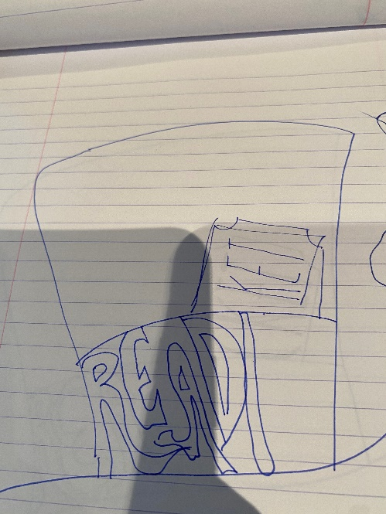
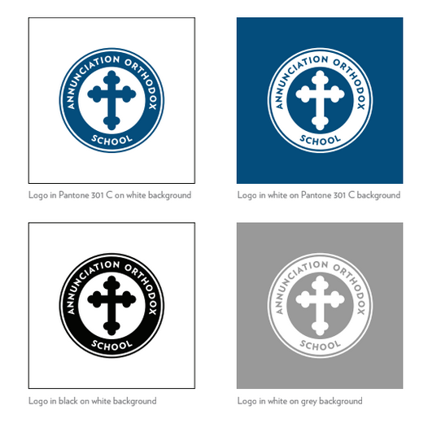

We’d like the slogan “READING IS YOUR GOLDEN TICKET TO ANYWHERE” to be the most prominent text (if this is too wordy, we can discuss shortening)
We’d like the top hat to be integrated into the overall logo design(see below image--we like how the text is integrated into the smoke and factory scape and hand-drawing)
We’d like the AOS and BOOK FAIR 2020 text to be less prominent
The next slide shows some of the t-shirts we’re considering, for your reference
AOS Logo will go in the back center of the shirt in the below approved representation
T-SHIRTS | BOOK FAIR 2020 | 7/16/2020

Slide 2
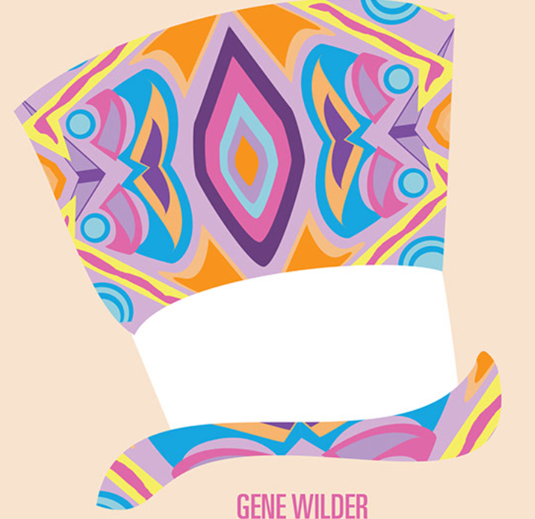
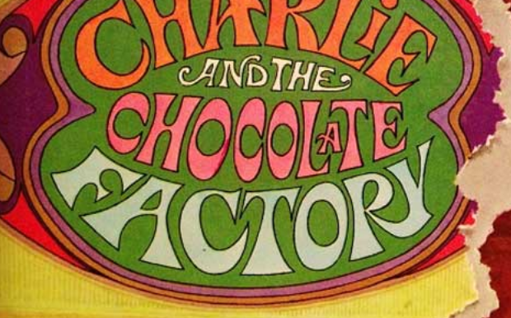
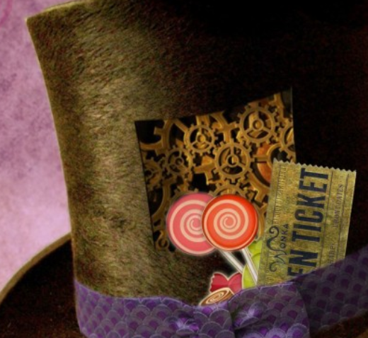
T-SHIRT –Presume will be 3 color print job depending on the color of the shirt; is white considered a color?
Like the shape of this hat
“READING IS YOUR GOLDEN TICKET TO ANYWHERE”
(in groovy font shown below)
AOS BOOK FAIR 2020
(in the Golden Ticket font or maybe
block font?)
Like the Golden Ticket Peaking partially out of hat
T-SHIRTS | BOOK FAIR 2020 | 7/16/2020

Slide 3
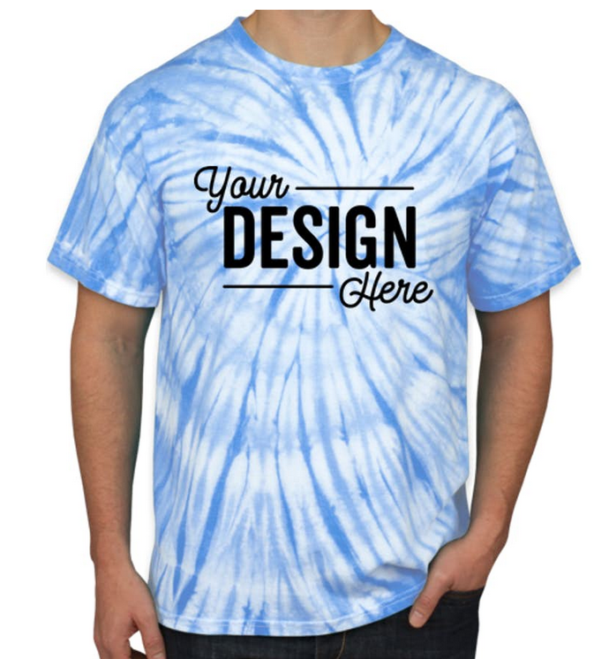
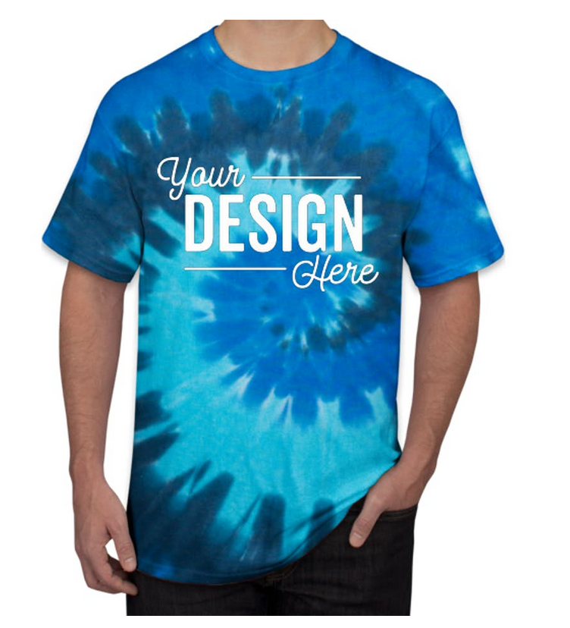
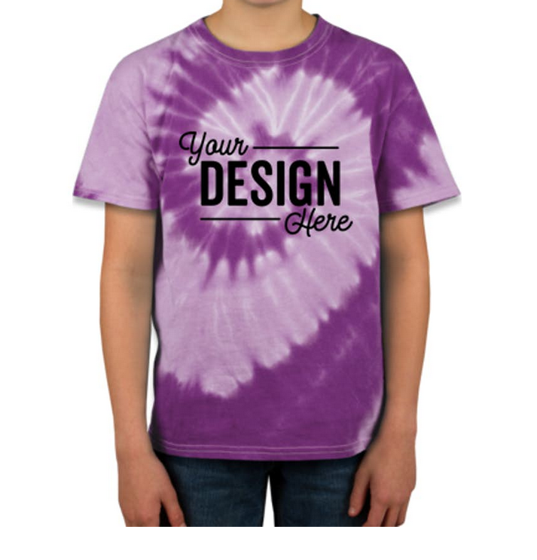
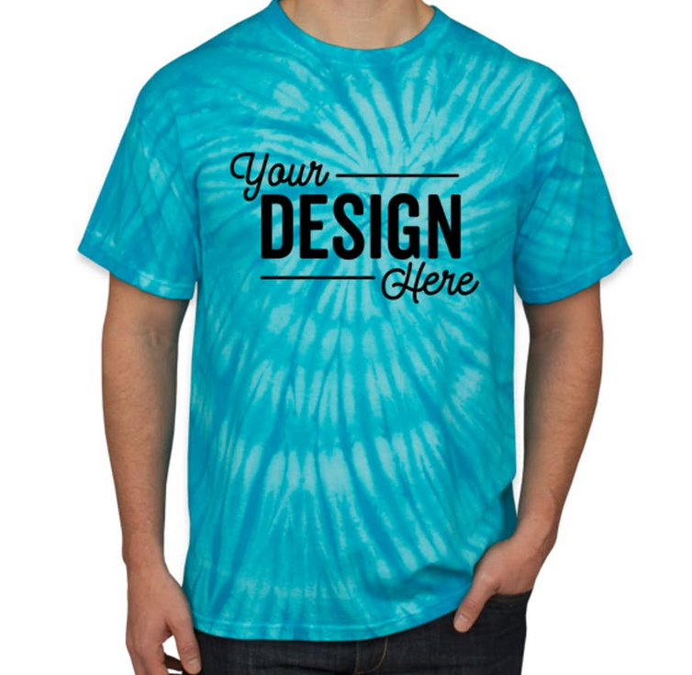
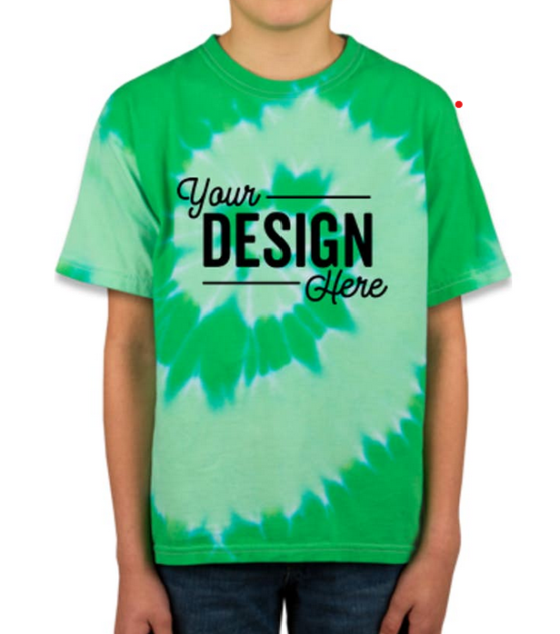
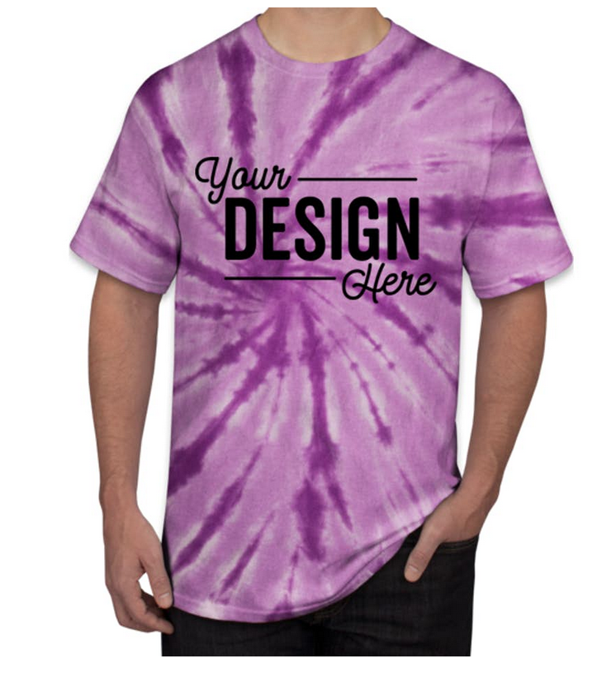
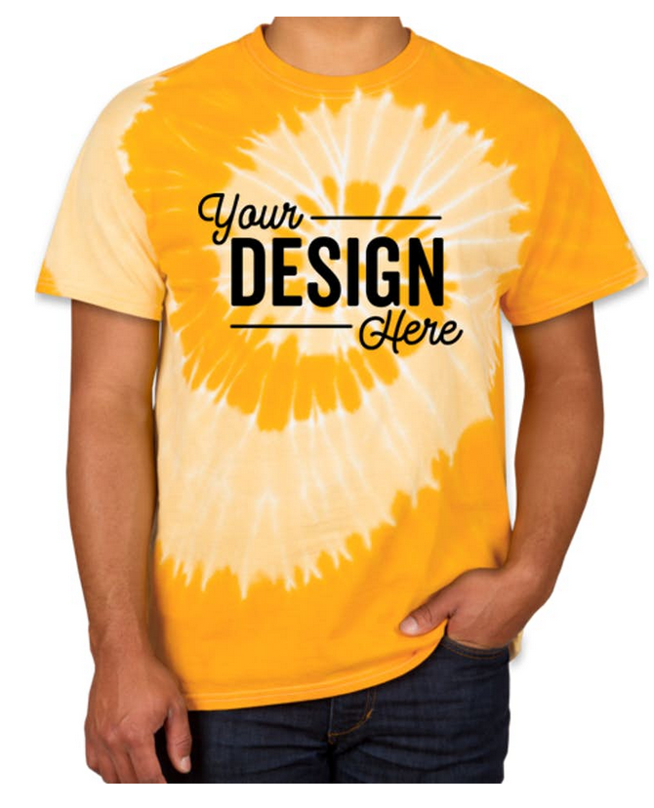
T-SHIRT Options
Purple
Columbia Blue
Ocean Rainbow
Kelly
Turquoise
Purple
Gold
T-SHIRTS | BOOK FAIR 2020 | 7/16/2020

