Slide 1
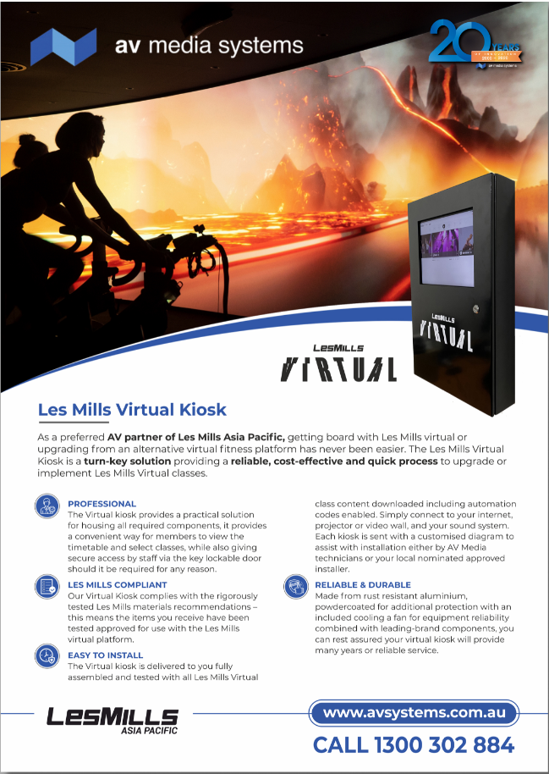
Please replace with latest provided logos
Please change to LES MILLS™ Virtual (first reference)
Subsequently, it should be LES MILLS Virtual
“…getting on board…”
“…components. It…”
Suggest to standardise so it’s “Virtual kiosk” throughout please
“…tested and approved…”
Please remove “a” from “cooling a fan”
And change “or” to “of”
Please move “EASY TO INSTALL” and the two rows beneath that to the next column
Please increase margin of clear space around the logo i.e. have the blue lines adjusted accordingly

Slide 2
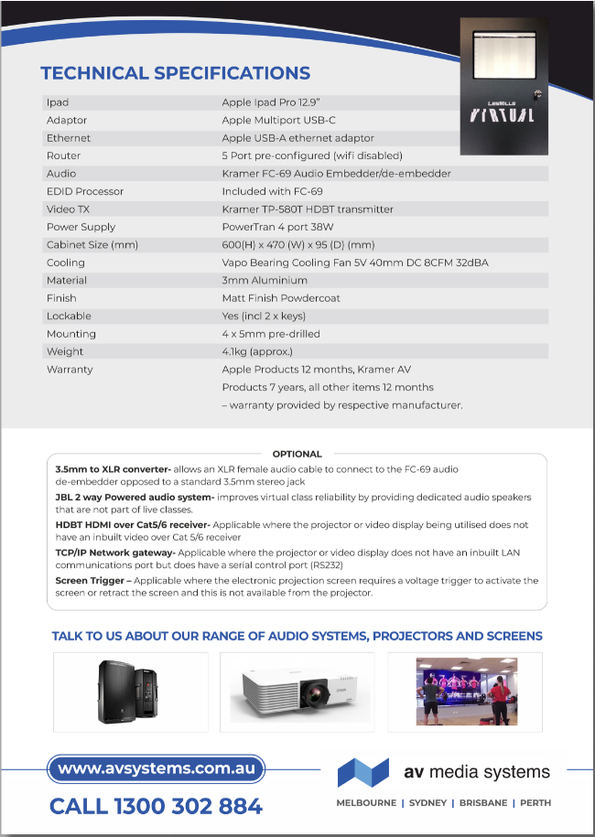
Please replace with latest provided logos
Please add space before “-”
Suggest capitalising first letter after “-” to standardise with the rest

