Slide 1
Existing About Page V1

Slide 2
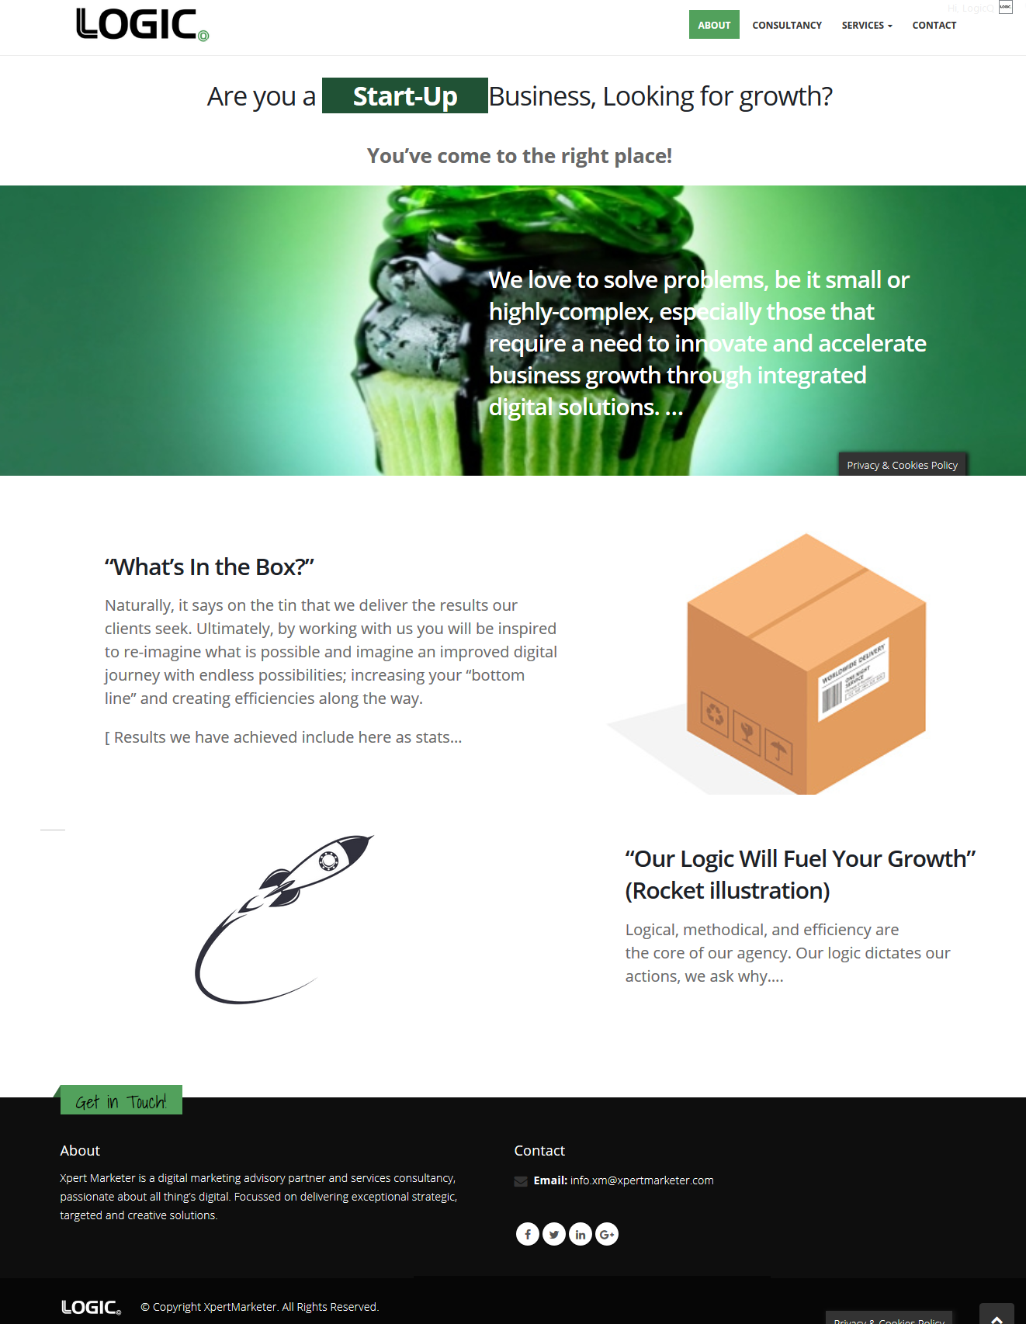

Slide 3
Existing About Page V2

Slide 4
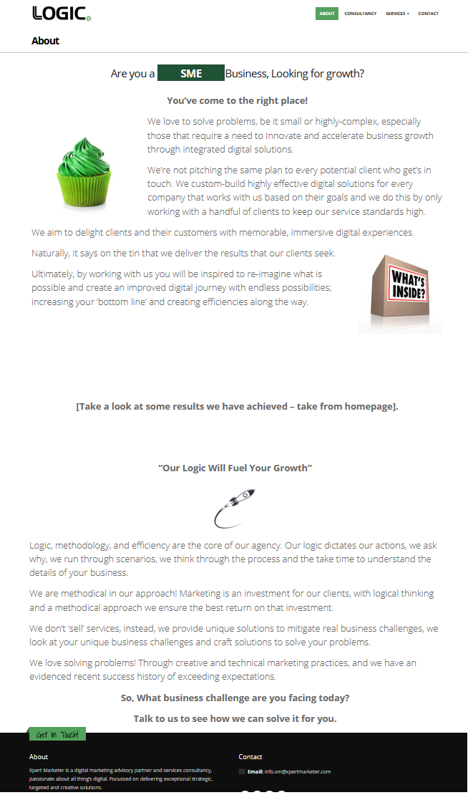

Slide 5
For Informative Purposes
Service Page Looks Like …

Slide 6
