Slide 1


Bali Investment Club
Invest in Bali | Live in Paradise | Join the Club
Investment Prospectus | August 2020

Slide 2

BIC Overview

Slide 3
The World is Changing
“The world is undergoing a great transformational change; new ideas, beliefs, and concepts are required for humanity to shift to the next stage of evolution, with a focus on shared values of planetary sustainability, business integrity, and loving compassion for all living things.”
Bali Investment Club

Slide 4
What is Bali Investment Club?
Bali Investment Club (BIC) is a social club of conscious investors, influencers and entrepreneurs creating the New Paradigm.
Our mission is to support profitable impact-driven projects, improve the lives of our members and the local community, and foster greater sustainability on the island of Bali.

Slide 5
The New Paradigm
A paradigm is generally defined as a framework that has unwritten rules and that directs actions. A shift occurs when one paradigm loses its influence and another takes over. We are witnessing the collapse of the the old paradigm; a system built on scarcity, lack, and fear. Hence, we sit on the precipice of a New Paradigm -- a loving, supportive, and collaborative framework that provides abundance for everyone.
Bali is the epicenter for emerging ideas; it is a hub for new networks, systems, communities, and projects that redefine the way we relate to each other and the world.

Slide 6
Our Core Values
People, Planet, Profit.
Truth, Trust, Faith.
BIC invests in initiatives that are beneficial for the people, the planet, and profits; this means that every stakeholder is considered. Stakeholders are its members, partners, employees, and the planet. Impact is what drives our members, while profits are what sustains them.

Slide 7
What Does BIC Offer?
BIC offers the following benefits to members interested in joining:
Source, curate, and nurture New Paradigm investments in Bali | BIC’s primary objective is to support New Paradigm projects that will provide positive impact and ROI to investors; people, planet, and profits We are creating a community of like-minded members who share common goals, are interested in creating conscious businesses, support the new paradigm, and value networking All members will have First Right of Refusal to new investment opportunities sourced by the Club All the investment opportunities sourced by the club have additional benefit vs investing directly
Provide long-term Indonesian work visas | We provide a two-year KITAS as the vehicle through which member investors will be able to legally stay in Bali, make investments, and own businesses
Support members with personal and professional services | BIC gives members access to legal, accounting, and tax professional services support, as well as migration services in Bali for personal benefit
Host exclusive networking events | Among other events, Komodo Kave is the club’s bi-monthly networking event in which members will be able to connect with other like-minded leaders, entrepreneurs, and investors. Find your next business partner at a BIC event
Improve the lives of the local community through charitable giving and vocational programs | BIC has partnered with the Kingdoms, local governments, and charitable organizations to assist the people of Bali with vocational programs that support their education and welfare

Slide 8
Why Bali?
Asked from a different perspective, WHY NOT Bali?
Bali offers Western country nationals an extremely low cost of living and an amazing quality of life. For example, Canggu is rated as a top 5 digital nomad destination in the world. Benefits of living on the “Island of the Gods” include affordability, friendly locals, low crime, great weather, and access to nature and healthy living. A number of expats have moved to Bali to experience life in paradise in recent years.
Moreover, with increased border control and immigration restrictions resulting from COVID-19, as well as the challenging impact that the virus has had on the lifestyle of people in Western countries, gaining a work and residency permit for Bali has become more desirable. There has been little impact from COVID-19 in Bali compared to other geographies, which makes it even more attractive as a destination.

Slide 9
What is a KITAS?
A KITAS (Kartu Izin Tinggal Sementara, or Temporary Stay Permit Card) is an Indonesian government permit that allows foreign nationals to stay for a specified period of time without having to renew their visas and/or work in Indonesia. When border restrictions are enforced, it is the only way for a foreigner to enter the country.
There are two ways to obtain a KITAS:
Company Sponsorship: an existing business in Bali employs and sponsors a person
Investor KITAS: invest $175,000+ into a foreign-owned local entity (PT PMA) and receive an Investor KITAS for two years, with the option to extend
The Bali Investment Club offers an alternative.
Among other benefits mentioned previously, the BIC membership will include a 2-year commissioner KITAS, with the option to extend. While this option does require a capital investment, it is considerably less than USD $175,000 and requires zero knowledge, experience and motivation to manage a business in Bali; supports local people and the land; provides a potential return on Investment; and gives positive ROI on impact driven investments..

Slide 10
Is BIC for you?
If you are a conscious investor or entrepreneur with USD $25,000* and:
Live in Bali with a KITAS** OR want to live in Bali with a KITAS (2+ years),
Seek paradigm-shifting investments with a positive ROI OR want to establish a business in Bali,
Want to support the local people and land of Bali,
Value a network of like-minded leaders, entrepreneurs and investors that share the vision, mission and resources to actualize the new paradigm...
...then we invite you to invest in Bali, live in paradise, and join the club.
*$29,000 membership fee as a tax-deductible donation for US/UK citizens **$5,000 discount for existing KITAS holders

Slide 11

Becoming a Member

Slide 12
Becoming a Member
BIC invites a limited number of members to join the club each month, and is selective based on a number of factors. There is a USD $1,000 deposit which is refunded to unsuccessful applicants. Remainder payment of USD $24,000* must be made within 48 hours of approval.
Submit Application and
$1,000 Deposit
Receive Invitation to Join
Receive Membership ID & Legal Documents
Open Club
Bank Account
Step 2
Step 4
Step 6
Step 1
Step 3
Step 5
Step 7
Interview with BIC Founder
Sign Membership Agreement & Make Balance Payment
Must be completed within 48 hours of approval
Begin KITAS Processing
This process may take up to 2-3 months to complete
*$29,000 membership fee as a tax-deductible donation for US/UK citizens. $5,000 discount for existing KITAS holders

Slide 13
Member Benefits
EXAMPLE BASED ON USD $25,000 INVESTMENT | Option A Investment Club ( eg. RSGI Project) | Option B Business Club
100 shares in (RSGI) PT Royal Spice Gardens Indonesia (ROI $115,106)* | ✓
Proceeds from the sales of product from a personal vanilla farm with 500 plants (ROI $56,687)* | ✓
USD $10,000 in a bank account for investment into existing or new project |  | ✓
A two-year KITAS work visa, with the option to extend | ✓ | ✓
Access to exclusive networking events and investment opportunities | ✓ | ✓
First right of refusal on new investment opportunities | ✓ | ✓
Access to professional business services; finance, legal, accounting and tax advice to minimise tax and maximise returns. | ✓ | ✓
Access to support for migration: travel, accommodation and recommendations (restaurants, activities, wellness facilities, etc.) | ✓ | ✓
Opportunity to become a founding member and earn 6 figures | ✓ | ✓
*Projected over 15 years.

Slide 14
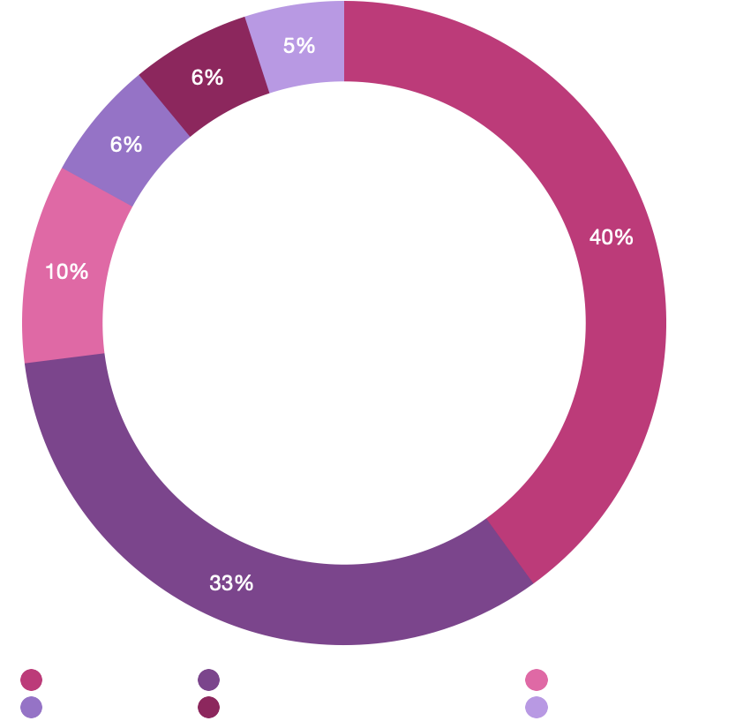
Membership Fee Breakdown
Based on a USD $25,000 investment, we allocate the following:
Personal BIC Business Account (USD $10,000):
Freedom of making investments within BIC ventures portfolio and/or individual business activities
Club Costs (USD $8,250):
Operations, membership services, KITAS
Programs (USD $3,000):
Vocational and charitable assistance programs to aid the local Balinese communities
Club Investment Capital (USD $2,500):
Capital for Founding Members to invest
Club Cash Reserves (USD $1,250):
Cash flow is king. The club keeps cash on reserve for miscellaneous expenses
*$5,000 discount for KITAS holders
$5,000 discount for KITAS Holders

Slide 15

Opening a Club Bank Account
TO BE COMPLETED
Once a member’s KITAS has been successfully processed, a club bank account will be opened in their name, with access to USD $10,000 for the purpose of making investments within BIC ventures portfolio and/or individual business activity.

Slide 16
Becoming a Founding Member
The next level in the BIC structure is to become a Founding Member; setup a Bali Investment Group (BIG), which is comprised of 5 new members. Each BIG affords the Founding Member benefits of USD $25,000 and 10% of any service fees paid by members within the group, as a Director of the new entity. Service fees include:
10% of annual profits from each member’s business activity
10% return on any investments made by the group
The Founding Member is the main point of contact for the members, and is responsible for communicating future investment opportunities.
A Founding Member will also receive an Investor KITAS, reducing the annual cost of renewing their KITAS by 75%.
Terms & Conditions will apply.

Slide 17
Investments Opportunities

Slide 18
Why BIC Investments?
The Club sources and filters different investment opportunities, evaluating and selecting those that are strong prospects. We will perform the following activities to support a successful evaluation and operation:
Investment Analysis
Due Diligence
Founder Support and Advisory
Incubation Services

Slide 19
Investment Opportunities
Sectors include:
Farming & Agriculture
Property & Land
Community & Retreat Centers
Health & Wellness
Travel & Tourism
Education & Consulting
Technology & Cryptocurrency
Online Business
Each presentation is filmed and distributed on the social media app Telegram for members to choose which project(s) to invest in.
The club takes care of the rest (e.g. due diligence, legal work, transfer of funds) in exchange for a 10% return.

Slide 20

Komodo Kave
BIC invites market-ready New Paradigm organizations with solid financials to present at Komodo Kave, the club’s New Paradigm shark tank. Conscious entrepreneurs pitch their New Paradigm projects to a panel of investors and advisors for capital funding, mentorship and networking.

Slide 21
Accelerate and Incubate
BIC curates opportunities with a New Paradigm accelerator program, helping organizations with:
Branding
Sales & CRM
Marketing
Go-To-Market Strategy
Product Development
Operations Management
BIC nurtures investments at its incubation space, a home for New Paradigm projects to collaborate, inspire and flourish.
Financial Modeling
Raising Finance to scale
Investor Readiness
Presentation Skills
Legal, Tax and Accounting
Team Building

Slide 22
Club Investment Capital (CIC)
The club sets aside a portion of its membership fees in the CIC, a pool of capital for founding members to invest in projects that are presented at Komodo Kave, or to the Club in other ways.
50% of all returns from the capital invested into the projects are divided equally between the club's founding members (1 vote = 1 share) while the remaining 50% goes distributed equally to the club members.
For all other members, the process to become a founding member is to bring 5 new members into the club. For every 10 members who join, the club will have approximately USD $25,000 to support new paradigm projects.

Slide 23
Create Your Own Investment
Do you want to start your own revenue-generating project in Bali? This could be anything from an online business to a new vegan restaurant.
Typically, USD $175,000 (2.5bn IDR) is required in investment capital to open a foreign-owned limited liability entity in Indonesia.
As a Club member, you will have the right to start your own project with your USD $10,000 investment. Any additional funds needed to establish the business can be transferred as a personal loan, and therefore recoverable before tax.
The Club is a social network of investors, business owners, entrepreneurs and leaders with all the support needed to help your project succeed.

Slide 24





Immediate Investment Opportunities

Slide 25

Giving Back to Bali

Slide 26

Vocational Programs
The smallest form of local government in Bali is a Banjar, which means neighborhood. The Chief Banjar is responsible for their local community, taking care of the cultural and religious values independently from the police.
BIC has chosen to support local Banjars with vocational programs that employ the poorest villagers, training them to fulfill jobs that add value to the community and restore the environment.

Slide 27
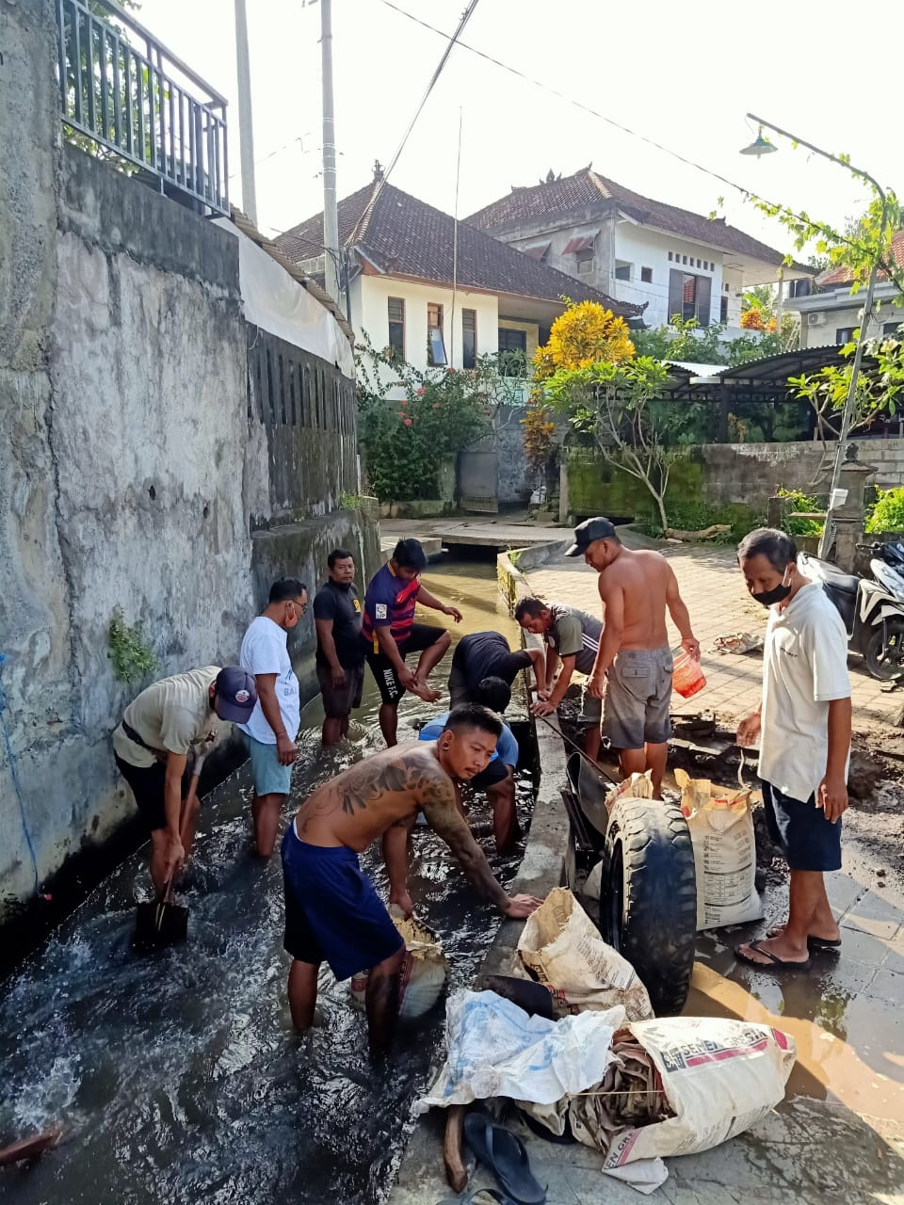
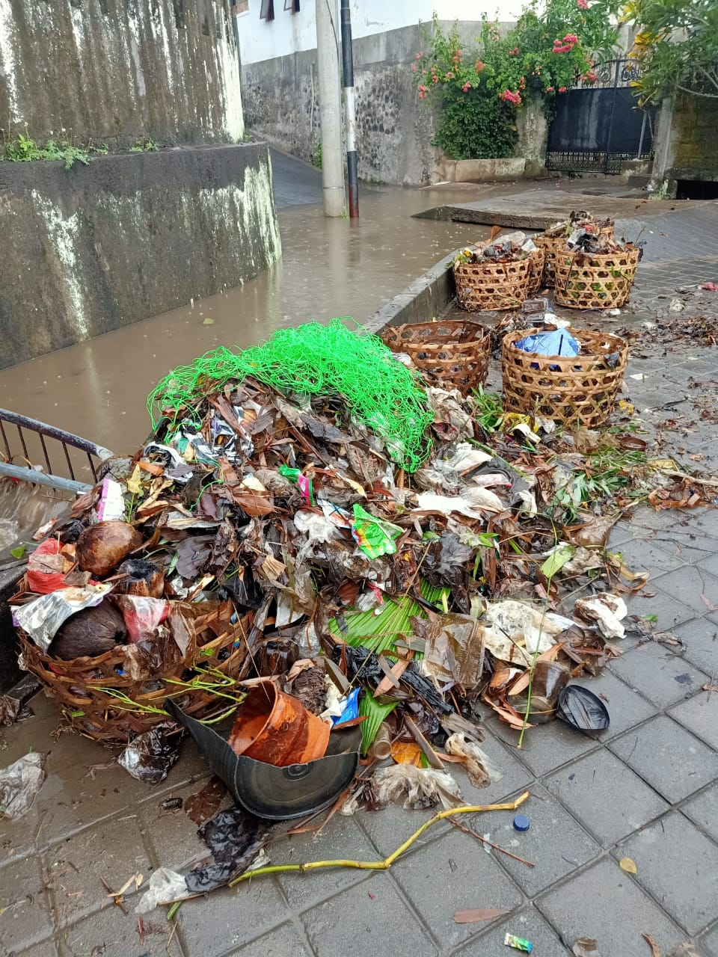
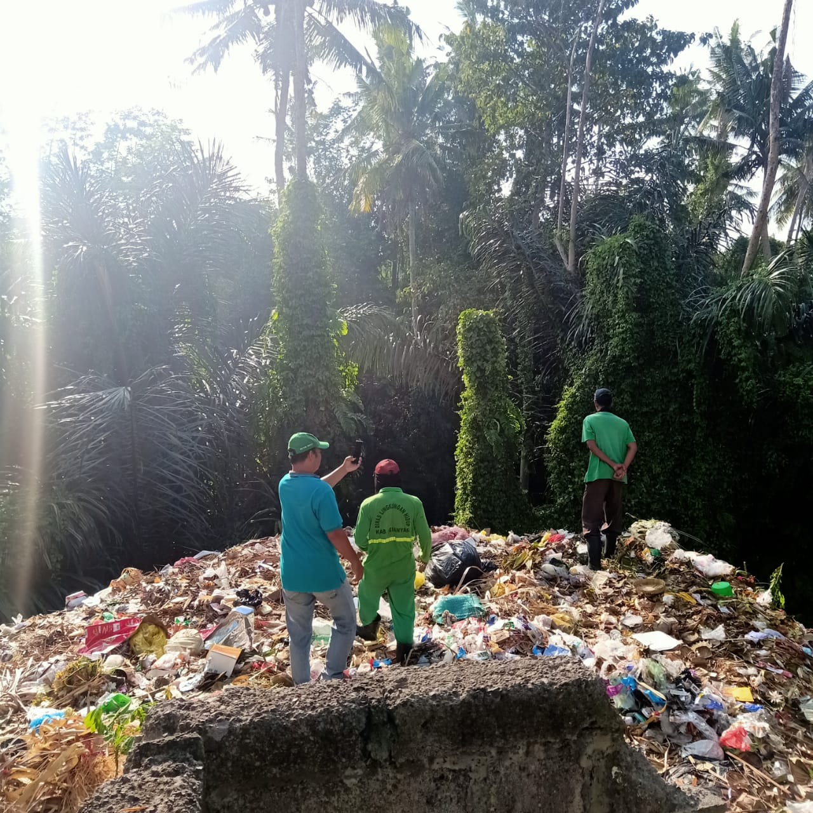
Cleaning the Land
Villagers who have a particular difficulty with learning new skills will be employed for basic tasks including cleaning local rivers and collecting plastic. It is not our intention to generate a profit from the vocational programs; rather, we will use our collective wealth to give back unconditionally.
Through this initiative, we will refine our vocational programs, learning about what the local people need the most, and how to deliver it -- at which point the model can be replicated with other local communities in Bali.

Slide 28
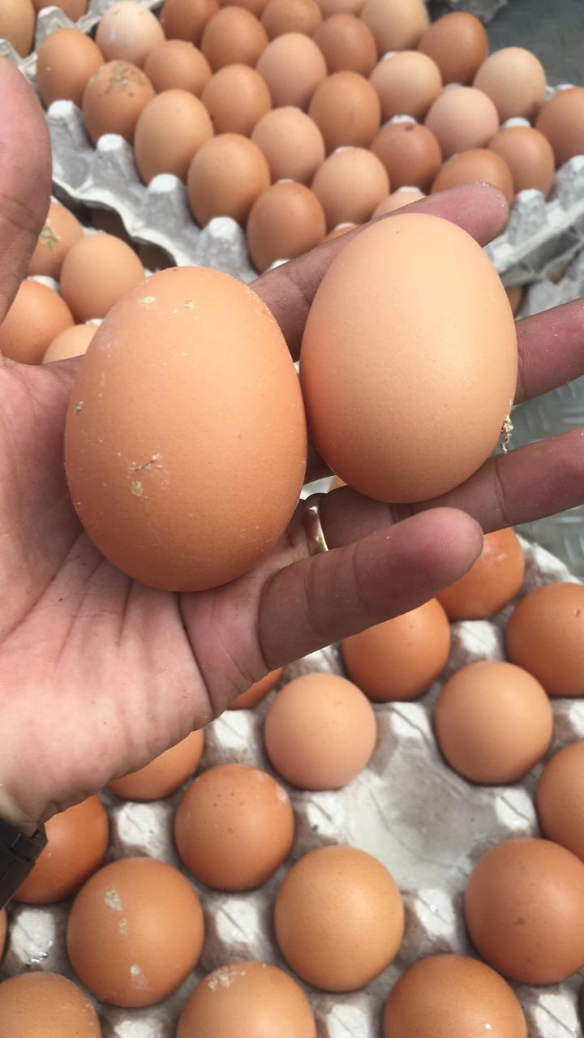
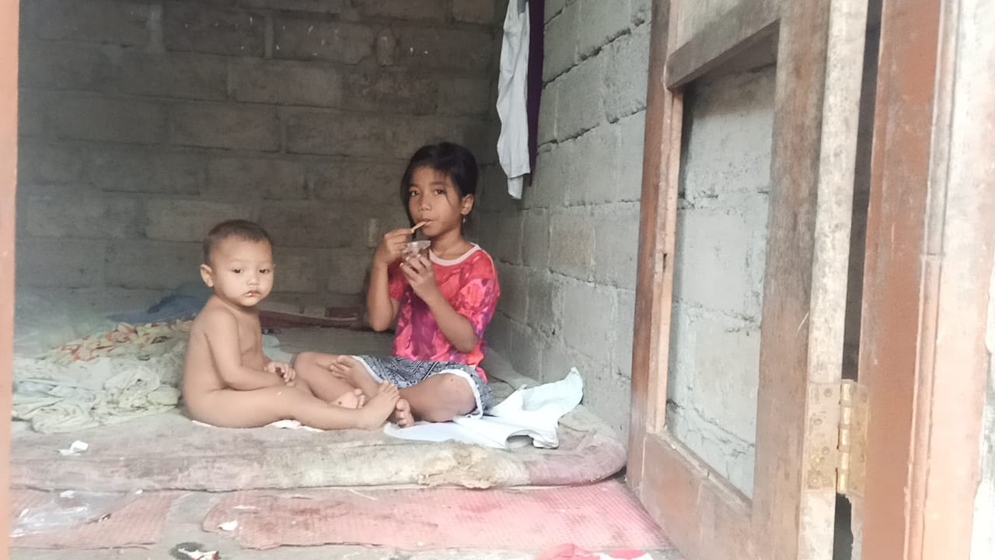
Providing Basic Needs
Food
For just USD $10/month, that contribution will feed a family of five. The club has allocated funds to provide rice, eggs, and oil to poor people within the local banjar. The people are asked to bring plastic in exchange for their food, which will then be recycled.
For people who want to eat better food, the club provides paid education to farm the land for fruits and vegetables, which will be given to those who work; any excess will be sold at market and given back to the village.

Slide 29
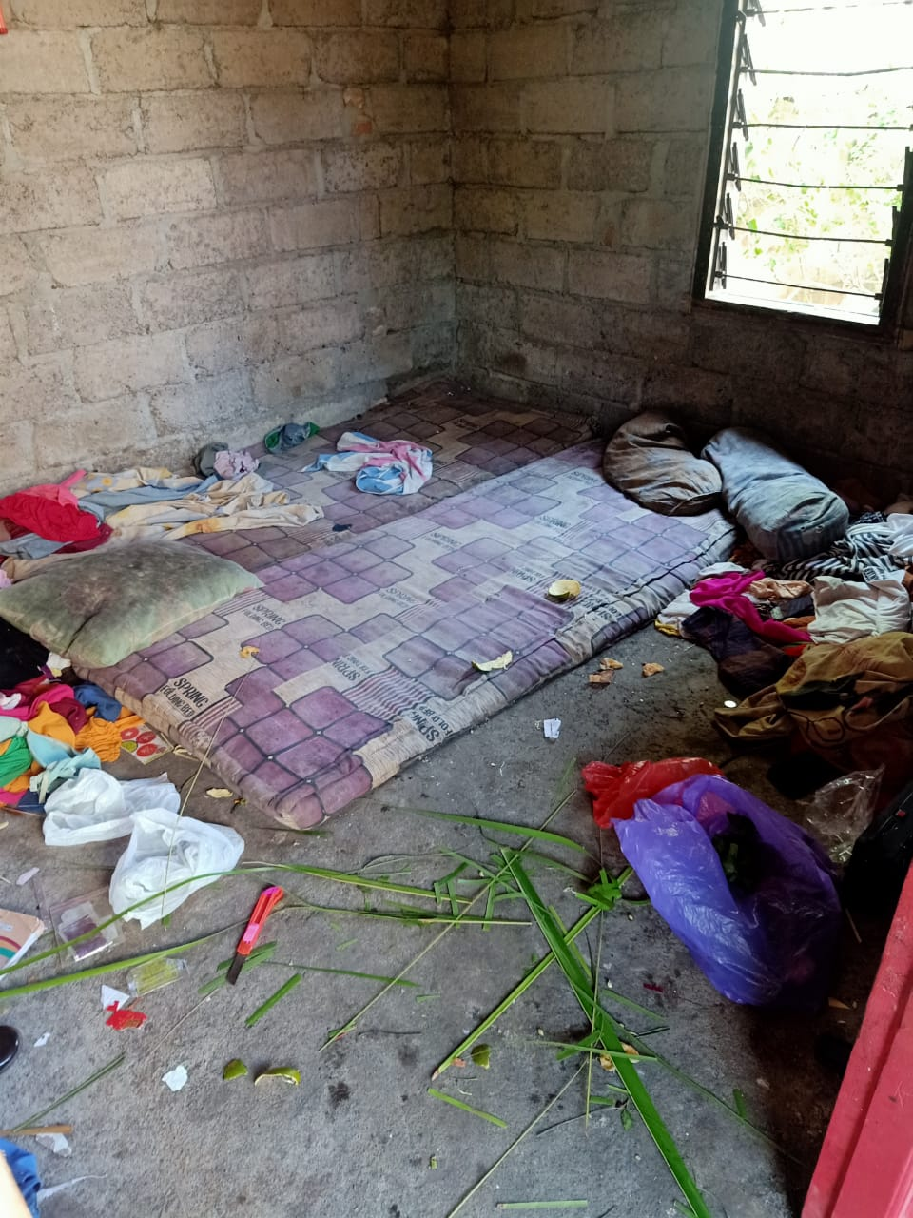
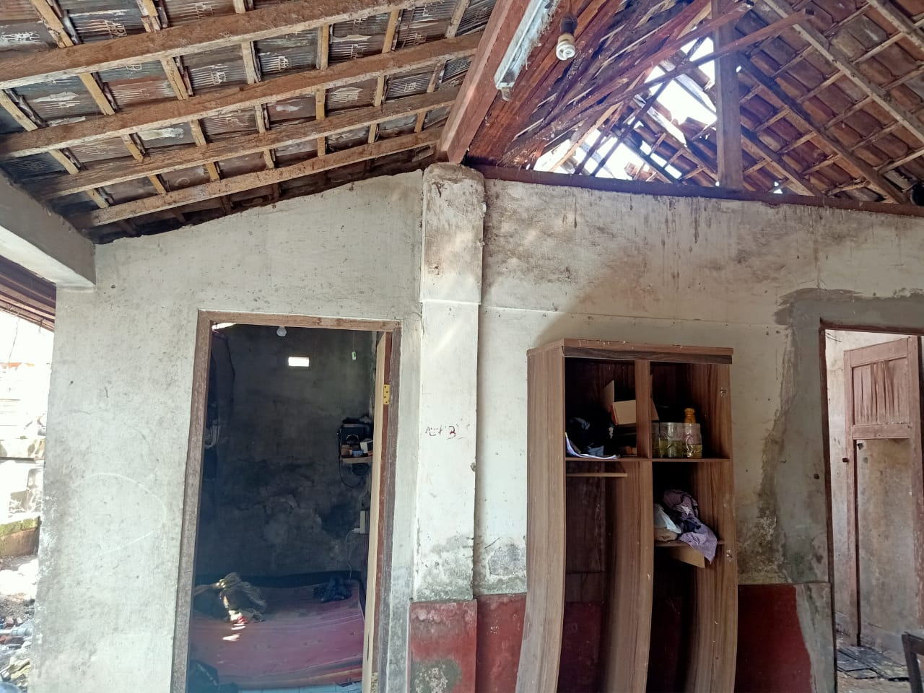
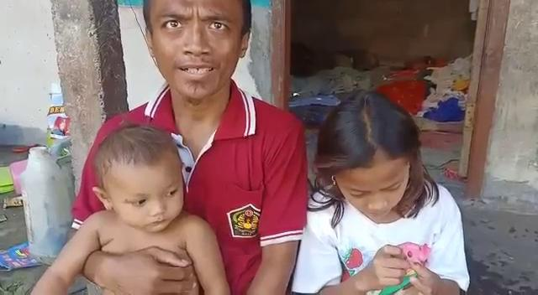
Providing Basic Needs (cont.)
Shelter
The living conditions are very poor. Most dwellings are small, with large holes in the roof, bare walls, and only dirty blankets for bedding. The club sponsors the local Banjar to repair the buildings by working with those living there, so that they learn the skills to help others. This way, the village can support each other and improve their living conditions as a community.

Slide 30

Charity
A portion of BIC’s membership fees will be invested into charitable activities. This may be our own charitable initiatives, choosing an existing organization to support, or a combination of both.
The founder of BIC has personally supported the Jodie O’Shea House, a Balinese orphanage that provides food, accommodation, and education to children in need, for 18 months. This would be an example of the type of organization the club would support.

Slide 31

Growing the Balinese Economy
The club provides a safe space for businesses to thrive, gaining access to the tools, knowledge, expertise and resources required for establishment, rapid growth and expansion. BIC makes Bali a more attractive proposition for businesses, creating value for the people they serve and the economy they participate within. Attracting overseas capital and bright entrepreneurs to the land of Bali will significantly increase the size of Bali’s economic output.

Slide 32
Become an Ambassador
BIC provides an opportunity to become an Ambassador and get paid $3,000 for each new member you introduce to the Club. This differs from being a Founding Member, which requires you to first become a paid Member, and get paid $5,000 for each new member you bring into the Club.
Being an Ambassador is an opportunity for those without capital to still support the Club and earn an income.

Slide 33

Namaste

