Slide 1

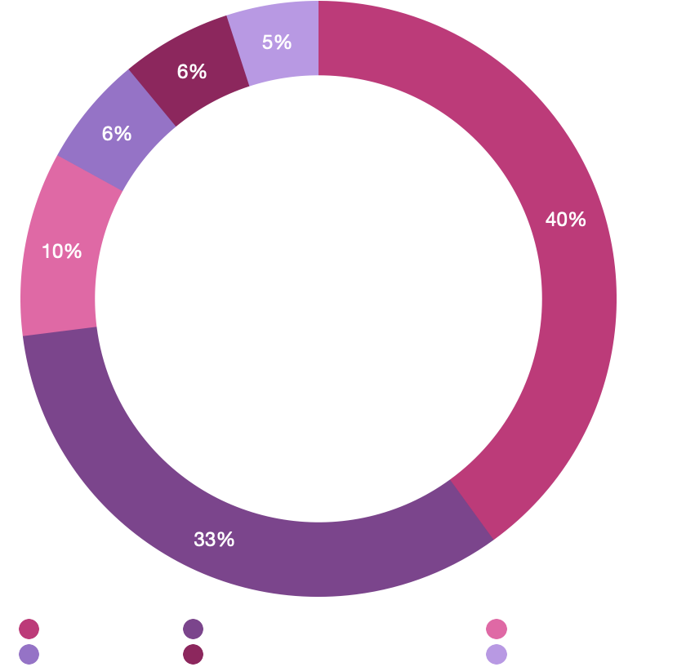
Bali Investment Club
Invest in Bali | Live in Paradise | Join the Club
What Is It?
Bali Investment Club (BIC) is a social club of conscious investors, influencers and entrepreneurs creating the New Paradigm.
Our mission is to support profitable impact-driven projects, improve the lives of our members and the local community, and foster greater sustainability on the island of Bali.
What Do You Get Access To?
Access to impact driven investments with positive ROI
2-Year Indonesian work visas
Club Business Account with $10,000
Personal migration and professional business services
Exclusive conscious startup networking events
Improving the lives of the local community through charitable giving and vocational programs
Opportunity to become a founding member and earn 6 figures
An investment vehicle designed to minimize tax and maximize returns
People, Planet, Profit. Truth, Trust, Faith.
Membership Fee
Membership is US$25,000, which grants the member a US$10,000 investment in high impact projects, a 2 year KITAS visa, and a number of benefits that support the growth of the member, local people and the land.
Apply Today
Go to apply.baliinvestment.club and complete an application form.
Receive Invitation to Join
Open Club
Bank Account
Submit Application and
$1,000 Deposit
Receive Membership ID & Legal Documents
Step 2
Step 4
Step 6
Step 1
Interview with BIC Founder
Step 3
Sign Membership Agreement & Make Payment
Must be completed within 48 hours of approval
Step 5
Begin KITAS Processing
This process may take up to 2-3 months to complete
Step 7
*$5,000 discount for existing KITAS holders

Slide 2
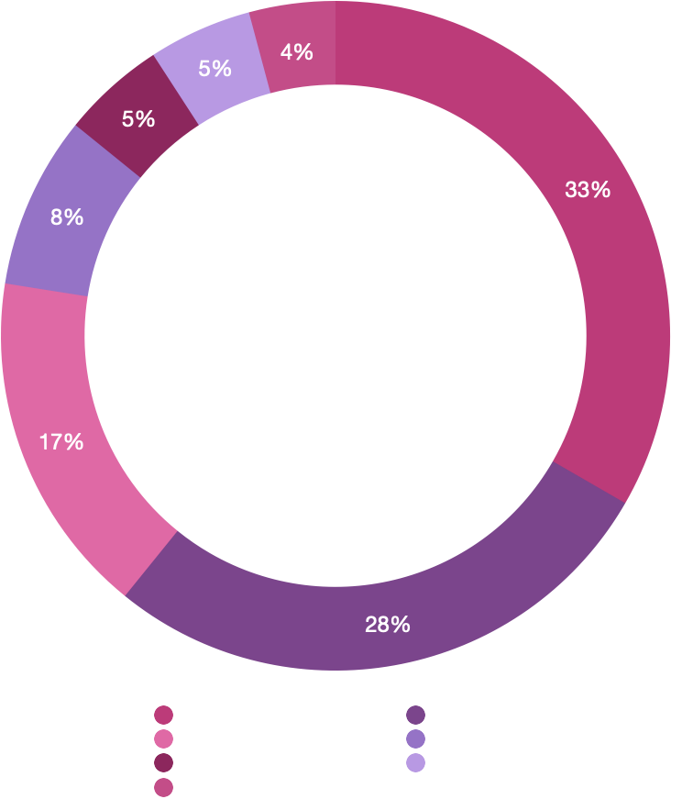
The Universe Ministry: BIC
Support The Universe | Live in Paradise | Join the Club
What Is The Universe Ministry?
The Universe Ministry is a spiritual non-profit organization established for furthering the upliftment, enlightenment, spiritual realization, and general welfare of people throughout the world, the betterment of life on planet Earth, and other spiritual, environmental, humanitarian, and beneficent purpose.
What Is BIC?
BIC is a social club of conscious investors, influencers and entrepreneurs creating the New Paradigm in Bali. Their mission is to support profitable impact-driven projects, improve the lives of members and the local community, and foster greater sustainability on the island of Bali and the World.
What Do You Get Access To?
Access to impact driven investments with positive ROI
Club Business Account with $10,000
2-Year Indonesian work visas
Personal migration and professional business services
Exclusive conscious startup networking events
Charitable giving and vocational programs for community dev.
Founding Member status with a vote and share in CIC
Investment vehicle for tax minimization and return optimization
Make a tax-deductible donation to The Universe
Donate US$30,000 and be gifted membership to BIC.
Meeting with Founding Member
Open Club
Bank Account
Receive Invitation to Join
Receive Membership ID & Legal Documents
Step 2
Step 4
Step 6
Step 1
Study Documentation
Step 3
Sign Membership Agreement & Make Donation
Must be completed within 48 hours of approval
Step 5
Begin KITAS Processing
This process may take up to 2-3 months to complete
Step 7
*$5,000 discount for existing KITAS holders
Notes:
Edit the membership fee allocation diagram to $30,000 with $5,000 being allocated to ministry projects, and rename it Donation allocation
Add ‘Access to impact driven investment opportunities with positive ROI’ to the ‘what do you get access to?’ table
Clean it up and make it sexy

