Slide 1

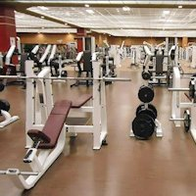
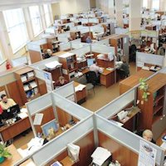

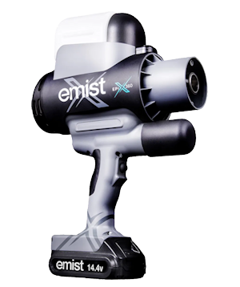
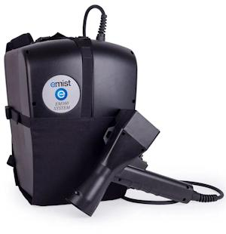

Covid 19! ADP Services NC offers disinfection services against the corona virus and other pathogens. Protect your clients, your staff and yourself.
Offices / Banks
Bars / Restaurants
Gyms / Sports Facilities
Data Centers /
911 Call Centers
Medical / Hospitals
Schools / Daycares
Adpservicesnc.com
1-800-876-1078

