Slide 1
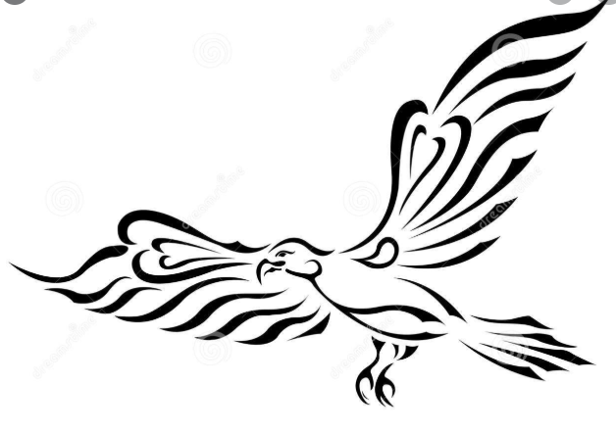
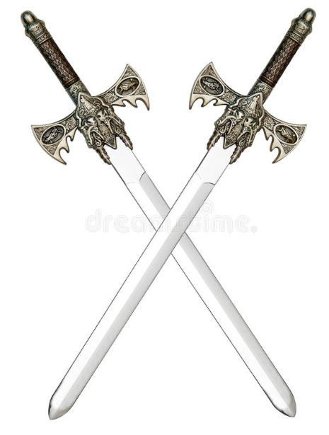
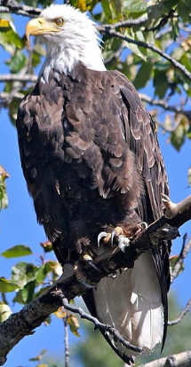

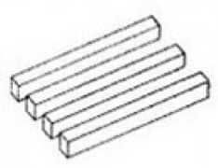
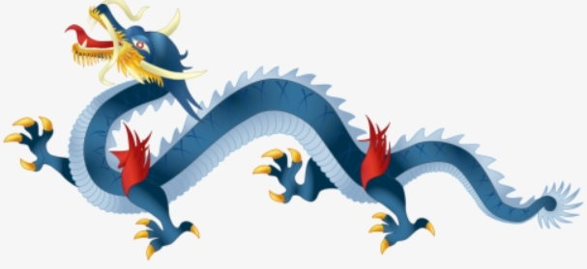
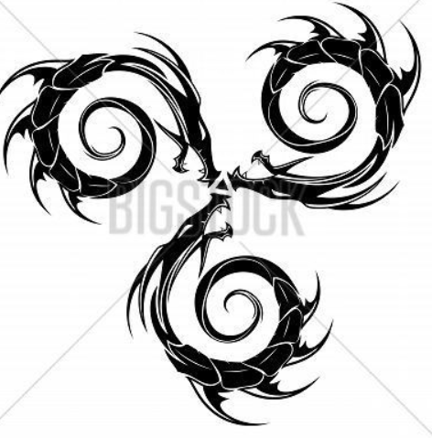

Create new symbols to represent each aspect
Make Ornate and medieval looking tilting toward eastern culture
Colors to be red, gold/yellow, and blue
Add helmet if seems appropriate
Tie everything together
Freedom Symbol
Put name in banner
Swords do not have to be the same
Duong
Blue Dragon to represent ingenuity and resilience of Vietnam
Round Shield
Bald Eagle to symbolize strength of US
Perspective Symbol to always look at a situation through different lenses
Symbol to represent making an impact on the world
Yin-Yang Symbol to represent good/bad of all situations
Triskelion Symbol to the threes of life
Foundation Symbol on bottom of shield: bricks, tree roots, etc
Place in banner
Libertatem melius

