Slide 1
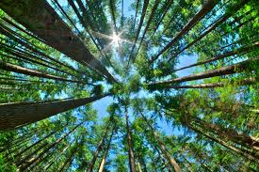
Timber Ventures
Pitch Deck

Slide 2
Introduction
Timber Ventures International (TVI) has secured exclusive access to a superior timber drying technology (iDry kilns) that has been in commercial production since 1980.
TVI will leverage this technology to build a hardwood drying business, initially focused on the stair tread market in Sydney and Brisbane.
Hardwood stair tread timber has an approximate gross margin of $XXXX/m3 (XX%).
TVI will sell directly to stair tread installers enabling us to retain the bulk of the gross margin as net profit.
iDry kilns are relatively inexpensive ($US79-205K), modular in design, and return approximately 300% per annum. As a result, TVI will be able to scale without additional equity or debt funding.
The Australian hardwood industry is worth around $7bn pa on 700,000m3 of sawn timber but 93% of logs are exported. With 10 kilns TVI would dry less than 1% of all sawn timber but turn over $XXm and nett $XXm with huge growth potential from value adding exported logs.
This is not a tech play but a cash cow investment to be held long term. We have a simple business model, using established technology to disrupt a technologically stagnant, but growing industry.

Slide 3
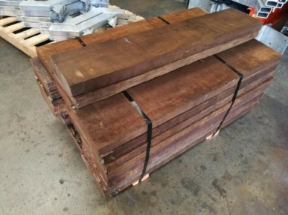
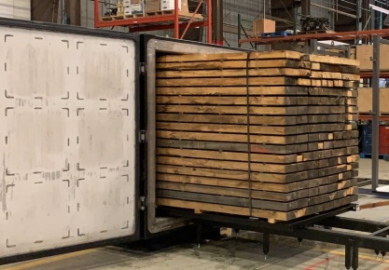

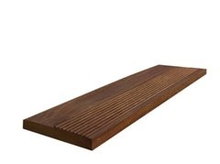
Business model
We are using established technology to disrupt the existing timber supply chain with a simple 4 step business model
Buy cut timber from sawmills
Dress and deliver
Sell dried stair treads to installers
Dry it in our kilns
$XXX m3
$XXXm3
$XXXm3
$XXXm3
~ $XXXm3
Net profit

Slide 4
Why stair treads
XX% margin
High absolute $ returns - ~$XXXm3 profit
Standardised product allowing optimisation of production processes
Large market – over 65 potential clients indicated interest in purchasing in Sydney alone ¹
Installers looking for alternatives – ~30% of Boral products out of specification resulting in no installer profit on those jobs
Significant drying time advantage over competitors: 1 week v 7-8 months
¹ TVI market survey data

Slide 5
Market overview
The total value of the Australian timber market is $23.9bn¹ with hardwood accounting for over $7bn and softwood the balance. The Australian hardwood market has been growing strongly, posting 10% growth in volume of logs harvested and a 13% increase in price in 2017 despite a 5% fall in housing construction.
The hardwood industry however is massively under developed with 93%² of all plantation hardwood logs being exported – with no value adding.
The total volume of sawn hardwood timber in 2018 was 700,000m3. With just 10 kilns we would dry less than 6,800m3 pa, gross $30.6m in revenue and net $18.5m with significant opportunity to expand.
In NSW logs are sourced through either State Forests NSW (Garth knows and has worked with the Chair previously) on either a quota or spot price basis or through the logging of private forests. TVI will commence by sourcing timber from private forests as there are numerous landholders and contract loggers to ensure timber supply and mitigate sourcing risk.
To quantify the direct addressable market TVI conducted extensive market research, contacting 98 stair installers, joineries and furniture manufacturers in addition to wholesalers. Stair installers pay between $XXX and $XXXXm3 with an average of just over $XX00m3 whereas wholesalers buy at around $XX00m3.
Include Mark’s timber data on stair tread market

Slide 6
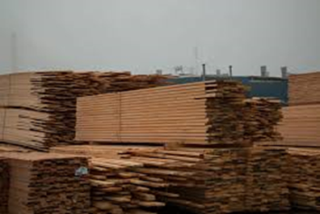
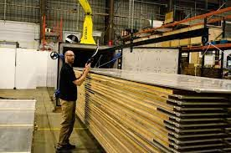
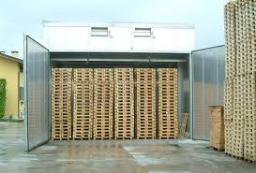
Comparison of drying techniques
Competitors
Timber Ventures
Green cut timber is left to air dry from 40% moisture to 20-25% taking 6-12 months depending on thickness and weather
Green timber is loaded into the kiln and automated drying programme for timber species selected.
Drying takes 6-7 days to dry 50mm timber in an iDry Turbo.
Air dried timber is loaded into an insulated room with multiple fans and a heat source.
Drying takes 2-6 weeks for 50mm timber.
Total time 7-14 months
Total time 7 days

Slide 7
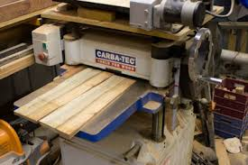
Post drying process
Dried stair treads are either delivered skip dressed or sized and finished with volumes being around 50:50 of each. We will commence by offering a skip dressed product as it is the simplest to produce.
Skip dressing involves running the dried timber through a thicknesser or moulder to roughly level two sides of timber and expose the grain. This allows the quality of the timber grade (Select, Standard or feature) to be assessed.
Once dressed, the timber is palletised ready for delivery to the client.

Slide 8
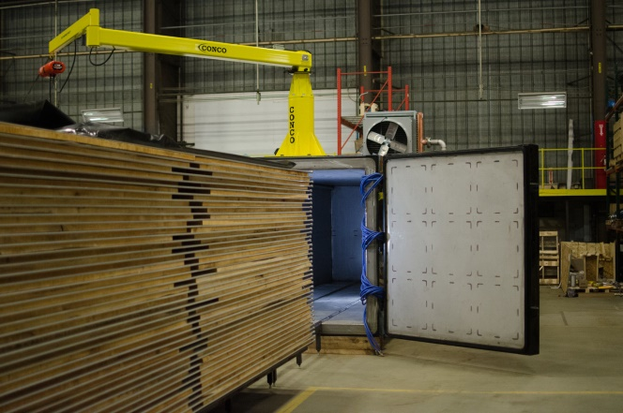
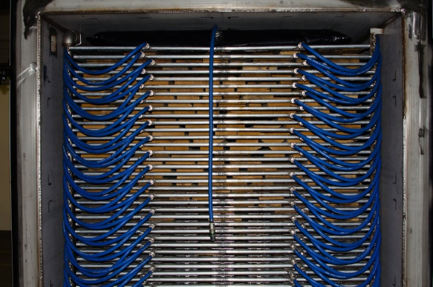
iDry kilns
The main drying advantage iDry kilns have over existing kilns is that they dry in a vacuum. When you dry in a vacuum you lower the boiling point of water, in our case to 20-23C.
A lower boiling point means less energy is required to evaporate that water but most importantly less stress on the timber whilst doing so. This results in less cracking and warping of timber and hence wastage (5% for iDry vs 10-20%).
The most important operational advantage is their ability to take freshly sawn timber and dry it within a week versus our competitors whose total drying time is 7-8 months at best for 50mm timber.
The drying time is a factor of two things:
Vacuum: which actively draws moisture from the core of the timber; and
Direct heating: the iDry Turbo uses heating plates between each layer of timber circulating warm water to provide even heating to the top and bottom of each piece of timber
The result is dried timber that has undergone less stress with fewer defects and more even moisture content, vital for structural integrity. Colours are also richer as the outer core of the timber hasn’t been bleached by the high temperatures of traditional kilns attempting to evaporate water.
iDry Turbo showing heating plates between timber layers
iDry Turbo loaded with connected heating plates

Slide 9
About iDry
iDry is a Vermont family owned business that has been developing and selling vacuum kilns since 1980. Acknowledged as the world leaders in vacuum kiln drying, iDry have several patents covering their modularised kilns and control systems.
iDry produces over 150 kilns per annum and has a remote service model which has allowed it to sell kilns in USA, Canada, Mexico, Sweden and New Zealand. iDry has also recently opened an office in Europe.
Exclusive agreement
On 17 June 2020 Timber Ventures International entered into an 18 month agreement for the exclusive Australian supply of all iDry and Vacutherm products subject to two minimum purchase requirements:
$USXX on or before 17 December 2020; and
$USXX on or before 17 December 2021.

Slide 10
TVI advantages
Business model is fully self-funding post initial investment which will be repaid within 24 months.
Exclusive access to technology 18 month exclusivity on all iDry products for Australia.
Less time to dry: the vacuum in the kiln actively draws moisture from the core of the timber and the heat plates ensure every piece of timber receives even heat from both above and below resulting in massive reductions in drying time.
Dry fresh cut timber iDry kilns can take timber straight from the sawmill for drying. Competitors need to pre-dry that same timber in their yard for 6-18 months (depending on thickness) before going into a conventional kilns.
No timber stock required because we can dry fresh cut timber we don’t need to hold timber stock, however we will eventually as 1 month pre-dried timber will reduce kiln times by up to 2 days – a 28% increase in output.
Less wastage iDry kilns have less than 5% wastage of timber (timber that is cracked or warped) vs conventional drying where wastage averages between 10-20% due to higher operating temperatures and no press to hold timber flat during drying.
Higher quality timber drying in a vacuum places less pressure on timber as it dries but also ensures greater uniformity of moisture content (~30% of Boral timber is outside of specification) and deeper richer colours.
Modular design allows for easy scaling of production and reduction in maintenance costs.
Specialty timbers can be dried quickly. Thick timber beams or slabs 90mm+ take 18-24 months to dry conventionally but can be done in 2-3 weeks by an iDry Turbo, opening up numerous architectural opportunities.

Slide 11
Strategic Plan
Phase 1
Order initial iDry Plus, lease setup location and order green timber
Run test batches of iDry – single timber species (blackbutt)
Sell stair treads by notification to client base – ie 9m3 available @ $XXXm3 first in first served
Expand capacity with additional iDry Turbo units and range of species
Secure additional timber supplies through private forests and independent sawmills
Phase 2
Develop client sales network – desktop/mobile app to enable pre-ordering of timber products (“pull” sales)
Identify and expand into high margin niche markets – large dimension and rare timbers, architectural products and timbers typically “damaged” in the drying process like Tallowood
Phase 3
Establish own sawmilling capacity

Slide 12
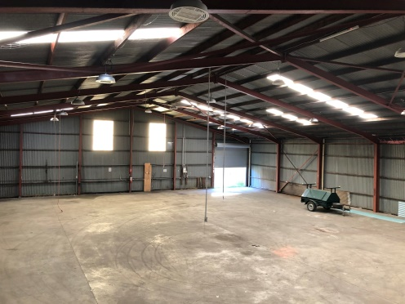
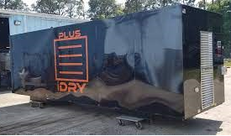
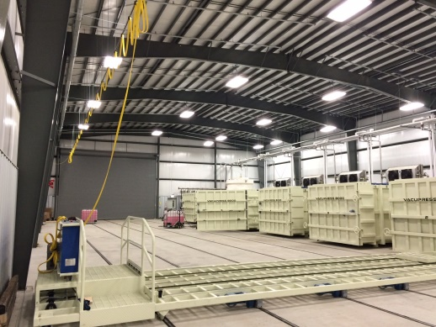
Business plan
Establishment
Rent 300m2+ warehouse space in Coffs Harbour – central to north coast hardwood forests. A site will be selected once an ETA for the initial kiln is established. Initial lease term 6 months with options for further terms of 3 years.
An example: 747m2 factory and hardstand in Coffs Harbour $36,000pa¹
We are also in preliminary discussions to lease a small sawmill as an alternative.
iDry trial
In order to minimise risk and reduce lead time (6 v 14 weeks) on the first machine we will order an iDry Plus ($US79K) to undertake initial production.
We will have conducted 2 production runs within the first month and will then decide whether to order an iDry Turbo (up to 14 week lead time) or undertake further testing.
Scaling production
Following the successful trial of the iDry Plus we will purchase an iDry Turbo as it has 380% greater throughput (being 50% larger and twice as fast to dry). Whilst more expensive, Turbos minimise the amount of labour in loading and reduce the floor space required for a given level of output.
We propose to acquire all future equipment debt free and it is likely that our growth will only be constrained by the availability of iDry Turbos and the seasonal availability of timber.
¹ https://www.realcommercial.com.au/for-lease/property-4-5-15-june-street-coffs-harbour-nsw-2450-503487042

Slide 13
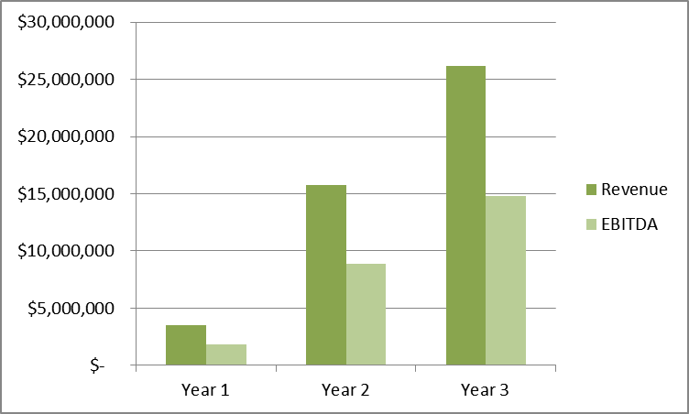
Financials
Timber Ventures will offer investors high levels of cash returns with the business netting around $XXK pm with just the iDry Plus and almost $XXK pm with a Plus and a Turbo in month 7.
From there we will ramp up production capacity in accordance with sales and iDry production capacity.
We view TVI as a long term hold, paying out 80%+ of net profit where there aren’t opportunities to grow the business.
By the time we have 10 total kilns (end of year 3) we expect to be distributing a total of approximately $XX per month and retaining $XXK pm.
 | Year 1 | Year 2 | Year 3
EBITDA
Cumulative cash
No. kilns
Monthly Recurring Profit

Slide 14
Raise and use of funds
We are raising $XxK for a XX% equity share in Timber Ventures International
Investor capital to be repaid within 24 months providing a free carried interest
Use of funds
Purchase iDry Plus $X,000
Transport X,000
Initial timber stock x,330
Rental bond x,200
Thicknesser 7,500¹
Working capital X,970
Total $x0,000
Capital table
XX/
nominee 61%
XX/
nominee 39%
¹Will not be required if we strike a deal to rent a sawmill

Slide 15
Risk
Risk | Mitigation
Disruption to log supply | Coffs Harbour is central to the hardwood timber forests of the north coast, allowing TVI to economically draw timber from a wider geographic area reducing the potential for localised issues such as weather or fires to impact supply.
Unable to obtain boards from sawmills | Diversify supply of boards, contract with state and private forests for own supply of logs and use contract sawmilling, Phase 3 develop own sawmilling capacity
Timber boards not to specification | Inspect and test delivered timber pre-drying to allow rejection of out of specification boards. Inspect post-drying boards to ensure they meet specification. Consider independent testing as part of out-bound QA process.
Kiln doesn’t perform to expectations | Warranty and product support for a fault. If operation of machine does not achieve expected levels of output increase number of machines or air-dry timber before placement in kiln to reduce kiln times.
Ability to supply required species timber | We will initially only dry loads of the most commonly used timber – blackbutt. As capacity and confidence in quality improve we will start to broaden the range of species we dry, this will also help mitigate any risks around supply of timber.
Copycat competitor | Our exclusive agreement for the supply of iDry equipment excludes direct competition in he short term but there are alternative kilns but with lesser performance. Phase 2 of the strategic plan is focussed on developing a highly connected and integrated sales channel with the market in order to create a barrier to entry.

Slide 16
Risk
Risk | Mitigation
Competitor response | In the short term competitors are unable to compete on drying time or quality and will only have price as an option. TVI has very low fixed costs and the lowest marginal costs of any competitor enabling us to match or better any pricing moves by a competitor. Given the size of the market, however, we believe we would need to expand beyond 3 kilns before competitors became aware of our activities and that would provide a substantial financial base to address any competitive challenges.
Business Model Risk
The certainty and timing of TVI's sales is a primary factor driving the year one financial performance of the Company. Equally, timber and iDry kiln availability may adversely affect expect performance.
Strategic Risk
Operating within a specific industry and within a particular time frame gives rise to a number of risks outside the control of the Company. A shift in the desires of customers as an outcome of market movements or government policy could have adverse effects on the company.
Insolvency Risk
The Company is an unlisted business and while the Directors believe the financial projections including the funding requirements are reasonable, there can be no guarantee they will be achieved or that the funding will be sufficient.
Regulatory Risk
Political, taxation, economic, legislative or regulatory change may have an adverse effect on the Company’s operations. Government action or policy change may adversely affect the Company’s operations and financial performance.
Liquidity Risk
At this point the shares in the Company are an unlisted illiquid stock, and therefore there is no open market for them. There can be no guarantee that the Company will achieve its stated objectives or that any forward-looking statements will eventuate. Accordingly, an investment in the Company should be regarded as speculative. This information does not purport to be a comprehensive statement of all risks; an investor should seek and obtain professional advice prior to deciding whether or not to invest in Timber Ventures.

Slide 17

Our team
XX Co-CEO
Wiueficwopow c
XX Co-CEO
Werhf cowh
XX Consultant
powefnowcn
XX
NSW Sales
Owhef oih w

