Slide 1


Al ROUF LIGHTING TECH CO LTD

Slide 2

AGENDA
Company profile
Introduction
Project
Design
Item
Technical
ROI

Slide 3
Company Profile
AL ROUF LED LIGHTING TECHNOLOGY CO. LTD was born to play the main role in engineered led lighting solution, Our working team have developed skills on daily basis in all lighting application fields for brighter retail and greener industrial .
By that concept and following this dream . AL ROUF have spent the past 6 years working with the top manufactures around the world to develop products that suits the harsh environmental situation on Saudi Arabia. From large scale to small scale project.
Some vendors codes we have :
ARAMCO 0010056392
SAUDI ELECTRICITY 2006100
SIPCHEM 103375
MARAFIQ 2000012009
MAADEEN 39380
SABIC 508386

Slide 4
INTRODUCTION
I am Ahmed FAIRS sales manger in Al Rouf Westren Region
I have being working in this field for more than 10 years
I have worked mostly with retail and I have background on industrial also.

Slide 5
PROJECTS
We have worked with :
PANDA
EXTRA
IKEA
JUFALI
IHCC
BIN LADEN GROUP

Slide 6
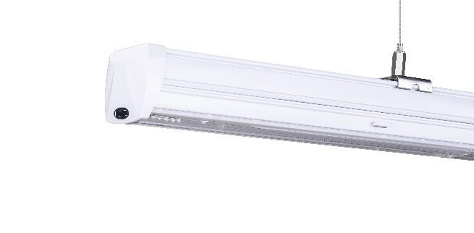
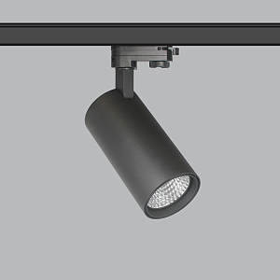
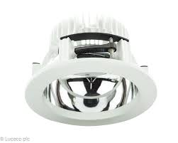
ITEMS
This are few of our line of products we use in the Retail .
LINEAR Light
Application
Wattage range :30W / 40W / 60W / 35W / 50W /70W.
Color Temperature :3000K-6500K. CRI>80 ,CRI>90,
160 lumen/ watt Efficiency , 5 Years Warranty (50000 Hours).
TRACK light
Application
Wattage range: 15W-45W , Color Temperature: 1900K-7000K, CRI>80-CRI>97, 130 Lumen/watt Efficiency, 5 years Warranty (50000 Hours ).
DOWN Light
Application
Wattage range: 15W-52W, Color Temperature:3000K-6500K, CRI>80-CRI>90, 130 Lumen/Watt Efficiency , 5 Years Warranty (50000 Hours).

Slide 7
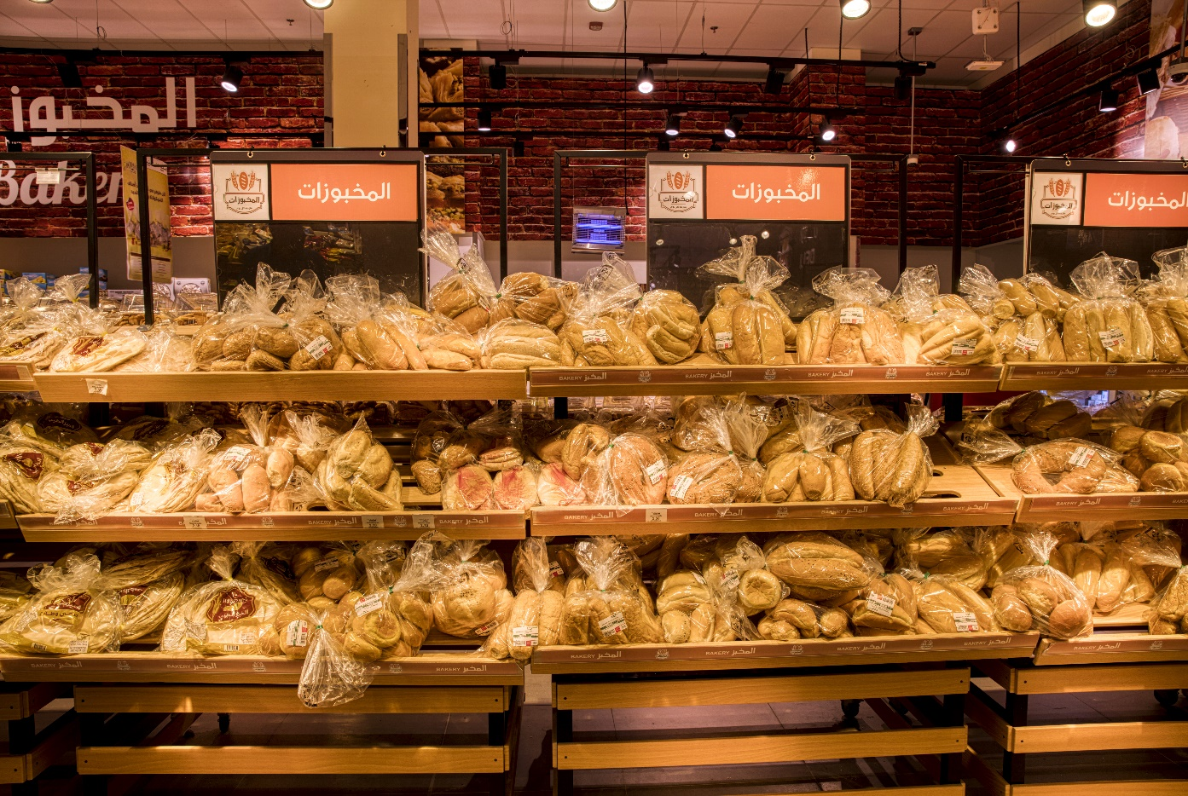
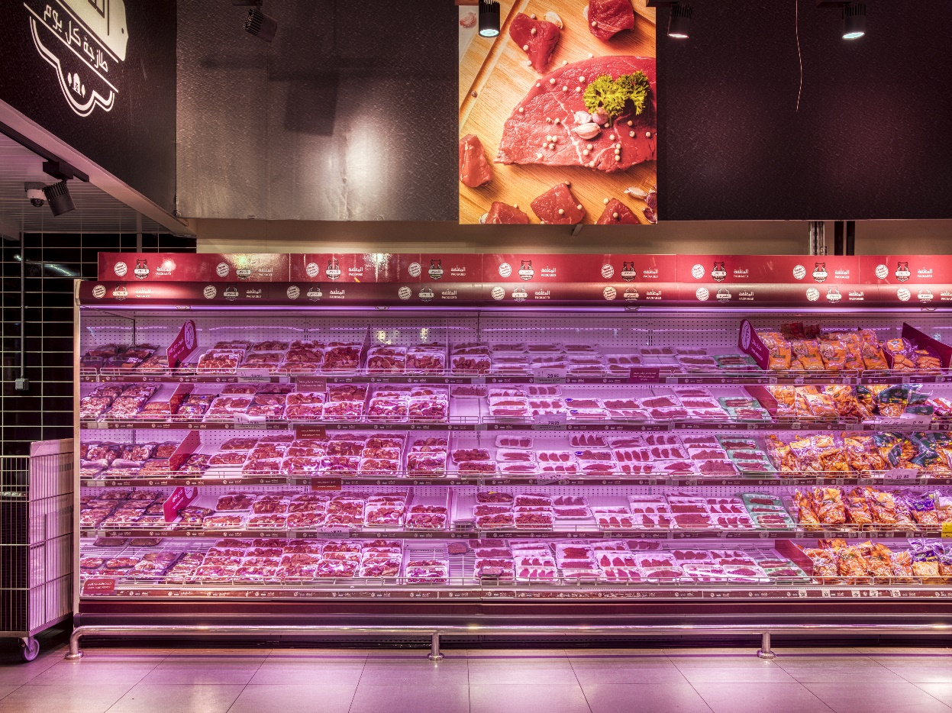
PROJECT PHOTOS
Bakery Area
Meat Area

Slide 8
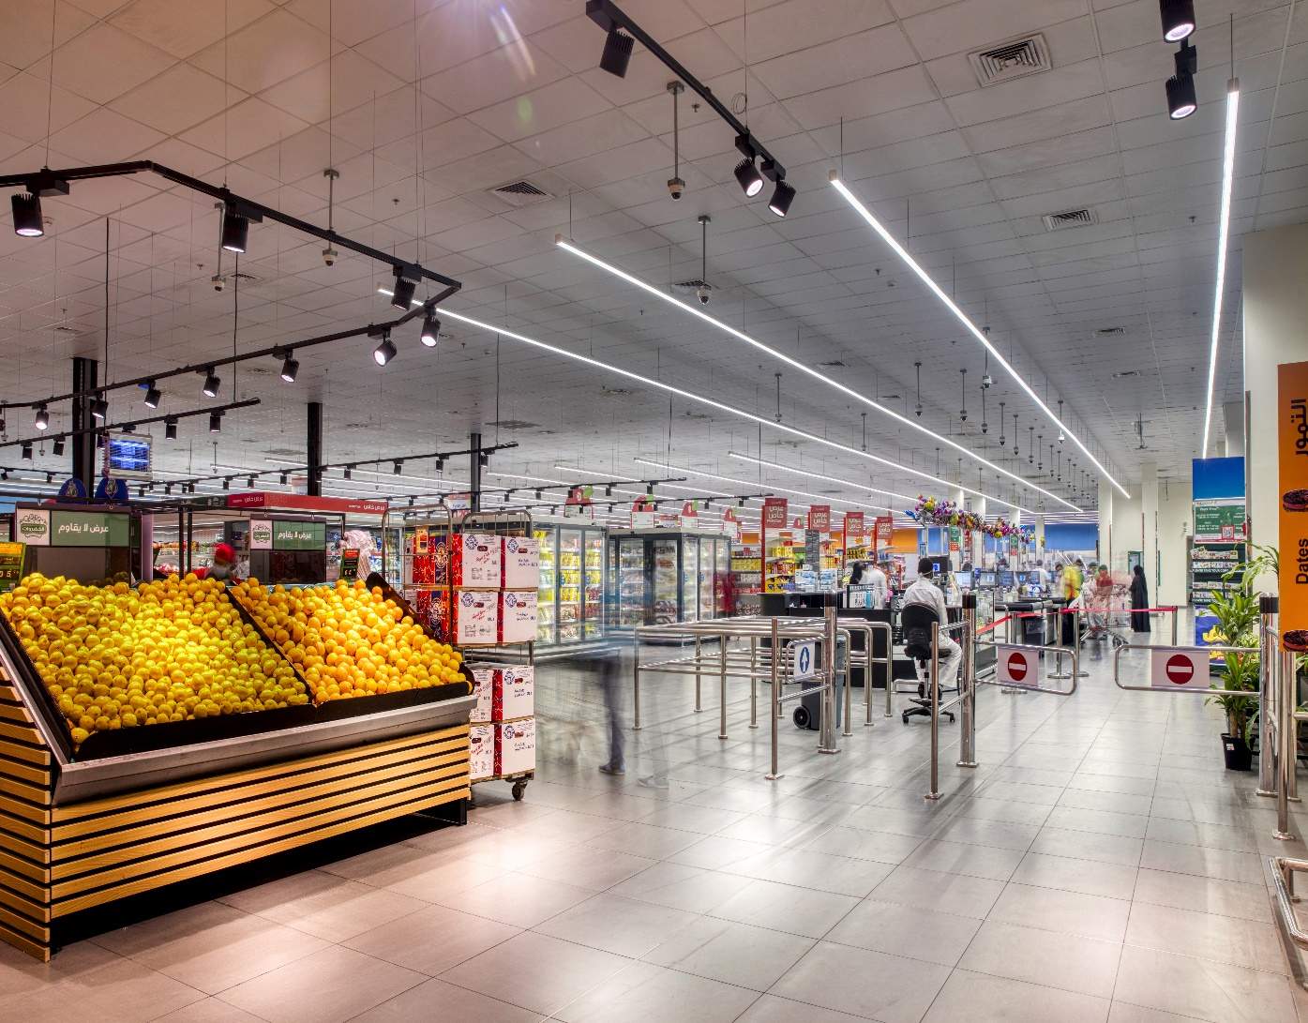
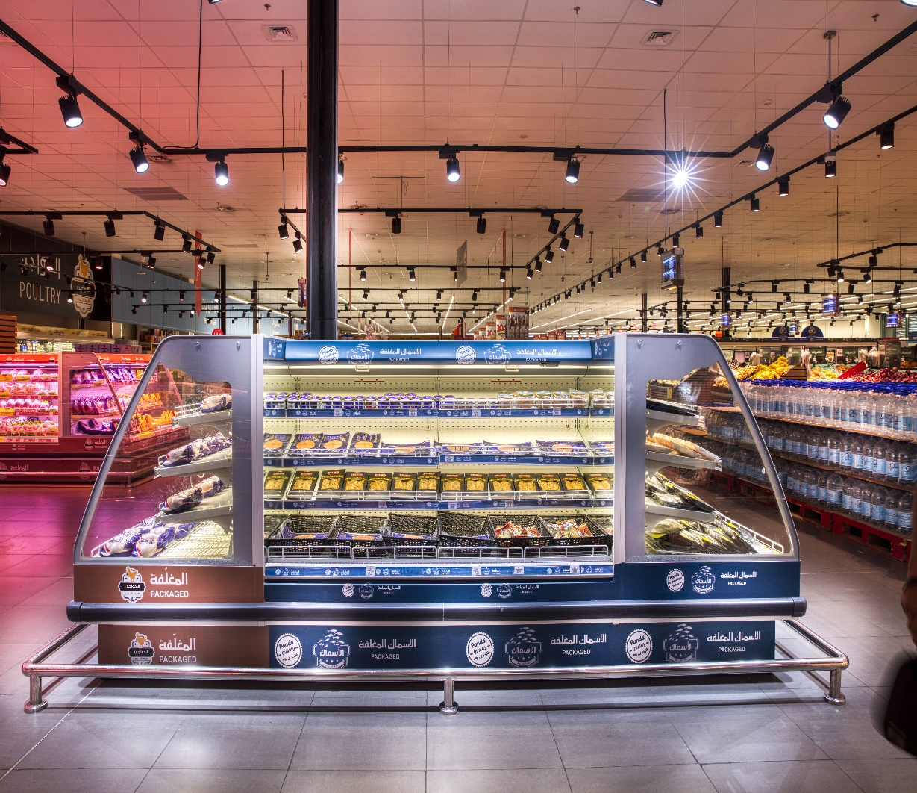
Sales Area
Deli Area

Slide 9
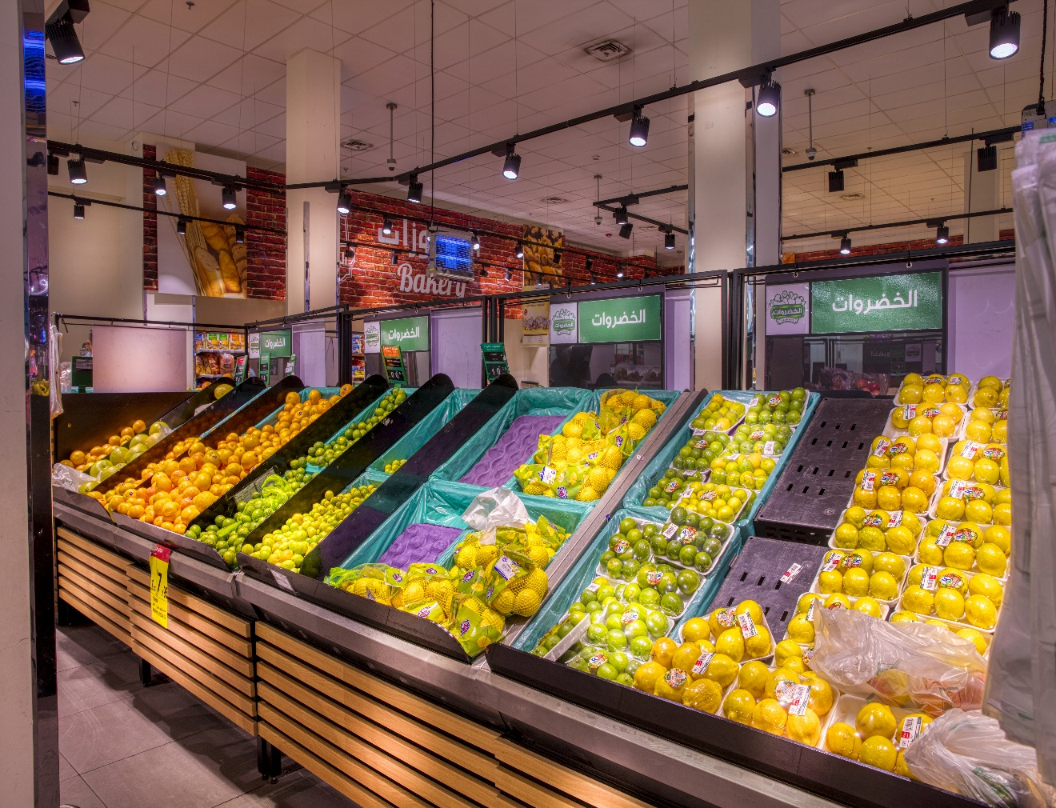
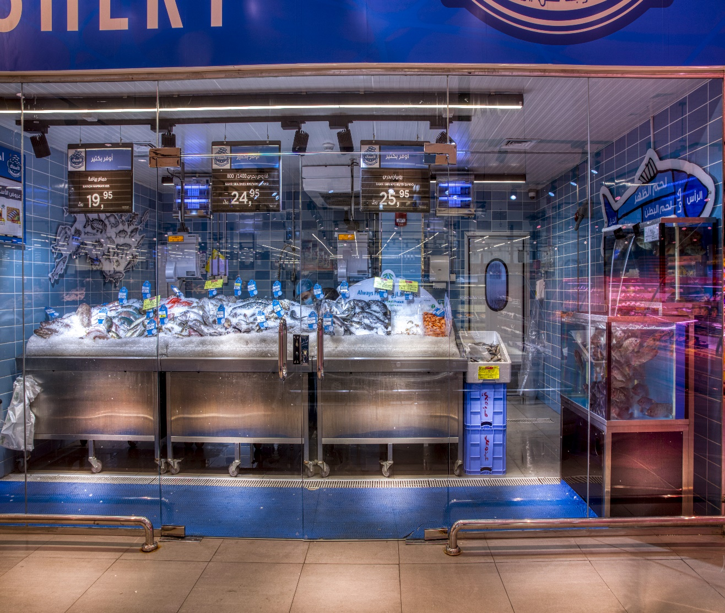
Fish Area
Fresh Area

Slide 10
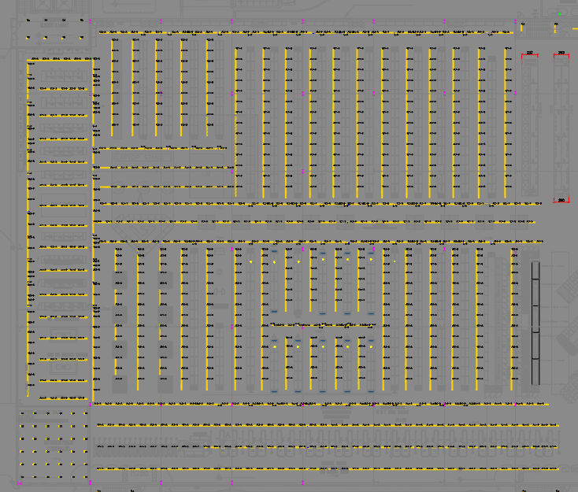
DESIGN
This is one of the our design we made for one of our biggest retail customer for sales area.

Slide 11
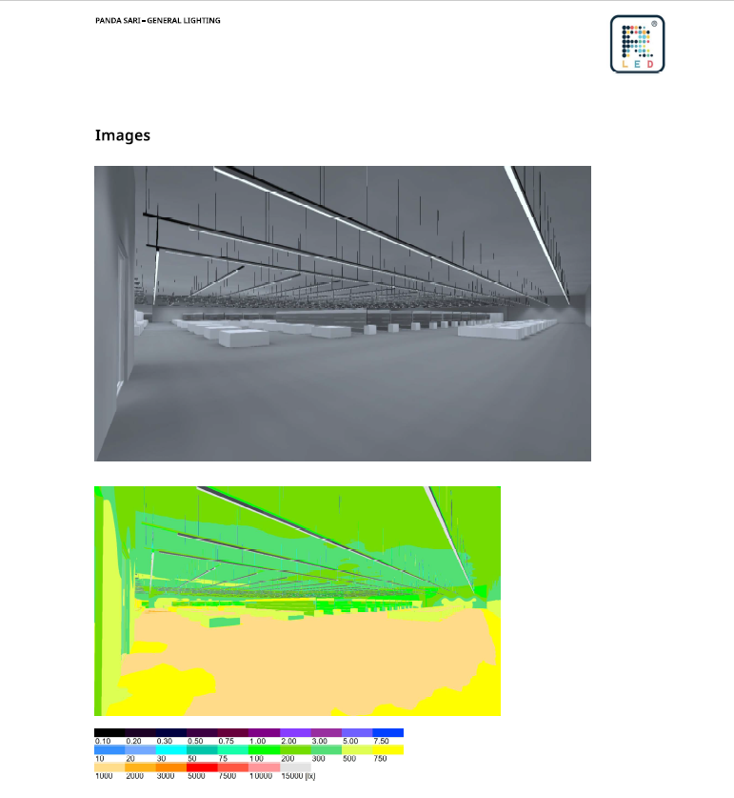
Dialux Design
This is one of our retail Dialux design it clearly shows how our product will look on the area and it also runs the simulation of the lux study in the selected area.

Slide 13
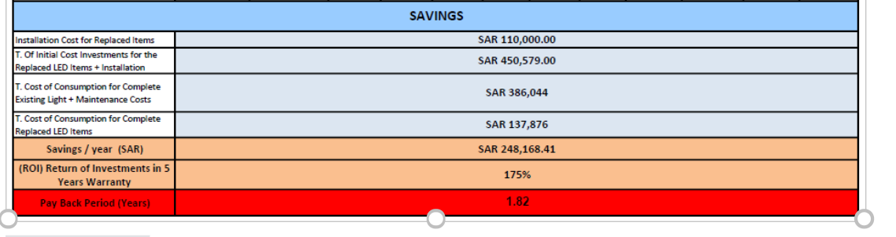
RETURN OF INVESTMENT (ROI)

