Slide 1
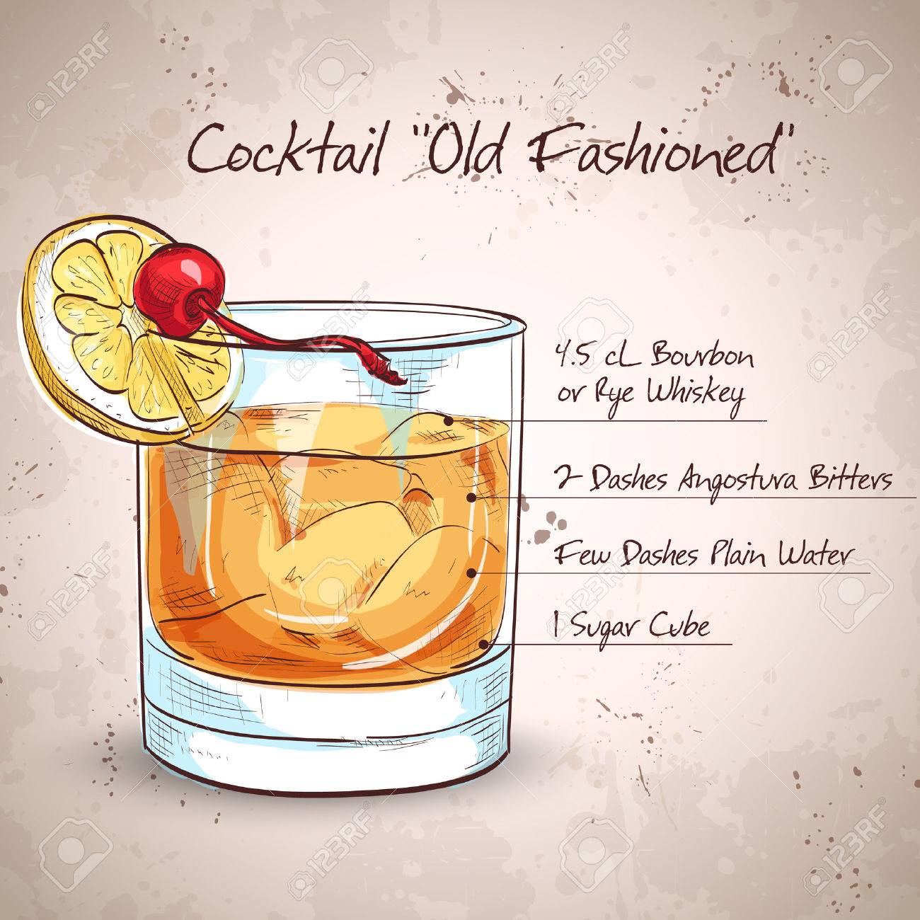
Old Fashioned
Cocktails by Bimber
30ml Bimber whisky
15ml Fortunella liqueur
5ml Angostura/Orange Syrup
Pour over ice, stir gently, garnish with a orange zest or orange wedge.
100 ml Abv. 37%

Slide 2
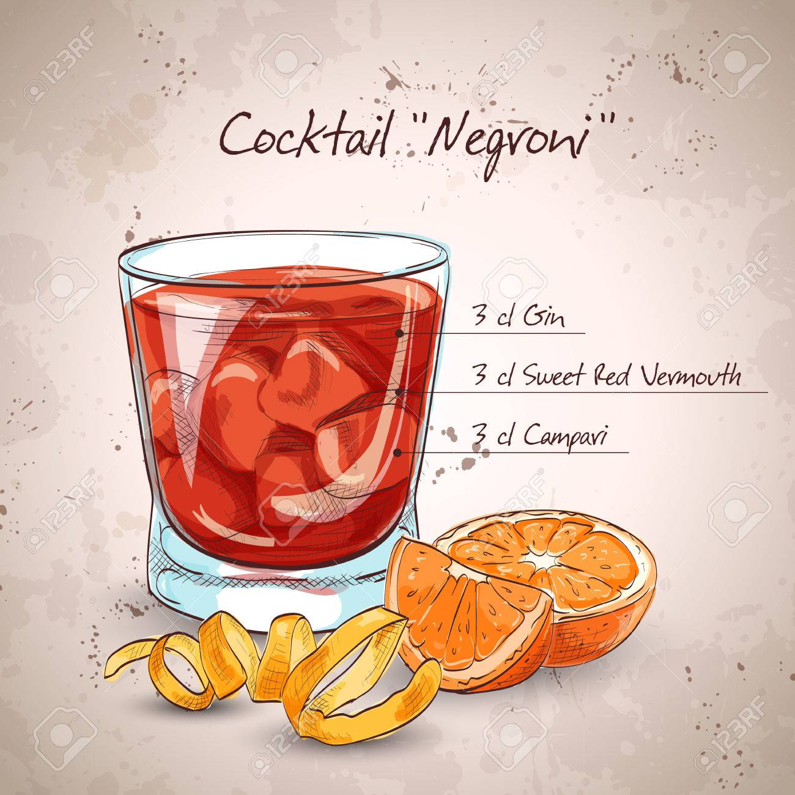
Negroni
Cocktails by Bimber
20ml Bimber whisky
10ml Fortunella liqueur
10ml Campari
10ml Sweet Vermouth
- Pour over ice, stir gently, garnish with orange zest or orange wedge.
100ml Abv. 33%

